Slide 1
Blinded with Science or Informed by Charts? A Replication Study

Slide 2
Blinded with Science(BwS) Study
Caution when encountering communications hinting at scientific credibility
Ignore spurious cues to a scientific basis
3 questions for about drug efficiency experiment
Use charts for some people and text for the others
Use Chemical formulae
See who has answered it correctly

Slide 3
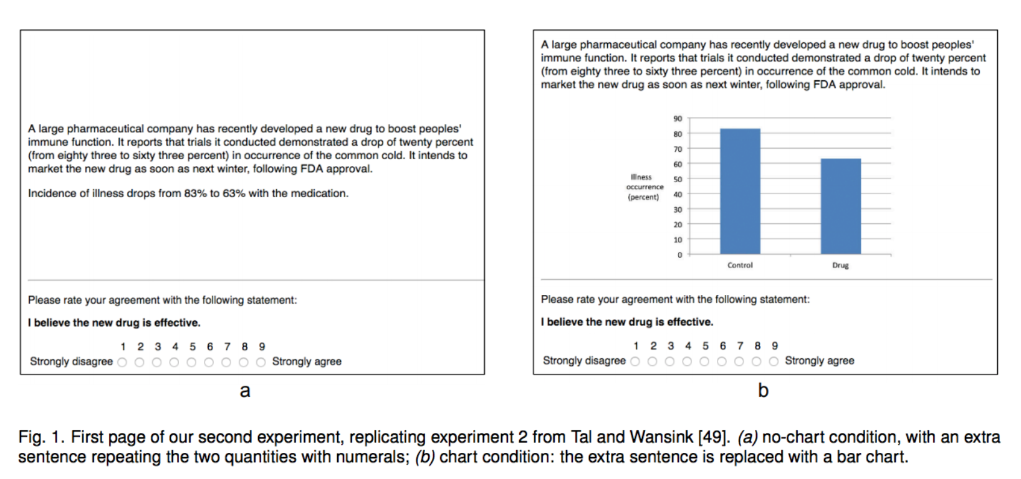
EXPERIMENT 1 – FIRST REPLICATION AND RATIONALE

Slide 4
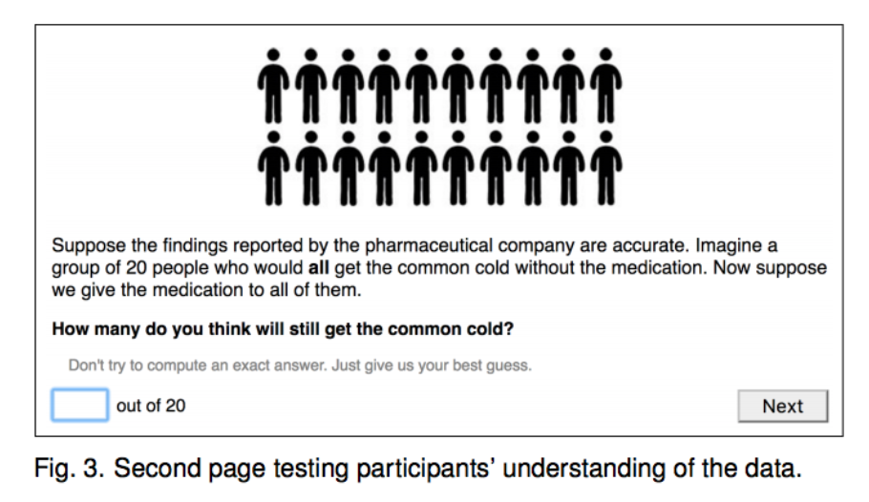
Follow up question – This study

Slide 5
Goal of this follow up question was to train people to expect questions to admit a single correct answer, which can sometimes cause them to underperform in estimation tasks due to miscalculation
This question was not an attention check
The people who answered “No” were supposed to justify themselves
Goal of this experiment was:
Q1. Will the results from the BwS study replicate?
Q2. Will the chart yield improved comprehension?

Slide 6
Result
There was no evidence for a substantial bias compare to BwS
The improved understanding did not seem to cause participants to judge the drug as more effective
Maybe it had something to do with the fact that numerals would be better than spelling out the numbers in the non-text part

Slide 7
EXPERIMENT 2 – SECOND REPLICATION
BwS only changed theirs to numerals, without repetition
It’s the same as the previous experiment, except the no-chart condition now shows the numbers also as numerals
It includes an extra sentence that repeats the two quantities
This has just the one question
The question question is closer to Experiment 1’s second question, with the difference that it admits answers on a 1–9 scale instead of simply Yes/No answers.

Slide 8
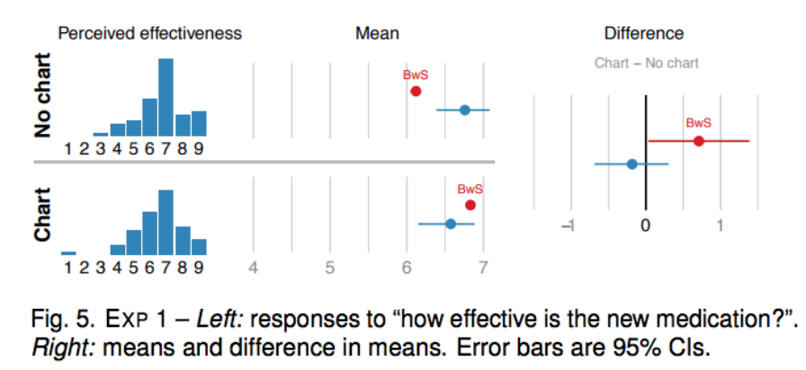
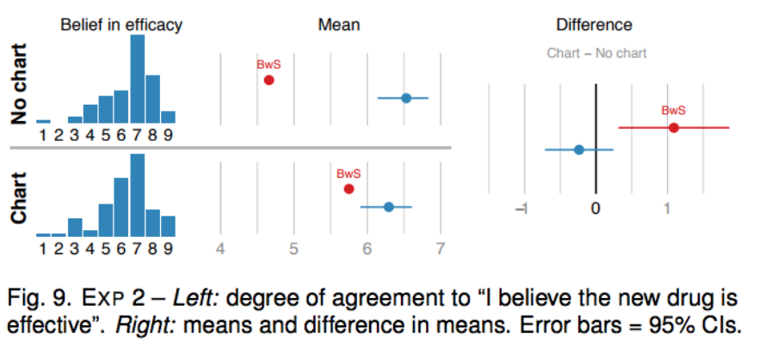
Results
Experiment 1
Experiment 2
Conclusion: Chart did not promote comprehension

Slide 9
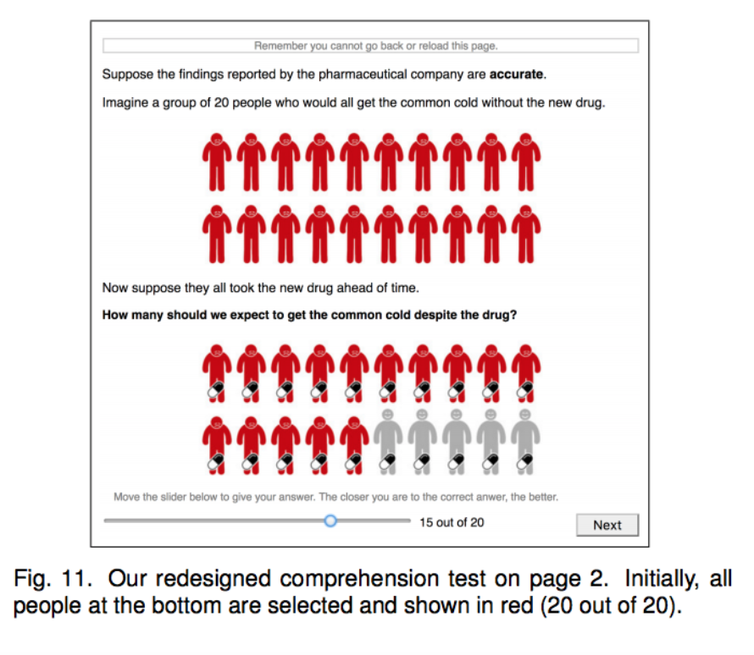
EXPERIMENT 3 – REVISITED COMPREHENSION TEST
Same as the previous one, only different comprehension test

Slide 10
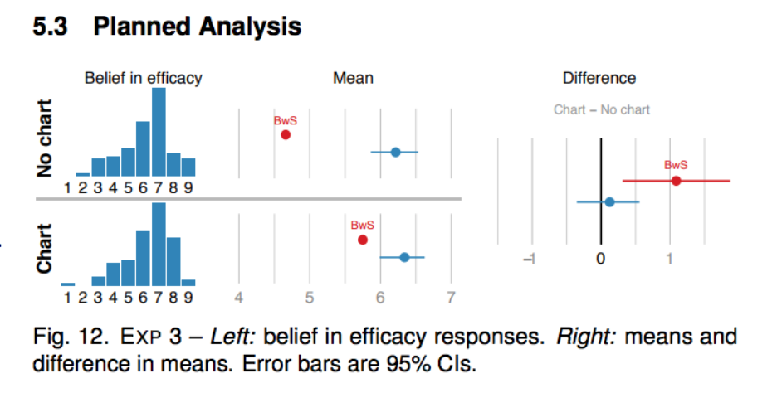
Results
Weak evidence for a positive effect of the
chart overall, but cannot at this point draw
definitive conclusions
Conclusion: Maybe the people taking this
test didn’t know what the FDA was? Or
maybe they didn’t speak any English

Slide 11
EXPERIMENT 4 – US POPULATION
Two new questions at the end:
Do you generally believe in science?
The drug we mentioned was fictional. Nevertheless, do you think that a large pharmaceutical company can design an effective drug for preventing the common cold?
They both had were to be answered on a scale of 1-10
They were done to unveil any some biases they implicitly had like charts are scientific or disbelief in medicine/ mistrust of the pharmaceutical industry

Slide 12
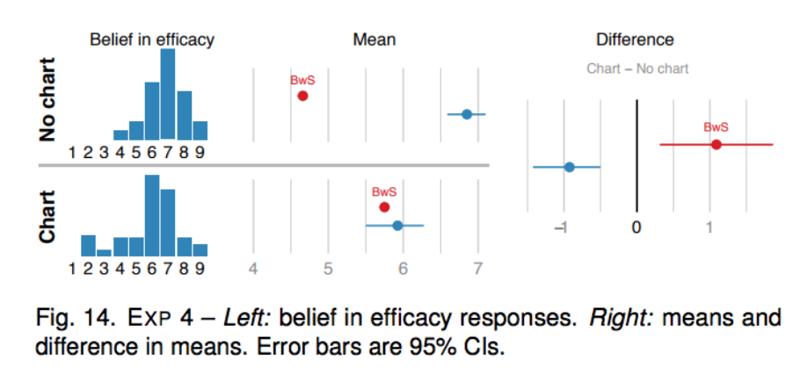
Results
Justification: People probably look at charts more cautiously
Because they’re more “official”. They then scrutinize it more
And the bias plays a role there

Slide 13
Conclusion
The No chart seemed more promising in this case
Asking the right questions is Important
We feel there has got to be a threshold. Text would better represent small data sets and charts, the larger ones

