Slide 1
PROJECT DATA STARTER
- Rajdeep Rao
-Prasanna Lalingkar

Slide 2
Dataset
The dataset we’ve used for this assignment is of the 'Toxic Release Inventory’
Industrial facilities that meet Toxics Release Inventory (TRI) Program reporting requirements submit their data to the EPA.
The TRI Basic Data Files contain the reporting form data elements most frequently requested by TRI data users, including the quantities of toxic chemicals released into the environment on site at facilities

Slide 3
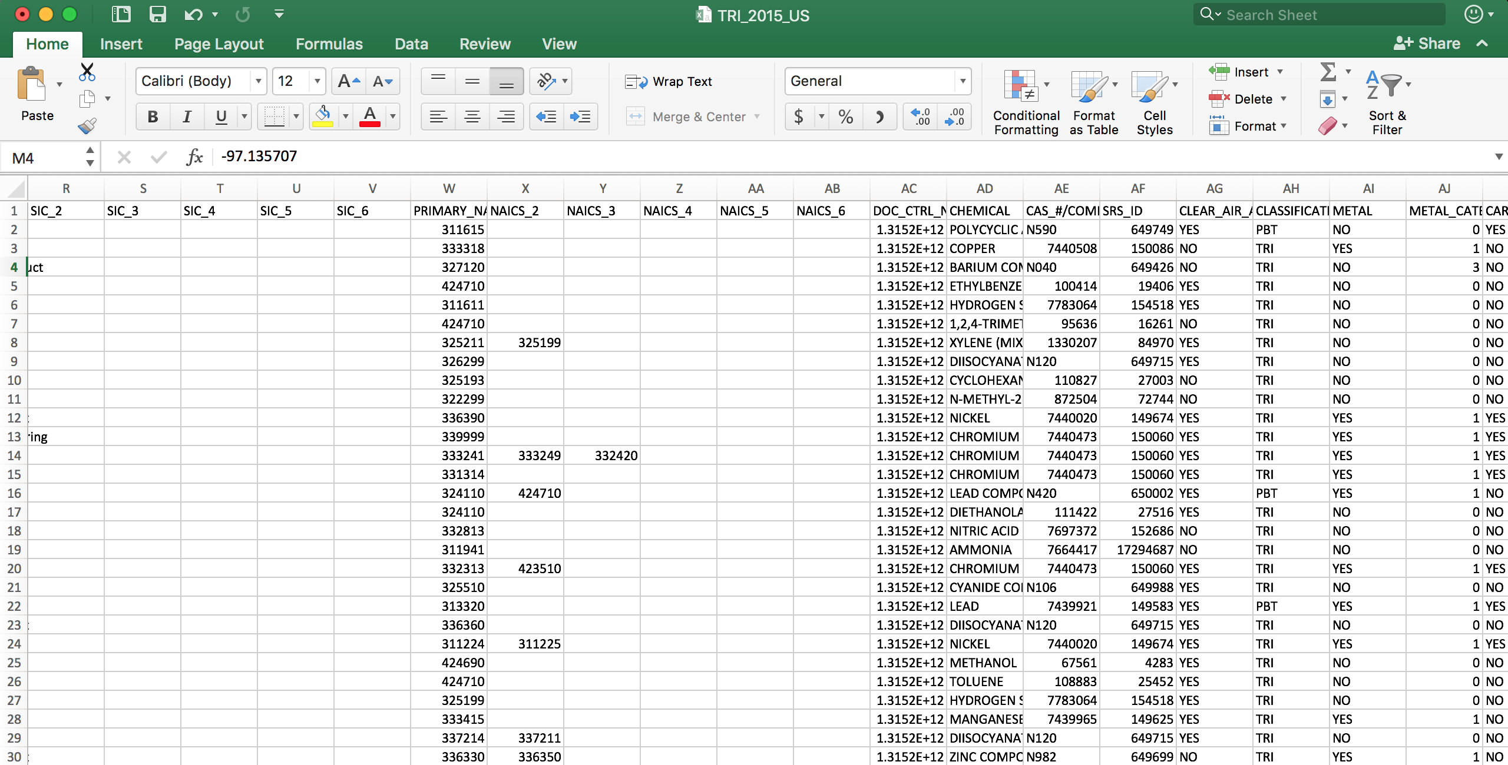
Dataset (2)
Each row has 109 columns. For simplicity's sake we are going to be focussing only on 3 of them, namely ’
CARCINOGEN
CLEAR_AIR_ACT_CHEMICAL
Petroleum Bulk Terminals

Slide 4
Visualization Technique
Cloropleth Map
Interaction Design
Abstract/ Explore
Filter
Framework Used
D3 js
Python HTTP Server

Slide 5
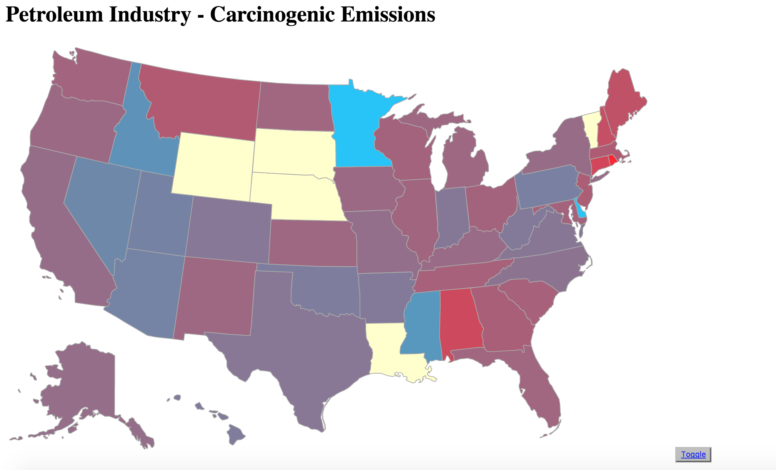
Interaction design
Abstract/Elaborate

Slide 6
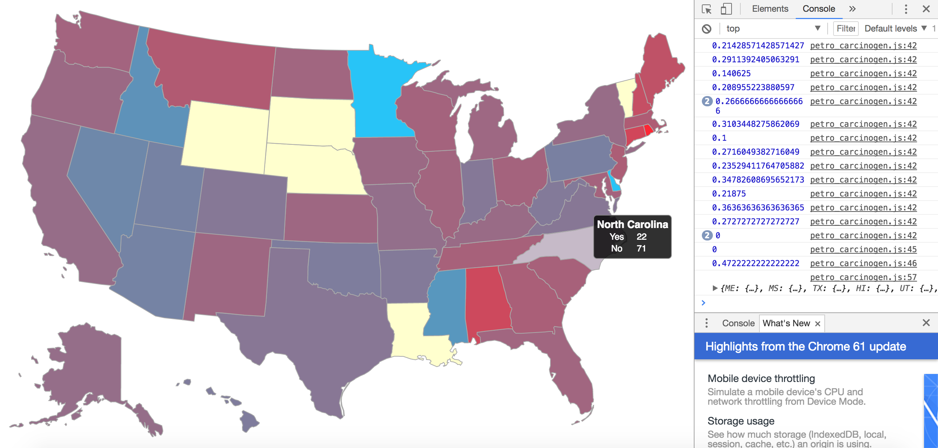

Slide 7
How was this done?
Created a local server
Accessed the served files (Dataset) using d3.csv()
Iterated over each entry and stored in a dictionary occurrences of yes and no
Stored as a dict: {“NC”:{“YES”:22, “NO”:71}}
Created another dictionary to interpolate over 2 colors using the YES and NO counts for each state
Normalized the values to get a good range of colors
Passed this to the drawing service
Drew the visualization

Slide 8
What’s next?
We can easily set filters for this visualization and have the user interact with it
Eg: Petroleum industry – toggle between Carinogenic and CleanAirChemicals
Toggle between different industries etc.

Slide 9
Questions?

Slide 10
Thank you

