Slide 1











Red Tape Navigator
AGENTIC AI FOR CITIZEN-FACING LICENSING AND COMPLIANCE
TEAM NAME
ONYX
TEAM MEMBERS
Rajdip Dhar · Imon Patra
Raktim Chakraborty · Anish Goswami
TRACK
Agentic AI
PROBLEM STATEMENT
The “Red Tape” Bureaucracy Navigator
One sentence in. A sourced licence plan and review-ready forms out. The citizen always signs.

Slide 2
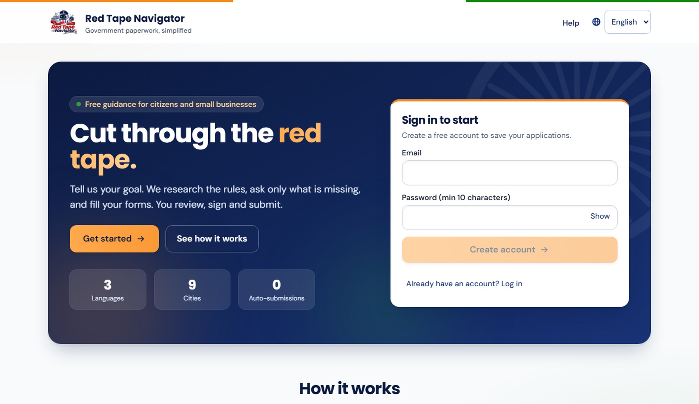

TEAM
ONYX
AGENTIC AI FOR CITIZEN SERVICES
Red Tape Navigator
The problem Citizens and small businesses lose weeks to scattered portals, outdated PDFs and contradictory rules, and often pay an agent to decode them.
LIVE APP · HOME
Proposed Solution
The idea A citizen states a goal in one sentence; an AI agent researches the rules, interviews them and fills the forms.
1
How it solves it One guided session replaces weeks of searching, decoding and re-typing across departments.
2
What is unique Asks only what is missing, cites every rule to its official source, and the citizen signs. Nothing is auto-submitted.
Value to government fewer incomplete files, faster approvals, higher compliance
3

Slide 3
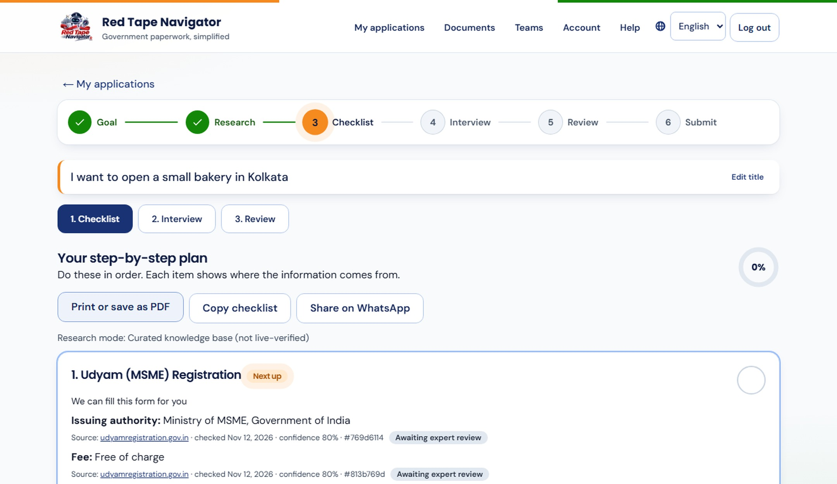
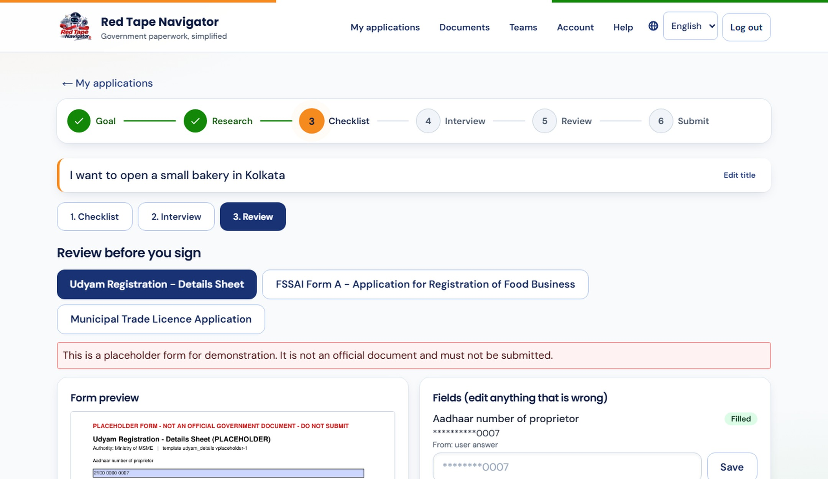
TEAM
ONYX
FROM ONE SENTENCE TO A REVIEW-READY FILE
Working Solution
1 Understand
2 Research
3 Interview
4 Fill forms
5 Review
Reads your goal in plain words, in any language
Finds licences, fees and documents, with sources
Asks only what is missing and checks each answer
Fills official PDFs and portal key-in sheets
You check every field, sign and submit yourself
STEP 2 · CITED PLAN
STEP 5 · REVIEW
A real-life scenario
Priya types: “I want to open a small bakery in Kolkata.”
She gets 6 licences in order, answers 22 questions and sees 3 filled forms.
She reviews, consents, downloads and submits herself.

Slide 4
TEAM
ONYX
BUSINESS MODEL, RESOURCES AND ROADMAP
Feasibility & Practicality
How easily can it be built?
Works on any phone or laptop browser
Rules drawn from official public pages
Built in stages, each testable on its own
Resources needed
Time: working core first, then city by city
Cost: free for citizens, low running cost
Support: legal volunteers, municipal partners
1
2
Challenges and our answers
Rules change: freshness checks, expert flags
Private data: encrypted, consent, erasable
Wrong advice: cited sources, human signs
Future scalability
From 9 cities today to every state
More languages and voice-first access
SMS and WhatsApp reminders for renewals
3
4
Proposed business model Free for citizens · licence for municipal bodies · assisted service via service centres and CAs

Slide 5
TEAM
ONYX
OUTCOMES FOR CITIZENS AND GOVERNMENT
Impact & Benefits
6
Licences mapped from one sentence
22
Questions, each asked once
3
Languages: English, हिन्दी & বাংলা
0
Auto-submissions, you stay in control
Who benefits
Citizens and first-time entrepreneurs
Vendors, bakers, home businesses
Departments: cleaner, complete files
Short and long term
Now: faster, error-free first filing
KPIs: time to file, rejections, visits
Later: verified rules for every city
Social, green, economic
Social: equal access in 3 languages
Green: paperless, less travel
Economic: no agent fees
Aligned with Digital India · Ease of Doing Business · MSME Udyam registration · DPDP Act 2023 consent and erasure

Slide 6
Thank You
TEAM ONYX | Red Tape Navigator
Our ask: a pilot with a municipal body to put this in citizens’ hands.
TRANSPARENT
PRIVATE
IN CITIZEN HANDS

