Slide 1
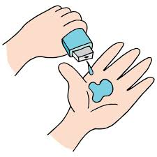
VOIS Innovation Marathon 2025-2026
Project Title – Agentic AI System for Chronic Kidney Disease Management in India
Team Number – 48
Name of Team Members - Aditya Raje , Nida Pathan
College Name – MESWCOE, Pune.

Slide 2

AGENDA
  Problem statement
  Project Overview
  Need of project
  Your solution
  Technical Flow Diagram
  Result
  Future Scope

Slide 3

PROBLEM STATEMENT
India has 138 million people living with chronic kidney disease—the second-highest burden globally—yet only 10% of end-stage renal disease patients can access life-saving treatment. With prevalence surging 47% in just six years (from 11.12% to 16.38%), over 50% of patients diagnosed only when kidneys have lost 85-90% function (stage 5), and only 1,850 nephrologists serving 1.3 billion people, India's healthcare system cannot scale to meet this crisis.
To Build an AI-powered Multi-Agent System using IBM Granite 3-8b-instruct , IBM watson Studio, IBM watsonx Orchestrate, IBM watsonx.ai, and Langflow that enables early CKD detection, personalizes treatment plans, multi lingual support and prevents 70,000+ annual progressions to kidney failure while making care accessible to rural populations where prevalence is 44% higher than urban areas.

Slide 4



PROJECT OVERVIEW
Vision: Transform CKD care from reactive to proactive using IBM's enterprise AI
Mission: Detect early, treat precisely, prevent progression—making world-class nephrology accessible to every Indian
Core Innovation: 6 specialized AI agents working as a coordinated care team
Technology Foundation:
IBM Granite 3-8b-instruct: Medical reasoning in 15+ Indian languages
IBM watsonx.ai: Model training & deployment
Watson Studio: Predictive analytics & ML models
watsonx Orchestrate: Agent coordination hub
Langflow: Visual workflow design & clinical validation
AstraDB: Vector database for patient records with IBM Embedded LLM
Target Impact: Prevent 70,000+ annual progressions to kidney failure

Slide 5
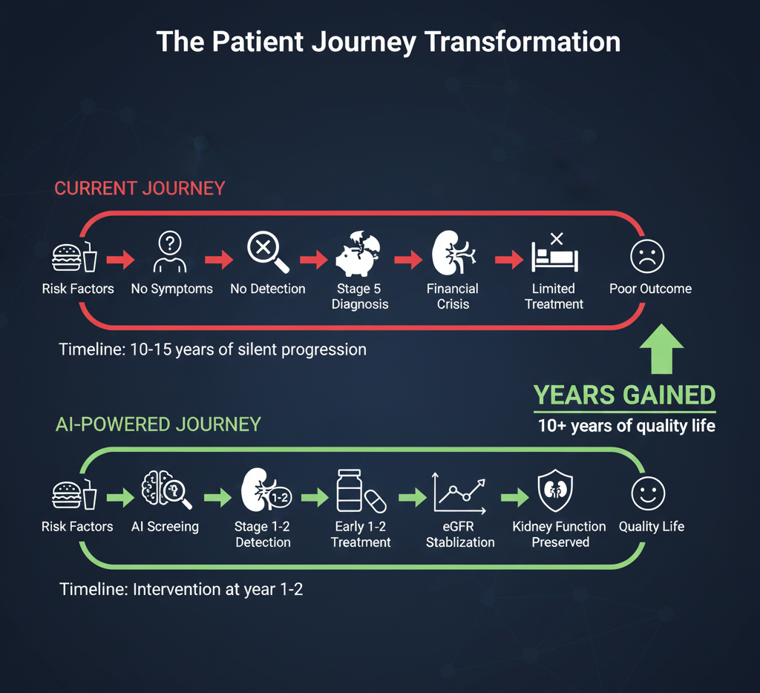
NEED OF PROJECT
Current reality: 50% diagnosed when kidneys already 85-90% damaged
What we need: Catch patients at Stage 1-2 when kidneys are 60-90% functional
Prevention is 10x cheaper than treatment
Without intervention: This number will hit 300,000+ by 2030
1 nephrologist serves 700,000 people (vs. 1:50,000 indeveloped countries)

Slide 6



WHO ARE THE END USERS?
Patients
Empowers patients to catch CKD at Stage 1-2, not Stage 5
Kidney-friendly meal plans: Based on YOUR regional cuisine (dal-roti, idli-sambar, fish curry)
Nephrologists
10x capacity: Serve 7 million patients instead of 700,000 through AI assistance
RAG Agent: Access 10,000+ research papers in seconds—get latest guidelines for complex cases

Slide 7



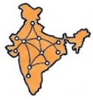
YOUR SOLUTION AND ITS VALUE PROPOSITION
Early Detection Agent
Detects CKD before symptoms appear. ​
Monitors eGFR trends + proteinuria + risk factors.​
Saves kidneys when 60–90% function remains.
Risk Stratification Agent
Predicts 3 & 5-year ESRD risk​.
Identifies 80% rapid progressors early.
Value proposition :
For Patients :
Early warning system
Personalized Care
RAG-Based CKD Stage
Agent
Instant CKD stage confirmation​.
Evidence-based treatment in seconds​.
Reduces diagnostic errors by 50%.
Virtual Nephrology Agent
Multilingual, patient-friendly consultations​.
Handles routine care automatically​.
10× nephrologist capacity at scale.
For Nephrologist :
10x productivity
Prevent ESRD using predictive analytics
Cardiovascular Protection Agent
Manages BP, diabetes & lipid risks​.
30% reduction in CV events.
Personalized Nutrition Agent
Indian kidney-safe regional diets​.
Patients eat familiar food, not restrictions​.
50% higher dietary adherence​.
Slows CKD progression naturally.
For India :
70% reduction through prevention
Close rural-urban gap

Slide 8
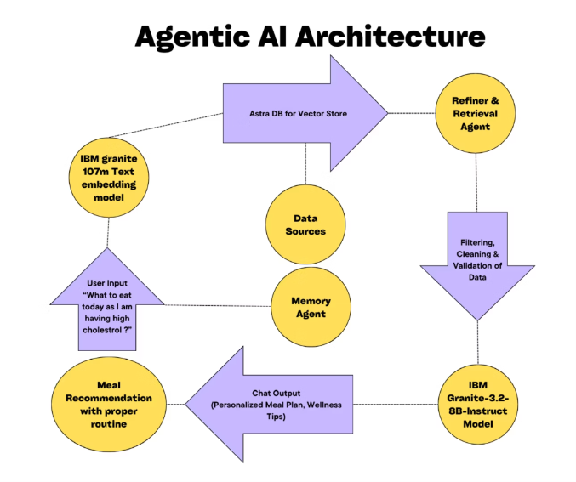
TECHNICAL FLOW DIAGRAM OF YOUR PROJECT

Slide 9
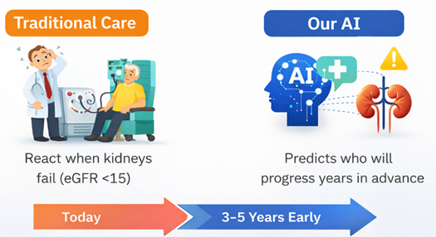
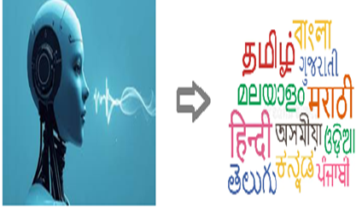

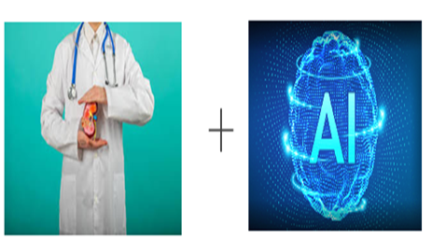
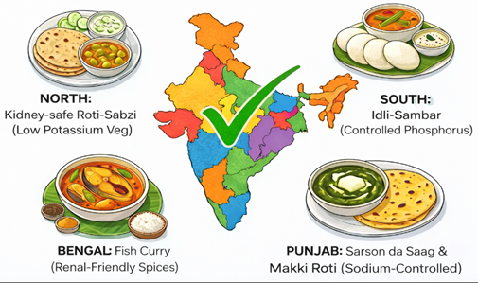
THE WOW IN YOUR SOLUTION
1.IBM Granite 4 – speaks 15+ Indian languages with context.
2.Early ESRD Prediction (3-5 years before)
3.10x productivity with AI
From 1850 tp 18500 virtual nephrologist
4.Agent rejects traditional renal diet and give customized Indian diet

Slide 10
MODELLING
Agent Design & Workflow Creation (Langflow)
Visual, rule-driven workflows defining agent intelligence
  Early Detection Agent – Monitors eGFR, proteinuria, BP, diabetes → triggers early risk alerts
  Risk Stratification Agent – Classifies patients into Low / Moderate / High risk
  RAG-Based CKD Stage Agent – Confirms CKD stage using evidence-based protocols
  Virtual Nephrology Agent – 24×7 AI consultations using IBM Granite medical knowledge
  Cardiovascular Protection Agent – Prevents heart complications via BP, glucose & lipid tracking
  Personalized Nutrition Agent – Generates kidney-friendly, Indian region-specific meal plans
2. Agent Orchestration & Coordination (IBM watsonx Orchestrate)
  Central brain managing all agents
  Intelligent routing of patient data to relevant agents
  Inter-agent communication (risk alerts → nephrology consult)
3. AI Intelligence Layer
  IBM Granite 3-8b-instruct (Foundation Model)
  IBM Watson Studio
  AstraDB (Vector Database)

Slide 11
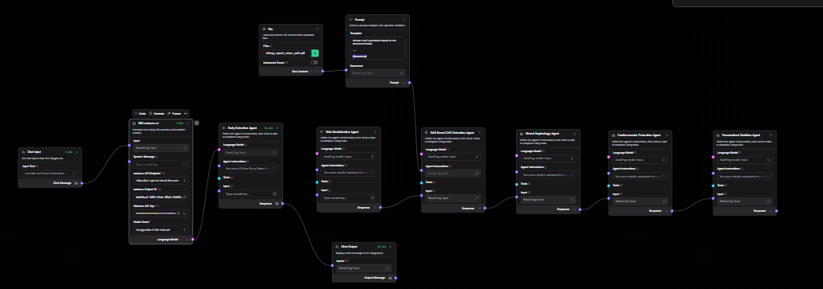
RESULTS
Workflow using Langflow:

Slide 12
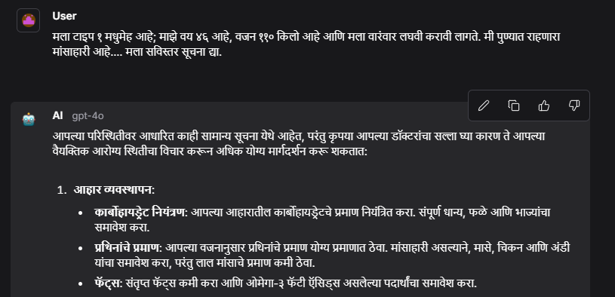
OUTPUTS
Multilingual Support

Slide 13
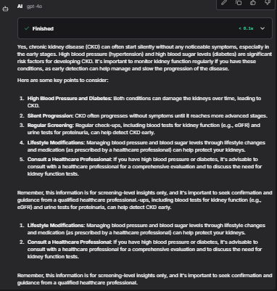

OUTPUTS
AGENT 1 : Early Detection Agent
OUTPUT
INPUT

Slide 14
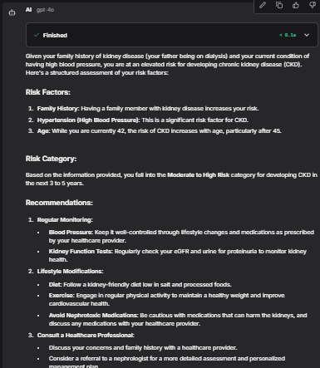
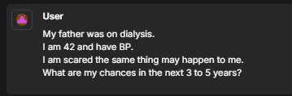
OUTPUTS
AGENT 2 : Risk Stratification Agent
INPUT
OUTPUT

Slide 15
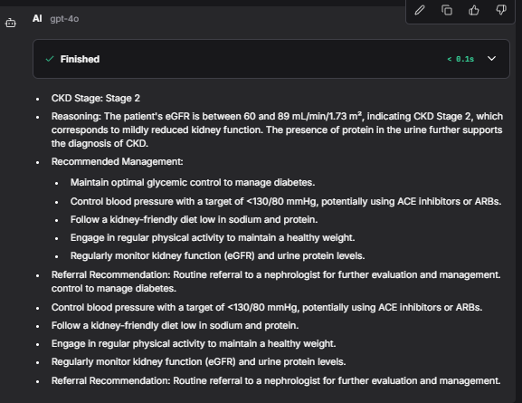
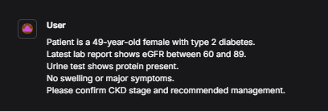
OUTPUTS
AGENT 3 : RAG Based CKD Stage Detection Agent
INPUT
OUTPUT

Slide 16
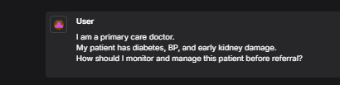
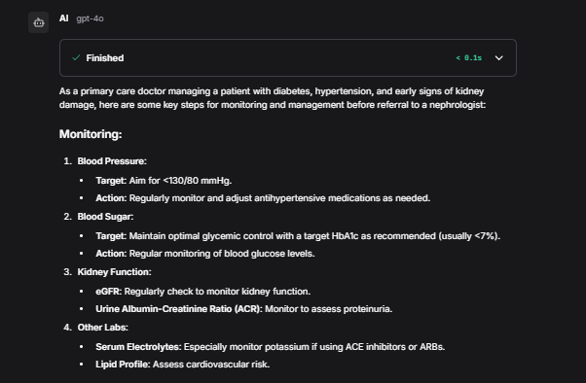
OUTPUTS
AGENT 4 : Virtual Nephrology Agent
INPUT
OUTPUT

Slide 17
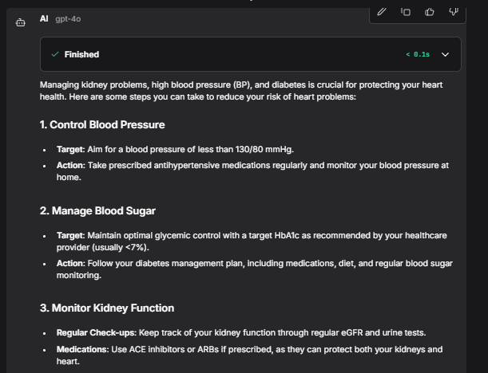

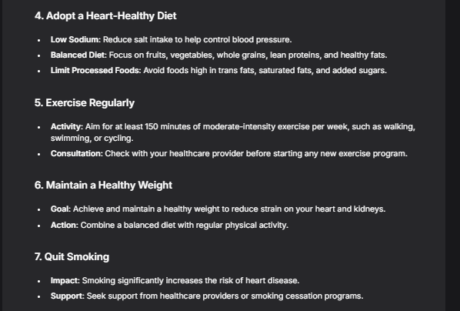
OUTPUTS
AGENT 5 : Cardiovascular Protection Agent
INPUT
OUTPUT

Slide 18
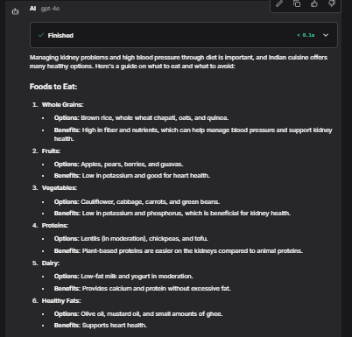
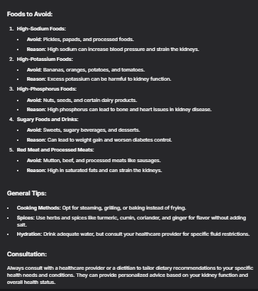
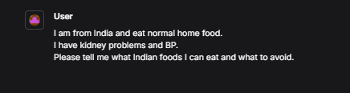
OUTPUTS
AGENT 6 : Personalized Nutrition Agent
INPUT
OUTPUT

Slide 19
RESULTS
COMPONENTS USED:-
Chat Input
Chat Output
IBM Watsonx.ai Agent
File Component Prompt Component
Model – IBM granite-3-8b-instruct
Watson API key
Project id
Watsonx Api endpoint

Slide 20
FUTURE SCOPE
Dialysis Optimization Agent
  Automates dialysis appointment scheduling
  Maximizes utilization of existing 5 dialysis machines
  Reduces patient waiting time & manual coordination
  Intelligent slot allocation based on urgency
  Future scale: 10 centers, 300+ machines
2. Financial Navigation Agent
  Guides patients for PMJAY enrollment (₹5 lakh coverage)
  Supports PMNDP & state health schemes
  Connects patients to charitable dialysis assistance
  Multilingual, step-by-step guidance
  Reduces out-of-pocket medical expenses

Slide 21

GITHUB LINK
Demo Link

Slide 22
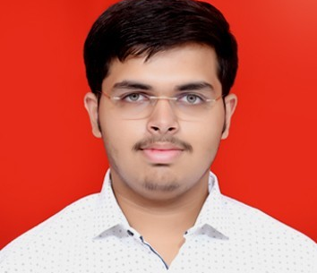
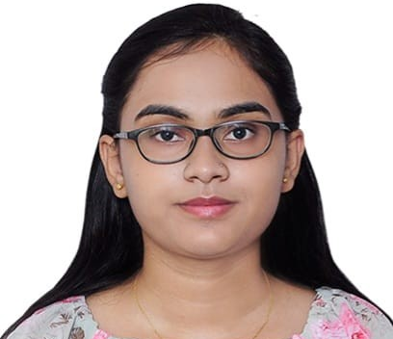
MEET OUR TEAM
Aditya Raje
Nida Pathan
.

Slide 23

CREDITS
- | Mentor from Edunet Foundation 1.Ms.Drishti Chakarvarty 2.Mr.Aman Shrivastva | -

Slide 24
RERFERNCES
epidemiology-of-chronic-kidney-disease
https://pmc.ncbi.nlm.nih.gov/articles/PMC9073222/
Research Paper
Prevalence of chronic kidney disease in India
The Indian Chronic Kidney Disease (ICKD) study:
national burden of chronic kidney disease

Slide 25
THANK YOU

