Slide 1
CREDIT CARD FRAUD DETECTION MODEL
Using
Logistic regression
Xgboost
Neural network

Slide 2
Model Description & Usage
Purpose: Estimate the probability of Fraudulent transaction for a customer of the bank when a credit/ debit card swiped
Uses : Can be used to block the card when the fraudulent transaction is detected
Strategy: P(.90) =block, P(0.7-0.9) = send them a message and block temp for few minutes until we get a reply, P(<.70) = no action required

Slide 3
Agenda
Variables Explained
Y – variable
X - Variable
Train-Test Split
Feature Engineering
Transformations
Target Encoding
Aggregate Encoding – Unique selling point
How Feature Importance changes before and after aggregate encoding
Models & Hyper parameter tuning
Logistic Regression
XGBoost
Neural Network
K-fold validation score comparison
Rank ordering analysis

Slide 4
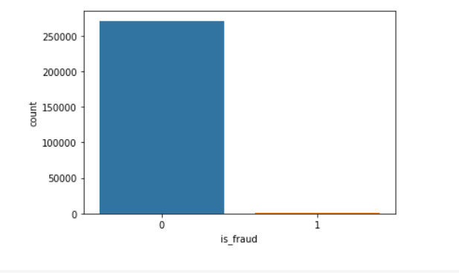
Y Variable Explained
Non-Fraud Transactions: > 99.5%
Fraud Transactions < 0.005

Slide 5
X Variable (1296675 0bservations)
Attributes | Type | Unique Values
Trans_date_trans_num | Date – Time | Time Ranges from 01-01-2019 to 01-12-2019
Cc_num | int
Merchant | Categorical | 169
Category | Categorical | 14
Gender | Categorical | 2
Name | Object
Job | Categorical | 28
Attributes | Type | Unique Values
Amt | Continuous
City | Object
State | Object
Zip | Object | 946
City_population | continuous
Date_of_birth | Date
Attributes | Type | Unique Values
Latitude, Longitude | Float
Merch- Lat, Long | Float

Slide 6
Test – Train Split
My train and split will be based on time
Data set | Time Range
Train Set | 01 – 01 -2019 to 01 – 10 -2019
Test Set | 01 – 11 – 2019 to 01 – 12 - 2019
Train Data
Non-Fraud | 907671
Fraud | 4178 (0.46%)
Test Data
Non-Fraud | 389003
Fraud | 5121 (1.31%)

Slide 7
Feature Engineering

Slide 8
Attributes | Transformed as
Trans_date_trans_num | Transaction hour Fraud rate
Trans_date_trans_num | Transaction week One hot encoding
Category | One hot encoding
Gender | Male = 1
Job | High_risk, low_risk One hot encoding
Latitude, Longitude | Distance
Merch- Lat, Long | Float
Attributes | Transformed as
Amt | Normalised
City | Fraud rate at the Zip code Target encoded – (street+city+state)
State | Object
Zip | Object
City_population | Continuous
Date_of_birth | Age Calculated Normalised
Name, cc_num | Agregate encoded- Calc avg amt, std amt

Slide 9
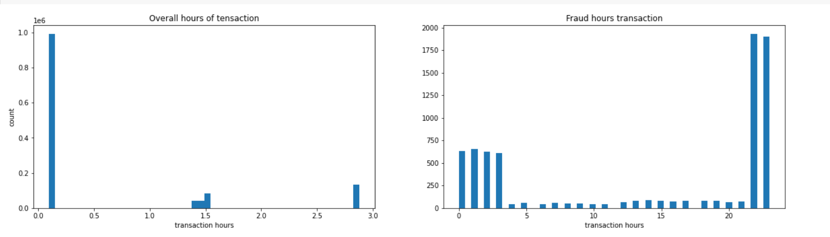
Hour of the transaction – EDA

Slide 10
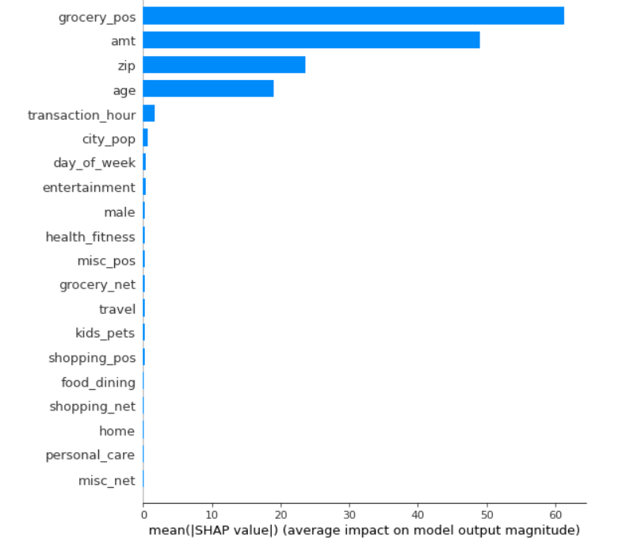
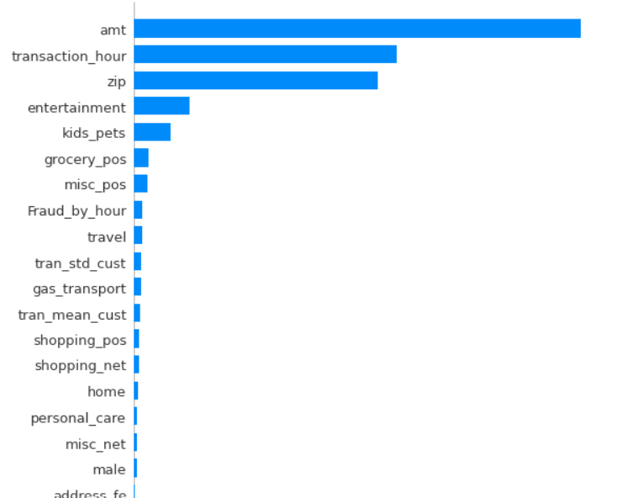
How my aggregation encoding helped in feature selection
Before
After

Slide 11
Model 1 – Logistic Regression
lr_model = LogisticRegression(solver='saga', max_iter=500)
Parameters:
By default -> solver = lbfgs & max_iter = 100
Changed to Solver – ‘saga & Max_iter – 500
Problem:
Convergence problem
Max iteration reached

Slide 12
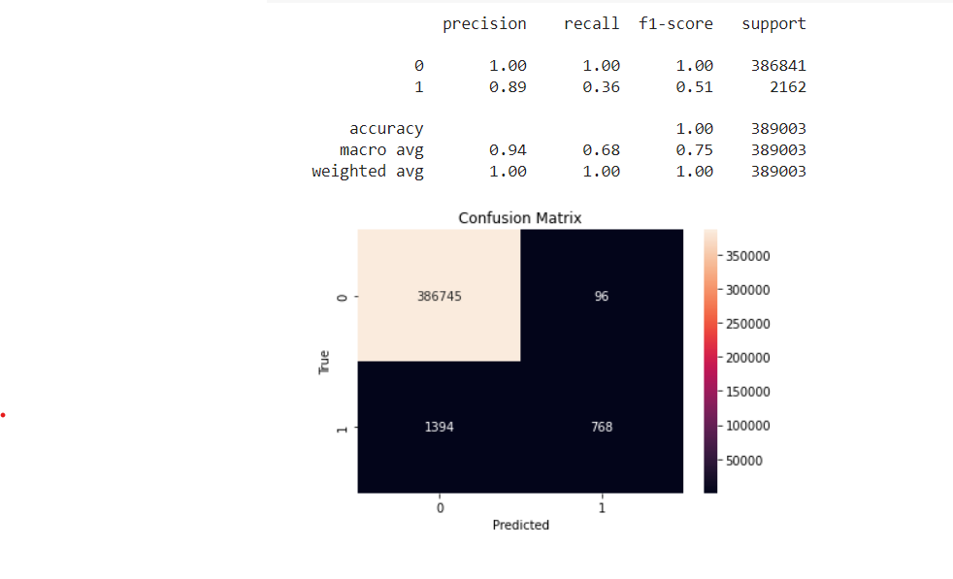
Performance

Slide 13
Model 2 – XGBoost
Initial parameters:
'objective':’ binary:logistic',
'max_depth’: 6,
'learning_rate’: 1.0,
'n_estimators’: 20
Accuracy
0.897

Slide 14
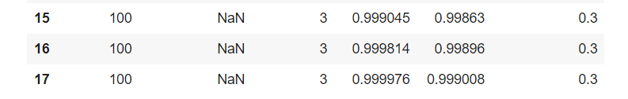
Hyper-parameter Tuning
Parameter | Values
n_estimators | 10 | 50 | 100
Learning_rate | 0.1 | 0.2 | 0.3
Max_depth | 3 | 4 | 5
# Trees
Depth
AUC Train
AUC Test
Learning rate

Slide 15
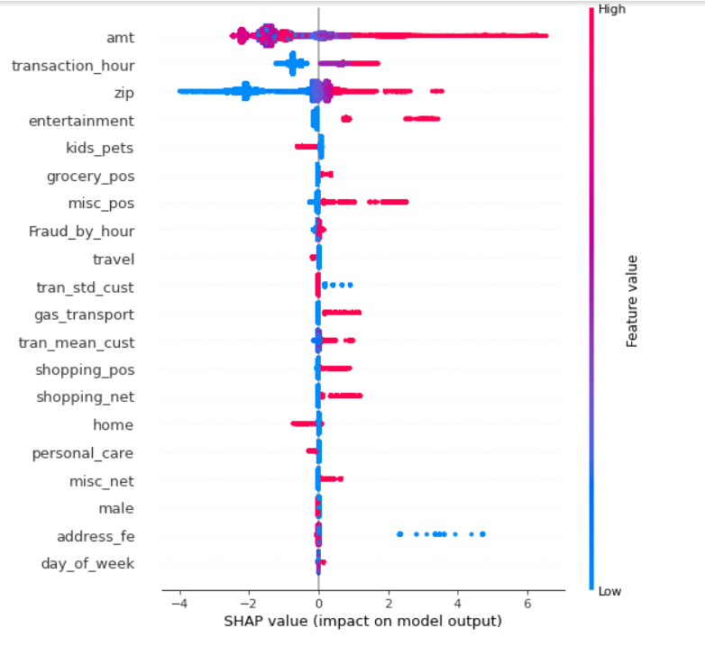
Feature Importance

Slide 16
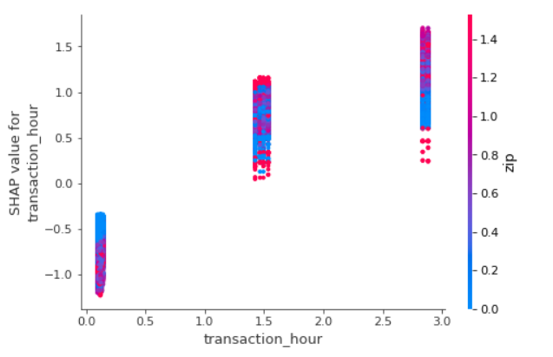
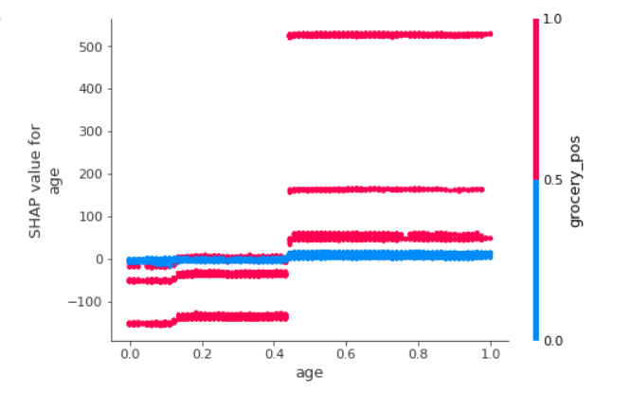
SHAP dependency plot

Slide 17
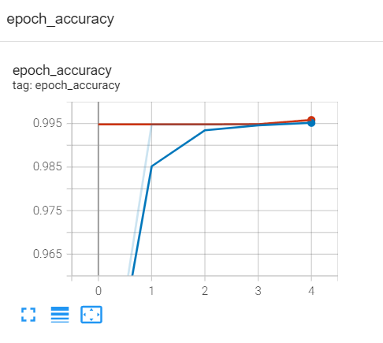
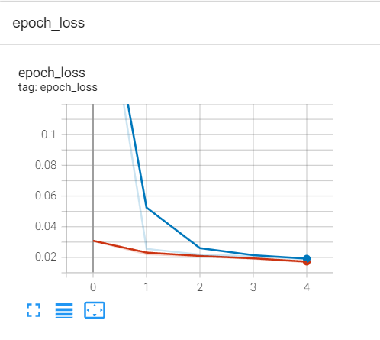
Model 3 -Neural Network (2 hidden layer and 1 output)
Parameter | Value
Batch size | 1000
Epoch | 5
Train data
Validation data

Slide 18
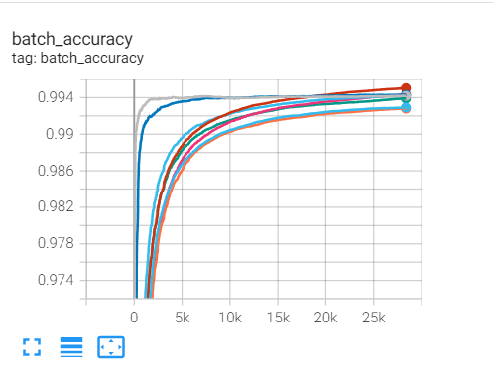
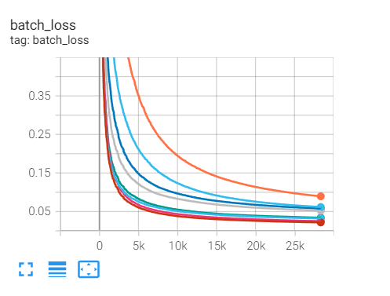
Hyperparameter Tuning
Parameter | Values
Optimizer | Adam | sgd
Drop out | 0.1 | 0.2
Units | 5 | 6

Slide 19
Model Analysis by K-Fold Validation in test set
Model | Accuracy | Loss
XGBoost | 99.97 | -
Neural Network | 99.58 | 0.018
Logistic regression | 92.70 | -

Slide 20
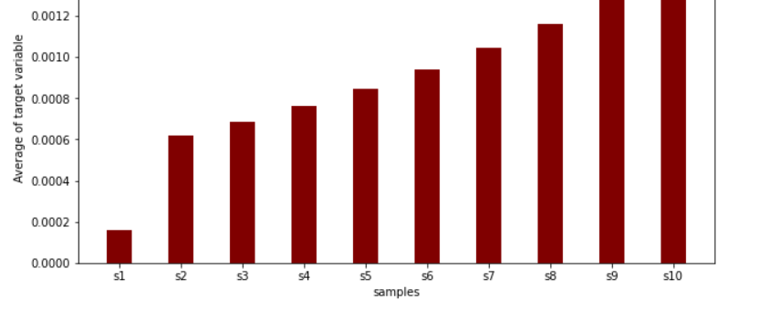
Model Analysis – Rank order Analysis with XGBoost prediction

