Slide 1


Welcome…
Classification: K-nearest Neighbor,Decision Trees, Random Forests
CS 797Q
Fall 2024
10/16/2024

Slide 2
Categories of Data Analysis Techniques
Category | Techniques Covered | Problem to be solved
Association Rules | Apriori | Relationships between items
Clustering | K-Means Clustering DB Scan | Grouping of similar items Identification of structures
Classification | K-nearest Neighbor Decision Trees Random Forests Logistic Regression Naive Bayes Support Vector Machines Neural Networks | Assignment of labels to objects
Regression | Linear Regression Ridge Lasso | Relationship between outcome and inputs
Time Series Analysis | ARMA | Identification of temporal structures Forecasting of temporal processes
Text Mining | Bag-of-Words Stemming/Lemmatization TF-IDF | Analysis of textual data

Slide 3
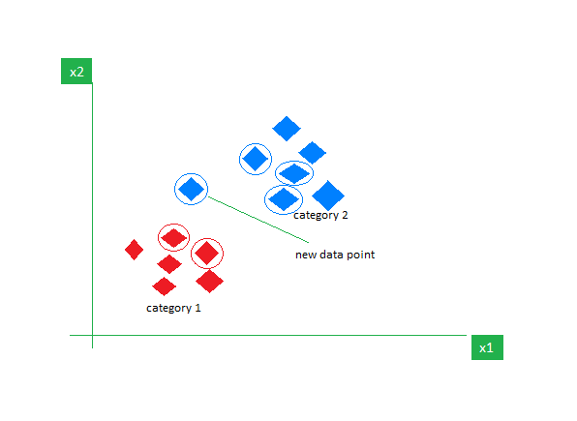
K- Nearest Neighbor
The K-Nearest Neighbors (KNN) algorithm is a supervised machine learning method employed to tackle classification and regression problems.

Slide 4
K- Nearest Neighbors
The K-NN algorithm works by finding the K nearest neighbors to a given data point based on a distance metric, such as Euclidean distance.
The class or value of the data point is then determined by the majority vote or average of the K neighbors.
This approach allows the algorithm to adapt to different patterns and make predictions based on the local structure of the data.

Slide 5


Distance Metrics Used in KNN Algorithm
Euclidean Distance
This is nothing but the cartesian distance between the two points which are in the plane/hyperplane.
Manhattan Distance
This metric is calculated by summing the absolute difference between the coordinates of the points in n-dimensions.

Slide 6

Distance Metrics Used in KNN Algorithm
Minkowski Distance
Euclidean, as well as the Manhattan distance, are special cases of the Minkowski Distance.
when p = 2 then it is the same as the formula for the Euclidean distance.
when p = 1 then we obtain the formula for the Manhattan distance.

Slide 7
How to choose the value of k for KNN Algorithm?
The value of k is very crucial in the KNN algorithm to define the number of neighbors in the algorithm.
The value of k in the k-nearest neighbors (k-NN) algorithm should be chosen based on the input data.
If the input data has more outliers or noise, a higher value of k would be better.
It is recommended to choose an odd value for k to avoid ties in classification

Slide 8
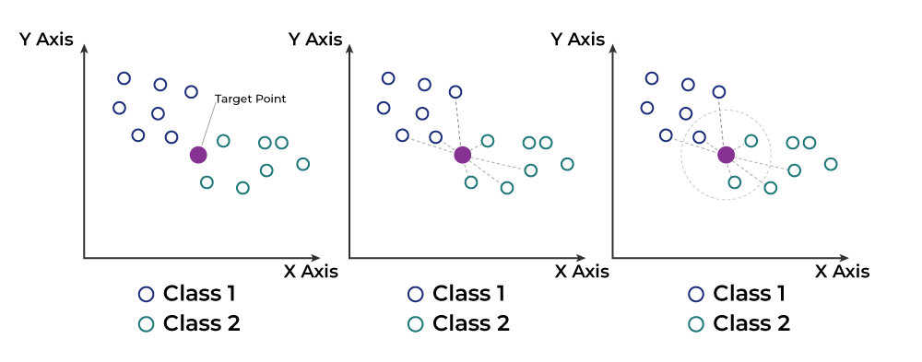
KNN algorithm
K-Nearest Neighbors (KNN) algorithm operates on the principle of similarity, where it predicts the label or value of a new data point by considering the labels or values of its K nearest neighbors in the training dataset.

Slide 9
KNN algorithm
Step 1: Selecting the optimal value of K
K represents the number of nearest neighbors that needs to be considered while making prediction.
Step 2: Calculating distance
To measure the similarity between target and training data points, Euclidean distance is used.
Distance is calculated between each of the data points in the dataset and target point.
Step 3: Finding Nearest Neighbors
The k data points with the smallest distances to the target point are the nearest neighbors.

Slide 10
KNN algorithm
Step 4: Voting for Classification or Taking Average for Regression
In the classification problem, the class labels of K-nearest neighbors are determined by performing majority voting.
The class with the most occurrences among the neighbors becomes the predicted class for the target data point.
In the regression problem, the class label is calculated by taking average of the target values of K nearest neighbors.
The calculated average value becomes the predicted output for the target data point.

Slide 11
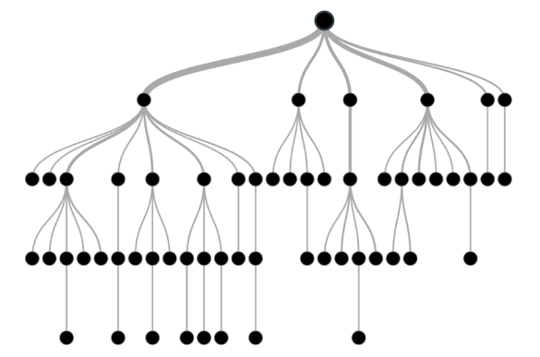
Decision Tree
A decision tree, which has a hierarchical structure made up of root, branches, internal, and leaf nodes, is a non-parametric supervised learning approach used for classification and regression applications.

Slide 12
Decision Tree Terminologies
Root Node: The initial node at the beginning of a decision tree, where the entire population or dataset starts dividing based on various features or conditions.
Decision Nodes: Nodes resulting from the splitting of root nodes are known as decision nodes. These nodes represent intermediate decisions or conditions within the tree.
Leaf Nodes: Nodes where further splitting is not possible, often indicating the final classification or outcome. Leaf nodes are also referred to as terminal nodes.
Sub-Tree: A sub-section of a decision tree is referred to as a sub-tree. It represents a specific portion of the decision tree.
Pruning: The process of removing or cutting down specific nodes in a decision tree to prevent overfitting and simplify the model.
Branch / Sub-Tree: A subsection of the entire decision tree is referred to as a branch or sub-tree. It represents a specific path of decisions and outcomes within the tree.
Parent and Child Node: In a decision tree, a node that is divided into sub-nodes is known as a parent node, and the sub-nodes emerging from it are referred to as child nodes.
The parent node represents a decision or condition, while the child nodes represent the potential outcomes or further decisions based on that condition.

Slide 13
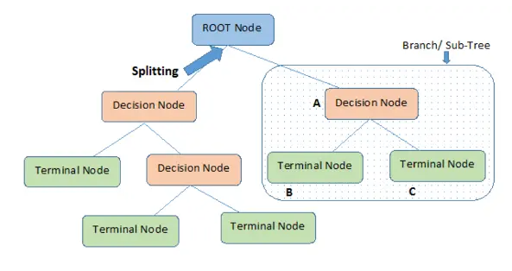
Decision Tree Terminologies

Slide 14
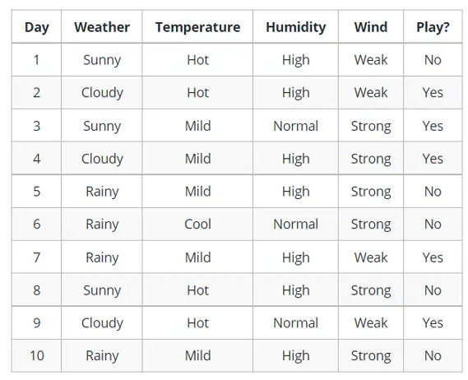
Example of Decision Tree

Slide 15
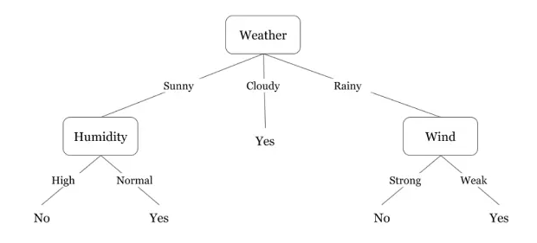
Example of Decision Tree

Slide 16
How Decision Trees Work?
Process of creating a decision tree involves:
Selecting the Best Attribute: Using a metric like Gini impurity, entropy, or information gain, the best attribute to split the data is selected.
Splitting the Dataset: The dataset is split into subsets based on the selected attribute.
Repeating the Process: The process is repeated recursively for each subset, creating a new internal node or leaf node until a stopping criterion is met (e.g., all instances in a node belong to the same class or a predefined depth is reached).

Slide 17
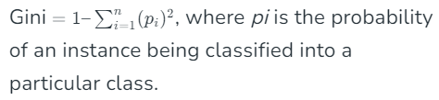
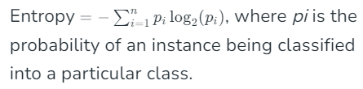
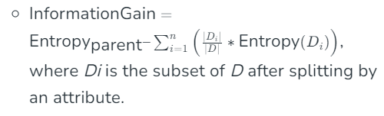
Metrics for Decision Trees
Gini Impurity: Measures the likelihood of an incorrect classification of a new instance if it was randomly classified according to the distribution of classes in the dataset.
Entropy: Measures the amount of uncertainty or impurity in the dataset.
Information Gain: Measures the reduction in entropy or Gini impurity after a dataset is split on an attribute.

Slide 18
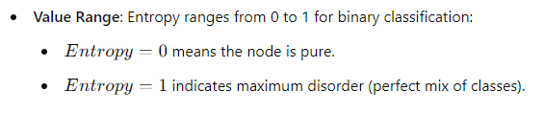
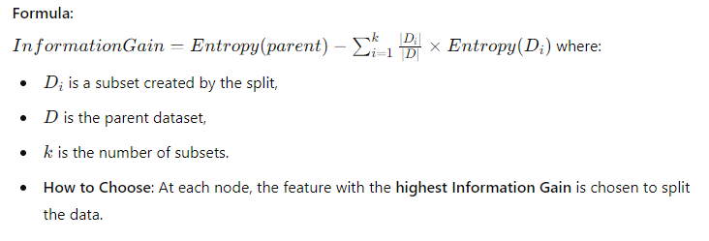
Gini Impurity:
Value Range: Gini ranges from 0 to 0.5
Gini=0 means the node is pure (all elements are of one class).Higher values indicate more mixed classes.
How to Choose: At each split, the feature with the lowest Gini Impurity is selected.
Entropy:
Information Gain:

Slide 19
Random Forest
Random Forest algorithm works by creating several decision Trees during the training phase.
Each tree is constructed using a random subset of the data set to measure a random subset of features in each partition.
This randomness introduces variability among individual trees, reducing the risk of overfitting and improving overall prediction performance.
In prediction, the algorithm aggregates the results of all trees, either by voting (for classification tasks) or by averaging (for regression tasks).

Slide 20
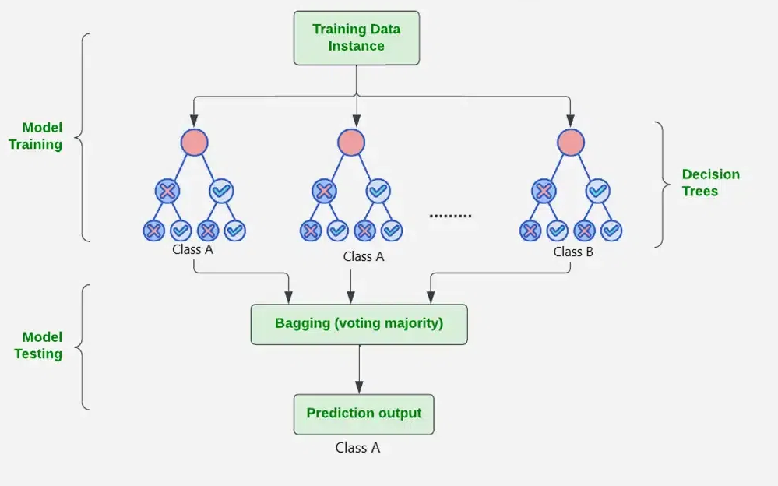
Random Forest

Slide 21
What are Ensemble Learning models
In ensemble learning, different models, often of the same type or different types, team up to enhance predictive performance.
It’s all about leveraging the collective wisdom of the group to overcome individual limitations and make more informed decisions in various machine learning tasks.
XGBoost,
AdaBoost
Random Forest,
Bagging, Voting.

Slide 22
What is Bagging & Boosting
Bagging is an ensemble learning model, where multiple week models are trained on different subsets of the training data.
Each subset is sampled with replacement and prediction is made by averaging the prediction of the week models for regression problem and considering majority vote for classification problem.
Boosting trains multiple based models sequentially. In this method, each model tries to correct the errors made by the previous models.
Each model is trained on a modified version of the dataset, the instances that were misclassified by the previous models are given more weight. The final prediction is made by weighted voting.

Slide 23
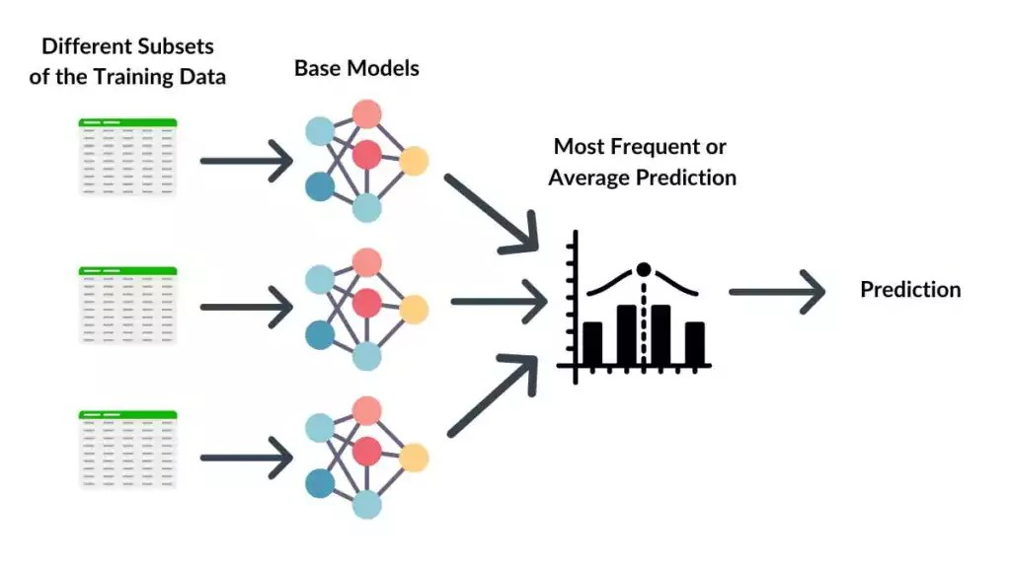
Bagging

Slide 24
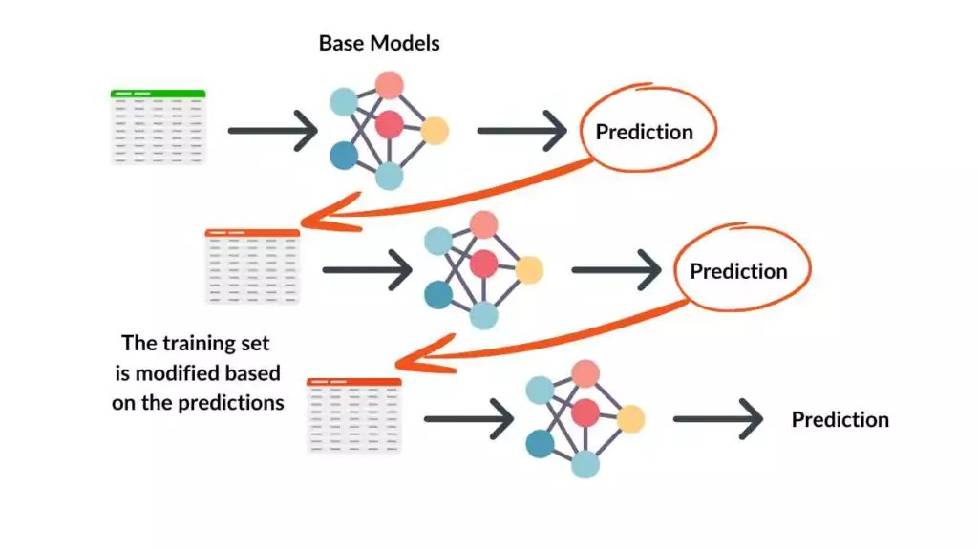
Boosting

Slide 25
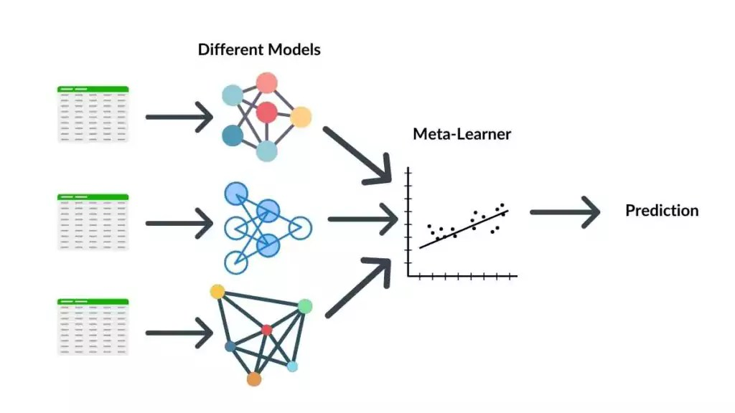
Stacking

Slide 26
Algorithm for Random Forest Work
Step 1: Select random K data points from the training set.
Step 2:Build the decision trees associated with the selected data points(Subsets).
Step 3:Choose the number N for decision trees that you want to build.
Step 4:Repeat Step 1 and 2.
Step 5: For new data points, find the predictions of each decision tree, and assign the new data points to the category that wins the majority votes.

