Slide 1
Phishing Attacks – Awareness & Prevention

Slide 2
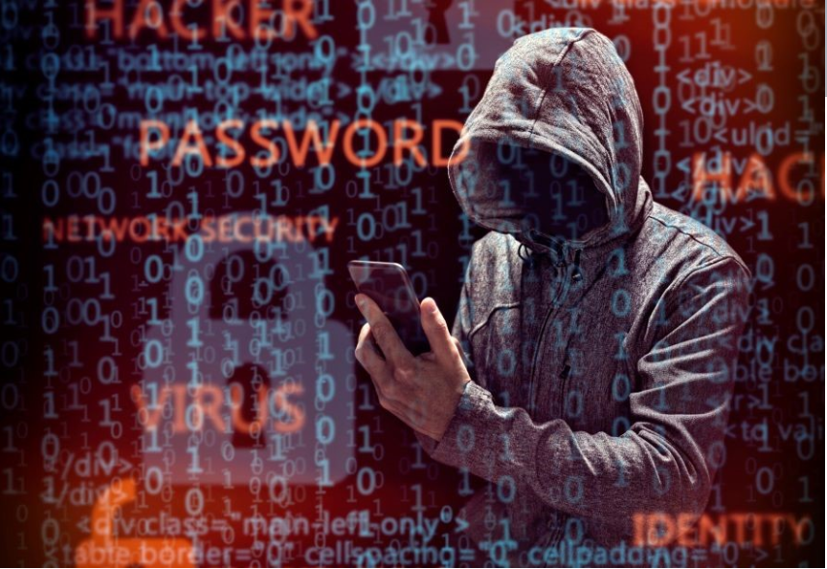
Introduction
Phishing is a type of cyberattack that uses deceptive messages to trick victims into revealing sensitive data such as login credentials, banking information, or personal identity details. These attacks typically impersonate trusted sources via email, messaging apps, or cloned websites.

Slide 3
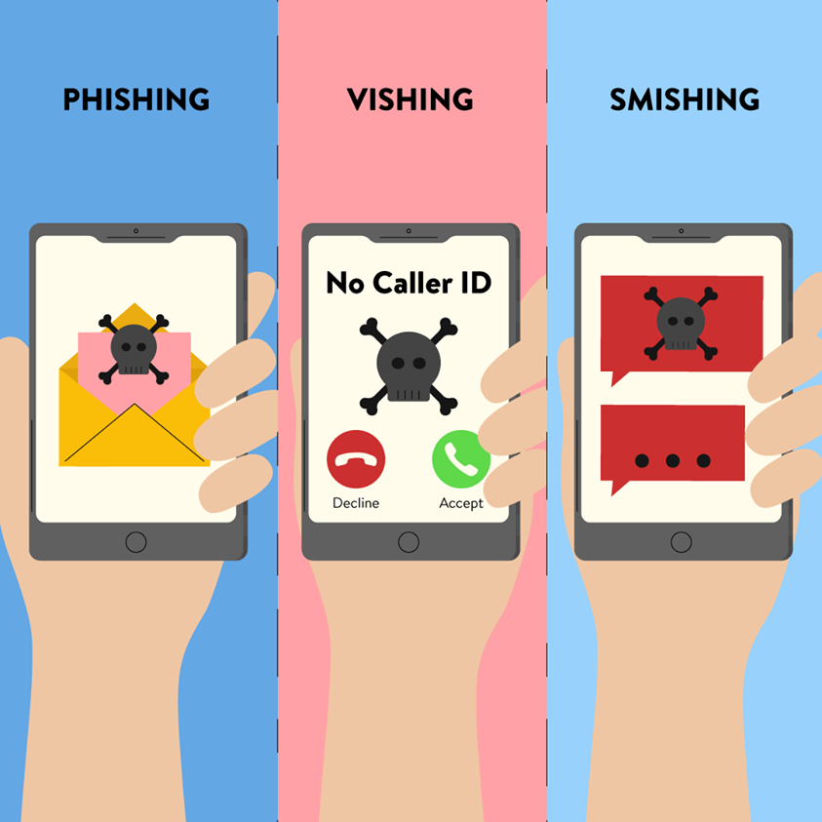
Types of Phishing Attacks
Email Phishing – Generic fraudulent messages claiming to be from legitimate institutions.
Spear Phishing – Customized attacks based on specific information about the target.
Whaling – Targeting senior executives ("big fish") with crafted messages.
Vishing (Voice Phishing) – Use of phone calls to impersonate legitimate representatives.
Smishing (SMS Phishing) – Malicious links or messages via SMS.
Pharming – Redirecting a website's traffic to a fake one without the user’s knowledge.

Slide 4
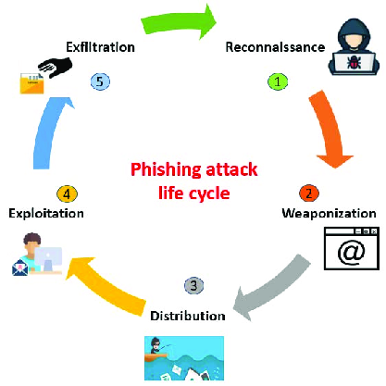
Phishing Techniques
Spoofed Email Domains – Small changes in domain names to deceive users.
Cloned Websites – Replicas of real websites used to capture login credentials.
Fake Attachments – Files containing malicious code (e.g., keyloggers, ransomware).
Deceptive Subject Lines – Urgent or alarming subjects to prompt quick action.
Use of Publicly Available Info – Leaked or public data used to craft believable messages.

Slide 5
Real-World Example
Google and Facebook Scam (2013–2015) – Attackers posed as a Taiwanese hardware company and sent fake invoices to Google and Facebook, tricking employees into wiring over $100 million to offshore accounts. The scam remained undetected for years.
Twitter Bitcoin Scam (2020) – A group of attackers gained access to Twitter’s internal tools through social engineering, allowing them to hijack high-profile accounts (Elon Musk, Barack Obama, etc.) and post bitcoin scam messages, collecting over $100,000 in cryptocurrency.
Sony Pictures Hack (2014) – Phishing emails containing malicious links were sent to Sony employees. Once clicked, the attackers accessed internal systems, leaking unreleased films, private employee data, and confidential emails. This caused significant financial and reputational damage.
Colonial Pipeline Ransomware (2021) – Believed to be triggered by a compromised VPN password obtained through phishing. This led to a ransomware attack that disrupted gas supply across the East Coast of the U.S., costing millions in recovery and ransom.

Slide 6
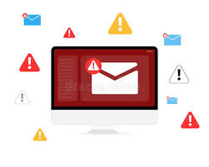
How to Identify Phishing Attempts
Suspicious Email Addresses – Slight misspellings or unrelated domain names.
Unexpected Attachments or Links – Especially from unknown senders.
Requests for Confidential Info – Legitimate companies don't ask for credentials via email.
Poor Grammar & Formatting – Common in fraudulent messages.
Mismatch Between Display Name and Actual Email Address

Slide 7

How to Prevent Phishing Attacks
Use Verified and Updated Security Software.
Regular Phishing Simulations and Security Training for Employees.
Deploy Anti-Phishing Toolbars and Firewalls.
Ensure HTTPS for Websites and Applications.
Verify Communications via Trusted Channels.
Utilize Threat Intelligence Platforms.

Slide 8
What to Do if You Fall for Phishing
Disconnect Affected Devices from the Network.
Reset All Related Account Passwords.
Notify Your Organization's Security Team Immediately.
Scan Systems Using Antivirus and Anti-Malware Tools.
Enable Fraud Alerts with Your Bank and Credit Agency.
Log the Incident and Learn from It.

Slide 9

Conclusion
Phishing continues to be a top method of cybercrime globally.
Ongoing awareness, proactive monitoring, and strong security practices are key defenses.
Encouraging a cybersecurity culture minimizes the risk and strengthens resilience.
Organizations should invest in continuous employee education, multi-layered defense systems, and routine incident response drills.
Building habits of caution—like verifying links, double-checking sources, and reporting suspicious messages—go a long way.

