Slide 1
Chit-Chat
A Real-Time Web Chat Application
Project Goal : Build a production-inspired real-time chat application that demonstrates full-stack architecture, real-time communication, and clean software design while providing a strong foundation for future scalability.
Chit-Chat is a full-stack web application designed to enable real-time communication between multiple users. The goal of this project is to understand and implement the core architecture behind modern chat applications while building a scalable foundation for future enhancements.
For Phase 1, users can join the application using a temporary username, participate in a shared chat room, and send or receive messages instantly without creating an account.
The application is being developed using a Modular Monolith Architecture with a Layered Design, making it simple to build, maintain, and extend as new features are introduced.

Slide 2
SCOPE
Phase 1
Join the chat using a temporary username
Connect to a shared chat room
Send and receive real-time messages
Support multiple users simultaneously
Web-based application with responsive UI
Phase 2
User authentication
Private user profiles
Multiple chat servers/channels
Direct messaging
Media sharing
Notifications and presence status

Slide 3
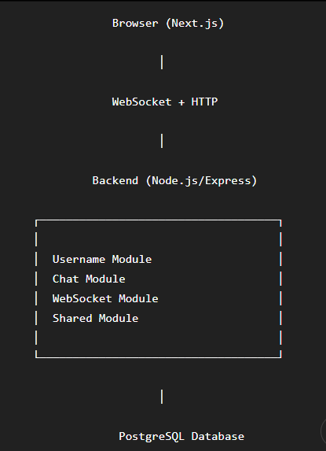
Phase 1 : Architecture Plan - Modular Monolith + Layered
Tech Stack
Frontend
Next.js
React
TypeScript
TailwindCSS
Backend
Node.js
Express.js
Real-time Communication
Socket.IO
(Socket.IO is much easier than raw WebSockets for an internship.)
Database
PostgreSQL
or
Supabase PostgreSQL
ORM
Prisma
Deployment
Frontend
Vercel
Backend
Render
Database
Supabase

Slide 4
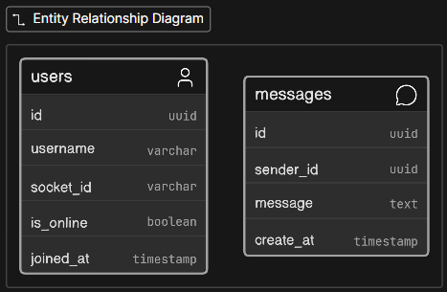
database
Phase 1 : Folder Structure
backend
frontend
backend/
src/
modules/
username/
chat/
websocket/
middleware/
routes/
prisma/
utils/
app.ts
server.ts
app/
components/
ChatWindow
MessageBubble
UsernameModal
MessageInput
hooks/
lib/
services/
Users id -> Messages.sender_id
API Endpoints
Socket.IO
socket.emit("join")
socket.emit("send_message")
socket.on("receive_message")
POST /join
POST /leave
GET /messages
Real-time Communication Happens over Socket.IO

Slide 5
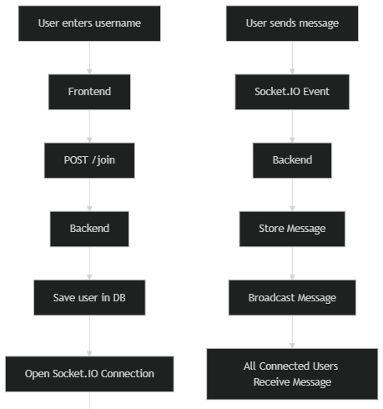
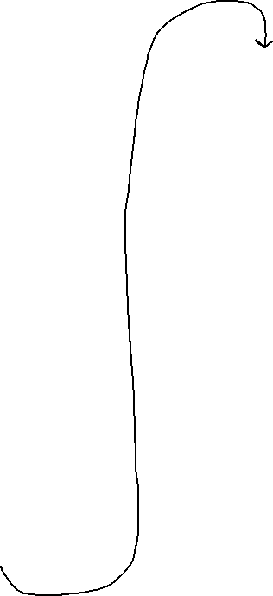
Phase 1 : The Flow

Slide 6
Phase 2 : Expansion
Expanded Database
users
profiles
servers
server_members
channels
messages
attachments
notifications
Authentication Module
Email/Password
Google Login
JWT/Supabase Auth
User Profile
Avatar
Bio
Last Seen
Status
Chat Rooms
Gaming
AI
Movies
Programming
General
Private Messaging
User A ↔ User B
Media Sharing
Images
Videos
Files
Typing Indicator
"Rajeev is typing..."
Read Receipts
✓
✓✓
Seen
Notifications
Push notifications
Email notifications
Why this architecture?
It balances simplicity with extensibility. For Phase 1, you only need a few modules and a straightforward database. As you add authentication, chat rooms, profiles, and privacy in Phase 2, you won't need to rewrite the application—you'll just add new modules and tables. This is exactly why a modular monolith is a great fit. It's easy to understand, easy to build, and scales well as features are introduced.

