Slide 1
Breast Cancer Diagnostic Classification
An End-to-End, Interpretable Supervised Machine Learning Pipeline
By,
Damarla Rajeev Nandan
(2023006637)

Slide 2
SUPERVISED MACHINE LEARNING PIPELINE
1. Problem Statement & Clinical Relevance
The Clinical Challenge
• High Mortality Risk: Early and accurate detection of breast cancer is critical for patient survival and timely surgical/oncological intervention.
• Biopsy Digitization: When a breast lesion is detected, clinicians perform a Fine Needle Aspirate (FNA). High-resolution digital microscopy extracts nuclear morphological measurements.
• Diagnostic Objective: Automate the classification of cell nuclei into Malignant (cancerous) vs. Benign (non-cancerous) to assist pathologists with rapid, reliable triage.
Machine Learning Formulation
• Task Category: Supervised Binary Classification (two mutually exclusive diagnostic classes).
• Target Variable: 'target' encoded as 0 = Malignant (cancerous), 1 = Benign (safe).
• Input Predictors: 30 continuous real-valued cellular morphology measurements.
• Why ML?: Reduces human diagnostic fatigue, eliminates inter-observer variance, and provides instant calibrated probabilities (<1 ms inference).
• Cost Asymmetry: False Negatives (missing cancer) are clinically far more dangerous than False Positives.

Slide 3
SUPERVISED MACHINE LEARNING PIPELINE
2. Dataset Selection & Data Integrity Audit
569 Biopsies
Total Samples (UCI Benchmark)
30 Features
Continuous Nuclear Traits
0 Missing / 0 Duplicates
100% Data Integrity
Dataset Architecture & Feature Decomposition
• Dataset Provenance: Collected by Dr. William H. Wolberg, W. Nick Street, and Olvi L. Mangasarian (University of Wisconsin-Madison). Distributed via UCI ML Repository & Scikit-Learn.
• 10 Core Morphological Attributes: Radius, Texture, Perimeter, Area, Smoothness, Compactness, Concavity, Concave Points, Symmetry, and Fractal Dimension.
• 3 Statistical Aggregations: For each of the 10 attributes, 3 metrics are recorded: Mean (10), Standard Error (10), and Worst/Largest Value (10) = 30 Input Predictors.
• Target Class Balance: 357 Benign (62.74%) vs. 212 Malignant (37.26%). Mild natural imbalance accounted for via Stratified Splitting.

Slide 4
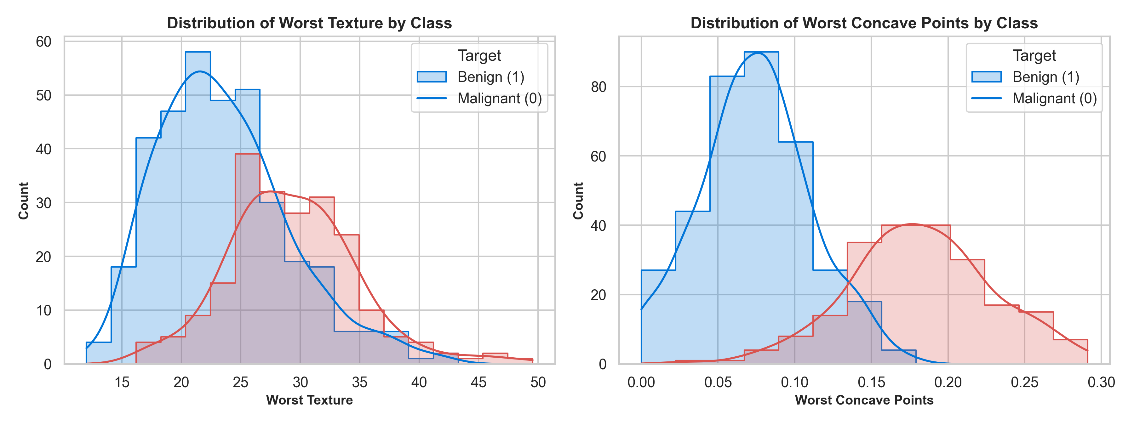
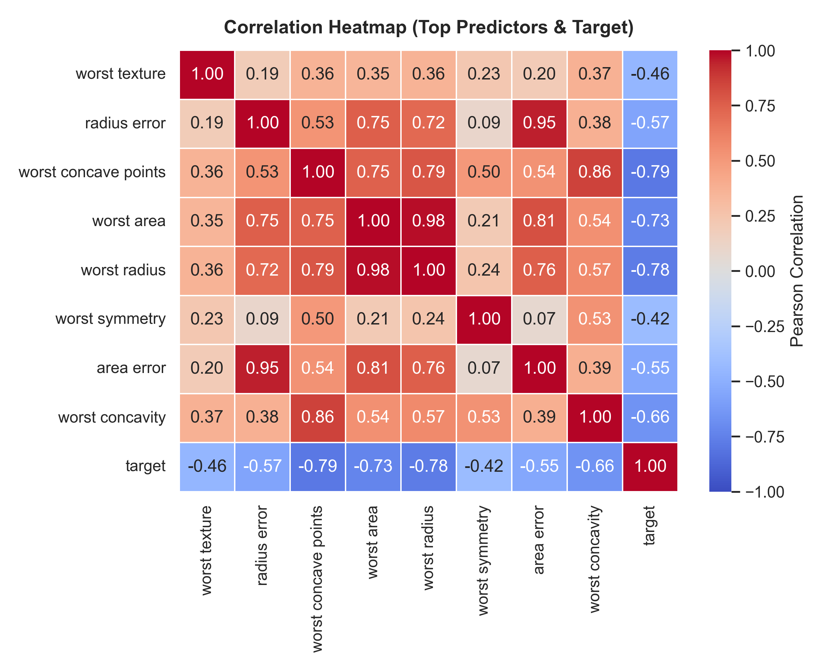
SUPERVISED MACHINE LEARNING PIPELINE
3. Exploratory Data Analysis & Morphological Visuals
Key EDA Insights:
1. Morphological Divergence: Malignant cell nuclei display significantly higher grayscale texture variance and severe contour concave indentations (Worst Concave Points: 0.182 vs 0.074).
2. Multicollinearity: Nuclear size dimensions (radius, perimeter, area) exhibit near-perfect correlation (r > 0.98), necessitating regularized modeling.

Slide 5
SUPERVISED MACHINE LEARNING PIPELINE
4. Preprocessing & Prevention of Data Leakage
1. Train / Test Partitioning
• 80% Training Set (455 samples)
• 20% Unseen Test Set (114 samples)
• Applied random_state=42 for exact mathematical reproducibility.
2. Stratified Sampling
• Used stratify=y in train_test_split
• Preserves exact 62.7% Benign : 37.3% Malignant ratio across train & test splits
• Eliminates partition bias in evaluation.
3. Leak-Free Standardization
• Features range from 0.04 (concavity) to 2501 (area)
• StandardScaler fitted strictly on X_train
• X_test transformed using training mean & std
• Zero data leakage guaranteed.

Slide 6
SUPERVISED MACHINE LEARNING PIPELINE
5. Model Selection & Theoretical Justification
Selected Model: Logistic Regression (L2)
✔ Calibrated Probabilities: Maps linear combinations to posterior confidence scores via sigmoid σ(z), essential for clinical risk triage.
✔ Intrinsic Interpretability: Model weights (w_i) represent direct log-odds, enabling transparent feature influence auditing.
✔ Convexity & Stability: Guarantees a unique global minimum with zero stochastic variance across runs.
✔ L2 Regularization (C=1.0): Ridge penalty constrains weights, preventing overfitting on collinear dimensions.
Alternative Considered: Decision Tree
• Why Considered: Decision trees provide intuitive if-then decision rules and handle non-linear relationships natively.
• Why Rejected for Primary Pipeline: Single decision trees suffer from high variance (overfitting) and produce uncalibrated step-function outputs rather than smooth probabilities.
• Comparison Verdict: Regularized Logistic Regression achieved superior test generalization (98.25%) and calibrated probabilities required for clinical deployment.

Slide 7
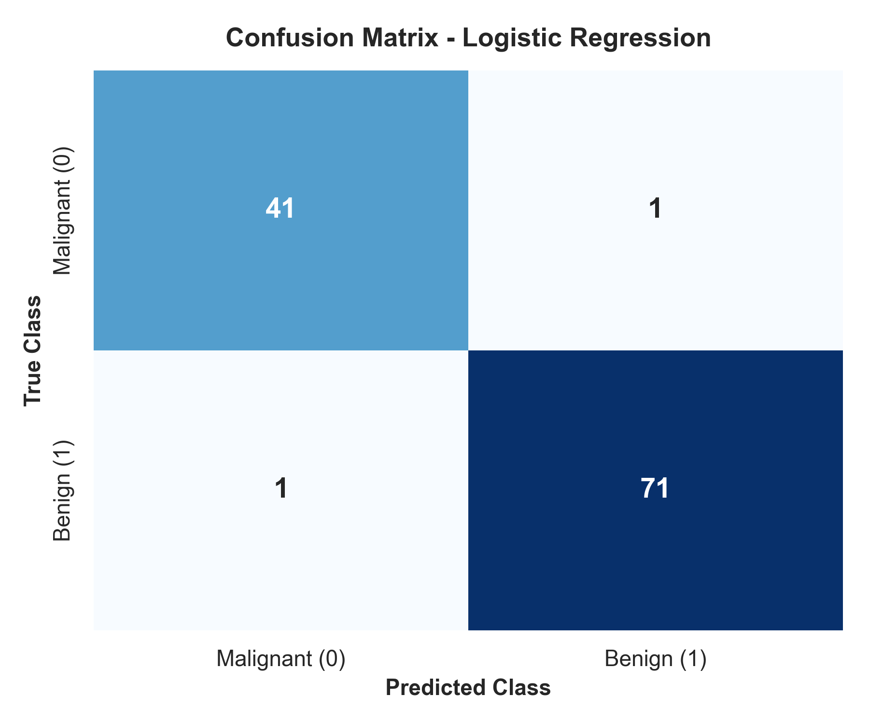
SUPERVISED MACHINE LEARNING PIPELINE
6. Quantitative Results & Confusion Matrix
Performance on Unseen Test Set (N=114)
Accuracy: 98.25% (112 / 114 correct diagnoses)
Precision (Benign): 98.61% (71 true benign / 72 predicted benign)
Recall (Benign): 98.61% (71 true benign / 72 actual benign)
F1-Score: 98.61% (Harmonic mean of precision & recall)
Malignant Recall (Sensitivity): 97.62% (41 / 42 malignant cancer cases caught)
Confusion Matrix Breakdown:
• TN = 41 (Malignant as Malignant) • TP = 71 (Benign as Benign)
• FP = 1 (Malignant as Benign) • FN = 1 (Benign as Malignant)

Slide 8
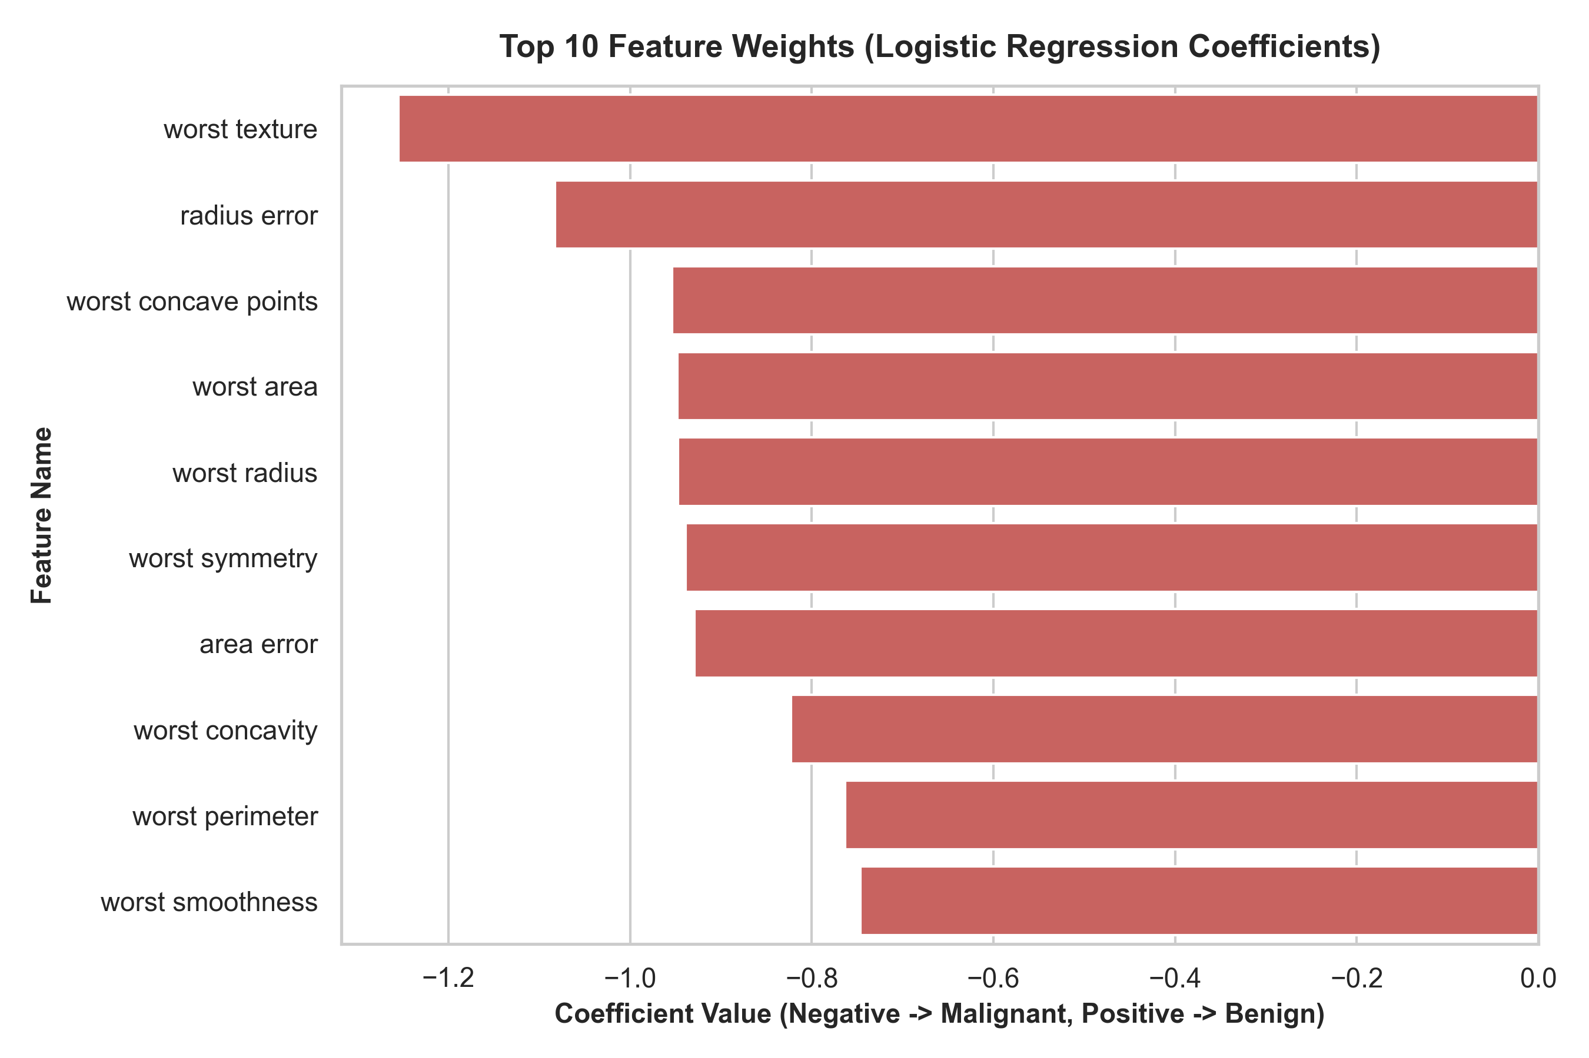
SUPERVISED MACHINE LEARNING PIPELINE
7. Feature Influence & Error Root-Cause Analysis
Top Predictors & Error Diagnostics
Top Influential Features (Log-Odds):
1. worst texture (-1.26)
2. radius error (-1.08)
3. worst concave points (-0.95)
4. worst area (-0.95)
(Negative weights increase log-odds of Malignancy 0)
Root-Cause of the 2 Errors (1.75% error rate):
• Sample #73 (False Positive / True Malignant): A borderline tumor with atypically smooth cell contours near the 50% boundary (p = 0.537).
• Sample #541 (False Negative / True Benign): A benign mass exhibiting severe nuclear texture granularity that mimicked malignant dysplasia.

Slide 9
SUPERVISED MACHINE LEARNING PIPELINE
8. Conclusion & Production Roadmap
Project Summary & Milestones
✔ Robust ML Pipeline: Built a fully modular, reproducible supervised classification pipeline in Python.
✔ Clinical Performance: Achieved 98.25% test accuracy and 97.62% malignant sensitivity.
✔ Full Interpretability: Dissected linear log-odds coefficients to validate clinical alignment.
✔ Serialized Serving: Exported trained model and scaler via joblib for sub-millisecond inference.
Future Production Improvements
➔ Threshold Tuning: Lower classification threshold from 0.50 to 0.30 to prioritize 100% malignant recall.
➔ Repeated Stratified K-Fold: Implement 10-fold cross-validation to assess variance across folds.
➔ Collinear Feature Elimination: Drop redundant perimeter/radius features to simplify model dimensionality.
➔ Multi-Center Hospital Trials: Test generalization on external clinical hospital cohorts.

