Slide 1
Other Search Methods
Unit 3

Slide 2
Bibliography
[1] S. J. Russell and P. Norvig. 2020, Artificial Intelligence: A modern approach, Fourth Edition, Pearson.
[2] T.B.Shahi, Artificial Intelligence, B.Sc.CSIT/BIM, KEC Publication.
[3] Claude AI, version 3.5 Sonnet, 2024, https://claude.ai
[4] ChatGPT, version 3.5/ 4o, 2024, https://chatgpt.com/

Slide 3
Local Search Methods
The search methods discussed earlier are useful for fully observable, deterministic, static, known environments where the solution is a sequence of actions.
But the real world is different.
Unlike systematic search methods that explore the entire search space, local search methods focus on improving a single current state iteratively.
Local search methods are a class of techniques used to solve optimization problems.
They are particularly useful for problems with large or infinite state spaces where finding a globally optimal solution is impractical due to memory constraints [3].

Slide 4
Key Characteristics
Key characteristics of local search methods:
They maintain a single current state, not a search tree.
They move only to neighbouring states.
They generally do not maintain a search history.
They can often solve large-scale problems that systematic algorithms cannot.
We will discuss mainly two popular types of local search methods:
Hill Climbing
Simulated Annealing [3]

Slide 5
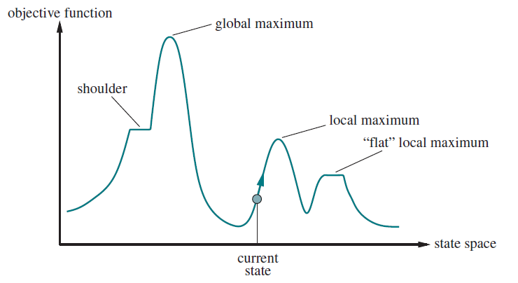
One Dimensional State Space Landscape
[1]

Slide 6
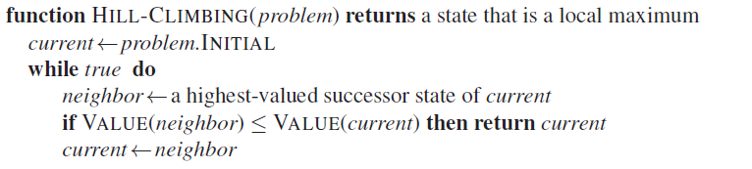
Hill Climbing
Hill Climbing is a simple optimization algorithm that attempts to find a better solution by making incremental changes to a single solution.
Algorithm:
1)Start with an initial solution.
2)Evaluate all neighbouring solutions.
3)If a neighbour is better than the current solution, move to that neighbour.
4)Repeat steps 2-3 until no better neighbour is found [3].
[1]

Slide 7
Hill Climbing
Types of Hill Climbing:
a) Steepest Ascent: Evaluates all neighbours and selects the best one.
b) First-Choice: Moves to the first improved neighbour it finds.
c) Random-Restart: Performs multiple hill climbing runs starting from different random initial states [3].

Slide 8
Hill Climbing
Advantages:
Simple to implement and understand.
Works well for many optimization problems.
Can quickly find a local optimum.
Disadvantages:
Can get stuck in local optima.
Sensitive to initial state.
Not suitable for problems with many local optima [3].

Slide 9
Applications
a) Machine Learning:
Local optimization in gradient-based learning algorithms
Hyperparameter tuning in simple models
b) Computer Vision:
Image segmentation
Local feature matching
c) Robotics:
Local path optimization
Sensor calibration [3]

Slide 10
Simulated Annealing
Simulated Annealing is inspired by the annealing process in metallurgy.
It introduces a probability of accepting worse solutions, which decreases over time.
Algorithm:
Start with an initial solution and temperature T.
While T > 0:
Generate a random neighbour solution.
If the neighbour is better, always move to it.
If the neighbour is worse, move to it with probability e^(-ΔE/T), where ΔE is the change in energy (cost).
Decrease T according to a cooling schedule [3].

Slide 11
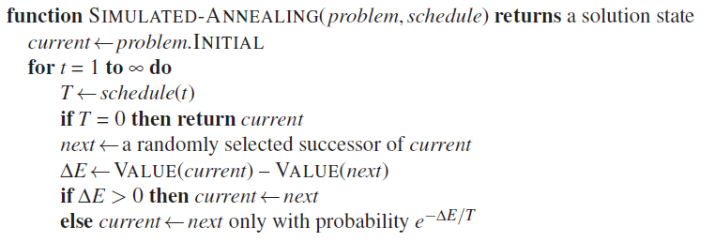
Simulated Annealing
Key Components:
Initial Temperature: Controls the initial probability of accepting worse solutions.
Cooling Schedule: Determines how the temperature decreases over time.
Neighbor Generation: Method to create nearby states.
Energy Function: Evaluates the quality of a solution [3].
[1]

Slide 12
Simulated Annealing
Advantages:
Can escape local optima.
Convergence to global optimum is guaranteed with a proper cooling schedule (in theory).
Works well for problems with many local optima.
Disadvantages:
Performance heavily depends on the cooling schedule.
May be slower than simpler methods for some problems.
Requires careful tuning of parameters [3].

Slide 13
Comparison of Hill Climbing and Simulated Annealing
Local Optima:
Hill Climbing gets stuck in local optima.
Simulated Annealing can escape local optima.
Convergence:
Hill Climbing converges faster but to a local optimum.
Simulated Annealing converges slower but can find global optimum.
Complexity:
Hill Climbing is simpler to implement and understand.
Simulated Annealing requires more complex implementation and parameter tuning [3].

Slide 14
Comparison of Hill Climbing and Simulated Annealing
Randomness:
Hill Climbing is deterministic (except for random-restart variant).
Simulated Annealing incorporates randomness in its decisions.
Parameter Tuning:
Hill Climbing requires minimal tuning.
Simulated Annealing needs careful tuning of initial temperature and cooling schedule.
Problem Suitability:
Hill Climbing works well for problems with few local optima.
Simulated Annealing is better for problems with many local optima [3].

Slide 15
Comparison of Hill Climbing and Simulated Annealing
In general, Hill Climbing might be preferred for its simplicity when the problem is well-behaved,
while Simulated Annealing could be chosen for more complex optimization problems where escaping local optima is crucial [3].

Slide 16
Applications of Simulated Annealing
a) VLSI Design:
Chip layout optimization in semiconductor manufacturing
Circuit board design
b) Image Processing:
Image reconstruction and noise reduction
Feature matching in computer vision
c) Machine Learning:
Training neural networks
Hyperparameter optimization in complex models
d) Financial Modeling:
Portfolio optimization
Risk management strategies [3]

Slide 17
Adversarial Search Methods
Adversarial search is a technique used in artificial intelligence for decision making in scenarios where two or more agents with conflicting objectives interact.
It's commonly used in two-player zero-sum games, where one player's gain is the other's loss.
Key concepts:
Game tree: A tree structure representing all possible game states and moves
Utility function: Evaluates the desirability of a game state
Terminal states: End game positions where the outcome is known
Depth-limited search: Searching to a fixed depth due to computational constraints [3].

Slide 18
The Minimax Algorithm
The minimax algorithm is a fundamental adversarial search method used to find the optimal move for a player, assuming that the opponent plays optimally.
Basic Principle:
Maximize your chances of winning while minimizing the opponent's chances
Algorithm Steps:
a. Generate the entire game tree down to the terminal states
b. Apply the utility function to each terminal state
c. Back up the values from terminal states towards the root:
At Min nodes, choose the minimum value
At Max nodes, choose the maximum value d. Choose the move at the root with the highest minimax value

Slide 19
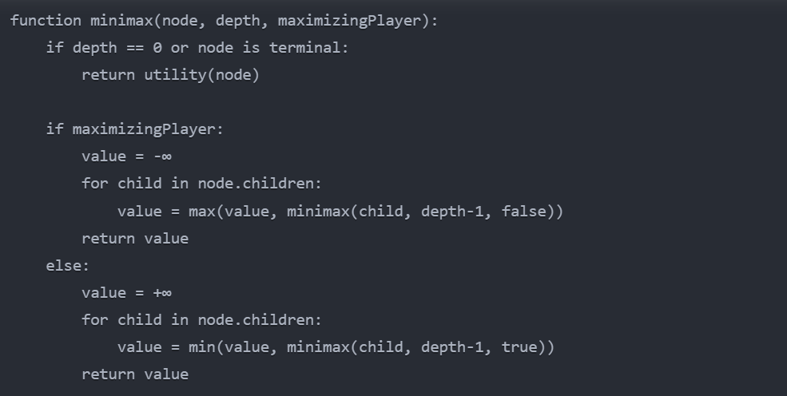
Pseudocode
[3]

Slide 20
Advantages and Limitations
Advantages:
Guaranteed to find the optimal move in deterministic, perfect information games
Conceptually simple and easy to implement
Limitations:
Exponential time complexity: O(b^d), where b is branching factor and d is depth.
Impractical for games with large branching factors or depths [3].

Slide 21
Alpha-Beta Pruning
It is an optimization technique for the minimax algorithm that significantly reduces the number of nodes evaluated in the game tree.
Basic Principle:
Maintain two values,
Alpha : the minimum score that the maximizing player is assured of
Beta : the maximum score that the minimizing player is assured of
Use these values to eliminate large portions of the search tree that cannot possibly influence the final decision.
Algorithm Steps:
a. Start the search with alpha = -∞ and beta = +∞
b. Update alpha and beta as the search progresses
c. Prune (stop evaluating) a branch when the current node's value is outside the [alpha, beta] window [3].

Slide 22
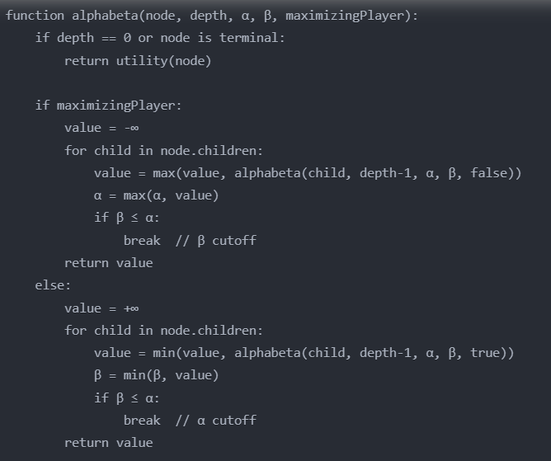
Pseudocode
[3]

Slide 23
Advantages
Advantages:
Drastically reduces the number of nodes evaluated
Best-case time complexity: O(b^(d/2))
Same optimal decision as regular minimax
Factors Affecting Efficiency:
Move ordering: Evaluating the best moves first improves pruning efficiency
Branching factor: More effective with larger branching factors
Depth of cutoffs: Earlier cutoffs lead to greater efficiency gains
Iterative Deepening:
Perform a series of alpha-beta searches with increasing depth
Improves move ordering and provides anytime behavior [3].

Slide 24
Applications
Classic Board Games:
Chess (e.g., DeepBlue, Stockfish)
Checkers
Othello/Reversi
Modern Game AI:
Used as part of more complex systems in Go, Poker, and video games
Decision Making:
Military strategy simulations
Automated negotiation systems [3]

Slide 25
Limitations and Future Directions
Scalability Issues:
Still impractical for games with very large branching factors
Handling Uncertainty:
Need for probabilistic models in games with incomplete information
Integration with Machine Learning:
Combining tree search with neural networks (e.g., AlphaZero approach)
Multi-agent Scenarios:
Extending to games with more than two players [3].

