Slide 1
Problem solving by searching
Unit 3

Slide 2
Bibliography
[1] S. J. Russell and P. Norvig. 2020, Artificial Intelligence: A modern approach, Fourth Edition, Pearson.
[2] T.B.Shahi, Artificial Intelligence, B.Sc.CSIT/BIM, KEC Publication.
[3] Claude AI, version 3.5 Sonnet, 2024, https://claude.ai
[4] ChatGPT, version 3.5/ 4o, 2024, https://chatgpt.com/

Slide 3
Introduction
Problem-solving by searching is a fundamental approach in artificial intelligence where an AI system explores a space of possible solutions to find a path from an initial state to a goal state.
This method is particularly useful for problems that can be represented as a state space [3].

Slide 4
General process of problem solving
Goal formulation: A goal is a desired state that the agent is attempting to reach.
Problem formulation: This is the process of considering the actions and states necessary to achieve the goal.
Search: The process of simulating the sequence of actions that lead to the goal state is searching, and the result is the solution.
Execute: Finally, the actions in the solution found is executed one at a time [1].

Slide 5
Key components of a well-defined problem
State Space: The set of all possible configurations or situations in the problem domain.
Initial State: The starting point of the problem.
Goal State: The desired end state or condition.
Actions: Operators that transform one state into another.
Transition model or successor function: It describes what each action does to the state it is applied to by returning the resulting state.
Path Cost: A measure of the cost associated with taking a particular path [1].

Slide 6
Different Search Methods
Uninformed search methods
Informed search methods
Local search methods
Adversarial search
Constraint Satisfaction Problems (CSPs)

Slide 7
Measuring problem-solving performance
We can evaluate an algorithm's performance in four ways:
Completeness: Is the algorithm guaranteed to find a solution when there is one, and to correctly report failure when there is not?
Cost optimality: Does it find a solution with the lowest path cost of all solutions?
Time complexity: How long does it take to find a solution? This can be measured in seconds, or more abstractly by the number of states and actions considered.
Space complexity: How much memory is needed to perform the search? [1]

Slide 8
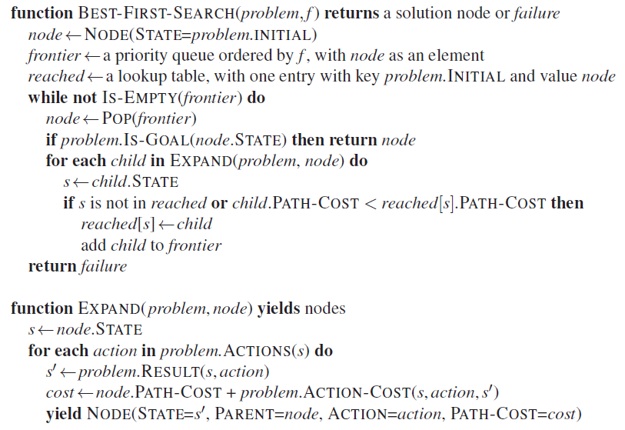
General Best First Search Pseudocode
[1]

Slide 9
Search Data Structures
Search algorithms require a data structure to keep track of the search tree.
A node in the tree is represented by a data structure with four components:
node.STATE: the state to which the node corresponds;
node.PARENT: the node in the tree that generated this node;
node.ACTION: the action that was applied to the parent’s state to generate this node;
node.PATH-COST: the total cost of the path from the initial state to this node. Mathematically, g(n) is used to denote the PATH-COST.
The states and actions along the path to that node can be recovered by following the PARENT pointers back from a node.
Doing this process from a goal node yields the solution.

Slide 10
Search Data Structures
The most appropriate choice of data structure for storing the frontier or fringe is a queue of some kind, because the operations on a frontier are:
IS-EMPTY(frontier) returns true only if there are no nodes in the frontier.
POP(frontier) removes the top node from the frontier and returns it.
TOP(frontier) returns (but does not remove) the top node of the frontier.
ADD(node, frontier) inserts node into its proper place in the queue.
Three types of queues mainly:
Priority queue: first pops the node with the minimum cost according to some evaluation function, f
First In First Out(FIFO) Queue: pops the node first added to the queue
Last In First Out (LIFO)Queue or Stack: pops the node last added to the queue
The reached states can be stored as a lookup table (e.g. a hash table( dictionary in python)) where each key is a state and each value is the node for that state [1].

Slide 11
Uninformed search methods
Breadth-First Search (BFS)
Depth-First Search (DFS)
Uniform-Cost Search
Iterative Deepening Search

Slide 12
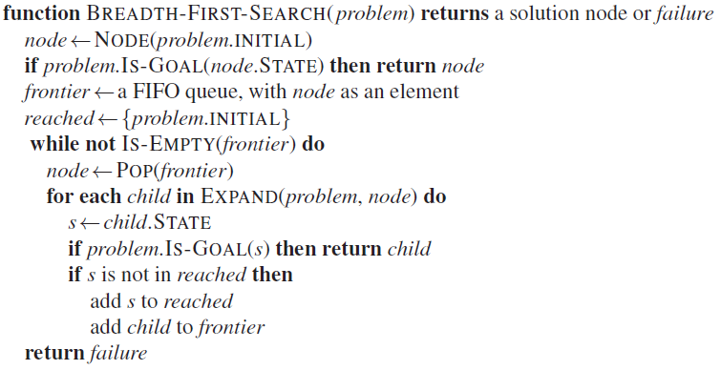
Breadth-First Search (BFS)
Explores all nodes at the present depth before moving to nodes at the next depth level
Complete and optimal for unweighted graphs
Time and space complexity: O(b^d), where b is branching factor and d is depth [3]
[1]

Slide 13
Applications:
a) Social Network Analysis:
Finding shortest connection chains between users
Analyzing friend circles and community structures
b) Web Crawling:
Indexing web pages for search engines
Mapping website structures
c) Network Routing:
Finding shortest paths in computer networks with uniform costs
d) Puzzle Solving:
Solving sliding puzzles or similar games with minimal moves
e) Garbage Collection in Programming Languages:
Identifying unreachable objects in memory management [3]

Slide 14
Depth-First Search (DFS)
Explores as far as possible along each branch before backtracking
Not complete (can get stuck in infinite loops) and not optimal
Time complexity: O(b^m), space complexity: O(bm), where m is maximum depth [3]

Slide 15
Applications
a) Maze Solving:
Finding paths through mazes in games or robotics
b) Topological Sorting:
Scheduling tasks with dependencies (e.g., in build systems or project management)
c) Cycle Detection:
Identifying circular dependencies in software or financial systems
d) File System Operations:
Searching for files, calculating directory sizes, or copying directory structures
e) Constraint Satisfaction Problems:
Solving Sudoku puzzles or similar logic games [3]

Slide 16
Uniform-Cost Search
Expands the node with the lowest path cost
Complete and optimal if step costs are non-negative
Time and space complexity: O(b^(C*/ε)), where C* is the cost of the optimal solution and ε is the minimum action cost [3]
[1]

Slide 17
Applications
a) GPS Navigation:
Finding lowest-cost routes when costs vary (e.g., considering traffic, tolls)
b) Network Packet Routing:
Determining optimal paths for data packets in networks with varying link costs
c) Resource Allocation:
Optimizing distribution of resources in manufacturing or supply chain management
d) Financial Planning:
Finding lowest-cost investment strategies or debt repayment plans [3]

Slide 18
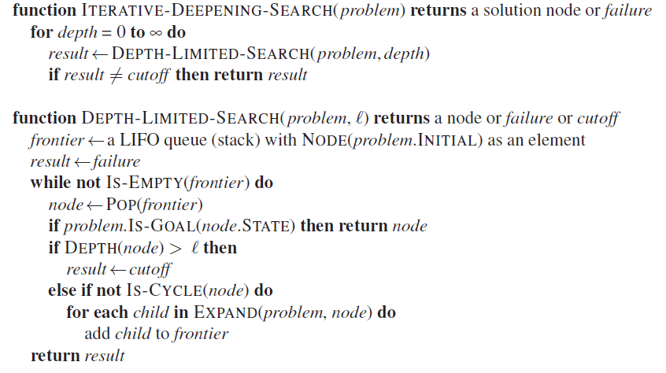
Iterative Deepening Search
Combines advantages of BFS and DFS
Performs repeated depth-limited searches, increasing the depth limit each time
Complete and optimal, with time complexity O(b^d) and space complexity O(bd) [3]
[1]

Slide 19
Applications
a) Game AI:
Decision making in chess engines or other strategy games with large state spaces
b) Automated Planning:
Generating action sequences in robotic task planning or logistics
c) Theorem Proving:
Exploring logical consequence chains in automated reasoning systems
d) Hierarchical Task Decomposition:
Breaking down complex tasks in project management or manufacturing processes

Slide 20
General applications of uninformed search methods
These uninformed search methods are particularly useful in scenarios where domain-specific knowledge is limited or where the problem structure is relatively simple.
They provide robust, general-purpose solutions that can be applied across a wide range of domains.
However, for more complex or large-scale problems, informed search methods or more advanced AI techniques are often preferred due to their improved efficiency [3].

Slide 21
BFS vs DFS vs UCS vs IDS
Search Strategy:
BFS: Explores all nodes at the current depth before moving deeper.
DFS: Explores as far as possible along each branch before backtracking.
UCS: Explores nodes in order of increasing path cost.
IDS: Repeatedly performs depth-limited DFS, increasing the depth limit each time.
Completeness:
BFS: Complete
DFS: Complete for finite spaces, not for infinite
UCS: Complete if step costs are positive
IDS: Complete
Optimality:
BFS: Optimal for unweighted graphs
DFS: Not optimal
UCS: Optimal
IDS: Optimal for unweighted graphs [3]

Slide 22
BFS vs DFS vs UCS vs IDS
Space Complexity:
BFS: O(b^d), where b is branching factor and d is solution depth
DFS: O(bm), where m is maximum depth
UCS: O(b^(C*/ε)), where C* is optimal solution cost and ε is minimum step cost
IDS: O(bd)
Time Complexity:
BFS: O(b^d)
DFS: O(b^m)
UCS: O(b^(C*/ε))
IDS: O(b^d)
Memory Usage:
BFS: High
DFS: Low
UCS: High
IDS: Low [3]

Slide 23
BFS vs DFS vs UCS vs IDS
Handling of Cycles:
BFS: Handles well
DFS: Can get trapped without cycle detection
UCS: Handles well
IDS: Handles well
Suitability for Infinite Spaces:
BFS: Not suitable
DFS: Can work if solution exists
UCS: Works if solution with finite cost exists
IDS: Can work
Order of Node Expansion:
BFS: Level by level
DFS: Deepest unexpanded node
UCS: Lowest cumulative path cost
IDS: Combines depth-first and breadth-first approaches [3]

Slide 24
BFS vs DFS vs UCS vs IDS
Implementation Complexity:
BFS: Simple (queue-based)
DFS: Simple (stack-based or recursive)
UCS: Moderate (priority queue-based)
IDS: Moderate (combines aspects of BFS and DFS)
In General,
BFS is good for shallow, wide trees;
DFS for deep trees or limited memory;
UCS for weighted graphs; and
IDS as a memory-efficient alternative to BFS that works well in unknown-depth spaces [3].

Slide 25
Informed Search Methods
Some information of the problem domain also known as heuristics is used to guide through the search space for efficiently finding the solution [2].
In a general sense, heuristics signal how far are we currently from the goal state.
Main types:
Greedy Best-First Search
A* Search
Iterative Deepening A* (IDA*)

Slide 26
Heuristic function
In the context of search algorithms, a heuristic function h(n) estimates the cost of the cheapest path from node n to a goal node [3].
Key Characteristics:
Admissibility
Consistency
Informedness

Slide 27
Admissibility
A heuristic h(n) is admissible if it never overestimates the cost to reach the goal.
Formally: h(n) ≤ h*(n) for all n, where h*(n) is the true cost.
Ensures optimality in algorithms like A* [3].

Slide 28
Consistency
A heuristic is consistent if its estimate is always less than or equal to the estimated distance from any neighbouring vertex to the goal, plus the cost of reaching that neighbour.
Formally: h(n) ≤ c(n,a,n') + h(n') for every node n and its successor n'.
Consistency implies admissibility.
Guarantees that A* expands nodes in order of increasing f = g + h.

Slide 29
Informedness
A more informed heuristic provides better estimates and typically leads to faster search.
However, computing a more informed heuristic might be more time-consuming.

Slide 30
Types of Heuristics
Problem-Specific Heuristics:
Tailored to a particular problem domain.
Example: In route-finding, straight-line distance to the goal.
Pattern Databases:
Precomputed tables of exact solution costs for subproblems.
Used in puzzle-solving problems like the 15-puzzle.
Relaxed Problems:
Simplify the problem by removing constraints.
The cost of solving the relaxed problem becomes the heuristic.
Landmarks:
Identify subgoals that must be achieved on the way to the final goal.
Used in planning problems.

Slide 31
Designing Heuristic Functions
Domain Knowledge:
Utilize expert knowledge about the problem domain.
Often leads to the most effective heuristics.
Relaxation:
Remove constraints from the original problem.
The solution to the relaxed problem provides a lower bound for the original.
Subproblem Extraction:
Solve a simpler version of the problem.
Use the cost of this solution as a heuristic.
Learning:
Use machine learning techniques to improve heuristics over time.
Can be based on experience from solving similar problems [3].

Slide 32
Trade-offs in Heuristic Design
Accuracy vs. Computation Time:
More accurate heuristics generally require more computation time.
Need to balance the time spent computing the heuristic vs. time saved in search.
Memory vs. Time:
Some heuristics (like pattern databases) trade memory for speed.
Generality vs. Effectiveness:
More general heuristics work across a wider range of problems but might be less effective for specific instances [3].

Slide 33
Greedy Best-First Search
Uses only the heuristic function h(n) to guide the search
Always expands the node that appears closest to the goal
Often faster than A*, but not guaranteed to find optimal solution
Can get stuck in local optima
More memory-efficient than A*
Useful when finding any solution quickly is more important than optimality [3]

Slide 34
Applications
a) Resource Allocation:
Quick decision making in time-sensitive resource distribution scenarios
b) Compression Algorithms:
Huffman coding for data compression
c) Machine Learning:
Feature selection in high-dimensional datasets
Approximate nearest neighbor search in recommendation systems
d) Scheduling:
Real-time job scheduling in operating systems [3]

Slide 35
A* Search
Combines the cost to reach the node and the estimated cost to the goal
Uses f(n) = g(n) + h(n), where g(n) is the cost to reach n, and h(n) is the heuristic estimate to the goal
Complete and optimal if the heuristic is admissible and consistent
Time and space complexity: O(b^d), but can be much more efficient in practice [3]

Slide 36
Applications
a) GPS Navigation and Route Planning:
Finding optimal routes considering distance, traffic, and road conditions
Real-time navigation updates in mobile apps
b) Video Game Pathfinding:
Character movement in strategy games, RPGs, and open-world environments
Obstacle avoidance in dynamic game worlds
c) Robotics:
Path planning for autonomous vehicles
Motion planning for robotic arms in manufacturing
d) Logistics and Supply Chain Optimization:
Optimizing delivery routes for shipping companies
Warehouse layout and inventory management
e) Network Routing:
Finding efficient paths in computer networks with complex topologies [3]

Slide 37
Key differences between A* and Greedy best first search
Evaluation Function:
Greedy Best-First Search: Uses only the heuristic function h(n) to evaluate nodes.
A*: Uses f(n) = g(n) + h(n), where g(n) is the cost from the start to the current node, and h(n) is the estimated cost from the current node to the goal.
Focus:
Greedy: Focuses solely on getting closer to the goal as quickly as possible.
A*: Balances the cost already incurred with the estimated cost to the goal.
Optimality:
Greedy: Not guaranteed to find the optimal solution. It may get stuck in local optima.
A*: Guaranteed to find the optimal solution if the heuristic is admissible and consistent [3].

Slide 38
Key differences between A* and Greedy best first search
Completeness:
Greedy: Not complete. It may fail to find a solution even if one exists, especially in graphs with loops.
A*: Complete, provided the branching factor is finite and all action costs are greater than some small positive constant.
Efficiency:
Greedy: Often faster than A* in reaching a goal, but the solution may not be optimal.
A*: May explore more nodes than Greedy, but ensures optimality.
Memory Usage:
Greedy: Generally uses less memory as it doesn't need to keep track of path costs.
A*: Can be memory-intensive, especially for large problems, as it needs to store more information about each node.
Heuristic Dependence:
Greedy: Extremely dependent on the quality of the heuristic. Poor heuristics can lead to very suboptimal solutions.
A*: Less sensitive to heuristic imperfections due to the inclusion of actual path cost [3].

Slide 39
Key differences between A* and Greedy best first search
Behavior in Mazes:
Greedy: May perform poorly in mazes with dead ends, as it can be led astray by the heuristic.
A*: Handles mazes more effectively by considering both progress towards the goal and the cost of the path taken.
Application Scenarios:
Greedy: Useful when finding any solution quickly is more important than finding the best solution.
A*: Preferred when the optimal solution is required and the problem size allows for potentially higher computational costs.
Theoretical Properties:
Greedy: Simpler to implement and analyze.
A*: Has stronger theoretical guarantees but requires more careful implementation and analysis [3].

Slide 40
A* vs Greedy Best First Search
In practice, the choice between Greedy Best-First Search and A* often depends on the specific problem requirements, available computational resources, and the quality of the available heuristic function.
A* is generally preferred when optimality is crucial and the problem size is manageable, while Greedy Best-First Search can be a good choice for larger problems where finding any reasonable solution quickly is more important than finding the absolute best solution [3].

Slide 41
Iterative Deepening A* (IDA*)
Combines iterative deepening with A* search
Uses less memory than A* while maintaining optimality
Particularly useful when memory is limited [3].

Slide 42
Applications
a) Puzzle Solving:
Solving complex puzzles like Rubik's Cube or 15-puzzle
Game AI for chess, Go, and other strategy games
b) Planning with Memory Constraints:
Mission planning for space probes with limited onboard computing power
Task planning in embedded systems

Slide 43
General applications of informed search methods
These informed search methods are particularly powerful in scenarios where domain-specific knowledge can be effectively incorporated into the search process.
They often provide more efficient solutions than uninformed methods, especially for complex, large-scale problems.
The choice of method depends on the specific problem characteristics, available heuristics, and computational resources [3].

Slide 44
Key Differences between Uninformed and Informed Search Methods
Heuristics: Informed methods use problem-specific knowledge (heuristics) to guide the search, while uninformed methods do not.
Efficiency: Informed methods are generally more efficient, especially for large search spaces.
Optimality: Some informed methods (like A* with admissible heuristics) guarantee optimal solutions, while others (like Greedy Best-First) may not.
Completeness: Both can be complete, but informed methods often find solutions faster.
Memory usage: Uninformed methods like BFS can use a lot of memory, while informed methods like A* can be more memory-efficient with good heuristics [3].

