Slide 1
Chapter 3
Digital Design and Computer Architecture, 2nd Edition
David Money Harris and Sarah L. Harris

Slide 2
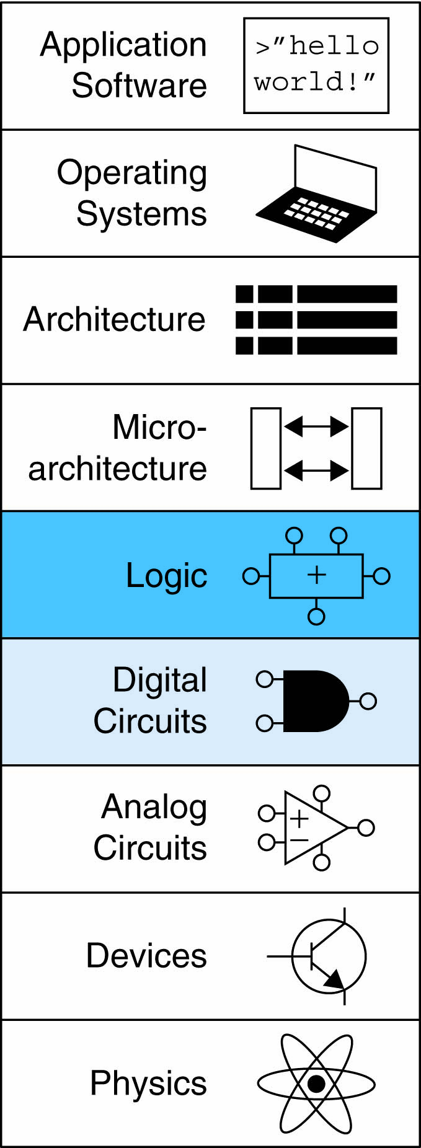
Chapter 3 :: Topics
Introduction
Latches and Flip-Flops
Synchronous Logic Design
Finite State Machines
Timing of Sequential Logic
Parallelism

Slide 3
Introduction
Outputs of sequential logic depend on current and prior input values – it has memory.
Some definitions:
State: all the information about a circuit necessary to explain its future behavior
Latches and flip-flops: state elements that store one bit of state
Synchronous sequential circuits: combinational logic followed by a bank of flip-flops

Slide 4
Sequential Circuits
Give sequence to events
Have memory (short-term)
Use feedback from output to input to store information

Slide 5
State Elements
The state of a circuit influences its future behavior
State elements store state
Bistable circuit
SR Latch
D Latch
D Flip-flop

Slide 6
Bistable Circuit
Fundamental building block of other state elements
Two outputs: Q, Q
No inputs

Slide 7
Bistable Circuit Analysis
Consider the two possible cases:
Q = 0:
then Q = 1, Q = 0 (consistent)
Q = 1:
then Q = 0, Q = 1 (consistent)
Stores 1 bit of state in the state variable, Q (or Q)
But there are no inputs to control the state

Slide 8
SR (Set/Reset) Latch
SR Latch
Consider the four possible cases:
S = 1, R = 0
S = 0, R = 1
S = 0, R = 0
S = 1, R = 1

Slide 9
SR Latch Analysis
S = 1, R = 0:
then Q = 1 and Q = 0
S = 0, R = 1:
then Q = 0 and Q = 1

Slide 10
SR Latch Analysis
S = 1, R = 0:
then Q = 1 and Q = 0
Set the output
S = 0, R = 1:
then Q = 1 and Q = 0
Reset the output

Slide 11
SR Latch Analysis
S = 0, R = 0:
then Q = Q_{prev}
S = 1, R = 1:
then Q = 0, Q = 0

Slide 12
SR Latch Analysis
S = 0, R = 0:
then Q = Q_{prev}
Memory!
S = 1, R = 1:
then Q = 0, Q = 0
Invalid State
Q ≠ NOT Q

Slide 13
SR Latch Symbol
SR stands for Set/Reset Latch
Stores one bit of state (Q)
Control what value is being stored with S, R inputs
Set: Make the output 1
(S = 1, R = 0, Q = 1)
Reset: Make the output 0
(S = 0, R = 1, Q = 0)
Must do something to avoid
invalid state (when S = R = 1)
Must do something to avoid
invalid state (when S = R = 1)

Slide 14
D Latch
Two inputs: CLK, D
CLK: controls when the output changes
D (the data input): controls what the output changes to
Function
When CLK = 1,
D passes through to Q (transparent)
When CLK = 0,
Q holds its previous value (opaque)
Avoids invalid case when
Q ≠ NOT Q

Slide 15
D Latch Internal Circuit

Slide 16
D Latch Internal Circuit

Slide 17
D Flip-Flop
Inputs: CLK, D
Function
Samples D on rising edge of CLK
When CLK rises from 0 to 1, D passes through to Q
Otherwise, Q holds its previous value
Q changes only on rising edge of CLK
Called edge-triggered
Activated on the clock edge

Slide 18
D Flip-Flop Internal Circuit
Two back-to-back latches (L1 and L2) controlled by complementary clocks
When CLK = 0
L1 is transparent
L2 is opaque
D passes through to N1
When CLK = 1
L2 is transparent
L1 is opaque
N1 passes through to Q
Thus, on the edge of the clock (when CLK rises from 0 1)
D passes through to Q

Slide 19
D Latch vs. D Flip-Flop

Slide 20
D Latch vs. D Flip-Flop

Slide 21
Registers

Slide 22
Enabled Flip-Flops
Inputs: CLK, D, EN
The enable input (EN) controls when new data (D) is stored
Function
EN = 1: D passes through to Q on the clock edge
EN = 0: the flip-flop retains its previous state

Slide 23
Resettable Flip-Flops
Inputs: CLK, D, Reset
Function:
Reset = 1: Q is forced to 0
Reset = 0: flip-flop behaves as ordinary D flip-flop

Slide 24
Resettable Flip-Flops
Two types:
Synchronous: resets at the clock edge only
Asynchronous: resets immediately when Reset = 1
Asynchronously resettable flip-flop requires changing the internal circuitry of the flip-flop
Synchronously resettable flip-flop?

Slide 25
Resettable Flip-Flops
Two types:
Synchronous: resets at the clock edge only
Asynchronous: resets immediately when Reset = 1
Asynchronously resettable flip-flop requires changing the internal circuitry of the flip-flop
Synchronously resettable flip-flop?

Slide 26
Settable Flip-Flops
Inputs: CLK, D, Set
Function:
Set = 1: Q is set to 1
Set = 0: the flip-flop behaves as ordinary D flip-flop

Slide 27
Sequential Logic
Sequential circuits: all circuits that aren’t combinational
A problematic circuit:

Slide 28
Sequential Logic
Sequential circuits: all circuits that aren’t combinational
A problematic circuit:
No inputs and 1-3 outputs
Astable circuit, oscillates
Period depends on inverter delay
It has a cyclic path: output fed back to input

Slide 29
Synchronous Sequential Logic Design
Breaks cyclic paths by inserting registers
Registers contain state of the system
State changes at clock edge: system synchronized to the clock
Rules of synchronous sequential circuit composition:
Every circuit element is either a register or a combinational circuit
At least one circuit element is a register
All registers receive the same clock signal
Every cyclic path contains at least one register
Two common synchronous sequential circuits
Finite State Machines (FSMs)
Pipelines

Slide 30
Finite State Machine (FSM)
Consists of:
State register
Stores current state
Loads next state at clock edge
Combinational logic
Computes the next state
Computes the outputs

Slide 31
Finite State Machines (FSMs)
Next state determined by current state and inputs
Two types of finite state machines differ in output logic:
Moore FSM: outputs depend only on current state
Mealy FSM: outputs depend on current state and inputs

Slide 32
FSM Design Procedure
Identify inputs and outputs
Sketch state transition diagram
Write state transition table
Select state encodings
For Moore machine:
Rewrite state transition table with state encodings
Write output table
For a Mealy machine:
Rewrite combined state transition and output table with state encodings
Write Boolean equations for next state and output logic
Sketch the circuit schematic

Slide 33
FSM Example
Traffic light controller
Traffic sensors: T_{A}, T_{B} (TRUE when there’s traffic)
Lights: L_{A}, L_{B}

Slide 34
FSM Black Box
Inputs: CLK, Reset, T_{A}, T_{B}
Outputs: L_{A}, L_{B}

Slide 35
FSM State Transition Diagram
Moore FSM: outputs labeled in each state
States: Circles
Transitions: Arcs

Slide 36
FSM State Transition Diagram
Moore FSM: outputs labeled in each state
States: Circles
Transitions: Arcs

Slide 37
FSM State Transition Table
Current State | Inputs |  | Next State
S | T_{A} | T_{B} | S'
S0 | 0 | X
S0 | 1 | X
S1 | X | X
S2 | X | 0
S2 | X | 1
S3 | X | X

Slide 38
FSM State Transition Table
Current State | Inputs |  | Next State
S | T_{A} | T_{B} | S'
S0 | 0 | X | S1
S0 | 1 | X | S0
S1 | X | X | S2
S2 | X | 0 | S3
S2 | X | 1 | S2
S3 | X | X | S0

Slide 39
FSM Encoded State Transition Table
Current State |  | Inputs |  | Next State
S₁ | S₀ | T_{A} | T_{B} | S'₁ | S'₀
0 | 0 | 0 | X
0 | 0 | 1 | X
0 | 1 | X | X
1 | 0 | X | 0
1 | 0 | X | 1
1 | 1 | X | X
State | Encoding
S0 | 00
S1 | 01
S2 | 10
S3 | 11

Slide 40
FSM Encoded State Transition Table
Current State |  | Inputs |  | Next State
S₁ | S₀ | T_{A} | T_{B} | S'₁ | S'₀
0 | 0 | 0 | X | 0 | 1
0 | 0 | 1 | X | 0 | 0
0 | 1 | X | X | 1 | 0
1 | 0 | X | 0 | 1 | 1
1 | 0 | X | 1 | 1 | 0
1 | 1 | X | X | 0 | 0
State | Encoding
S0 | 00
S1 | 01
S2 | 10
S3 | 11
S'₁ = S₁ ⊕ S₀
S'₀ = S₁S₀T_{A} + S₁S₀T_{B}

Slide 41
FSM Output Table
Current State |  | Outputs
S₁ | S₀ | L_{A1} | L_{A0} | L_{B1} | L_{B0}
0 | 0
0 | 1
1 | 0
1 | 1
Output | Encoding
green | 00
yellow | 01
red | 10

Slide 42
FSM Output Table
Current State |  | Outputs
S₁ | S₀ | L_{A1} | L_{A0} | L_{B1} | L_{B0}
0 | 0 | 0 | 0 | 1 | 0
0 | 1 | 0 | 1 | 1 | 0
1 | 0 | 1 | 0 | 0 | 0
1 | 1 | 1 | 0 | 0 | 1
Output | Encoding
green | 00
yellow | 01
red | 10
L_{A1} = S₁
L_{A0} = S₁S₀
L_{B1} = S₁
L_{B0} = S₁S₀

Slide 43
FSM Schematic: State Register

Slide 44
FSM Schematic: Next State Logic

Slide 45
FSM Schematic: Output Logic

Slide 46
FSM Timing Diagram

Slide 47
FSM State Encoding
Binary encoding:
i.e., for four states, 00, 01, 10, 11
One-hot encoding
One state bit per state
Only one state bit HIGH at once
i.e., for 4 states, 0001, 0010, 0100, 1000
Requires more flip-flops
Often next state and output logic is simpler

Slide 48
Review: FSMs
Next state determined by current state and inputs
Two types of finite state machines differ in output logic:
Moore FSM: outputs depend only on current state
Mealy FSM: outputs depend on current state and inputs

Slide 49
Review: FSM Design Procedure
Identify inputs and outputs
Sketch state transition diagram
Write state transition table
Select state encodings
For Moore machine:
Rewrite state transition table with state encodings
Write output table
For a Mealy machine:
Rewrite combined state transition and output table with state encodings
Write Boolean equations for next state and output logic
Sketch the circuit schematic

Slide 50
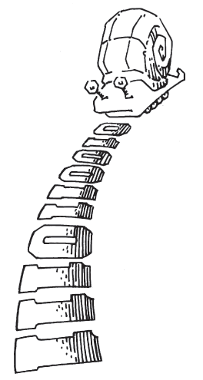
Moore vs. Mealy FSM
Alyssa P. Hacker has a snail that crawls down a paper tape with 1’s and 0’s on it. The snail smiles whenever the last two digits it has crawled over are 01. Design Moore and Mealy FSMs of the snail’s brain.

Slide 51
State Transition Diagrams
Mealy FSM: arcs indicate input/output

Slide 52
Moore FSM State Transition Table
Current State |  | Inputs | Next State
S₁ | S₀ | A | S'₁ | S'₀
0 | 0 | 0
0 | 0 | 1
0 | 1 | 0
0 | 1 | 1
1 | 0 | 0
1 | 0 | 1
State | Encoding
S0 | 00
S1 | 01
S2 | 10

Slide 53
Moore FSM State Transition Table
Current State |  | Inputs | Next State
S₁ | S₀ | A | S'₁ | S'₀
0 | 0 | 0 | 0 | 1
0 | 0 | 1 | 0 | 0
0 | 1 | 0 | 0 | 1
0 | 1 | 1 | 1 | 0
1 | 0 | 0 | 0 | 1
1 | 0 | 1 | 0 | 0
State | Encoding
S0 | 00
S1 | 01
S2 | 10
S₁’ = S₀A
S₀’ = A

Slide 54
Moore FSM Output Table
Current State |  | Output
S₁ | S₀ | Y
0 | 0
0 | 1
1 | 0

Slide 55
Moore FSM Output Table
Current State |  | Output
S₁ | S₀ | Y
0 | 0 | 0
0 | 1 | 0
1 | 0 | 1
Y = S₁

Slide 56
Mealy FSM State Transition & Output Table
Current State | Input | Next State | Output
S₀ | A | S'₀ | Y
0 | 0
0 | 1
1 | 0
1 | 1
State | Encoding
S0 | 00
S1 | 01

Slide 57
Mealy FSM State Transition & Output Table
Current State | Input | Next State | Output
S₀ | A | S'₀ | Y
0 | 0 | 1 | 0
0 | 1 | 0 | 0
1 | 0 | 1 | 0
1 | 1 | 0 | 1
State | Encoding
S0 | 00
S1 | 01

Slide 58
Moore FSM Schematic

Slide 59
Mealy FSM Schematic

Slide 60
Moore & Mealy Timing Diagram

Slide 61
Factoring State Machines
Break complex FSMs into smaller interacting FSMs
Example: Modify traffic light controller to have Parade Mode.
Two more inputs: P, R
When P = 1, enter Parade Mode & Bravado Blvd light stays green
When R = 1, leave Parade Mode

Slide 62
Parade FSM
Unfactored FSM
Factored FSM

Slide 63
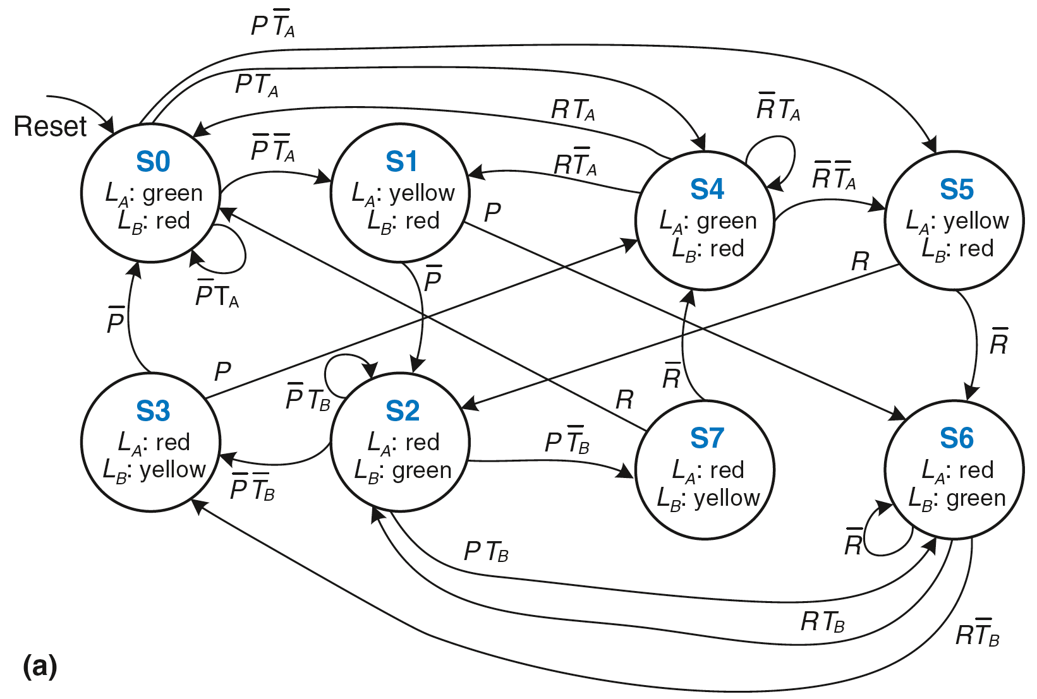
Unfactored FSM

Slide 64
Factored FSM

Slide 65
Review: Finite State Machines (FSMs)
Next state determined by current state and inputs
Two types of finite state machines differ in output logic:
Moore FSM: outputs depend only on current state
Mealy FSM: outputs depend on current state and inputs

Slide 66
Review: FSM Design Procedure
Identify inputs and outputs
Sketch state transition diagram
Write state transition table
Select state encodings
For Moore machine:
Rewrite state transition table with state encodings
Write output table
For a Mealy machine:
Rewrite combined state transition and output table with state encodings
Write Boolean equations for next state and output logic
Sketch the circuit schematic

Slide 67
Timing
Flip-flop samples D at clock edge
D must be stable when sampled
Similar to a photograph, D must be stable around clock edge
If not, metastability can occur

Slide 68
Input Timing Constraints
Setup time: t_{setup} = time before clock edge data must be stable (i.e. not changing)
Hold time: t_{hold} = time after clock edge data must be stable
Aperture time: t_{a} = time around clock edge data must be stable (t_{a} = t_{setup} + t_{hold})

Slide 69
Output Timing Constraints
Propagation delay: t_{pcq} = time after clock edge that the output Q is guaranteed to be stable (i.e., to stop changing)
Contamination delay: t_{ccq} = time after clock edge that Q might be unstable (i.e., start changing)

Slide 70
Dynamic Discipline
Synchronous sequential circuit inputs must be stable during aperture (setup and hold) time around clock edge
Specifically, inputs must be stable
at least t_{setup} before the clock edge
at least until t_{hold} after the clock edge

Slide 71
Dynamic Discipline
The delay between registers has a minimum and maximum delay, dependent on the delays of the circuit elements

Slide 72
Setup Time Constraint
Depends on the maximum delay from register R1 through combinational logic to R2
The input to register R2 must be stable at least t_{setup} before clock edge
T_{c} ≥

Slide 73
Setup Time Constraint
Depends on the maximum delay from register R1 through combinational logic to R2
The input to register R2 must be stable at least t_{setup} before clock edge
T_{c} ≥ t_{pcq} + t_{pd} + t_{setup}
t_{pd} ≤

Slide 74
Setup Time Constraint
Depends on the maximum delay from register R1 through combinational logic to R2
The input to register R2 must be stable at least t_{setup} before clock edge
T_{c} ≥ t_{pcq} + t_{pd} + t_{setup}
t_{pd} ≤ T_{c} – (t_{pcq} + t_{setup})
(t_{pcq} + t_{setup}):
sequencing overhead

Slide 75
Hold Time Constraint
Depends on the minimum delay from register R1 through the combinational logic to R2
The input to register R2 must be stable for at least t_{hold} after the clock edge
t_{hold} <

Slide 76
Hold Time Constraint
Depends on the minimum delay from register R1 through the combinational logic to R2
The input to register R2 must be stable for at least t_{hold} after the clock edge
t_{hold} < t_{ccq} + t_{cd}
t_{cd} >

Slide 77
Hold Time Constraint
Depends on the minimum delay from register R1 through the combinational logic to R2
The input to register R2 must be stable for at least t_{hold} after the clock edge
t_{hold} < t_{ccq} + t_{cd}
t_{cd} > t_{hold} - t_{ccq}

Slide 78
Timing Analysis
Timing Characteristics
t_{ccq} = 30 ps
t_{pcq} = 50 ps
t_{setup} = 60 ps
t_{hold} = 70 ps
t_{pd} = 35 ps
t_{cd} = 25 ps
t_{pd} =
t_{cd} =
Setup time constraint:
T_{c} ≥
f_{c} =
Hold time constraint:
t_{ccq} + t_{cd} > t_{hold} ?

Slide 79
Timing Analysis
Timing Characteristics
t_{ccq} = 30 ps
t_{pcq} = 50 ps
t_{setup} = 60 ps
t_{hold} = 70 ps
t_{pd} = 35 ps
t_{cd} = 25 ps
t_{pd} = 3 x 35 ps = 105 ps
t_{cd} = 25 ps
Setup time constraint:
T_{c} ≥ (50 + 105 + 60) ps = 215 ps
f_{c} = 1/T_{c} = 4.65 GHz
Hold time constraint:
t_{ccq} + t_{cd} > t_{hold} ?
(30 + 25) ps > 70 ps ? No!

Slide 80
Timing Analysis
Add buffers to the short paths:
Timing Characteristics
t_{ccq} = 30 ps
t_{pcq} = 50 ps
t_{setup} = 60 ps
t_{hold} = 70 ps
t_{pd} = 35 ps
t_{cd} = 25 ps
t_{pd} =
t_{cd} =
Setup time constraint:
T_{c} ≥
f_{c} =
Hold time constraint:
t_{ccq} + t_{cd} > t_{hold} ?

Slide 81
Timing Analysis
Add buffers to the short paths:
Timing Characteristics
t_{ccq} = 30 ps
t_{pcq} = 50 ps
t_{setup} = 60 ps
t_{hold} = 70 ps
t_{pd} = 35 ps
t_{cd} = 25 ps
t_{pd} = 3 x 35 ps = 105 ps
t_{cd} = 2 x 25 ps = 50 ps
Setup time constraint:
T_{c} ≥ (50 + 105 + 60) ps = 215 ps
f_{c} = 1/T_{c} = 4.65 GHz
Hold time constraint:
t_{ccq} + t_{cd} > t_{hold} ?
(30 + 50) ps > 70 ps ? Yes!

Slide 82
Clock Skew
The clock doesn’t arrive at all registers at same time
Skew: difference between two clock edges
Perform worst case analysis to guarantee dynamic discipline is not violated for any register – many registers in a system!

Slide 83
Setup Time Constraint with Skew
In the worst case, CLK2 is earlier than CLK1

Slide 84
Setup Time Constraint with Skew
In the worst case, CLK2 is earlier than CLK1
T_{c} - t_{skew} ≥ t_{pcq} + t_{pd} + t_{setup}

Slide 85
Setup Time Constraint with Skew
In the worst case, CLK2 is earlier than CLK1
T_{c} - t_{skew} ≥ t_{pcq} + t_{pd} + t_{setup}
T_{c} ≥

Slide 86
Setup Time Constraint with Skew
In the worst case, CLK2 is earlier than CLK1
T_{c} - t_{skew} ≥ t_{pcq} + t_{pd} + t_{setup}
T_{c} ≥ t_{pcq} + t_{pd} + t_{setup} + t_{skew}
t_{pd} ≤

Slide 87
Setup Time Constraint with Skew
In the worst case, CLK2 is earlier than CLK1
T_{c} - t_{skew} ≥ t_{pcq} + t_{pd} + t_{setup}
T_{c} ≥ t_{pcq} + t_{pd} + t_{setup} + t_{skew}
t_{pd} ≤ T_{c} – (t_{pcq} + t_{setup} + t_{skew})

Slide 88
Hold Time Constraint with Skew
In the worst case, CLK2 is later than CLK1
t_{ccq} + t_{cd} >

Slide 89
Hold Time Constraint with Skew
In the worst case, CLK2 is later than CLK1
t_{ccq} + t_{cd} > t_{hold} + t_{skew}
t_{cd} >

Slide 90
Hold Time Constraint with Skew
In the worst case, CLK2 is later than CLK1
t_{ccq} + t_{cd} > t_{hold} + t_{skew}
t_{cd} > t_{hold} + t_{skew} – t_{ccq}

Slide 91
Violating the Dynamic Discipline
Asynchronous (for example, user) inputs might violate the dynamic discipline

Slide 92
Metastability
Bistable devices: two stable states, and a metastable state between them
Flip-flop: two stable states (1 and 0) and one metastable state
If flip-flop lands in metastable state, could stay there for an undetermined amount of time

Slide 93
Flip-Flop Internals
Flip-flop has feedback: if Q is somewhere between 1 and 0, cross-coupled gates drive output to either rail (1 or 0)
Metastable signal: if it hasn’t resolved to 1 or 0
If flip-flop input changes at random time, probability that output Q is metastable after waiting some time, t:
P(t_{res} > t) = (T₀/T_{c} ) e^{-t/τ}
t_{res} : time to resolve to 1 or 0
T₀, τ : properties of the circuit

Slide 94
Metastability
Intuitively:
T₀/T_{c}: probability input changes at a bad time (during aperture)
P(t_{res} > t) = (T₀/T_{c} ) e^{-t/τ}
τ: time constant for how fast flip-flop moves away from metastability
P(t_{res} > t) = (T₀/T_{c} ) e^{-t/τ}
In short, if flip-flop samples metastable input, if you wait long enough (t), the output will have resolved to 1 or 0 with high probability.

Slide 95
Synchronizers
Asynchronous inputs are inevitable (user interfaces, systems with different clocks interacting, etc.)
Synchronizer goal: make the probability of failure (the output Q still being metastable) low
Synchronizer cannot make the probability of failure 0

Slide 96
Synchronizer Internals
Synchronizer: built with two back-to-back flip-flops
Suppose D is transitioning when sampled by F1
Internal signal D2 has (T_{c} - t_{setup}) time to resolve to 1 or 0

Slide 97
Synchronizer Probability of Failure
For each sample, probability of failure is:
P(failure) = (T₀/T_{c} ) e^{-(Tc} ^{- tsetup)/τ}

Slide 98
Synchronizer Mean Time Between Failures
If asynchronous input changes once per second, probability of failure per second is P(failure).
If input changes N times per second, probability of failure per second is:
P(failure)/second = (NT₀/T_{c}) e^{-(Tc} ^{- tsetup)/τ}
Synchronizer fails, on average, 1/[P(failure)/second]
Called mean time between failures, MTBF:
MTBF = 1/[P(failure)/second] = (T_{c}/NT₀) e^{(Tc} ^{- tsetup)/τ}

Slide 99
Example Synchronizer
Suppose: T_{c} = 1/500 MHz = 2 ns τ = 200 ps
T₀ = 150 ps t_{setup} = 100 ps
N = 10 events per second
What is the probability of failure? MTBF?

Slide 100
Example Synchronizer
Suppose: T_{c} = 1/500 MHz = 2 ns τ = 200 ps
T₀ = 150 ps t_{setup} = 100 ps
N = 10 events per second
What is the probability of failure? MTBF?
P(failure) = (150 ps/2 ns) e^{-(1.9 ns)/200 ps}
= 5.6 × 10⁻⁶
P(failure)/second = 10 × (5.6 × 10⁻⁶ )
= 5.6 × 10⁻⁵ / second
MTBF = 1/[P(failure)/second] ≈ 5 hours

Slide 101
Parallelism
Two types of parallelism:
Spatial parallelism
duplicate hardware performs multiple tasks at once
Temporal parallelism
task is broken into multiple stages
also called pipelining
for example, an assembly line

Slide 102
Parallelism Definitions
Token: Group of inputs processed to produce group of outputs
Latency: Time for one token to pass from start to end
Throughput: Number of tokens produced per unit time
Parallelism increases throughput

Slide 103
Parallelism Example
Ben Bitdiddle bakes cookies to celebrate traffic light controller installation
5 minutes to roll cookies
15 minutes to bake
What is the latency and throughput without parallelism?

Slide 104
Parallelism Example
Ben Bitdiddle bakes cookies to celebrate traffic light controller installation
5 minutes to roll cookies
15 minutes to bake
What is the latency and throughput without parallelism?
Latency = 5 + 15 = 20 minutes = 1/3 hour
Throughput = 1 tray/ 1/3 hour = 3 trays/hour

Slide 105
Parallelism Example
What is the latency and throughput if Ben uses parallelism?
Spatial parallelism: Ben asks Allysa P. Hacker to help, using her own oven
Temporal parallelism:
two stages: rolling and baking
He uses two trays
While first batch is baking, he rolls the second batch, etc.

Slide 106
Spatial Parallelism
Latency = ?
Throughput = ?

Slide 107
Spatial Parallelism
Latency = 5 + 15 = 20 minutes = 1/3 hour
Throughput = 2 trays/ 1/3 hour = 6 trays/hour

Slide 108
Temporal Parallelism
Latency = ?
Throughput = ?

Slide 109
Temporal Parallelism
Latency = 5 + 15 = 20 minutes = 1/3 hour
Throughput = 1 trays/ 1/4 hour = 4 trays/hour
Using both techniques, the throughput would be
8 trays/hour

