Slide 1
City Level Delivery Promise
27th Dec 2021

Slide 2
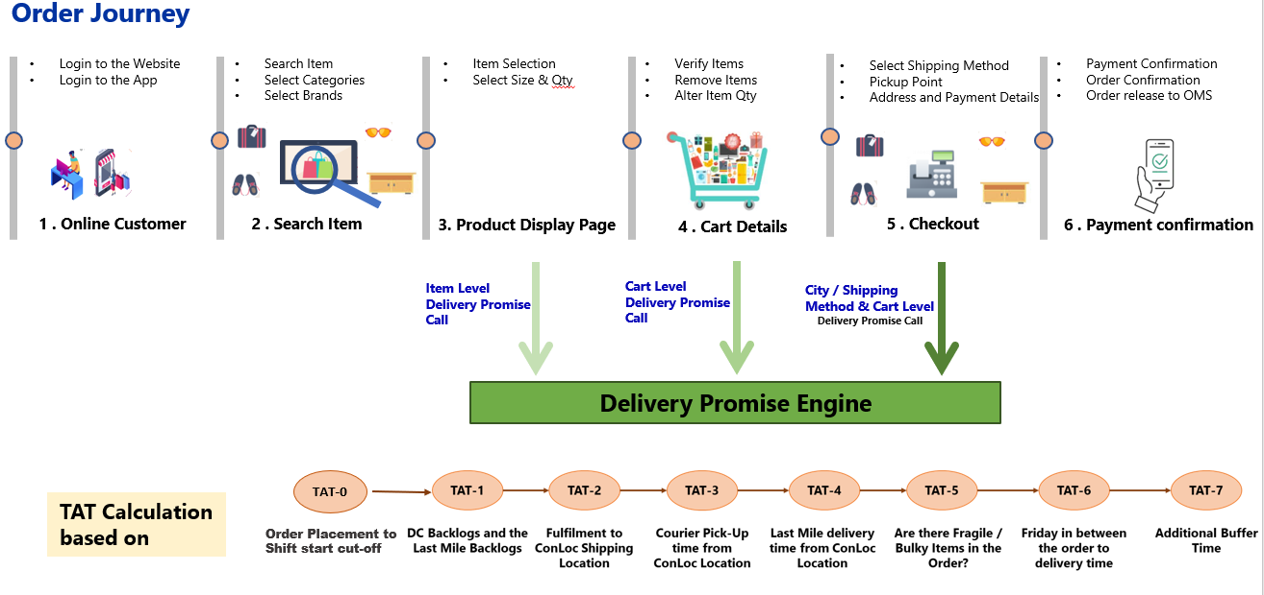
CLDP – What is expected?
Delivery promise to be triggered from PDP and Cart as well along with checkout page for better delivery date visibility to customers.
A new “Microservice based Delivery Promise Engine “ to be included in Landscape for dynamic TAT Calculations
Dynamic TAT calculations ( Based on Master Setups, Current DC Capacities, DC & Last Mile Back logs etc) – 10 Different variables, 3 different sources
Multiple Delivery Options– Multi DC Sourcing, Spilt vs Consolidated Shipments etc.
Item level TAT enquiry calls from Hybris at multiple stages in Order Journey prior to confirmation.

Slide 3
Project is planned in 3-phased approach
Drops | Features | Target | Scope | Outcome
Drop 1 | Enable Dynamic TAT | Establish Full integration Architecture for DP CLDP Enable/Disable Switch ( Microservice & Hybris) Integration Exception Handing Sahla User Journey ( UI for Managing TAT) with Excel Upload Dynamic TAT calculations by TAT Microservice Multi DC Orders | Checkout Page UAE CP/MX/HC/HB Consolidated | Dynamic TAT UI for TAT 19th December
Drop 2 | Extend DP to PDP & Cart | Extension of CLDP to PDP & Cart | Product Display Page Add to Cart Page Checkout Page UAE CP/MX/HC/HB | Consistent User Journey 17th April
 | Roll Out | KSA ( Drop 1,2) | KSA
Drop 3 | Shipment Options | Multiple Options to Customer ( Consolidated vs Split) | Checkout Page UAE /KSA CP/MX/HC/HB | Choice for Customers
Rollouts | Rollouts to Territories | Ramp Up ** To be Planned

Slide 4




High level Architecture
HYBRIS
API Gateway
Fetch the uploaded data from Sahla DB & update Mem DB
Data source - Excel upload and UI workflow for TAT Management
1
6
TAT MS
TAT Engine
Microservice Layer to
manage TAT Master
Sahla.com
Get TAT Calculation request from Hybris
Get the shipment data from OMS/WMS
Get Sourcing & Fulfillment Calc from OMS
Use the TAT Computer Logic to get the DA
Return TAT
Redis Cache DB ( In-Mem DB)
TAT-0
TAT-1(a)/1(b)
TAT-2
Sahla DB
TAT-3
TAT-4 (4.1/4.2)
TAT-5
TAT-6
TAT-7
EDT (TAT-0+ TAT-N
Spring boot Schedular A
Delivery Date Promised to Customer
Pending and undelivered Shipment data from OMS loaded to Mem-DB
2
5
4
DP (B)
IBM ACE
OMS
Sourcing and fulfillment calc. in OMS
Sourcing and fulfillment rules engine
3
DP (A)

Slide 5
TAT Details
1 | TAT0 Shift Cut Off Time | Timeline from order placement to shift start cut-off
2 | TAT1a Shipping Capacity | Total DC processing capacity, which will be a master at DC/territory level
3 | TAT1b Last Mile Capacity | Total last mile delivery capacity by region (destination)
4 | TAT2 Fulfill to Shipping CONLOC | Time taken for fulfillment from source territory to destination region
5 | TAT3 Carrier Pick up Time | Carrier partner pickup timings by Region
6 | TAT4.1 Last Mile delivery time | Time taken for last mile deliveries
7 | TAT4.2 Last mile day cut off | Last mile buffer to be added in calculated TAT for next day
8 | TAT5 Fragile-Bulky Indicator | Fragile / Bulky items - additional 24 Hours
9 | TAT 6 Friday Factor | Additional time for number of Fridays and public holiday between Order Time and Estimated Delivery Time
10 | TAT7 Buffer Time | Additional buffer time for events & unforeseen situations

