Slide 1
Data Analysis across Disparate Data Sources

Slide 2


Who we are…
I'm working at the Huawei Technologies India, on BigData technologies. In the past I was head of team of SE(System Engineers) to innovate and develop features on existing opensource BigData technologies such as Hadoop, Hbase, Spark, ZK, CarbonData.
I'm one of the key members in CarbonData team which developed, incubated and took it as Top Level Project in Apache. I'm also a committer of Apache CarbonData. Currently I'm working on openLooKeng with a vision to make it to be the best, fastest, and most reliable big data analytics engine providing unified access to all data sources and at the same time bringing native database experience to BigData. I'm one of the PMCs of openLooKeng.
I’m working at the Huawei Technologies India on BigData technologies. I had been involved in various engineering teams since last 14yrs focused on relational database engines for varied usages like embedded, in memory, on disk, distributed storage and processing; as part of the same have been working on openGauss, Postgres like engines so far.
Since, last 2 years have been contributing to openLooKeng project with vision to make it as a goto solution for data virtualization, with bringing unified native database experience to BigData.

Slide 3
Content
Current Big Data Analytics Market
Data Platforms – Analysts view
openLooKeng solution
Key business cases to solve
openLooKeng architecture, design
openLooKeng roadmap, future work

Slide 4
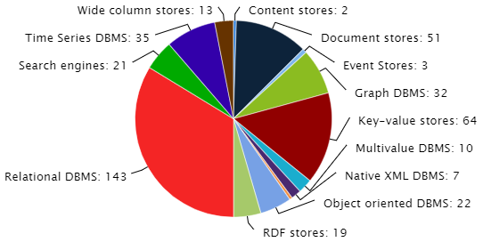
Current situation of big data market - rapid growth, fragmented landscape, complex to use
Big data platform market: 53B, fragmented landscape, and call for consolidation
Splunk, which is growing rapidly, accounts for only 11% of the total number of new players.
Old database vendors account for less than 10% of the market, and others account for more than 50% of the market.
Number of systems per category
High service share is a major obstacle to big data projects
Source:
Market Research Future:Global Big Data Market Research Report: Forecast to 2023
IDC: Global Half-Year Big Data Spending Guide, 2018H2

Slide 5
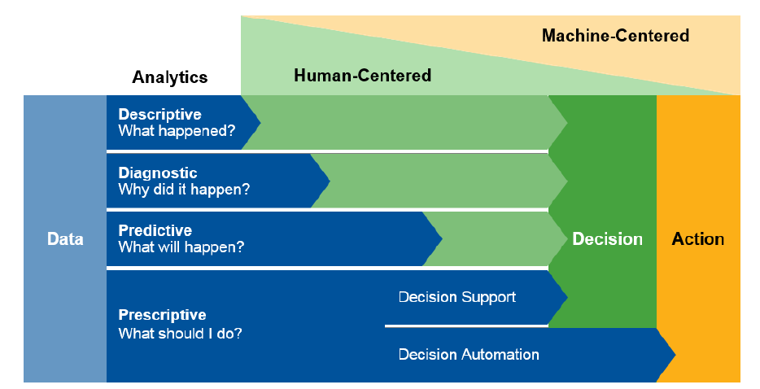
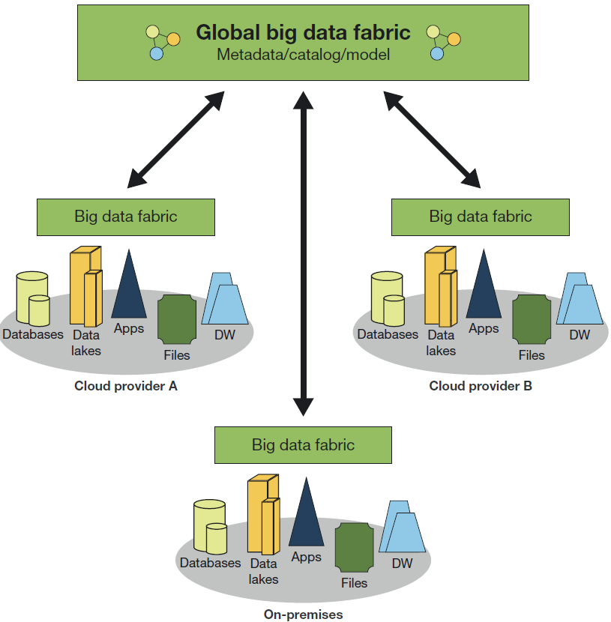
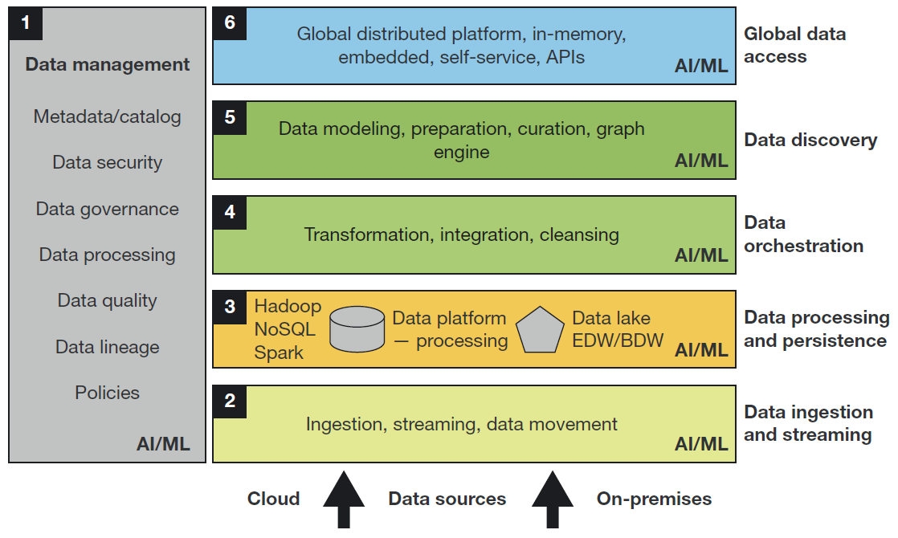
Data Platforms – Analysts view
Problems with Existing Data Platforms
Existing platforms can’t handle the growing diversity in data sources and increasing complexity of data integration.
Rising demand of real-time, event driven data sharing, and business-led data modeling.
Hybrid and multi-cloud architectures further complicates challenges faced by organizations. Today operational data has remained siloed and hidden, leading to dark data.
What is Data Fabric?
Providing a complete, single view of trusted business data
Securing data across the enterprise
Delivering a self-service and collaborative platform to business users
Enabling real-time sharing of data with business users, customers, and partners
Minimizing big data platform complexity
Gartner 2019 planning guide for data and analytics
Current
Desired
Forrester 2019 Big Data Fabric 2.0
Too many types of SQL dialects; No standard tools for different systems;Traditional extract, transform, and load (ETL) approach is expensive, slow (T+1) and cumbersome

Slide 6


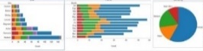
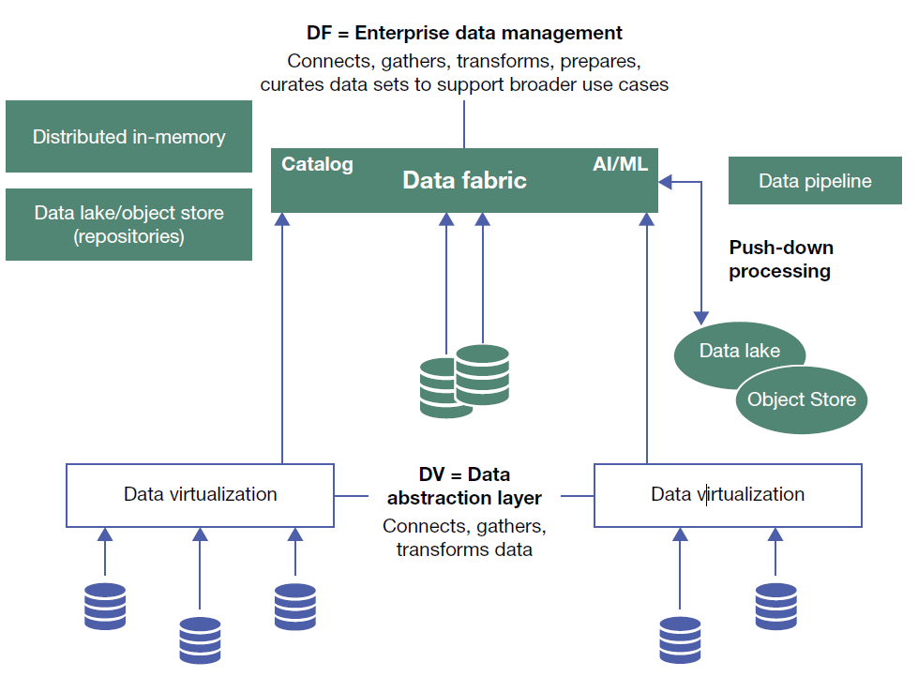





Data Fabric Reference Architecture, virtualization engine
Notebook
USQL/DSL
NLP
Interaction
Visualization
Input
Sources
Data virtualization
L
A
N
D
I
N
G
Z
O
N
E
Acquire
(Transport/Integration)
Governed Data store
Data Analysis
Streaming
Stream Processing
ETL
Data ware houses,
Domain specific stores,
Graph DB,
Time series store,
Data lake,
Columnar store,
NoSQL
Batch Processing
CDC
Replication
Continuous Intelligence
AI Model Generation,
lookup
ML models
Data Discovery
MDM
Quality
Data Anonymization
GDPR compliant, Distributed, Scalable,
Performance oriented
Data Governance Catalog, Data lineage, Policies, Security, Authorization
Forrester 2020 Data Virtualization vs Data Fabric
Interactive Query
Batch Query
Stream Query
interactive query
Batch Query
Stream Query
SQL, HQL, Flink SQL, Java API...
Data virtualization engine
Remote cluster
OLTP
OLAP
Hadoop
NoSQL
Multi-source
Multiple data sources
Multi-syntax data syntax
Multi-regions
Remote cluster
OLTP
OLAP
Hadoop
NoSQL
Unified entry, simplifying complexity, and supporting multiple scenarios with a single engine; Virtual view of global data and high-performance query; Efficient cross-source/cross-domain collaborative computing, without migration of data consumption

Slide 7

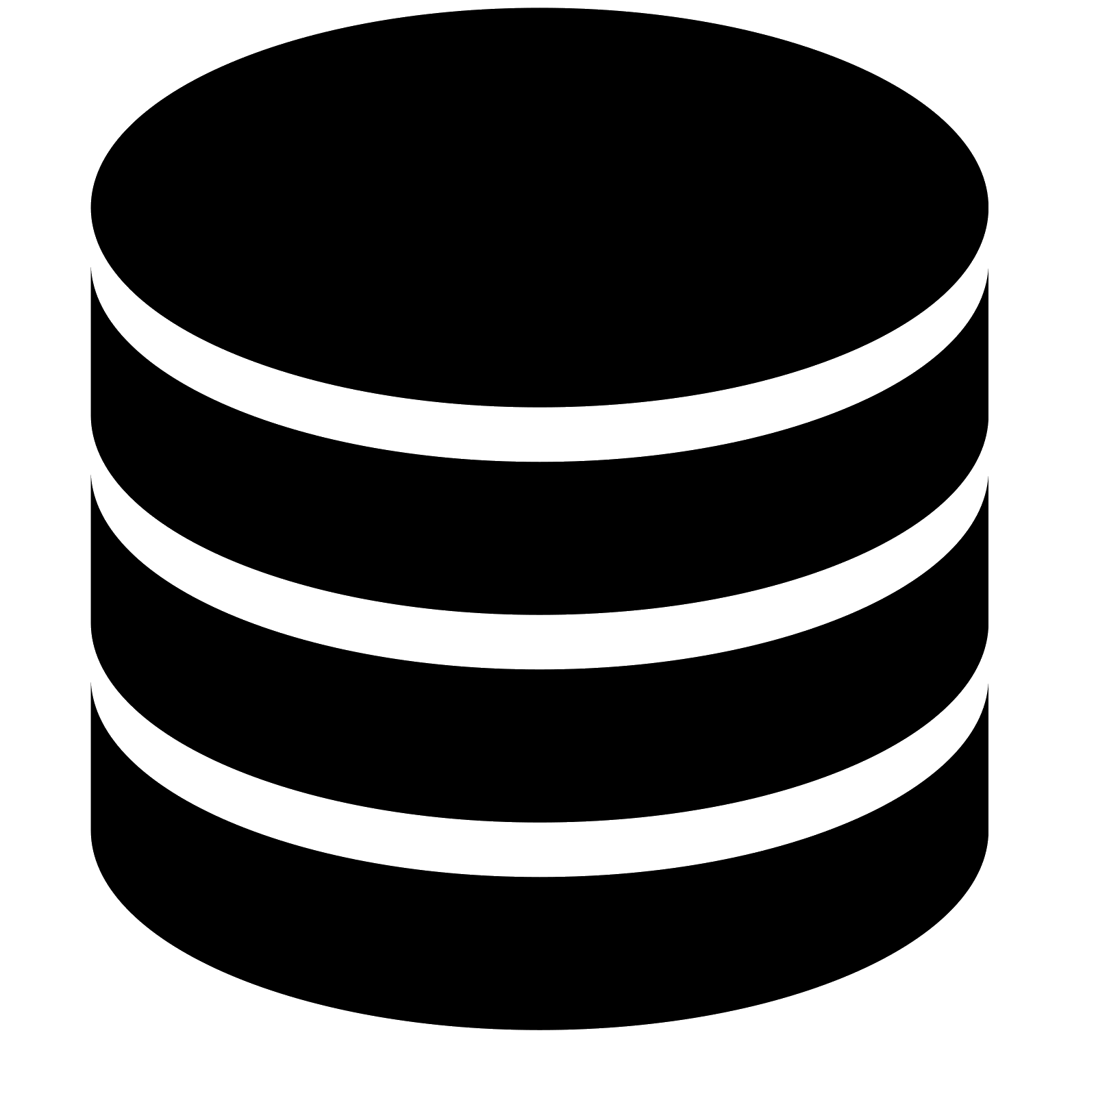














openLooKeng: Unified and Efficient Data Virtualization Converged Analysis Engine, Simple Big Data
BI/AI/Query analysis tool
Unified entry, simplifying complexity, and supporting multiple scenarios with a single engine
Unified data access interface
ODBC
SQL
JDBC
REST
Kernel enhancement, high-performance query
VDM (data virtual supermarket)
Engine kernel (converged analysis, query optimization, high availability, and data virtualization)
heuristic indexing
Scheduling optimization
Dynamic filtering
operator pushdown
Cache
AA High Availability
Horizontal scaling
Cross-source association analysis, zero data migration
Unified Data Source Connection Framework
Cross-domain collaborative computing, WAN deployment, and LAN experience
Data center A
Data center B
Data center C

Slide 8
openLookeng within the Big Data landscape: Fusion Analytics Engine for Big Data
Applications
Data Sources
Management
Data enable
Data integration
Data development
Data governance
Virtual data warehouse
RDBMS
Security
Query Engine
AI
LOG
Batch
Stream
Fusion analysis
Graph
Search
ML
DL
Computing Engine
Hive
Spark
Flink
openLooKeng
GraphBase
GeoMesa
ElasticSearch
Tenant
External Data
HBase
openLooKeng is the entrance to the data lake
YARN
Configuration
(IoT)
Data Management
Data catalog
Catalog
Data security
Security
Performance
WEB
Social Media
Fault
Data storage
HDFS
TXT | ORC | Parquet | Carbon
Distributed storage
FS-HDFS | Object| File
Data storage
3rd party
ARM
X86
VM
Cloud
Notes:
First, the current big data platform is relatively complex. The architecture includes underlying hardware, including the data storage layer, data management layer, data engine layer, and data enablement layer. User data are stored in the data storage layer as a data source. Users can use different query engines to analyze data based on their application scenarios. For example, in the batch scenario, most users use Hive and Spark. In the stream scenario, Flink are more popular. In the graph processing scenario, GraphBase is available. For text search, most users use ES. As shown in the preceding figure, the overall engine is fragmented. OpenLooKeng is an efficient data virtualization analysis engine. The goal is to served as the entry point of the data lake.

Slide 9


Convergent analysis: unified SQL entry and cross-source convergent query
ISV application
ISV application
A Data Analysis System
A Data Analysis System
Business Pain Points
cross-source aggregation analysis
4
ANSI SQL Driver
1
For multiple heterogeneous data sources, task scripts for matching protocols need to be developed separately, which is difficult to develop.
Cross-source analysis tasks have a long pipeline, low efficiency, and difficult to be automated.
openLooKeng
1
2
3
ANSI SQL Unified Interface
Hive JDBC HQL
HBase Client
ES Client
High-performance MPP analysis engine
OpenLooKeng Advantages
Unify ANSI SQL 2003 to shield access differences between heterogeneous data sources, simplify application development, and improve development efficiency.
High-performance analysis engine, providing analysis within 100 ms to seconds, improving the performance of cross-source heterogeneous data convergence analysis by 2 to 10 times.
Data source A
HIVE
Data source B
HBase
Data source C
ES
Data source A
HIVE
Data source B
HBase
Data source C
ES
High threshold and complex development
Unified SQL entry, multi-source convergence, simplifying development and management

Slide 10
Convergent analysis: cross-DC joint query, enhanced data analysis capability
Analysis/Query
Analysis/Query
DC1
Shared switching platform
DC2
Business Pain Points
ISV analysis platform
ISV analysis platform
Data volume expansion leads to hierarchical and decentralized data storage: There are over 3000 types of data in 21 cities and cities across the province. The total amount of data accessed every day is greater than or equal to 200 TB
The cross-region analysis efficiency of target audience analysis is low. Manually extract data in batches to the provincial center (every day), which is inefficient and takes a long time to analyze data. If a large amount of data is queried, you need to travel to the local office for processing
Front-end processor
Manually process cross-region data, and analyze T+1 data sharing.
Front-end processor
Data Source
Data Source
Hive
MPPDB
Hive
MPPDB
SparkSQL
SparkSQL
Analysis/Query
Analysis/Query
OpenLooKeng Advantages
DC1
DC2
ISV data middle station
Cross-region collaborative computing, T+0 real-time data sharing and analysis
ISV data middle station
Streamline data access in remote data centers. Cross-DC data query does not require a business trip to the local area
Only filtered data is transmitted across clusters, saving network bandwidth. The cross-DC data analysis duration is shortened from days to minutes
openLooKeng
openLooKeng
High-performance MPP analysis engine
High-performance MPP analysis engine
DC Connector
DC Connector
Data Source
Data Source
Hive
Hive
MPPDB
SparkSQL
MPPDB
SparkSQL

Slide 11
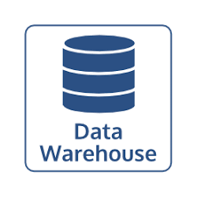
Converged Analysis: One Data Saves Storage Costs
Application
Application
Compatibility and performance are not satisfied
Data Source
Data Source
openLooKeng
production trading system
APP application
Service database
ETL
HIVE
ETL
production trading system
APP application
Service database
ANSI SQL Unified Interface
HBase
High-performance MPP analysis engine
......
MPPDB theme library
HDFS
The ETL process is long, data is repeatedly migrated, and data consistency is poor.
One copy of data, reducing the ETL process and unnecessary data migration
Business Pain Points
openLooKeng Advantages
Duplicate data storage, which is high construction costs.
Multiple big data technologies are used to cope with different business scenarios, and data is stored repeatedly.
Data is scattered across data sources, which makes it difficult to summarize and correlate data, and the data consumption efficiency is low.
The data transfer efficiency between components is low. The Hive analysis results are generated and imported to the theme database. Due to a large number of tables and a large amount of data, errors or failures occur frequently.
Spatiotemporal database query and batch analysis based on a single piece of data
Data does not need to be exported again.
Supporting the import of massive data into the database with high throughput
Supports high-concurrency query and analysis.

Slide 12
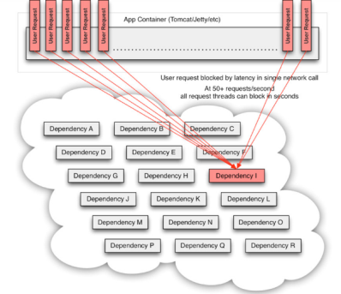
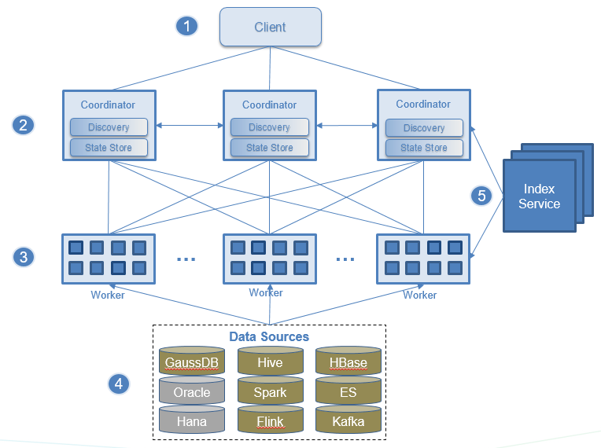
High availability: rock-solid "database" experience
Common Faults in the Big Data Domain
OpenLooKeng High Reliability Assurance
Limited resources cannot ensure the stability of ultra-large query scenarios, affecting service stability. Resources need to be scaled horizontally and quickly.
User behavior:
Nonstandard SQL code submission causes insufficient resources.
Query-level resource control
Query-level single-node resource limit
Query-level cluster resource limit
Insufficient cluster computing resources for a large number of concurrent tasks:
Exceeded the query memory limit of a single node.
Cluster Query Memory Limit Exceeded
Cluster resource autoscaling
Storage-computing separation architecture, stateless computing nodes, and on-demand expansion
Cluster autoscaling based on service load
Limit traffic based on the cluster service load. (Maximum memory of a single task, maximum memory allowed by a single node, and time limit for a single query)
Big data analysis requires in-depth call of component stacks, which has a long call chain and many dependent components, making service performance difficult to ensure.
Internal exception of the distributed cluster:
Management Node Fault
Compute Node Faults
Cluster Network Communication Failure
Disk Faults on Cluster Nodes
Automatic handling of node faults
Services are unaware of node faults.
The management node automatically removes frequently faulty compute nodes to avoid the short board effect.
Storage and computing are separated. The computing node is stateless. The fault of a single node does not affect the new SQL submission.
The management node supports HA and seamlessly switches over the standby management node.

Slide 13
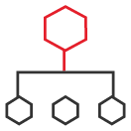



OpenLooKeng Architecture
openLooKeng cluster1
openLooKeng cluster2
Discovery server
Coordinator
...
Coordinator
Discovery server
Coordinator
MPP architecture
HA, no single point of failure
AZs
/DCs
Worker
Worker
Worker
Worker
Worker
Worker
vectorized column processing engine
Data Center
Connector
In-memory pipeline processing
Coordinator HA
DC-Connector
Enhanced scheduler & planner
Reliable execution
Dynamic Filters
Virtual Data Mart
Heuristic Indexing
Data Source
Connector
Data Source
Connector
MySQL
Hive
Elasticsearch
MySQL
Hive
Notes:
OpenLooKeng is a typical MPP-like architecture engine. The overall engine includes coordinator nodes and worker nodes. The coordinator node is responsible for parsing user SQL statements, generating an execution plan, scheduling an execution plan. The worker receives the physical plan and performs data analysis and processing. OpenLooKeng uses the Data Source Connector framework to access multiple data sources, such as MySQL, Hive, and ES. In addition, the DataCenter connector can connect to different OpenLooKeng clusters across networks for cross-domain data access. In general, OpenLooKeng uses multiple coordinators to avoid single points of failure. In addition, workers use the memory to process data. Column-based processing improves data analysis and processing performance.

Slide 14


OpenLooKeng Interactive Scenario Key Technologies
Client
Coordinator
Coordinator
Data source side, more suitable for openLooKeng
Bucket/Partition
Small File Merge
Query Field Sorting
Engine layer, enhancing the interactive query capability
- Cache acceleration:
Execution plan cache
Metadata cache
Incremental column cache
- Optimizer:
predicate pushdown
Dynamic filtering
RBO&CBO
CTE
- Adaptive scheduler
Additional layers for faster interactive queries
Heuristic index layer (bitmap/bloomfilter/min-max)
Data cache layer
Serialization & deserialization
Metadata Cache
Dynamic filter planning
Semi join optimization rule
Predicate pushdown
Index optimizer
Metadata API
Data Location API
Parser/analyzer
planner
scheduler
Create index
Create cache
Execution plan cache
Java
Affinity Scheduler
Worker
Serialization
Deserialization
Worker
Worker
Processor
Processor
Dynamic filter
Predicate filter
Dynamic filter
Predicate filter
Data Stream API
Data Stream API
Data cache
Data cache
Index layer
DataSource

Slide 15
Dynamic Filtering
Depending on the join condition and the data read from the build-side table, dynamic filters are generated during runtime and applied to the table scan phase of the probe-side table, thereby reducing the amount of data involved in the join operation and effectively reducing I/O reading and network transmission.
Client
grammatical semantic analysis
Coordinator
Dynamic Filtering
DynamicFilter Service
Execution plan generation
Dynamic filtering query optimization rule
Add the DynamicFilterSource operator to collect data on the build side.
Distributed cache is used for DF processing
Applicable to inner join & right join
Applies to scenarios whenthe join selectivity is high
Execution plan scheduling
3 Merge
Worker
Join
Worker
2 Get
Distributed Cache
ProbeTableScan
DynamicFilter Source
4Apply
DynamicFilter
1Build
BuildTableScan
Data Source

Slide 16
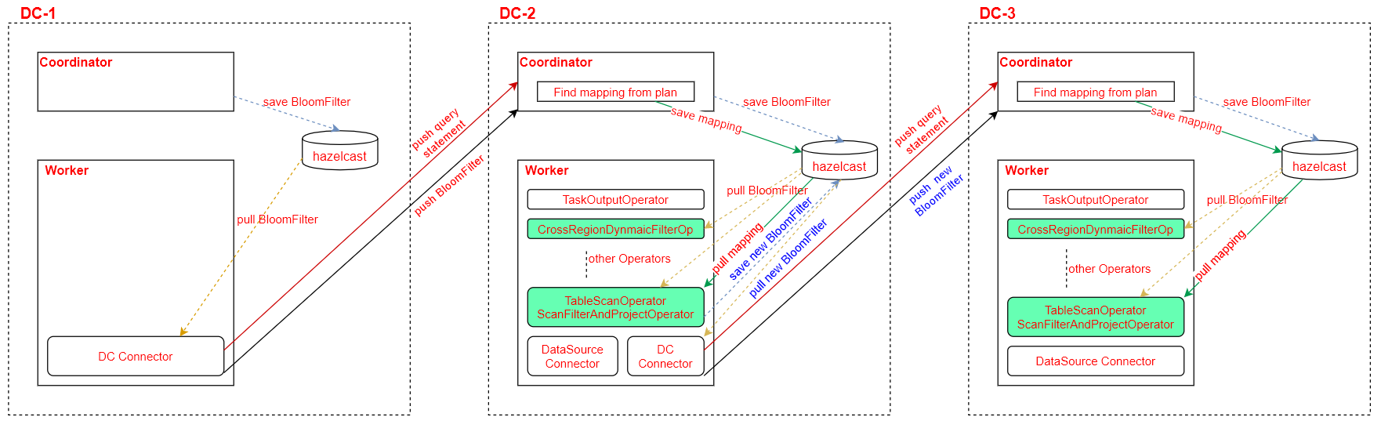
Cross-domain Dynamic Filtering
DC-2 Coordinator: 1) Saves the BF filter of DC-1 to the Hazelcast with QueryId as the key. 2) Determine whether the current query has a cross-region dynamic filter. If yes, set the cross-region-dynamic-filter in the session. 3) The mapping relationship from the column name of Query in the plan to the outputSymbols of the plan is stored in the Hazelcast. 4) Check whether the TableScanNode of the plan contains the DC table. If yes, mark it. The BF filter may be pushed down.
DC-2 Worker: 1) CrossRegionDynamicFilterOp obtains BF filter and outputSymbols from Hazelcast and judges whether there are filtered columns. If yes, filter is applied to filter pages. (2) The filter application of TableScanOperator is similar to that in step 1. 3) If a DC table exists in TableScanNode, a new BF filter is generated and stored in Hazelcast for sending the new BF filter to the lower-level DC.

Slide 17



Traditional Index challenges in big data, Solution
Client
Query Engine
Query Engine
Parser/analyzer
planner
scheduler
Client
Parser/analyzer
planner
scheduler
Execution Engine
Execution Engine
limited network bandwidth
decoupled
Heuristic index layer
Storage Engine
Storage Engine
HDFS
HDFS
Storage engine and computing engine are decoupled
The index technology faces great challenges since the data is not controlled by the computing engine
Agnostic to the underlying data source and can be used by any query engine
Existing data can be indexed without rewriting existing data files
Create new index types that are not supported by the underlying data source
Index data does not occupy data source storage space
Filtering data in early stage, reducing the amount of data transmitted over the network and the amount of data involved in engine calculation
Notes:
But in big data scenarios, what impact will the indexing technology bring? Different from traditional database engines, storage and computing are usually decoupled in big data scenarios. For better scalability, computing and storage can be flexibly expanded. In the big data scenario, all user data is stored in Hive or HDFS. The computing engine cannot maintain its own indexes for acceleration.
Therefore, openLooKeng proposes a heuristic indexing framework to solve the above problems. The heuristic index framework attempts to extract an index layer interface from the openLooKeng engine to decouple the index implementation from the data source. Overall, the main features of the openLooKeng heuristic indexing framework are as follows: 1、Indexes are independent of the underlying data source and can be used by any query engine 2、Existing data can be indexed without overwriting existing data files 3、You can create a new index type that is not supported by the underlying data source 4、Index data does not occupy the storage space of the data source.

Slide 18
Heuristic index architecture
Client
Coordinator
Coordinator
Data filtered in coordinator
Metadata API
Data Location API
Heuristic index
Index optimizer
HIndex-Sparse Index
Provides a unified index framework.
Supports multiple index structures.
Sparse index: Bloomfilter, Min-Max
Thick index: Bitmap and Btree
Task scheduling phase:
Cut out the split to reduce the number of tasks scheduled to the worker.
Index-based affinity scheduling
Data reading phase:
Reduce the amount of data loaded to the computing memory.
Parser/analyzer
planner
scheduler
Create index
Affinity Scheduler
Worker
Worker
Worker
Processor
Processor
Index filtering
Index filtering
Data Stream API
Data Stream API
Data filtered in worker
HIndex-Dense Index
Index layer
DataSource
Notes:
A more detailed introduction to heuristic indexing techniques is shown in Figure . Generally, a user enters the SQL statement to obtain the result. The coordinator analyzes the syntax and semantics of the SQL statement, generates and schedules the execution plan, processes the data on the worker, obtains the data from the data source, processes the data, and returns the result to the coordinator. Overall, heuristic indexing hopes to provide a unified framework to support different types of indexing techniques. In general, the openLooKeng heuristic index framework provides commands for creating indexes and optimizes them in the task scheduling and data reading phases.
Multiple index structures
Sparse index：Bloomfilter、Min-Max
Dense index：Bitmap
Task scheduling phase
Cut the split to reduce the number of tasks scheduled to the worker
Index-based affinity scheduling
Data read phase
Reducing the amount of data to be loaded to the computing memory

Slide 19

OpenLooKeng Open Source One Year Anniversary – One Official Version Every 3 Months
openLooKeng
(open source)
openLooKeng 1.0.0
(released)
openLooKeng 1.1.0
(released)
openLooKeng 1.2.0
(released)
openLooKeng 1.3.0
(released)
openLooKeng 1.4.0
(released)
2020.06
2020.09
2020.12
2021.03
2021.06
2021.09
OpenLooKeng 0.1.0 was released in the community on June 30, 2020. It provides unified SQL interfaces, cross-source/cross-domain analysis capabilities, supports interactive query scenarios, and provides competitive features such as heuristic indexing, dynamic filtering, high availability AA, elastic scaling, and dynamic UDF.
Version | 1.0.0 | 1.1.0 | 1.2.0 | 1.3.0 | 1.4.0
Summary | Supports IUD for ORC and virtual data marts. | Cross-DC dynamic filtering enhancement | DM optimization + general operator push-down framework | Resource isolation + enhanced reliability | Yarn + Heuristic Index enhancement, Star Tree for JDBC
High performance | Operator push-down, dynamic filtering enhancement, and execution plan cache | Heuristic index enhancement, performance optimization for TPC-DS | Data Management Optimization, Pre-aggregation Based on Star Tree Index, CTE Reuse | Enhanced CBO to support Sorted Source Aggregator to reduce memory usage | Enhanced memory connector for large datasets, Plan, Scheduling optimization for LLQ,
North-South ecosystem | The northbound SQL syntax conversion tool supports the HQL/Impala syntax. Supports 10+ data sources in the southbound direction. | Southbound interconnection with more data sources: openGauss, MongoDB, ElasticSearch7.x, and hive metastore user transparent transmission | Enhanced northbound compatibility A new general operator push-down framework is provided in the southbound direction, which is simpler, more flexible, and more efficient. HBase Connector performance optimization | Added the hudi connector, greenplum connector, and clickhouse connector. Connector supports multi-shard query. The memory connector function is enhanced. | Update Index sql, show index enhancement, star tree for jdbc connectors
Enterprise-class | Containerized deployment, Try-me, SQL Editor | High concurrency capability enhancement, interconnection with Ranger permission management, and Admin Dashboard | Fine-grained permission control and query retry enhancement | Resource isolation and enhanced reliability (task level recovery) | openLooKeng on yarn

Slide 20
Optimization Direction of Big Data Engine Performance from OpenLooKeng
① Data loading:
Cooperation between storage and calculation: Lack of effective coordination between storage and calculation
② Data calculation:
Efficient Calculation: Computational Power Consumption on Unrelated Control Flows
Acceleration ratio: The acceleration ratio of a large-scale cluster is less than 0.5.
CPU/network: limited data processing logic cannot be fully utilized
③ Data exchange:
Data exchange format: cannot be automatically adjusted based on network characteristics.
Serialization: Performance loss of serialization and deserialization
Zero-Copy: data copy of memory and operating system buffers
Compute
Filter
3
2
Massive
Partitioned
Parallel
Execution
Join
Scan
Scan
1
Storage
HDFS | Cloud Storage | S3 | Ceph
Notes:
Problems of the current engine in the end-to-end process:
① Data loading:
Collaboration between storage and computing: Separation of storage and computing becomes a trend, and there is no effective collaboration between storage and computing.
② Data calculation:
Low payload: The current big data widely uses dynamic type processing, which requires type processing during running. As a result, the computing power is consumed in the control flow that is irrelevant to actual calculation.
Low acceleration ratio: The acceleration ratio of a large-scale cluster is less than 0.5?%.
CPU/network not fully utilized: The synchronization and implementation framework required in the data processing logic makes the CPU/network not fully utilized at the same time.
③ Data exchange:
The data exchange format cannot be automatically adjusted based on network characteristics.
backpressure mechanism
Serialization: Data needs to be serialized and deserialized during the exchange process, which deteriorates the exchange performance.
Zero-Copy: Data needs to be copied between the application memory and the operating system buffer.

Slide 21
OmniRuntime: Code once, run fast everywhere
Pipeline optimization
Unified Runtime Base
OLK
Spark
Hive
Flink
Presto
Spark
Hive
Flink
Local
optimization
Local
optimization
Local
optimization
Local
optimization
Common Big Data Runtime
OmniCache | OmniJit | OmniData
computing
General
computing
Heterogeneous
computing
Kunpeng
X86
Ascend
GPGPU
FPGA
DPU
Vertical optimization for each engine
Implement the native runtime operator.
Use codegen to optimize operators.
One base supports different engines, reducing repeated optimization work
Fully exploit common and heterogeneous computing capabilities

Slide 22
OpenLooKeng: Enable Fast Data Value Realization
Convergence analysis
High performance
North-South ecosystem
Enterprise-class features
Cross-source heterogeneous data: Supports association analysis of heterogeneous data from multiple sources in a data lake, significantly improving query efficiency.
Cross-domain: Supports cross-DC collaborative analysis, simplifying development and improving data access efficiency.
One piece of data: Data migration is not required, eliminating data silos and redundancy, and reducing costs.
SQL on Hadoop architecture: supports query of TB-level data and hundreds of billions of records in a single SQL statement, and queries of multiple tables in seconds.
Features such as heuristic index enhancement, dynamic filtering (cross-DC), operator push-down, cache, and CBO optimization enable E2E query latency to be improved by 2 to 10 times on average compared with traditional engines.
Supports 100+ concurrent processing, achieving end-to-end response within seconds*
The northbound interface supports standard SQL 2003, JDBC, and ODBC interfaces to connect to various typical BI and data analysis applications.
SQL tools are supported to implement syntax conversion between HQL and Impala non-standard SQLs. HQL UDFs can be dynamically loaded to reduce development requirements.
Provides a unified data source access framework for southbound services, supporting access of more than 10 types of data sources.
Auto Scaling is supported to improve resource utilization.
Support Coordinator AA to ensure service continuity
Supports container-based deployment, one-click installation, and Admin Dashboard, improving O&M efficiency and simplifying integration operations.
Supports the ORC IUD feature to improve enterprise-level application capabilities.
*The preceding data is calculated in typical scenarios, and the results vary in different environments.

Slide 23
openLooKeng Roadmap
openLooKeng Vision
Make Big Data Simple!
Release 2020
Interactive Engine Extreme Performance
Release 2021
Extremely stable batch processing engine
Release 2022
Ultimate performance of all-scenario engines
Heuristic Index: Improving Point Query Performance
Push Down: improves cross-source analysis performance.
DC Connector: Efficient cloud-edge collaboration
Tiered Cache Storage: Storage-computing Separation Supports High-Performance Query
Refactoring Code Complete Security Vulnerability Fixes
Enhanced dynamic filtering
UCatalog Manager
CarbonData Connector
ACID for carbon and Hive orc
Adaptive scheduling: supports more than 500 concurrent processing.
OmniCache: Improving 100 PB Analytics Performance
Java RDMA Library: Improving Networking Cost-effectiveness
Query-level fault tolerance
Affinity aware scheduler
Large cluster support
OmniFunction: multi-calculation scheduling
Big Data Computing on the Web: Vertical Integration of Multiple Computing Powers and Hard Powers

Slide 24
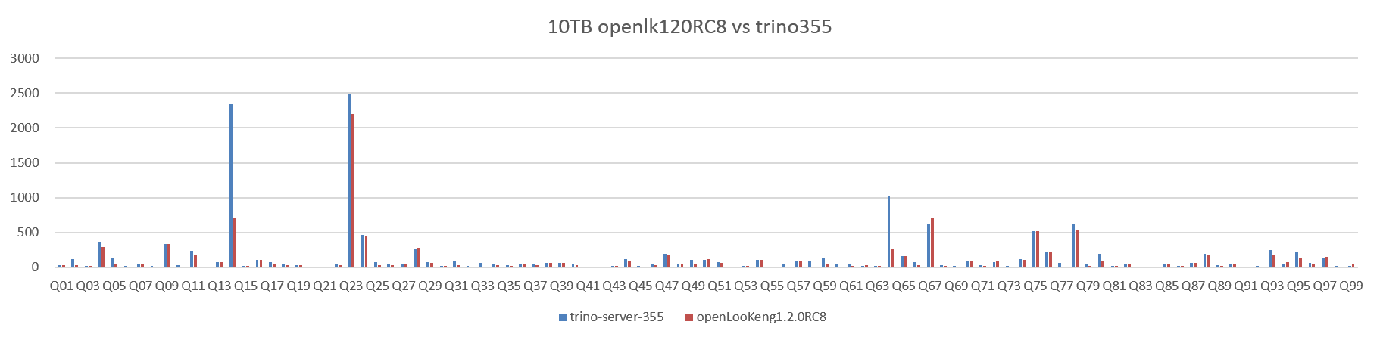
TPCDS Test Comparison
 | tpcds-1TB | tpcds-3TB | tpcds-10TB
The openLooKeng performance is improved when compared with Trino | ↑ 3% | ↑ 14% | ↑ 28%
Test background:
Node: 11 compute nodes
Memory: 384 GB
CPU:2*2*Intel(R) Xeon(R) Gold 6154 CPU @ 3.00 GHz 18 Cores
OS:CentOS 7.6
Data volume: 10 TB
Total Time Required for TPC-DS Test Cases: 32% better performance than Impala 3.4
OpenLooKeng supports 100% TPC-DS, while Impala supports only 78% of test cases.

Slide 25
Thank you!

