Slide 1

Batch Number: A15
SECOND REVIEW
A Multimodal Fake Job and Recruitment Scam Detection System Using Natural Language Processing and Machine Learning
Team Members | Supervisor
Student Name / Register Number Syed Junaid Bukhari-RA2211026020063 Rajeev Patnaik Rayagada-RA2211026020038 Jayadev Nukala-RA2211026020059 | Name : Dr. G. Deena Designation : Assistant Professor Department : CSE-AIML

Slide 2
PROBLEM STATEMENT
Rapid increase in fake job postings on online platforms
Job seekers face financial loss and personal data theft
Manual verification is time-consuming and error-prone
Traditional filters fail to detect context-based fraud
Need for an automated ML-based detection system

Slide 3
BACKGROUND & MOTIVATION
Exponential surge in fraudulent job postings across major recruitment platforms.
Financial loss and identity theft risks for vulnerable job seekers
Traditional keyword-based filters fail to detect context-aware linguistic patterns.
Machine Learning enables pattern recognition in large datasets
Motivation to build a secure and trustworthy job screening system

Slide 4
OBJECTIVES
To identify fake job postings automatically
To train robust ML classifiers capable of handling highly imbalanced fraud datasets.
To train ML models for job classification
To maximize Precision (89%) to ensure minimal false alarms for legitimate postings.
To deploy a real-time web interface (Streamlit) for instant job verification.

Slide 5
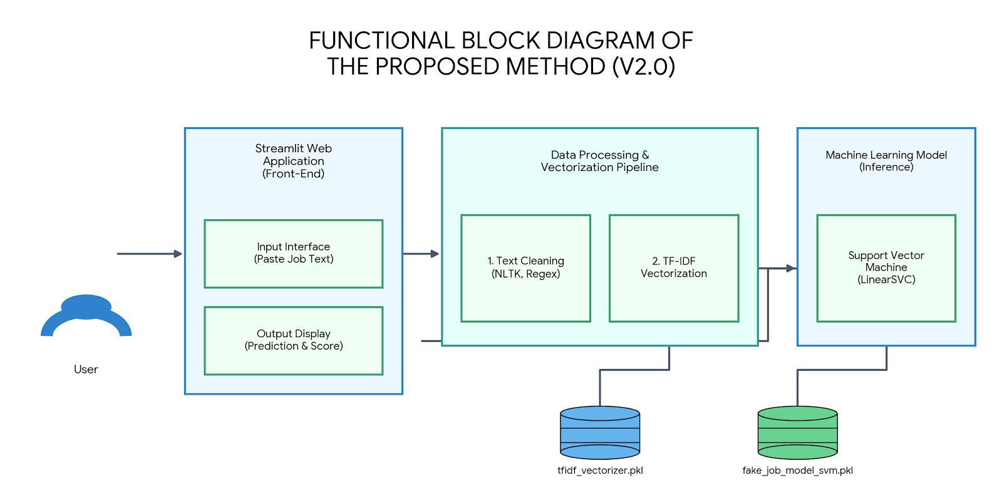
FUNCTIONAL BLOCK DIAGRAM OF THE PROPOSED METHOD

Slide 6
METHODOLOGY
Dataset Acquisition: Employment Scam Aegean Dataset (EMSCAD).
Preprocessing Pipeline: Concatenating text fields (Title + Description + Requirements) and handling missing values.
Feature Engineering: TF-IDF Vectorization (Top 5,000 features).
Model Training: Model Training: Deep Neural Network (MLP) with Adam Optimizer.
Evaluation Framework: Precision Optimization, F1-Score, and overall Accuracy analysis.
Deployment: Real-time inference engine using Streamlit Web App.

Slide 7
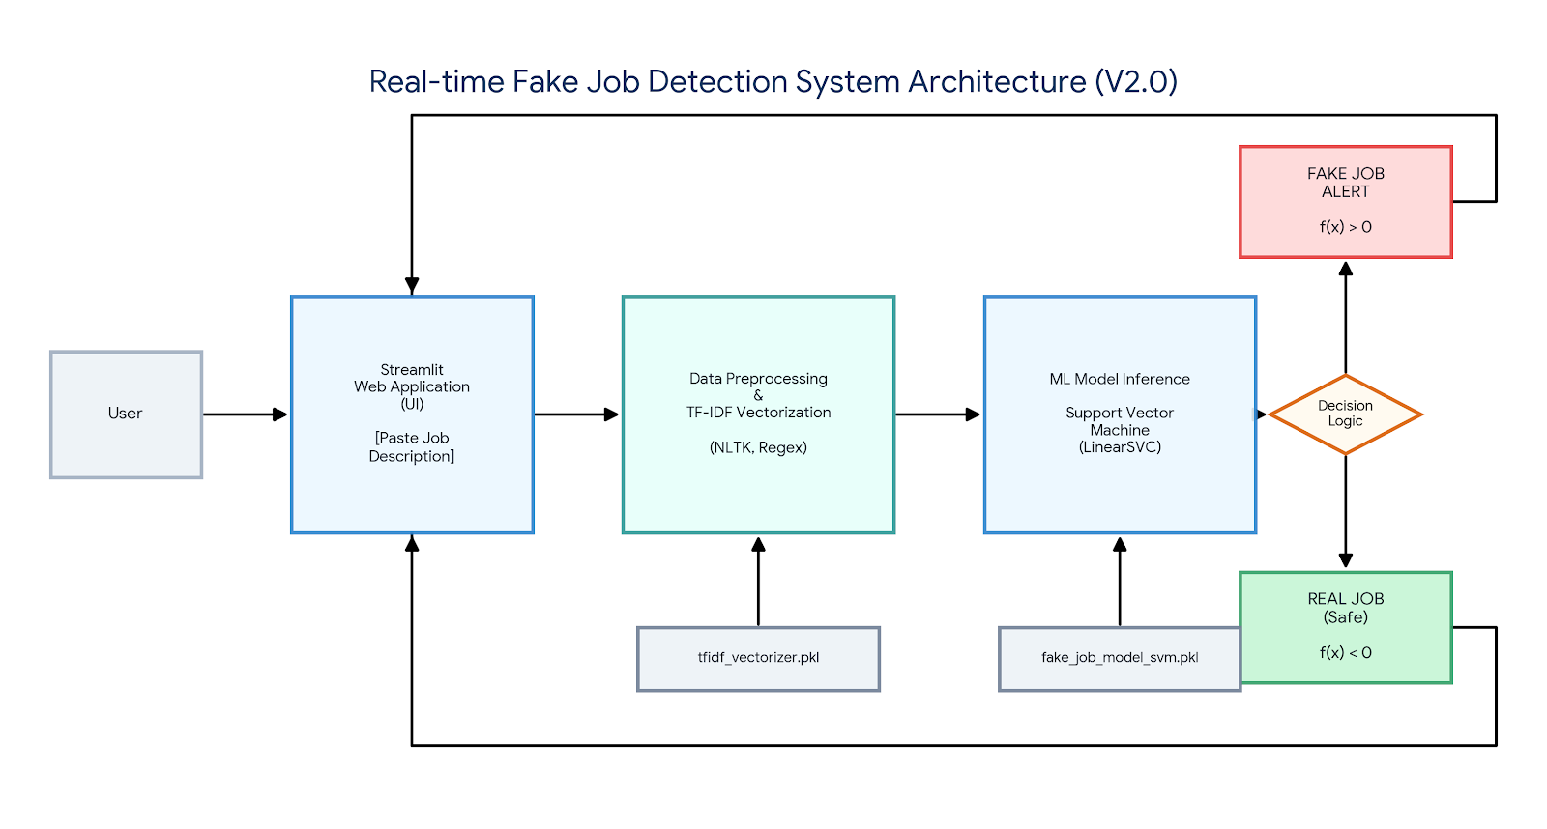
ARCHITECTURE DIAGRAM

Slide 8

MATHEMATICAL MODELS & EQUATIONS
Binary Classification Problem
$D=\{\left(x_{i}, y_{i}\right)\}$​ → Job posting text
$y_{i}∈\left\{0,1\right\}$ → 0 = Real, 1 = Fake
Feature Extraction (TF-IDF)
$TF−IDF=TF ∗IDF$
Support Vector Machine (LinearSVC) Model
$f\left(x\right)=w^{T}x+b$
$f\left(x\right)>0 →$ Fake
$f\left(x\right)<0 →$ Real

Slide 9
RESULTS AND DISCUSSION
Dataset Overview
Total Records: 17,880
Real Jobs: 17,014
Fake Jobs: 866
Train/Test Split: 80% / 20%
Model Performance (Test Data)
MetricValue
Accuracy- 98.43%
Precision- 89%
Recall- 77%
F1-Score- 83%
 | Predicted Real | Predicted Fake
Actual Real | 3386 | 17
Actual Fake | 39 | 134

Slide 10
RESULTS AND DISCUSSION
Manual / rule-based filtering
COMPARISON WITH EXISTING MODELS
Traditional Methods
Manual / rule-based filtering
Low scalability
Accuracy: 70–80%
Existing ML Models
Naïve Bayes, SVM
Basic vectorization (Bag of Words)
Accuracy: 85–90%
Proposed Model
Technique: TF-IDF + Deep Neural Network (MLP)
Accuracy: 98.43%
Optimization: High Precision (89%) to minimize false alarms
Status: Live Streamlit Web App Deployment

Slide 11
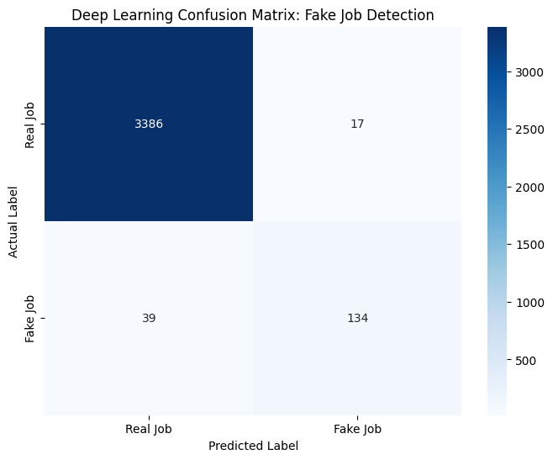
RESULTS AND DISCUSSION
Dataset Overview:
Total Records: 17,880
Class Distribution: 17,014 Real / 866 Fake
Train/Test Split: 80% / 20%
Model Performance (Test Data):
Accuracy: 98.43%
Recall (Fake): 77%
Precision (Fake): 89%
F1-Score: 83%

Slide 12
TOOLS USED
Core Language & IDE: Python, Jupyter Notebook, VS Code
Data Processing: Pandas, NumPy, NLTK & Regex
Machine Learning: Scikit-learn (for TF-IDF & Deep Neural Network / MLP)
Visualization: Matplotlib, Seaborn
Deployment & Serialization: Streamlit, Joblib

Slide 13
SCOPE OF THE PROJECT
Browser Extension Integration: Can be deployed as a plug-in to automatically scan job boards (LinkedIn, Indeed) in real-time.
Helps reduce online employment fraud
Contextual AI Upgrade: Transitioning from SVM to Transformer models (like BERT)
Real-time job posting verification in future
Multimodal Metadata Verification: Expanding the model to verify non-text features like company domain age, logo authenticity, and email domains.

Slide 14
REFERENCES
[1] S. Sharma, R. Gupta, and P. Verma, “Fake Job Posting Detection Using Machine Learning Techniques,” IEEE Conference on Artificial Intelligence and Machine Learning, 2024. https://ieeexplore.ieee.org/document/11007003
[2] P. K. Prashanth et al., “Online recruitment fraud detection using deep learning,” Int. J. Scientific Computing, 2025. https://ijsci.com/index.php/home/article/view/1087
[3] V. Itnal et al., “Fake/real job posting detection using machine learning,” IJRASET, 2025. https://www.ijraset.com/research-paper/fake-real-job-posting-detection-using-machine-learning
[4] K. Pradeep et al., “Fake job posting detection,” IJRASET, 2025. https://www.ijraset.com/research-paper/fake-job-posting-detection
[5] S. Kale et al., “Fake job detection system,” IJRASET, 2024. https://www.ijraset.com/research-paper/fake-job-detection-system
[6] J. Fating et al., “Fake job listing detection using machine learning,” IJRASET, 2023. https://www.ijraset.com/research-paper/fake-job-listing-detection-using-machine-learning-approach
[7] N. G. Teegala and N. R. Reddy, “Machine learning approach for fraudulent job posting detection,” J. Social Innovation & Human Services, 2025. https://fringeglobal.com/ojs/index.php/jsihs/article/view/a-machine-learning-approach-for-detecting-fraudulent-job-posting
[8] P. Deka, A. Seal, and S. Banik, “Review of machine learning techniques for fake job detection,” IJERA, 2025. https://ijera.in/index.php/IJERA/article/view/25
[9] K. S. Sridevi et al., “Real vs fake job posting detection,” IRJAEM, 2024. https://goldncloudpublications.com/index.php/irjaem/article/view/423
[10] S. Ramya et al., “Fake job prediction using machine learning algorithms,” IJERST, 2025. https://ijerst.org/index.php/ijerst/article/view/982

