Slide 1
Dictionaries ,Functions , Modules and Packages , Exception Handling in Python

Slide 2
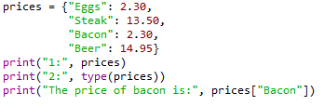

Dictionaries
Dictionaries are lists of key-valued pairs.
In:
Out:

Slide 3
1. Creating a Dictionary:
# Creating an empty dictionary
my_dict = {}
# Creating a dictionary with key-value pairs
student = {
"name": "Alice",
"age": 25,
"grade": "A"
}

Slide 4
2.Accessing Dictionary Values:
# Accessing values by key
name = student["name"]
age = student["age"]
3. Modifying Dictionary Values:
# Modifying a value
student["age"] = 26
# Adding a new key-value pair
student["city"] = "New York"

Slide 5
4. Iterating Through a Dictionary:
for key, value in student.items():
print(f"{key}: {value}")
5. Checking if a Key Exists:
if "age" in student:
print("Age exists in the dictionary")
6. Dictionary Methods:
# Getting all keys
keys = student.keys()
# Getting all values
values = student.values()

Slide 6
7. Dictionary Comprehension:
# Creating a new dictionary with comprehension
squares = {num: num**2 for num in range(1, 6)}
8. Removing a Key-Value Pair:
# Removing a key-value pair
del student["grade"]
9. Default values with ‘get()’:
# Using get() to provide a default value
grade = student.get("grade", "N/A")

Slide 7
Question 1
# Given a dictionary 'student', remove the 'age' key-value pair.
student = {
"name": "Alice",
"age": 25,
"grade": "A"
}
# Your code here
del student["age"]

Slide 8
Question 2
# Create a dictionary 'colors' with the following color codes:
# Red: #FF0000, Green: #00FF00, Blue: #0000FF
# Your code here
colors = {
... "Red" : "#FF0000",
... "Green" : "#00FF00",
... "Blue" : "0000FF"
... }

Slide 9
Question 3
# Given a dictionary 'scores', find and print the keys (subject names) with scores less than 60.
scores = {
"Math": 75,
"Science": 58,
"History": 92,
"English": 45
}
# Your code here

Slide 10
Question 4
# Given a list of words, create a dictionary 'word_lengths' where the keys are words and the values are their lengths.
words = ["apple", "banana", "cherry", "date"]
# Your code here

Slide 11
Question 5
# You have a dictionary 'inventory' with items and their quantities. Add 10 more apples to the inventory.
inventory = {
"apples": 25,
"bananas": 15,
"oranges": 30
}
# Your code here

Slide 12
Functions
A function is a block of code which only runs when it is called. You can pass data, known as parameters, into a function. A function can return data as a result.
Types of Python Functions:
Python Built-in Functions.
Python Recursion Functions.
Python Lambda Functions.
Python User-defined Functions.

Slide 13

Basic Syntax Rules
Function Syntax
def...: indicates that you are defining a new function.
function() refers to the name of your function. By convention, this name is typically lowercase and represents a verb/action.
a,b refers to parameters (values or variables) that can be used within the statements of your function’s definition (......). If your function has no parameters, an empty parenthetical () is used.
The return statement is an optional statement that will return a value for your function to your original call.
def function(a, b):
......
return a + b

Slide 14

Basic Syntax Rules (cont.)
Calling a function
Call the function by referring to its name (function()) and by placing any necessary arguments (1, 2) within the parenthesis separated by commas. myValue = function(1, 2)
If you wish, you can set your function call equal to a variable (myValue). The value returned by the function will be assigned to your variable name.
myValue = function(1, 2)

Slide 15
1. Defining a Function: You define a function using the `def` keyword followed by the function name and a pair of parentheses. Function names should be descriptive and follow Python naming conventions. ```python def my_function(): # Function code goes here ```

Slide 16
2. Function Parameters:
You can pass zero or more parameters to a function, which are specified within the parentheses. These parameters allow you to pass data into the function. ```python def greet(name): print(f"Hello, {name}!")

Slide 17
3. Function Invocation:
You call (or invoke) a function by using its name followed by parentheses. If the function has parameters, you provide the required arguments within the parentheses.
```python
greet("Alice")
```

Slide 18
4. Function Return Value:
Functions can return values using the `return` statement. You can capture the return value when you call the function.
```python
def add(a, b):
return a + b
result = add(5, 3)
```

Slide 19
5. Default Parameters:
You can assign default values to function parameters, allowing them to be optional. If a value is not provided, the default is used.
```python
def greet(name="Guest"):
print(f"Hello, {name}!")
```

Slide 20
6. Docstrings:
It's good practice to include a docstring that explains the function's purpose, parameters, and return value. Docstrings are enclosed in triple quotes.
```python
def add(a, b):
"""
Add two numbers and return the result.
Parameters:
a (int): The first number.
b (int): The second number.
Returns:
int: The sum of a and b.
return a + b

Slide 21
7. Scope:
Functions have their own local scope, which means variables defined inside a function are not accessible outside of it. Global variables can be accessed within a function, but to modify them, you need to declare them as `global`.
8. Lambda Functions:
Python supports anonymous functions (functions with no names) known as lambda functions. They are often used for small, simple operations.
```python
double = lambda x: x * 2
result = double(5)
```

Slide 22
9. Recursion:
Python functions can be recursive, meaning they can call themselves. This is useful for solving problems that can be broken down into smaller, similar subproblems.
```python
def factorial(n):
if n == 0:
return 1
else:
return n * factorial(n-1)
```
Functions are a fundamental concept in Python and are used extensively in Python programming for a wide range of tasks. They help make your code modular and more maintainable.

Slide 23
Question 1:
```python
# Define a function 'add_numbers' that takes two numbers as input and returns their sum.
# Your code here
```
*Explanation*: This question tests your ability to define a basic function. The function should accept two numbers as arguments and return their sum.

Slide 24
Question 2:
```python
# Create a function 'is_even' that takes an integer as input and returns True if it's even, and False if it's not.
# Your code here
```
*Explanation*: This question checks your understanding of using functions with conditionals. The function should determine if the input integer is even and return a Boolean value.

Slide 25
Question 3:
```python
# Define a function 'calculate_average' that accepts a list of numbers as input and returns the average value.
# Your code here
```
*Explanation*: This question evaluates your understanding of working with functions and lists. The function should compute the average of the numbers in the input list.

Slide 26
Question 4:
```python
# Create a function 'find_max' that takes a list of numbers as input and returns the maximum value in the list.
# Your code here
```
*Explanation*: This question assesses your knowledge of functions and working with lists. The function should find and return the maximum value from the input list.

Slide 27
Question 5:
```python
# Write a function 'is_prime' that checks if a given number is a prime number and returns True if it is, and False if it's not.
# Your code here
```
*Explanation*: This question evaluates your understanding of functions and prime number checking. The function should determine if the input number is prime and return a Boolean value.

Slide 28
Question 6:
```python
# Define a function 'reverse_string' that takes a string as input and returns the reverse of that string.
# Your code here
```
*Explanation*: This question checks your knowledge of string manipulation in functions. The function should reverse the input string and return the result.

Slide 29
Modules and Packages
In Python, modules and packages are organizational structures that help you manage and structure your code. They allow you to break your code into smaller, more manageable pieces, making it easier to develop, maintain, and collaborate on large projects. Here's an overview of modules and packages in Python:
- A module is a single Python file that can contain variables, functions, and classes.
- Modules are used to organize code and make it reusable. You can import and use the contents of a module in other Python scripts.
- To create a module, you simply create a `.py` file with Python code. For example, you can create a file named `my_module.py`.

Slide 30
Importing a Module:
- You can import a module in another Python script using the `import` statement. For example: `import my_module`.
Accessing Module Contents:
- You can access variables, functions, and classes in a module using dot notation, such as `my_module.my_function()` or `my_module.my_variable`.

Slide 31
Creating a Python module is quite straightforward. Here's a step-by-step guide on how to create a simple module along with an example:
Step 1: Create a Module File
1. Open a text editor or an integrated development environment (IDE) like Visual Studio Code, PyCharm, or even a simple text editor like Notepad.
2. Create a new file and save it with a `.py` extension. You can name the file something meaningful to your module. For this example, let's create a module for basic math operations and name it `math_operations.py`.
Step 2: Define Functions in the Module
In the `math_operations.py` file, you can define functions that perform various mathematical operations. Here's an example with a few basic operations:

Slide 32
```python
# math_operations.py
def add(x, y):
return x + y
def subtract(x, y):
return x - y
def multiply(x, y):
return x * y
def divide(x, y):
if y == 0:
return "Division by zero is not allowed"
return x / y
```

Slide 33
Step 3: Using the Module
Now that you've created your module, you can use it in other Python scripts.
Create a new Python script, and you can import and use the `math_operations` module:
```python
# main.py
# Import the math_operations module
import math_operations
# Use functions from the module
result1 = math_operations.add(5, 3)
result2 = math_operations.subtract(10, 4)
result3 = math_operations.multiply(7, 2)
result4 = math_operations.divide(9, 3)

Slide 34
# Print the results
print("Addition:", result1)
print("Subtraction:", result2)
print("Multiplication:", result3)
print("Division:", result4)
```
Step 4: Running the Main Script
Save the `main.py` script and run it. You should see the results of the mathematical operations:
```plaintext
Addition: 8
Subtraction: 6
Multiplication: 14
Division: 3.0
```
In this example, the `math_operations` module contains functions for basic math operations, and you import and use these functions in your `main.py` script. This demonstrates how you can create and use a simple Python module for code organization and reusability.

Slide 35
Packages:
- A package is a directory (folder) that contains one or more modules. It allows you to organize related modules together.
Creating a Package:
- To create a package, you need to create a directory and place one or more module files inside that directory.
- The directory must contain a special file named `__init__.py`. This file can be empty or contain initialization code.

Slide 36
Importing from a Package:
- You can import modules from a package using dot notation. For example, if you have a package named `my_package` with a module named `my_module`, you can import it as `import my_package.my_module`.
Subpackages:
- Packages can also contain subpackages, which are simply packages within packages. This allows for a hierarchical organization of code.
Namespace Management:
- Packages and modules help manage namespaces. They prevent naming conflicts by organizing code into separate scopes, which makes it easier to avoid naming collisions.

Slide 37
Here's an example of a simple module and package structure:
```plaintext
my_package/
__init__.py
module1.py
module2.py
subpackage/
__init__.py
sub_module1.py
```
In this example, you can import `module1` from `my_package` as `import my_package.module1`, and you can import `sub_module1` from the `subpackage` as `import my_package.subpackage.sub_module1`.
Modules and packages are essential for building modular, maintainable, and scalable Python projects. They help in structuring your codebase and promoting code reusability.

Slide 38
Creating a Python package involves organizing modules into directories and using an `__init__.py` file within those directories. Here's how to create a package with an example:
Step 1: Create a Package Directory
1. Create a directory (folder) to serve as your package. Give it a meaningful name. For this example, let's create a package called "my_package."
2. Inside the "my_package" directory, create an empty file named `__init__.py`. This file is necessary to indicate that the directory should be treated as a package.
Your package directory structure should look like this:
```
my_package/
__init__.py
```

Slide 39
Step 2: Create Module Files Inside the Package
Inside the "my_package" directory, create one or more module files. These are Python files that contain code. For this example, let's create two modules: `module1.py` and `module2.py`.
```plaintext
my_package/
__init__.py
module1.py
module2.py
```

Slide 40
Step 3: Define Functions in the Modules
In the `module1.py` and `module2.py` files, define some functions:
```python
# module1.py
def greet(name):
return f"Hello, {name}!"
# module2.py
def square(x):
return x * x
```

Slide 41
Step 4: Using the Package
You can use the modules within your package in other Python scripts.
Create a new Python script, and you can import and use the modules from the "my_package" package:
```python
# main.py
from my_package import module1, module2
greeting = module1.greet("Alice")
squared = module2.square(5)
print(greeting)
print(f"5 squared is {squared}")
```

Slide 42
Step 5: Running the Main Script
Save the `main.py` script and run it. You should see the following output:
```plaintext
Hello, Alice!
5 squared is 25
```
In this example, we've created a Python package named "my_package" that contains two modules, "module1" and "module2." We then imported and used these modules in the `main.py` script. This demonstrates how you can create and use a package with modules in Python for better code organization and reusability.

Slide 43
Exception handling in Python is a technique used to handle and manage runtime errors or exceptions that may occur during the execution of a program. Exceptions are events or errors that can disrupt the normal flow of your program. Python provides a robust mechanism to handle these exceptions using `try`, `except`, and optionally `finally` blocks. Here's an overview of exception handling in Python:
1. The `try` Block:
The `try` block is used to enclose the code that might raise an exception. You put the code you want to test for exceptions within this block.
```python
try:
# Code that might raise an exception
result = 10 / 0
except:
# Code to handle the exception
print("An exception occurred")
```

Slide 44
2. The `except` Block:
The `except` block follows the `try` block and contains code to handle specific exceptions. You can specify the type of exception you want to catch.
```python
try:
result = 10 / 0
except ZeroDivisionError:
print("Division by zero is not allowed")
except:
print("An exception occurred")
```

Slide 45
3. Handling Multiple Exceptions:
You can handle multiple exceptions by having multiple `except` blocks or using a tuple of exception types.
```python
try:
value = int("abc")
except (ValueError, TypeError):
print("An error occurred")
```

Slide 46
4. The `else` Block (optional):
The `else` block is executed if no exceptions occur within the `try` block.
```python
try:
result = 10 / 2
except ZeroDivisionError:
print("Division by zero is not allowed")
else:
print("No exceptions occurred. Result is:", result)
```

Slide 47
5. The `finally` Block (optional):
The `finally` block is used to execute code whether an exception occurs or not. This block is often used for cleanup operations.
```python
try:
result = 10 / 2
except ZeroDivisionError:
print("Division by zero is not allowed")
else:
print("No exceptions occurred. Result is:", result)
finally:
print("This code always gets executed")
```

Slide 48
6. Custom Exceptions:
You can define custom exceptions by creating a new class that inherits from the `Exception` class. This allows you to handle application-specific exceptions.
```python
class CustomError(Exception):
def __init__(self, message):
self.message = message
try:
raise CustomError("This is a custom exception")
except CustomError as ce:
print(f"Custom exception occurred: {ce.message}")
```
Properly handling exceptions in your Python code helps make your programs more robust and user-friendly by preventing crashes and providing informative error messages.

Slide 49
Reading and writing to files in Python: The file object
File handling in Python can easily be done with the built-in object file.
The file object provides all of the basic functions necessary in order to manipulate files.
Open up notepad or notepad++. Write some text and save the file to a location and with a name you’ll remember.

Slide 50
The open() function
Before you can work with a file, you first have to open it using Python’s in-built open() function.
The open() function takes two arguments; the name of the file that you wish to use and the mode for which we would like to open the file
By default, the open() function opens a file in ‘read mode’; this is what the ‘r’ above signifies.
There are a number of different file opening modes. The most common are: ‘r’= read, ‘w’=write, ‘r+’=both reading and writing, ‘a’=appending.
Use the open() function to read the file in.

Slide 51
The close() function
Likewise, once you’re done working with a file, you can close it with the close() function.
Using this function will free up any system resources that are being used up by having the file open.

Slide 52
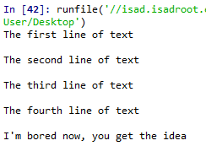

Reading in a file and printing to screen example
Using what you have now learned about for loops, it is possible to open a file for reading and then print each line in the file to the screen using a for loop.
Use a for loop and the variable name that you assigned the open file to in order to print each of the lines in your file to the screen.
In:
Out:

Slide 53
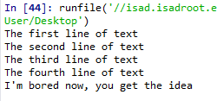


The read() function
However, you don’t need to use any loops to access file contents. Python has three in-built file reading commands:
1. <file>.read() = Returns the entire contents of the file as a single string:
2. <file>.readline() = Returns one line at a time:
3. <file>.readlines() = Returns a list of lines:

Slide 54


The write() function
Likewise, there are two similar in-built functions for getting Python to write to a file:
1. <file>.write() = Writes a specified sequence of characters to a file:
2. <file>.writelines() = Writes a list of strings to a file:
Important: Using the write() or writelines() function will overwrite anything contained within a file, if a file of the same name already exists in the working directory.

Slide 55
Practice – writing to a file in Python
Part 1:
Open the file you created in the last practice and ready it for being written to.
Write a string to that file. Note: this will overwrite the old contents.
Remember to close the file once you are done.
Part 2:
Create a list of strings.
Use the open() function to create a new .txt file and write your list of strings to this file.
Remember to close the file once you are done.

Slide 56
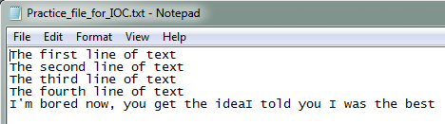

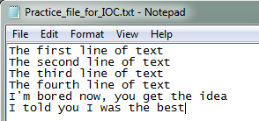
The append() function
If you do not want to overwrite a file’s contents, you can use the append() function.
To append to an existing file, simply put ‘a’ instead of ‘r’ or ‘w’ in the open() when opening a file.

Slide 57
Practice – appending to a file in Python
Open the text file you created in part two of the writing to a file practice, and ready it for appending.
Define a string object.
Appending this new string object to the file.
Remember to close the file once you are done.

Slide 58

A word on import
To use a package in your code, you must first make it accessible.
This is one of the features of Python that make it so popular.
In:
There are pre-built Python packages for pretty much everything.
In:

Slide 59
Real time Applications

Slide 60
Plotting in Python
Before creating an plots, it is worth spending sometime familiarising ourselves with the matplotlib module. It will save a lot of time later on.

Slide 61

Some history….
Matplotlib was originally developed by a neurobiologist in order to emulate aspects of the MATLAB software.
The pythonic concept of importing is not utilised by MATLAB, and this is why something called Pylab exists.
Pylab is a module within the Matplotlib library that was built to mimic the MATLAB style. It only exists in order to bring aspects of NumPy and Matplotlib into the namespace, thus making for an easier transition for ex-MATLAB users, because they only had to do one import in order to access the necessary functions:
However, using the above command is now considered bad practice, and Matplotlib actually advises against using it due to the way in which it creates many opportunities for conflicted name bugs.

Slide 62

Getting started
Without Pylab, we can normally get away with just one canonical import; the top line from the example below.
We are also going to import NumPy, which we are going to use to generate random data for our examples.

Slide 63
Different graph types
A simple line graph can be plotted with plot().
A histogram can be created with hist().
A bar chart can be created with bar().
A pie chart can be created with pie().
A scatter plot can be created with scatter().
The table() function adds a text table to an axes.
Plus many more….

Slide 64

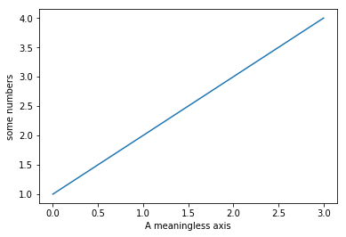
Our first plot
You may be wondering why the x-axis ranges from 0-3 and the y-axis from 1-4.
If you provide a single list or array to the plot() command, Matplotlib assumes it is a sequence of y values, and automatically generates the x values for you.
Since python ranges start with 0, the default x vector has the same length as y but starts with 0.
Hence the x data are [0,1,2,3].

Slide 65
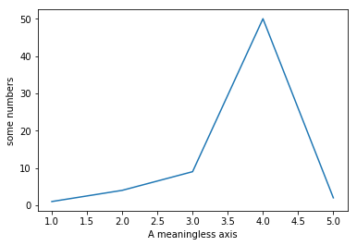

The plot() function
The plot() argument is quite versatile, and will take any arbitrary collection of numbers. For example, if we add an extra entry to the x axis, and replace the last entry in the Y axis and add another entry:

Slide 66
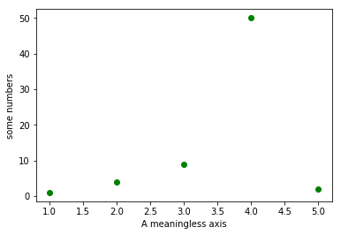
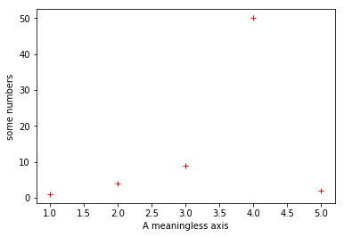
The plot() function
The plot() function has an optional third argument that specifies the appearance of the data points.
The default is b-, which is the blue solid line seen in the last two examples. The full list of styles can be found in the documentation for the plot() on the Matplotlib page

Slide 67


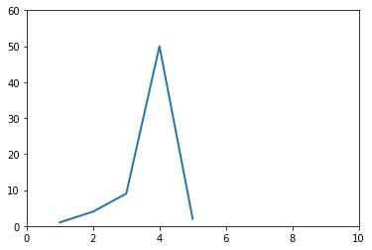
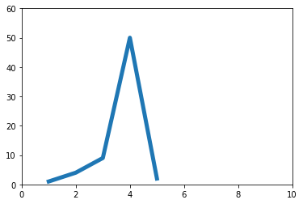
The plot() function
You can quite easily alter the properties of the line with the plot() function.

Slide 68
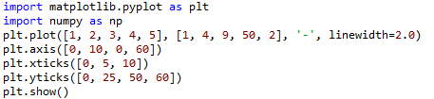
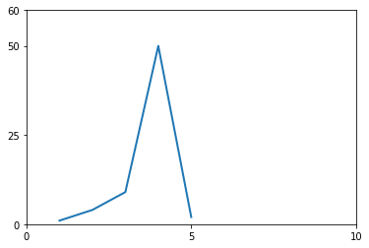
Altering tick labels
The plt.xticks() and plt.yticks() allows you to manually alter the ticks on the x-axis and y-axis respectively.
Note that the tick values have to be contained within a list object.

Slide 69
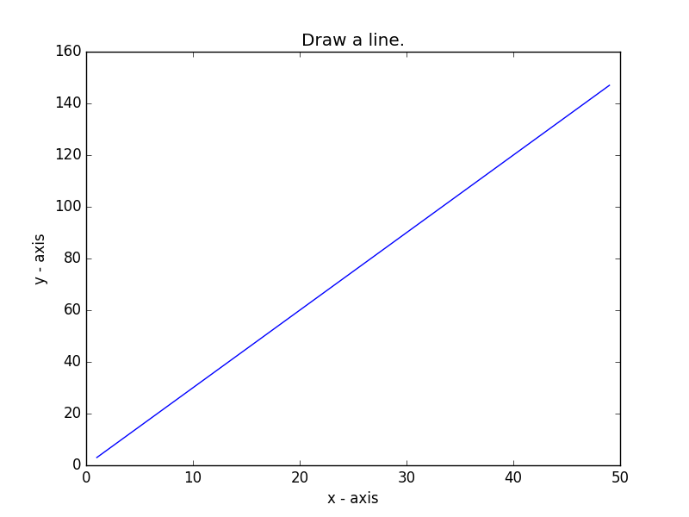
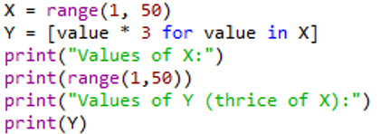

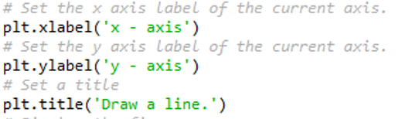

Practice - Basic line graph
Let’s write a Python program to draw a line graph with suitable labels for the x-axis and y-axis. Include a title.

Slide 70
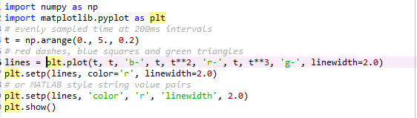
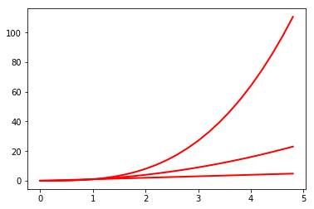
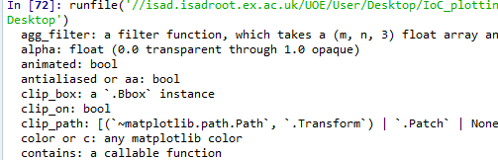
The setp() function
The setp() allows you to set multiple properties for a list of lines, if you want all the lines to be matching.
You can use the setp() function along with either the line or lines function in order to get a list of settable line properties.

Slide 71
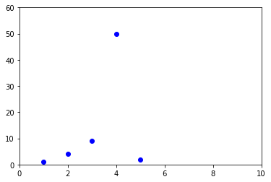

The axis() function
The axis() function allows us to specify the range of the axis.
It requires a list that contains the following:
[The min x-axis value, the max x-axis value, the min y-axis, the max y-axis value]

Slide 72
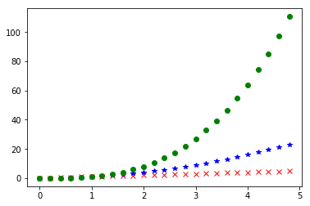
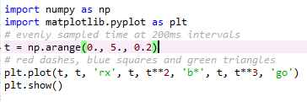
Matplotlib and NumPy arrays
Normally when working with numerical data, you’ll be using NumPy arrays.
This is still straight forward to do in Matplotlib; in fact all sequences are converted into NumPy arrays internally anyway.

Slide 73
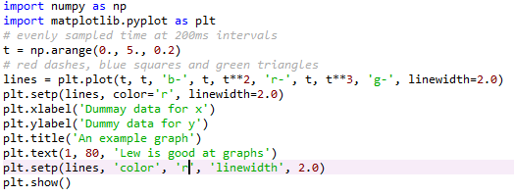
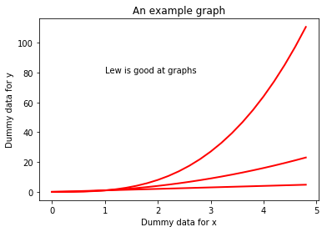
Working with text
There are a number of different ways in which to add text to your graph:
- title() = Adds a title to your graph, takes a string as an argument
- xlabel() = Add a title to the x-axis, also takes a string as an argument
- ylabel() = Same as xlabel()
- text() = Can be used to add text to an arbitrary location on your graph. Requires the following arguments: text(x-axis location, y-axis location, the string of text to be added)
Matplotlib uses TeX equation expressions. So, as an example, if you wanted to put in one of the text blocks, you would write plt.title(r'$\sigma_i=15$').

Slide 74
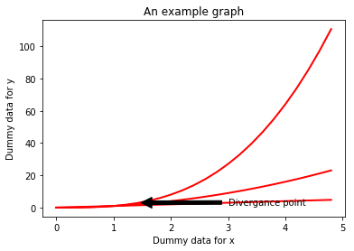
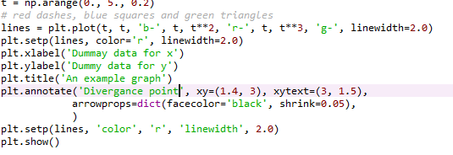
Annotating data points
The annotate() function allows you to easily annotate data points or specific area on a graph.

Slide 75
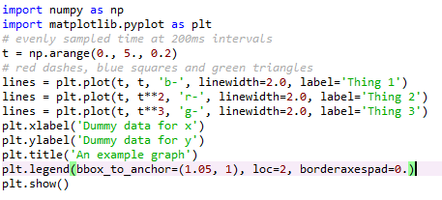
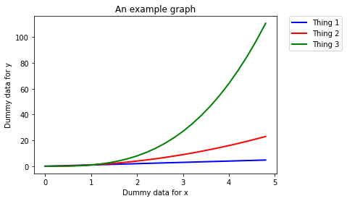
Legends
The location of a legend is specified by the loc command. There are a number of in-built locations that can be altered by replacing the number. The Matplotlib website has a list of all locations in the documentation page for location().
You can then use the bbox_to_anchor() function to manually place the legend, or when used with loc, to make slight alterations to the placement.

Slide 76
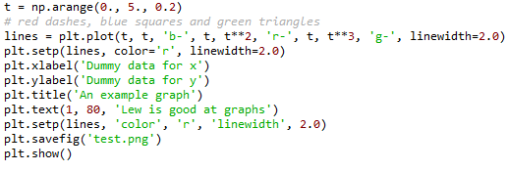
Saving a figure as a file
The plt.savefig() allows you to save your plot as a file.
It takes a string as an argument, which will be the name of the file. You must remember to state which file type you want the figure saved as; i.e. png or jpeg.
Make sure you put the plt.savefig() before the plt.show() function. Otherwise, the file will be a blank file.

Slide 77

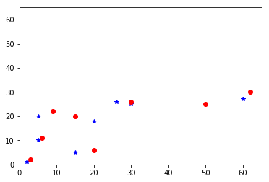
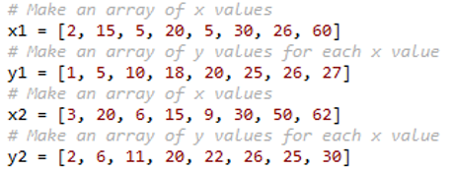


Scatter plot exercise
Let’s write a Python program to plot quantities which have an x and y position; a scatter graph.

Slide 78
Debugging
Debugging is in fundamental aspect of coding, and you will probably spend more time debugging than actually writing code.
EVERYONE has to debug, it is nothing to be ashamed of.
In fact, you should be particularly concerned if you do write a programme that does not display any obvious errors, as it likely means that you are just unaware of them.
There are a number of debugging programmes available to coders. However, debugging the most common issues that you’ll encounter when developing programmes can be done by following a few key principles.
However, always remember that sometimes fixing a bug can create new bugs.

Slide 79
Print everything
When debugging, the most important function at your disposal is the print command. Every coder uses this as a debugging tool, regardless of their amount of experience.
You should have some sense as to what every line of code you have written does. If not, print those lines out. You will then be able to see how the values of variables are changing as the programme runs through.
Even if you think you know what each line does, it is still recommended that you print out certain lines as often this can aid you in realising errors that you may have overlooked.

Slide 80
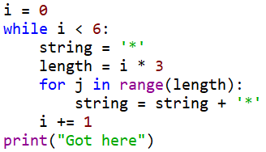



Print examples
Did this chunk of code run?
I want the value of variable to be 10 upon completion of the for loop. Did the for loop work correctly?
No.
Yes, it did.

Slide 81
Run your code when you make changes
Do not sit down and code for a hour or so without running the code you are writing. Chances are, you will never get to the bottom of all of the errors that your programme reports when it runs.
Instead, you should run your script every few minutes. It is not possible to run your code too many times.
Remember, the more code you write or edit between test runs, the more places you are going to have to go back an investigate when your code hits an error.

Slide 82
Read your error messages
Do not be disheartened when you get an error message. More often than not, you’ll realise what the error is as soon as you read the message; i.e. the for loop doesn’t work on a list because the list is empty.
This is particularly the case with Python, which provides you with error messages in ‘clear English’ compared to the cryptic messages given by offered by other languages.
At the very least, the error message will let you know which lines is experiencing the error. However, this may not be the line causing the error. Still, this offers a good starting point for your bug search.

Slide 83
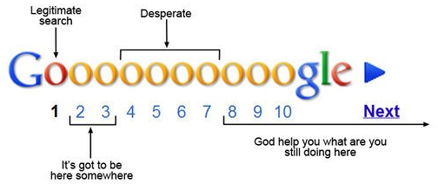
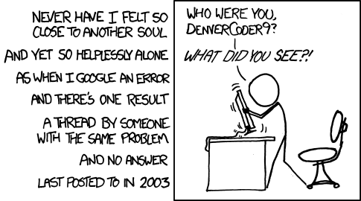
Google the error message
If you cannot work out the cause of an error message, google the error code and description.
This can sometimes be a bit of a hit-or-miss, depending on the nature of the error.
If your error is fairly specific, then there will nearly always be a webpage where someone has already asked for help with an error that is either identical or very similar to the one you are experiencing; stackoverflow.com is the most common page you’ll come across in this scenario.
Do make sure that you read the description of the problem carefully to ensure that the problem is the same as the one you are dealing with. Then read the first two or three replies to see if page contains a workable solution.

Slide 84
Comment out code
You can often comment out bits of code that are not related to the chunk of code that contains the error.
This will obviously make the code run faster and might make it easier to isolate the error.

Slide 85
Binary searches
This method draws upon a lot of the methods we have already covered.
Here, you want to break the code into chunks; normally two chunks, hence this method’s name.
You then isolate which chunk of code the error is in.
After which, you take the chunk of code in question, and divide that up, and work out which of these new chunks contains the error.
So on until you’ve isolate the cause of the error.

Slide 86
Git Links
https://github.com/pcakhilnadh/Introduction-To-Python-Programming/tree/master/Exercise

