Slide 1
Project
Music Recommendation Engine
Team members
S. No | Name | Roll Number
1 | ABHISHIKTH VENKAT SAGAR | 2311CS020319
2 | KAVALA RAJEEV | 2311CS020320
3 | KELLA SAI KUMAR | 2311CS020321
4 | KETHAMREDDY NIHAS REDDY | 2311CS020322
5 | KETHINENI KOUSHITHA | 2311CS020323

Slide 2

Contents
Introduction
Dataset Overview
Attributes of each variable
Data Preprocessing
Data Analysis Steps

Slide 3
Introduction
Overview: A Python-based system leveraging Spotify dataset to recommend songs with similar audio features using machine learning.
Importance: Music recommendation enhances user experience on platforms like Spotify by suggesting songs matching taste.
Purpose: Helps users discover songs akin to their favorites (e.g., "Train of Love") by analyzing features like danceability and valence.

Slide 4
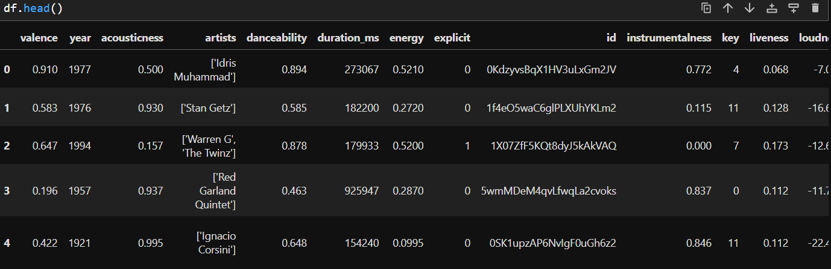
Dataset Overview
Source: Spotify dataset (data.csv) loaded via pd.read_csv().
Size: 170,653 songs, 19 features (Cell 4: df.shape).
Key Features:
Danceability, Valence, Energy, Tempo, Loudness

Slide 5
Attributes of each variable
name – Name of the song
artists – Name of the artist(s)
album_name – Name of the album
popularity – Popularity score of the song
duration_ms – Duration of the song (in milliseconds)
explicit – Whether the song has explicit content (True/False)
danceability – Measure of how danceable the song is (0-1)
energy – Measure of intensity and activity of a song (0-1)
speechiness – Presence of spoken words in the track (0-1)
acousticness – Probability of the song being acoustic (0-1)
instrumentalness – Whether the song is mostly instrumental (0-1)
valence – Positivity of the song’s musical mood (0-1)
tempo – Tempo of the song in BPM
track_genre – Genre of the song

Slide 6
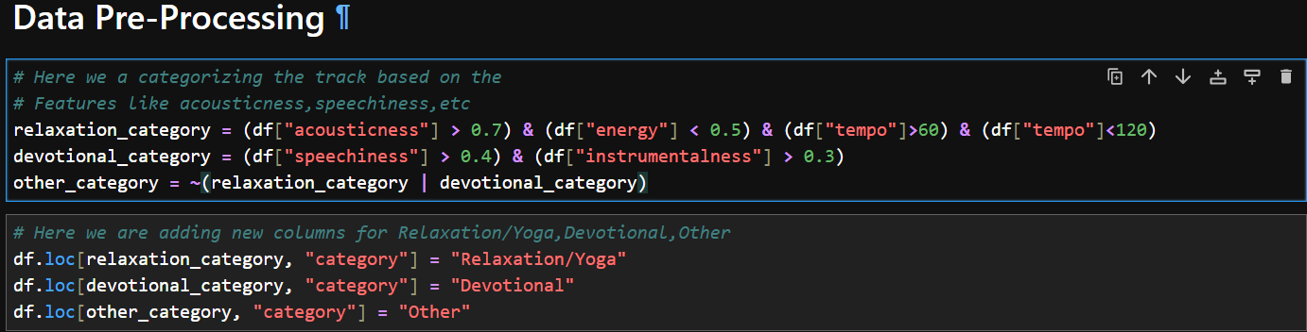
Data Preprocessing
Handling Missing Values: No null values (Cell 5: df.info() shows 170,653 non-null entries).
Standardization: StandardScaler applied to numerical features (Cell 8: scaler.fit_transform()), ensuring consistent scaling for NearestNeighbors.
Feature Selection: 9 key features (valence, danceability, etc.) chosen for similarity (Cell 8);
filtered subset df_filtered (1,199 rows) for Relaxation/Yoga (Cell 12).

Slide 7
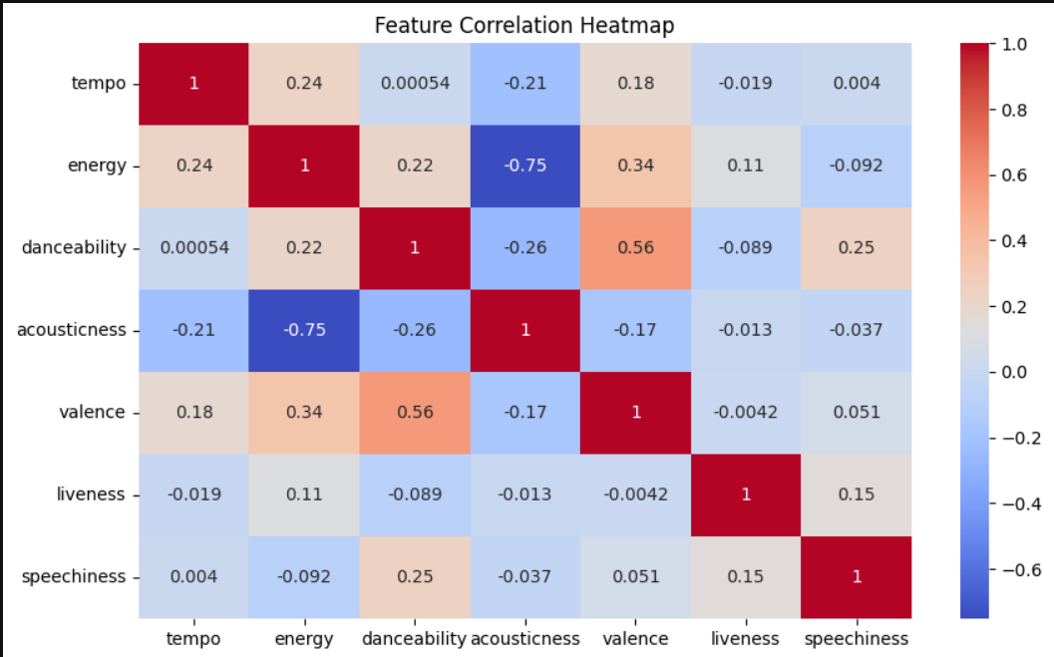
Data Analysis Steps
✔ Imported Libraries – Used Pandas, NumPy for data processing and Seaborn, Matplotlib for visualization. Scikit-learn used for building the recommendation model.
✔ Descriptive Statistics – Analysed attributes like tempo, loudness, energy, valence to understand their influence on recommendations.
✔ Missing Value Imputation – Checked for missing values and handled them through imputation and normalization.
✔ Graphical Representation – Conducted Exploratory Data Analysis (EDA) to examine trends in popularity, mood-based segmentation, and track attributes.
✔ Modeling – Implemented Content-Based Filtering, KNN, and Hybrid Models to enhance recommendation accuracy.

Slide 8
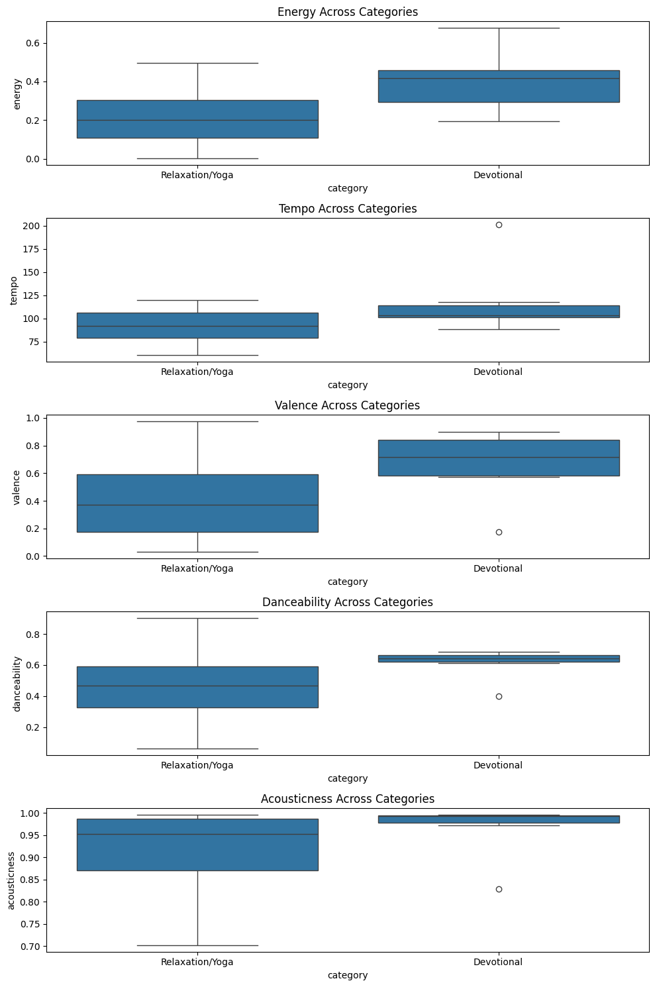
Boxplot: For Detecting outliers.

Slide 9
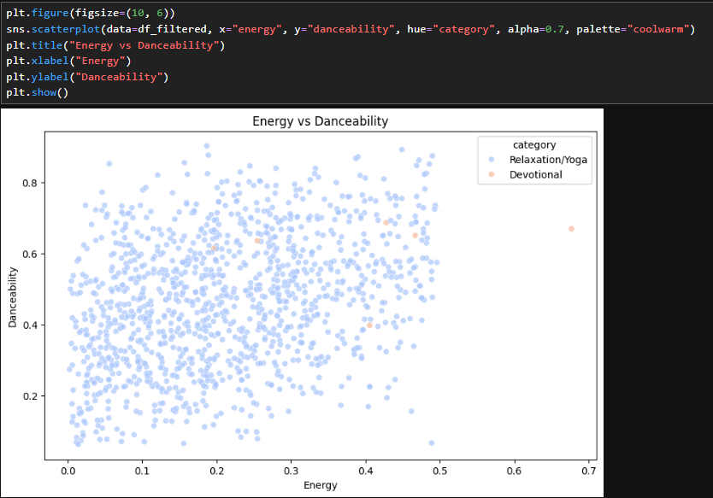
Scatter Plot for Relationship between Energy and Danceability

Slide 10
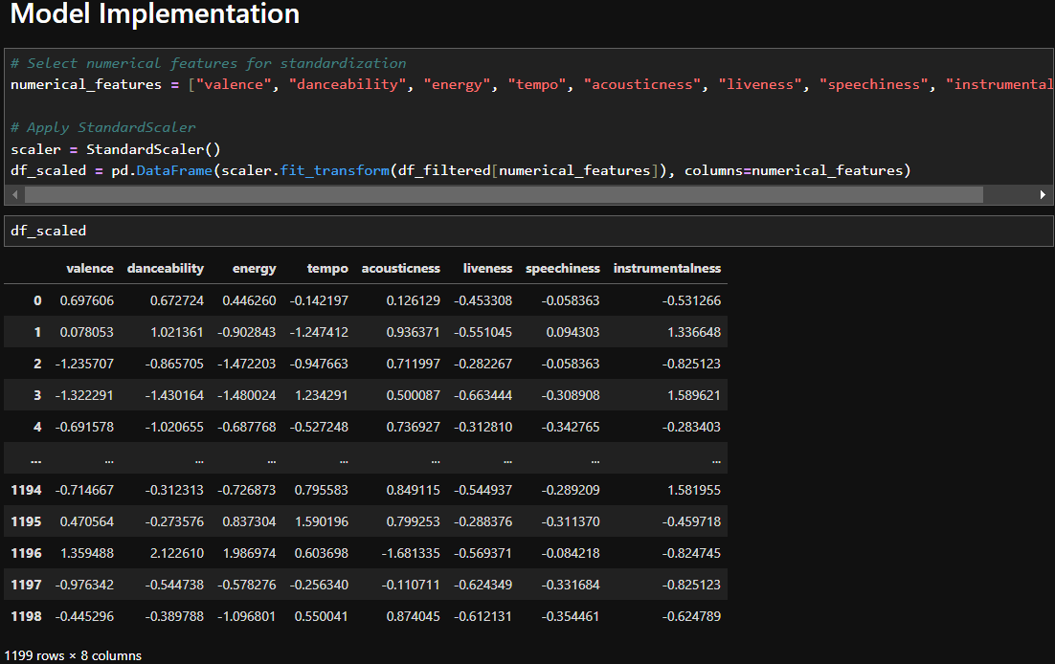

Slide 11
Thank You

