Slide 1
Project
Music Recommendation Engine
Team members
S. No | Name | Roll Number
1 | ABHISHIKTH VENKAT SAGAR | 2311CS020319
2 | KAVALA RAJEEV | 2311CS020320
3 | KELLA SAI KUMAR | 2311CS020321
4 | KETHAMREDDY NIHAS REDDY | 2311CS020322
5 | KETHINENI KOUSHITHA | 2311CS020323

Slide 2

Contents
Introduction
Dataset Overview
Attributes of each variable
Data Preprocessing
Data Analysis Steps

Slide 3
Introduction
Overview: A Python-based system leveraging Spotify dataset to recommend songs with similar audio features using machine learning.
Importance: Music recommendation enhances user experience on platforms like Spotify by suggesting songs matching taste.
Purpose: Helps users discover songs akin to their favorites (e.g., "Train of Love") by analyzing features like danceability and valence.

Slide 4
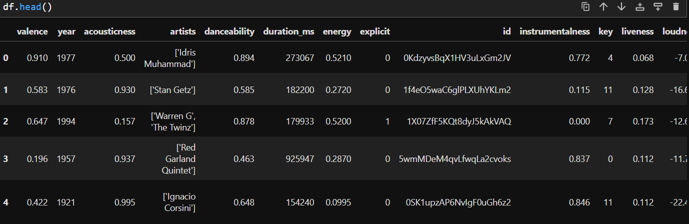
Dataset Overview
Source: Spotify dataset (data.csv) loaded via pd.read_csv().
Size: 170,653 songs, 19 features (Cell 4: df.shape).
Key Features:
Danceability, Valence, Energy, Tempo, Loudness

Slide 5
Attributes of each variable
name – Name of the song
artists – Name of the artist(s)
album_name – Name of the album
popularity – Popularity score of the song
duration_ms – Duration of the song (in milliseconds)
explicit – Whether the song has explicit content (True/False)
danceability – Measure of how danceable the song is (0-1)
energy – Measure of intensity and activity of a song (0-1)
speechiness – Presence of spoken words in the track (0-1)
acousticness – Probability of the song being acoustic (0-1)
instrumentalness – Whether the song is mostly instrumental (0-1)
valence – Positivity of the song’s musical mood (0-1)
tempo – Tempo of the song in BPM
track_genre – Genre of the song

Slide 6
Data Preprocessing
Handling Missing Values: No null values (Cell 5: df.info() shows 170,653 non-null entries).
Standardization: StandardScaler applied to numerical features (Cell 8: scaler.fit_transform()), ensuring consistent scaling for NearestNeighbors.
Feature Selection: 9 key features (valence, danceability, etc.) chosen for similarity (Cell 8);
filtered subset df_filtered (1,199 rows) for Relaxation/Yoga (Cell 12).
Categorizing music tracks into Relaxation/Yoga, Devotional, or Other based on their acoustic, speech, energy, instrumental, and tempo features. It assigns:
Relaxation/Yoga if the track is highly acoustic, low-energy, and has a moderate tempo.
Devotional if the track has a high speech component and is largely instrumental.
Other if it doesn’t fit the above categories.

Slide 7
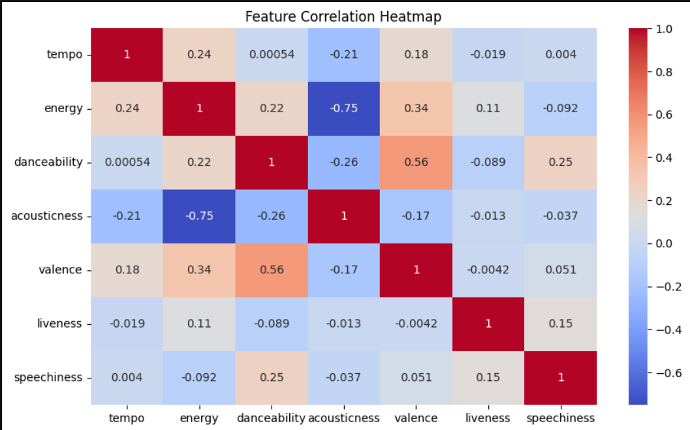
Data Analysis Steps
✔ Imported Libraries – Used Pandas, NumPy for data processing and Seaborn, Matplotlib for visualization. Scikit-learn used for building the recommendation model.
✔ Descriptive Statistics – Analysed attributes like tempo, loudness, energy, valence to understand their influence on recommendations.
✔ Missing Value Imputation – Checked for missing values and handled them through imputation and normalization.
✔ Graphical Representation – Conducted Exploratory Data Analysis (EDA) to examine trends in popularity, mood-based segmentation, and track attributes.
✔ Modeling – Implemented Content-Based Filtering, KNN, and Hybrid Models to enhance recommendation accuracy.

Slide 8
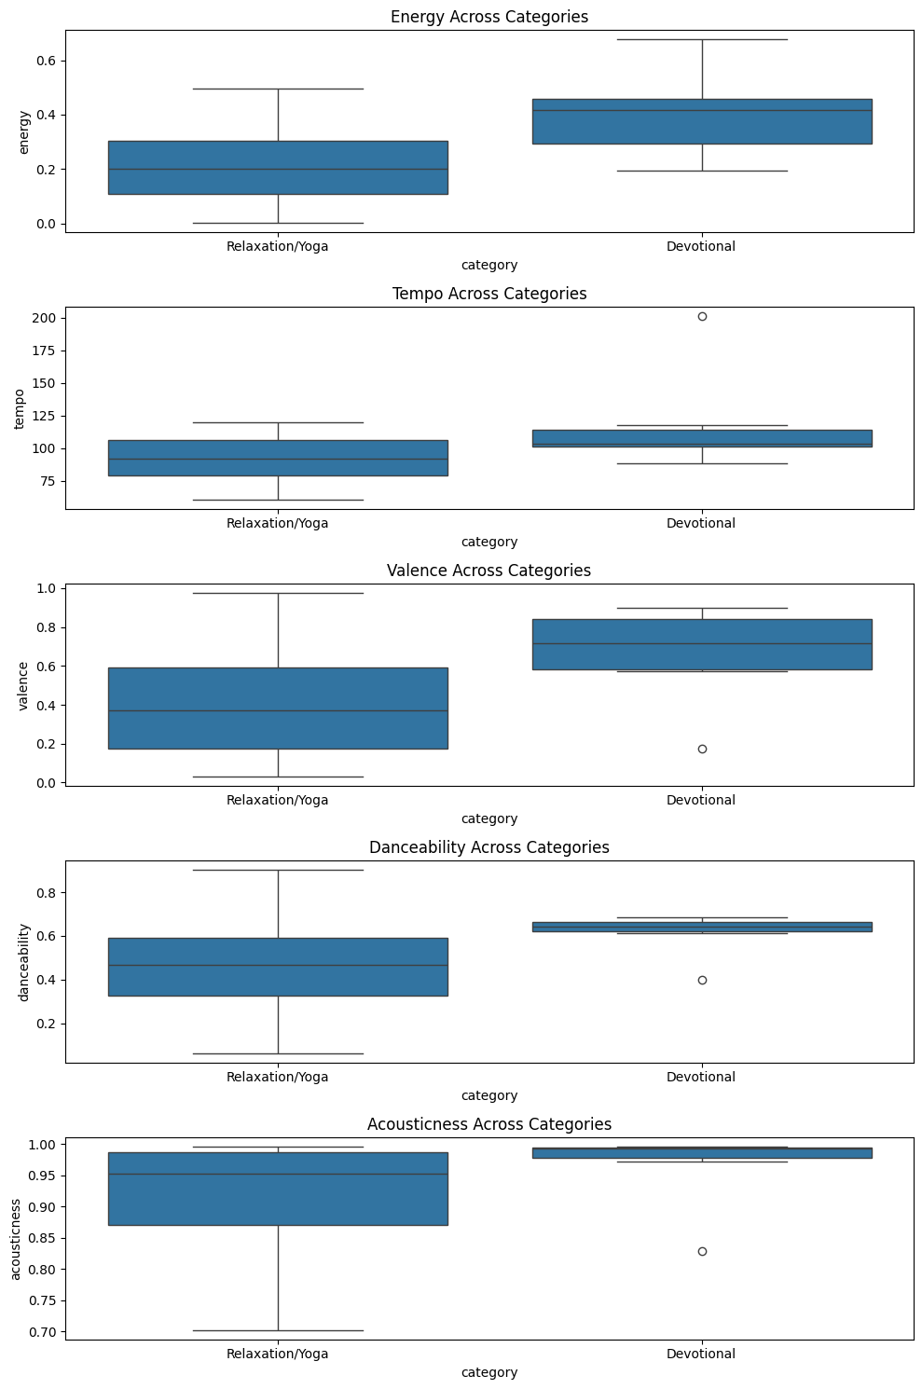
Boxplot: For Detecting outliers.

Slide 9
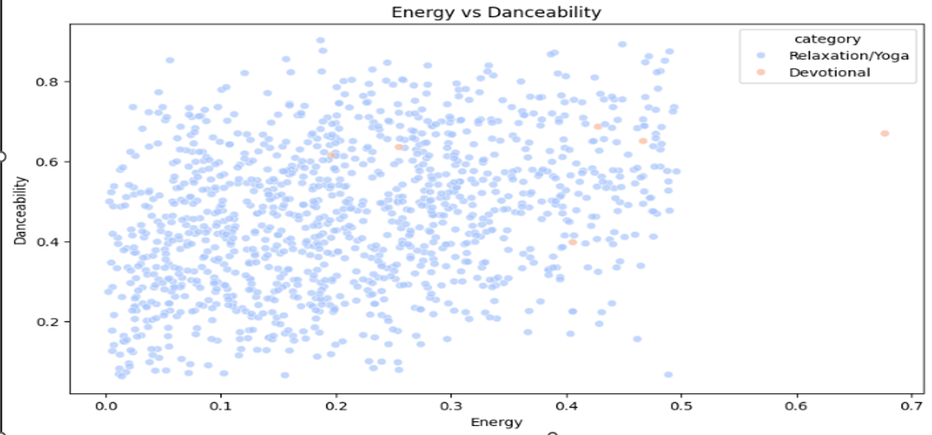
Scatter Plot for Relationship between Energy and Danceability

Slide 10
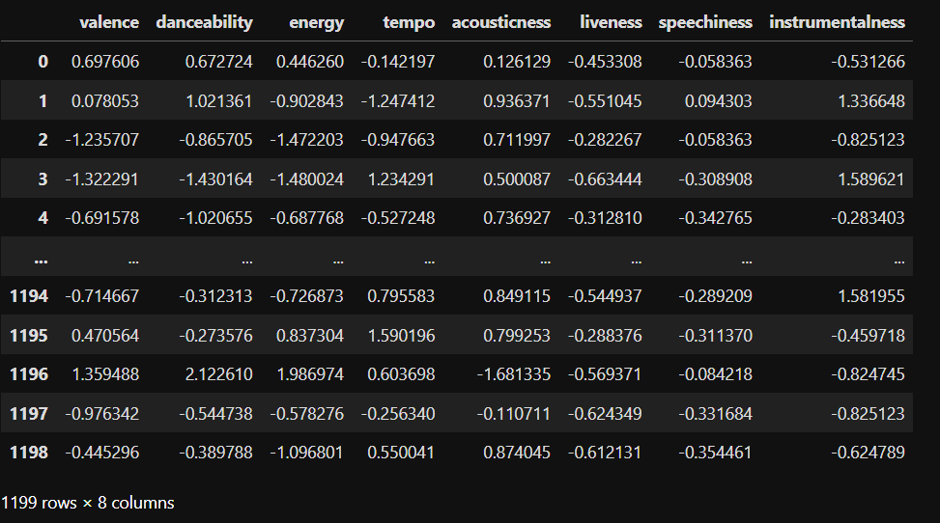
Numerical Features Scaling

Slide 11

Initializing Nearest Neighbours model
This NearestNeighbors model from sklearn.neighbors finds similar songs based on numerical features in df_scaled.
Uses cosine similarity to measure song similarity by comparing feature vector angles.
Searches for 6 nearest neighbors (1 input song + 5 most similar songs).
Works with scaled numerical features like acousticness, energy, tempo, speechiness, and instrumentalness for accurate recommendations.

Slide 12
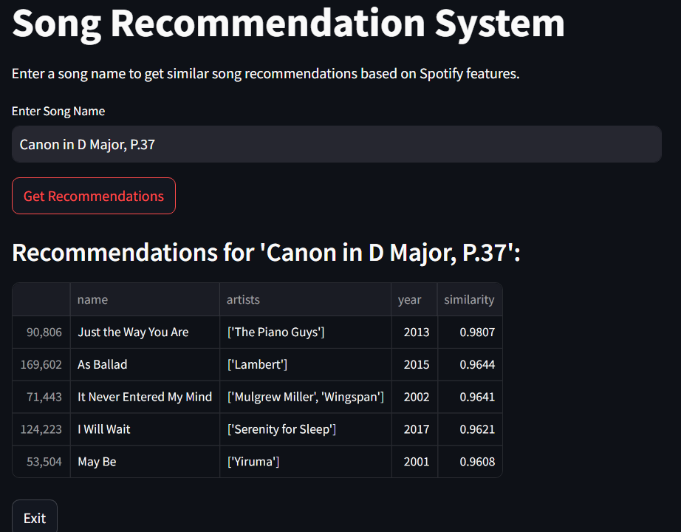
Output

Slide 13
Thank You

