Slide 1
Predictive Analysis of Cryptocurrency Market Trends and Prices
Project Advisor : Abdi Awl
Proposed by
Rajeev Koneru

Slide 2

Introduction

Slide 3
Problem Statement
The primary aim of this project is to apply data science techniques to analyze historical data and predict the future prices.

Slide 4
Objectives and Goals
Conduct Exploratory Data Analysis (EDA)
Provide Insights on Data Patterns
Implement Price Prediction Model
Evaluate Model Accuracy

Slide 5

Data
This Dataset contains 234 Crypto Coins/Altcoins with historical Open, High, Low, Close, and Volume (OHLCV) prices traded in the Binance Exchange and various timeframes.

Slide 6
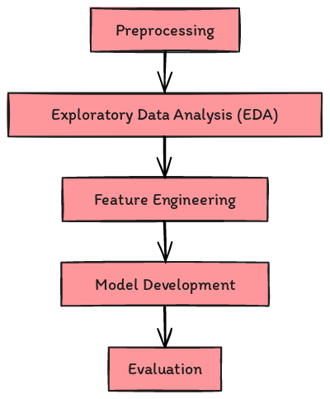
Methodology

Slide 7

Exploratory Data Analysis

Slide 8
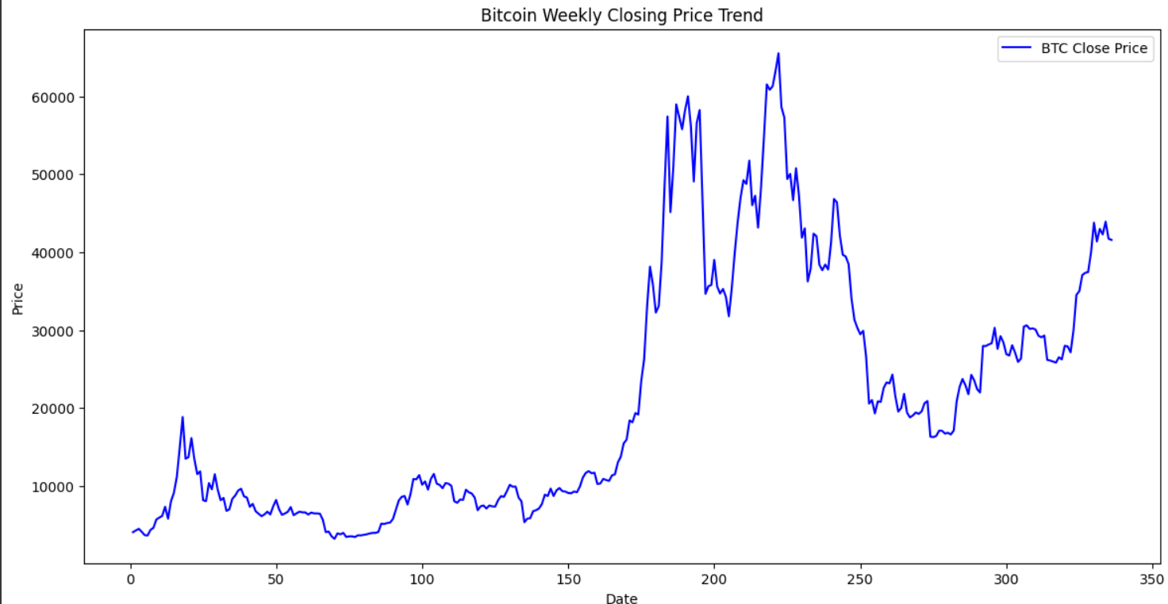
Price Trend Analysis

Slide 9
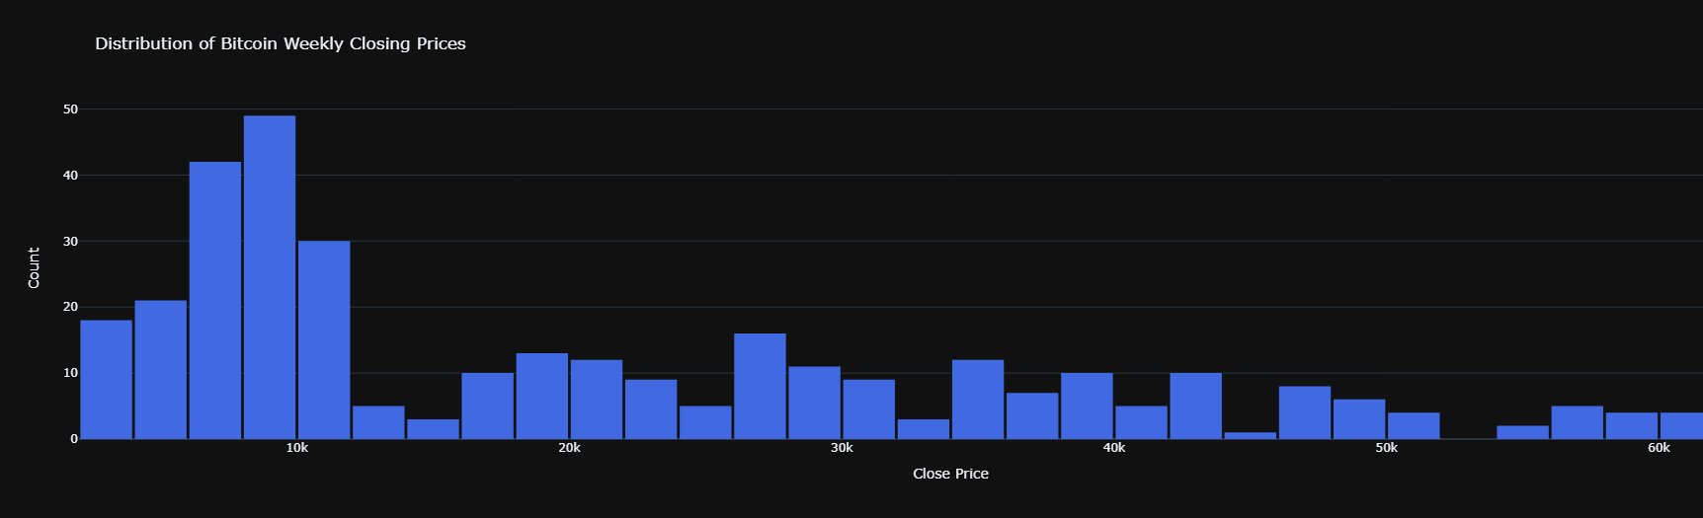
Distribution of BTC Weekly Closing Prices

Slide 10
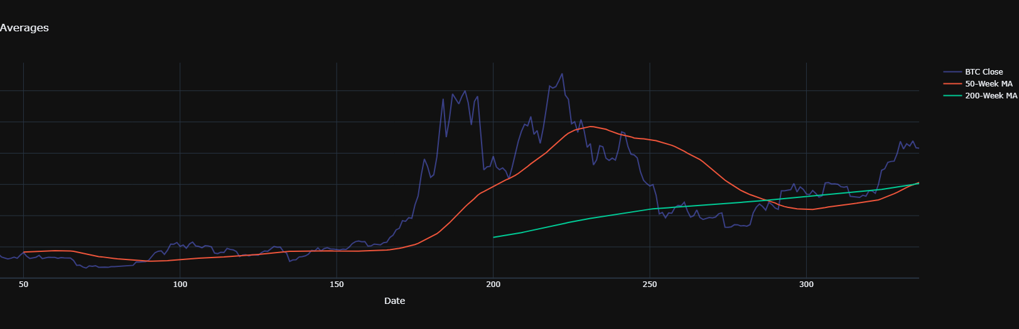
BTC Price and Moving Averages

Slide 11
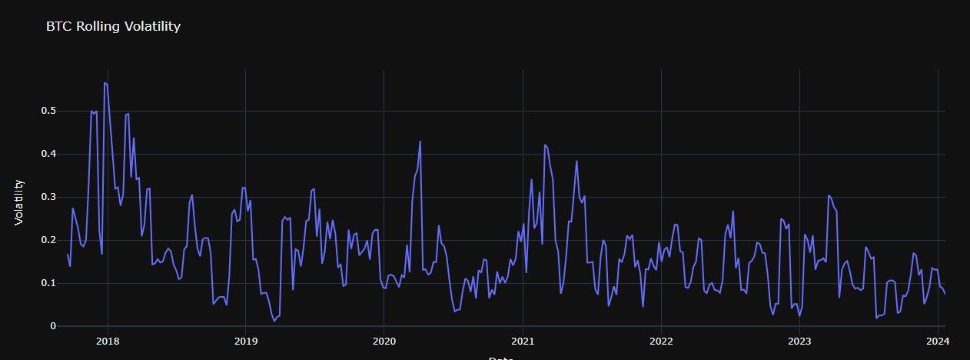
Rolling Volatility

Slide 12
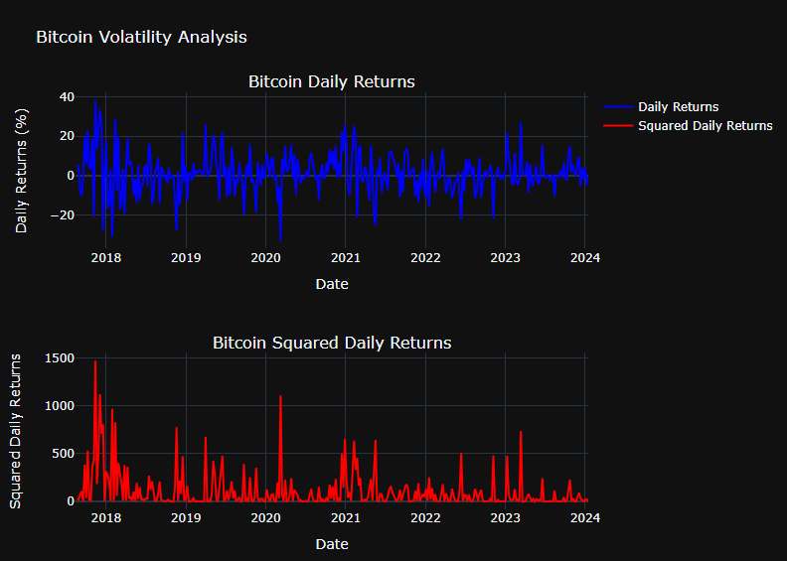
Volatility Clustering

Slide 13
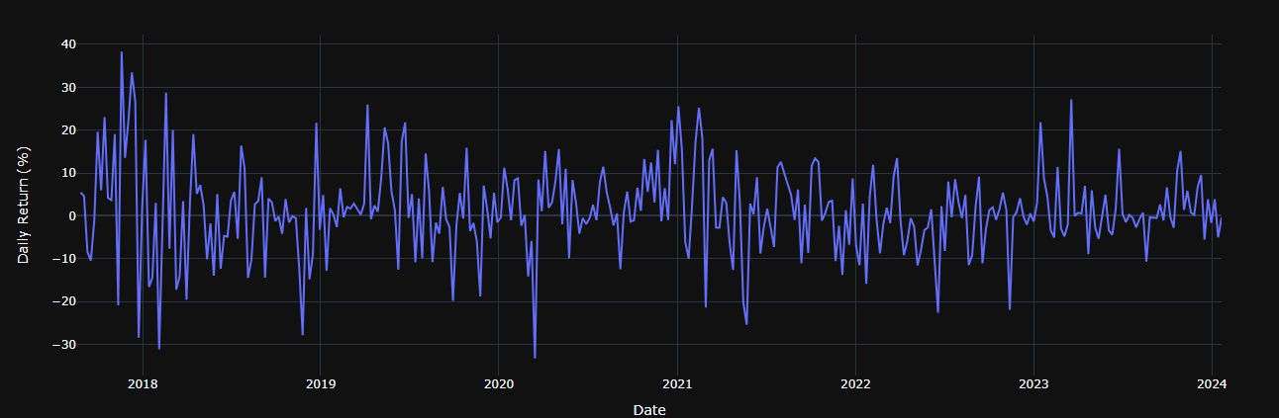
Price Change and Return Analysis

Slide 14
Feature Engineering
Log Transformation
Differencing
Rolling Window Statistics
Lag Features
Fourier Transforms
Holiday Indicators
Market Indicators

Slide 15
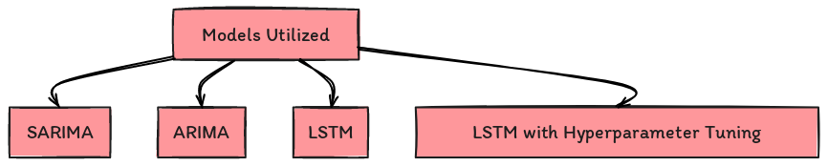
Modeling

Slide 16
Evaluation
1. Root Mean Square Error
2. mean absolute error
3. mean absolute percentage error

Slide 17
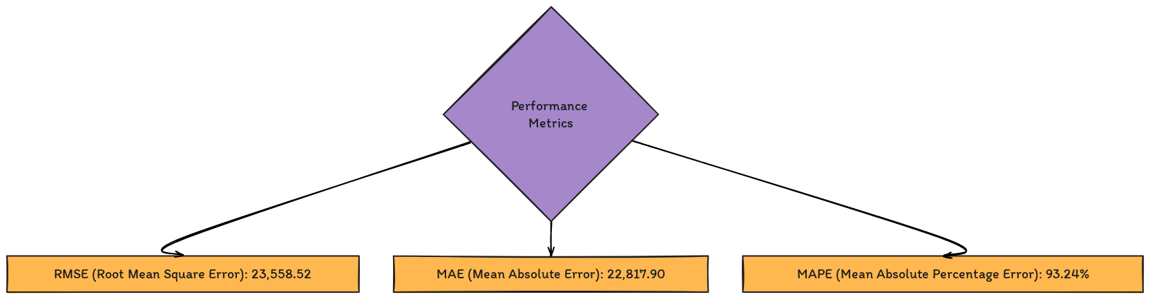
Seasonal Autoregressive Integrated Moving Average(SARIMA)

Slide 18
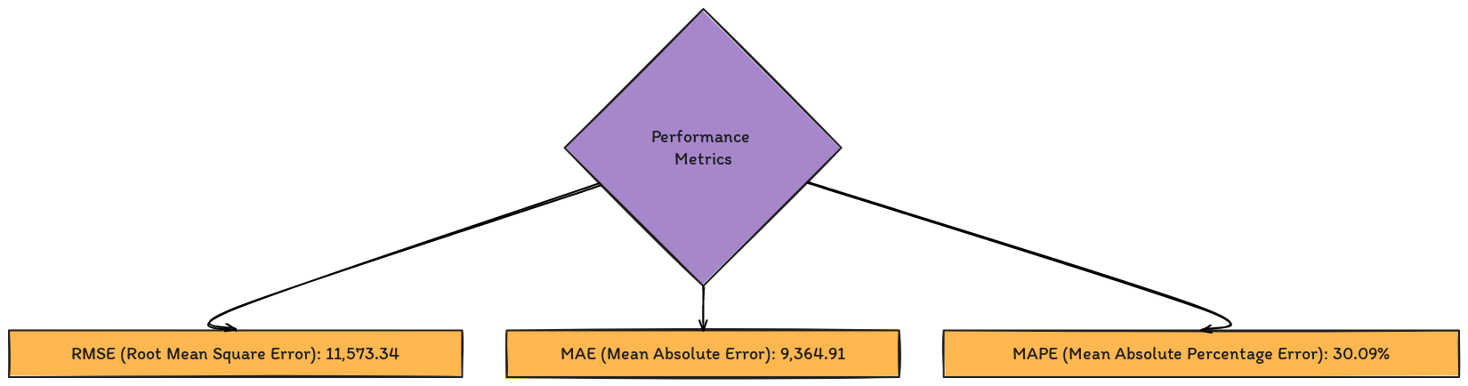
Autoregressive Integrated Moving Average(ARIMA)

Slide 19
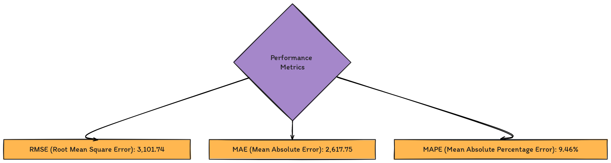
Long Short-Term Memory (LSTM)

Slide 20
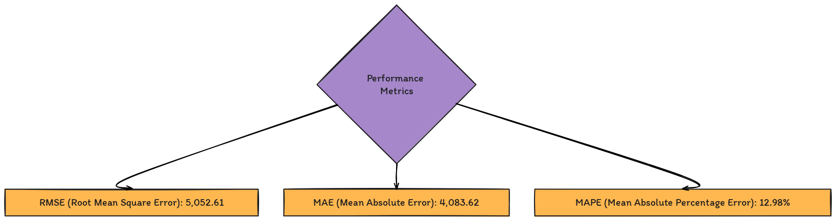
LSTM (After Hyperparameter Tuning)

Slide 21
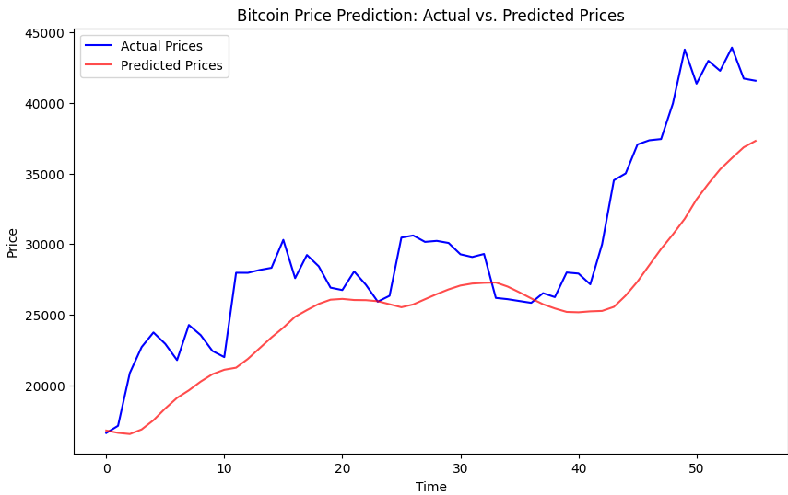
Prediction

Slide 22
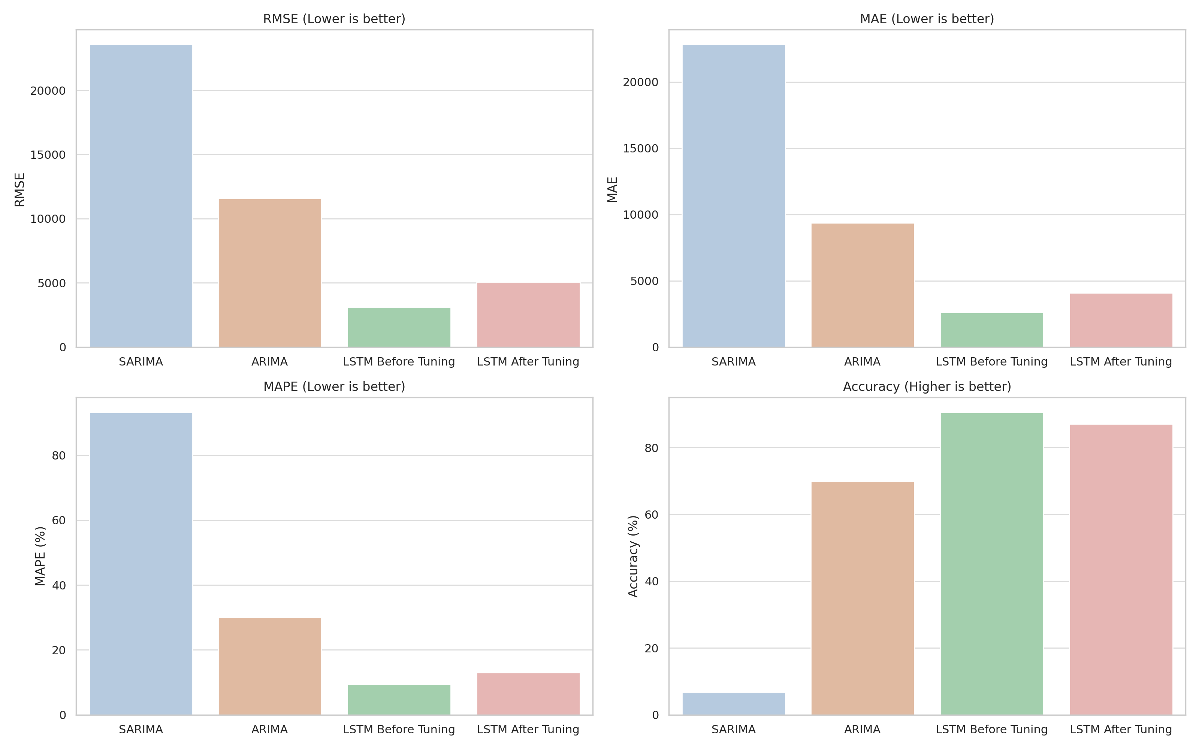
Conclusion

Slide 23
References
Rob J Hyndman and George Athanasopoulos - "Forecasting: Principles and Practice"
Robert H. Shumway and David S. Stoffer - "Time Series Analysis and Its Applications: With R Examples"
Andrew Ng - "Machine Learning Yearning"
Ian Goodfellow, Yoshua Bengio, and Aaron Courville - "Deep Learning"
Christopher M. Bishop - "Pattern Recognition and Machine Learning"
Trevor Hastie, Robert Tibshirani, and Martin Wainwright - "Statistical Learning with Sparsity: The Lasso and Generalizations"
Francois Chollet - "Deep Learning with Python"
Sepp Hochreiter and Jürgen Schmidhuber - "Long Short-Term Memory" (Foundational paper on LSTM networks)
Zachary C. Lipton, John Berkowitz - "A Critical Review of Recurrent Neural Networks for Sequence Learning"
Bradley Efron, Trevor Hastie - "Computer Age Statistical Inference: Algorithms, Evidence, and Data Science"

Slide 24


