Slide 1
MAZE SOLVER

Slide 2
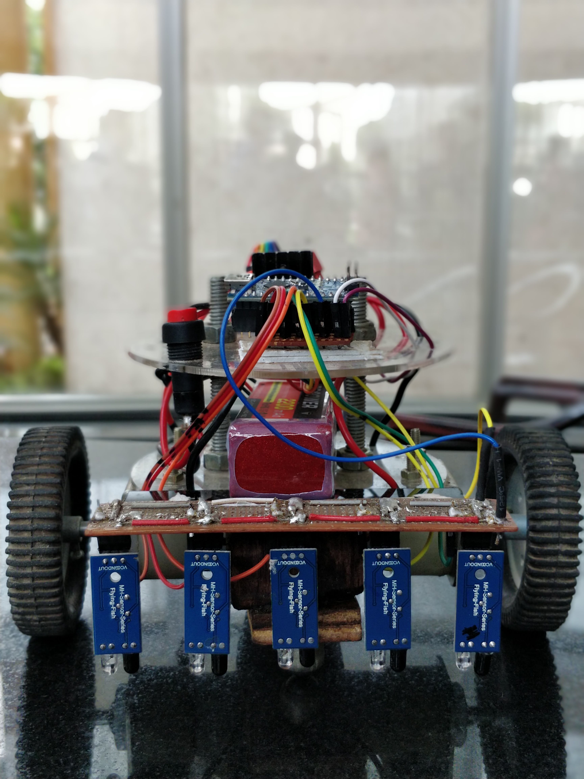
The Model

Slide 3
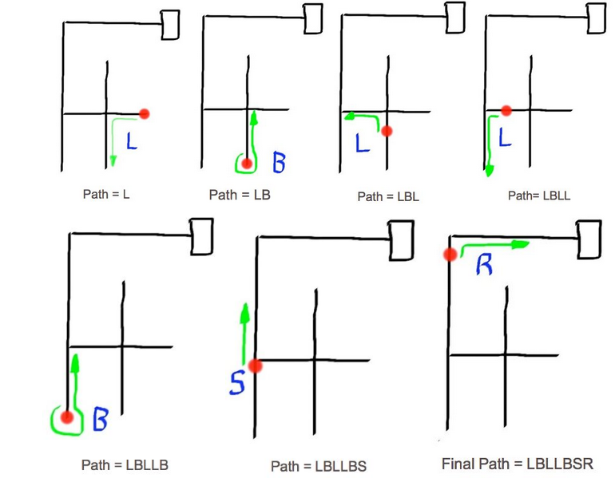
The Algorithm – Left Hand Wall

Slide 4
The Logic
A maze solver based on a line follower solves mazes using an algorithm called the left/right hand rule
It is like entering a maze, keeping your left hand on the wall till you reach the end
The bot memorises the path and uses a path shortening algorithm to calculate the shortest path
PID control system helps it to stay on the line an run as smoothly as possible

Slide 5
Materials used
Acrylic sheets for the chassis
L298N motor driver
Arduino nano microcontroller
IR modules
Li-Po battery
DC motors and castor wheels
Miscellaneous materials for the chassis and electronics

