Slide 1
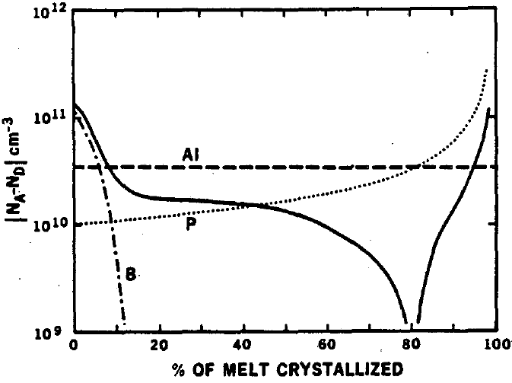
p-type
region
n-type
region

Slide 2

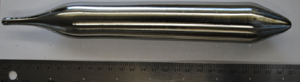
0%
Seed end
(or head)
Small samples to be cut from a HPGe wafer for radial impurity distribution measurements
Shoulder
% of melt crystalized
HPGe Boule
Typical sampling point where a wafer is cut from the boule for vertical impurity distribution measurements
100%
Tail

