Slide 1
LangChain
Raj

Slide 2
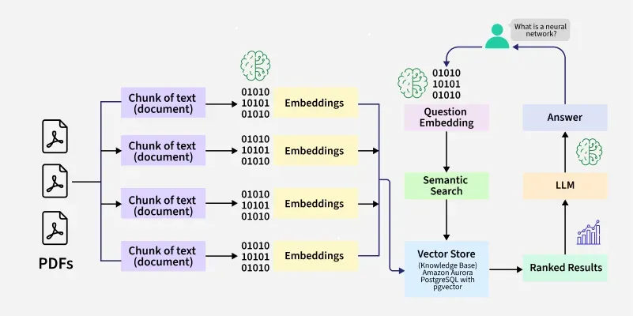
What is LangChain?
LangChain is an open-source framework for building applications using Large Language Models (LLMs).

Slide 3
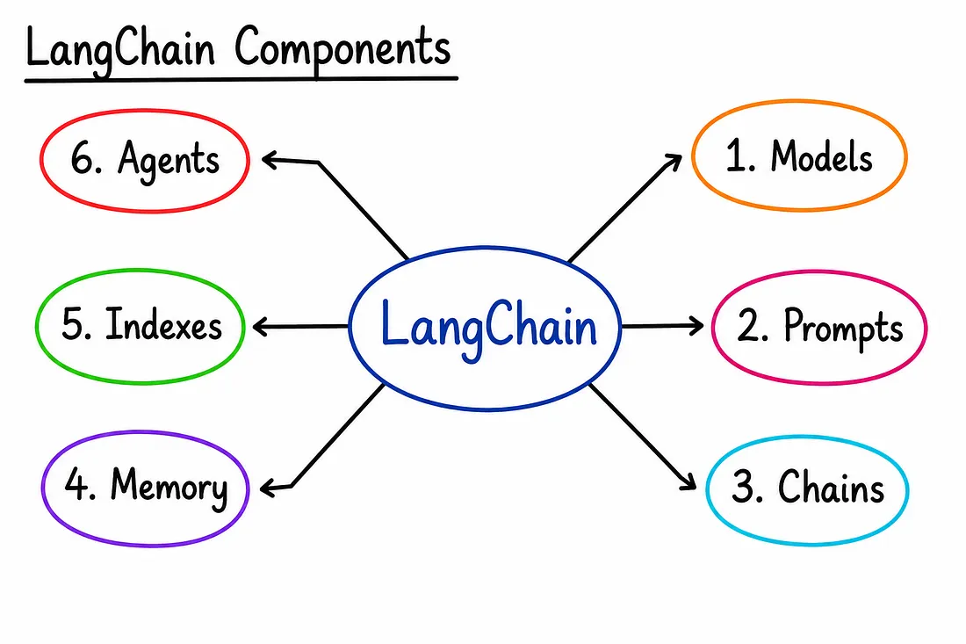

Slide 4
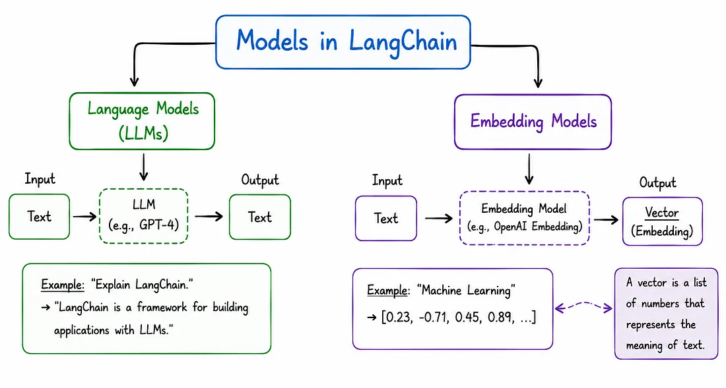
Models
In LangChain, “Models” are the core interfaces through which we interact with AI models.

Slide 5
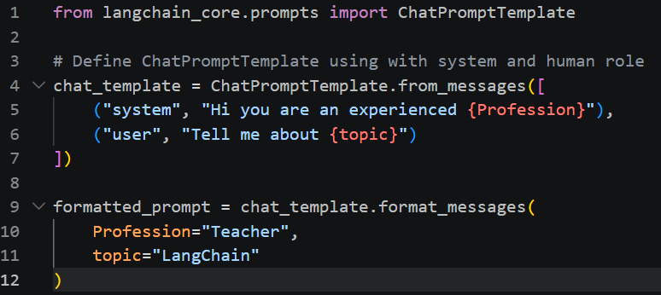
Prompts
In LangChain, prompts are structured templates used to generate dynamic and reusable inputs for large language models (LLMs).

Slide 6
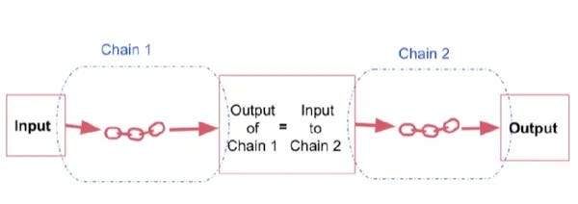
Chains
In LangChain, Define a sequence of steps where each step can use an LLM, process data or call tools.

Slide 7
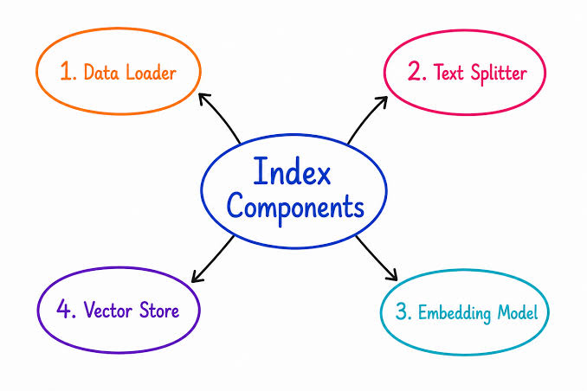
Indexes
In LangChain, Indexes connect your application to external knowledge – such as PDFs, website or databases

Slide 8
Memory
In LangChain, maintains context from past interactions, enabling better responses in conversations and multi step tasks.
LLM API calls are stateless

Slide 9
Setup
Create a new folder
Open it in VS Code
Create a new Venv
python –m venv venv
4. Activate venv
venv/scripts/activate
5. Create requirements.txt
6. Install packages from requirements.txt
pip install –r requirements.txt

