Slide 1
TalentLens AI
AI Resume Screening System — College Capstone Project
Author: Rajendra Prasad Pedamallu
COLLEGE_NAME: Bennett University
Re/pository: https://github.com/Rajendra13188/TalentLens-AI

Slide 2
TALENTLENS AI — AI RESUME SCREENING SYSTEM
Problem Statement & Industry Motivation
The Modern Hiring Dilemma
• Mass Application Overload: Recruiters receive hundreds of resumes per technical job opening.
• ATS 'Black-Box' Syndrome: Legacy tools output opaque percentages without explainable justifications.
• Privacy & Compliance Risks: Cloud screening APIs expose confidential applicant PII to external vendors.
• Brittle Document Parsers: Systems crash on corrupted, blank, or scanned PDFs.
The TalentLens AI Approach
✔ 100% Free & Local Execution: Completely sovereign offline screening without paid APIs or API keys.
✔ Transparent Mathematical Scoring: Explainable 0–100 matching formula displayed per candidate.
✔ Zero-Retention In-Memory Storage: Uploaded resumes parsed in-memory and never saved to disk.
✔ Fault-Tolerant PyMuPDF Extractor: Detects and isolates corrupt, empty, and scanned image documents.

Slide 3
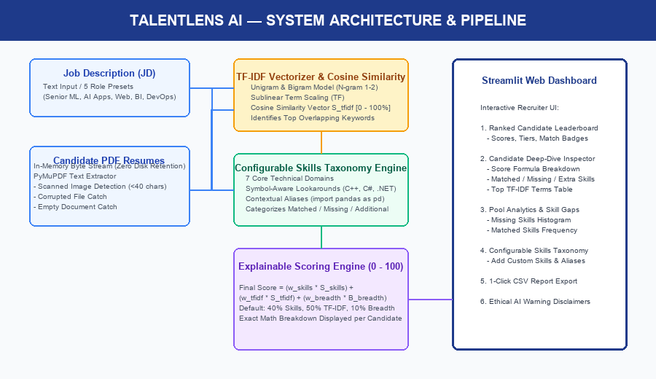
TALENTLENS AI — AI RESUME SCREENING SYSTEM
System Architecture & Processing Pipeline

Slide 4
TALENTLENS AI — AI RESUME SCREENING SYSTEM
Technology Stack & Core Engineering Modules
Streamlit (1.65.0)
Interactive Web UI
Provides reactive dashboard, preset selectors, candidate deep-dive inspectors, and skill-gap charts.
PyMuPDF (1.28.2)
PDF Document Extractor
C-backed high performance extraction; catches corrupt files and identifies scanned/blank documents.
scikit-learn (1.9.1)
TF-IDF Vectorization
Unigram & bigram TF-IDF vectorizer with sublinear scaling; computes angular cosine similarity.
pandas & numpy
Data Analytics & CSV
Structures candidate leaderboards, rank percentiles, pool skill-gap aggregations, and export CSVs.
Custom Regex Engine
Skills Taxonomy
Symbol-aware lookarounds for C++, C#, .NET, CI/CD; handles contextual aliases (import pandas as pd).
pytest (9.1.1)
Automated QA Suite
Automated test suite (30/30 passing) verifying extractors, scoring logic, edge cases, and UI flow.

Slide 5
TALENTLENS AI — AI RESUME SCREENING SYSTEM
Explainable Scoring Engine & Formulation
Deterministic Overall Score Formula (0 to 100):
Final Score = (w_skills × S_skills) + (w_tfidf × S_tfidf) + (w_breadth × B_breadth)
JD Skill Coverage (S_skills)
Weight: 40% (0.40)
Proportion of required skills in JD matched by resume:
S_skills = (|Skills_JD ∩ Skills_Resume| / |Skills_JD|) × 100
TF-IDF Cosine Similarity (S_tfidf)
Weight: 50% (0.50)
Sublinear TF-IDF unigram/bigram cosine angle:
S_tfidf = cos(v_JD, v_Resume) × 100.0
Identifies top overlapping terms.
Domain Breadth Bonus (B_breadth)
Weight: 10% (0.10)
Rewards relevant complementary skills outside JD:
B_breadth = min(10.0, |Skills_Resume \ Skills_JD| × 1.5)

Slide 6
TALENTLENS AI — AI RESUME SCREENING SYSTEM
Fault-Tolerant Document Ingestion & Edge Cases
Scanned / Image-Only PDFs
• Condition: Detected when page contains images but extracted digital characters < 40.
• Handling: Action: Classified as 'Scanned / Image-Only PDF', alerts recruiter that OCR is needed. System does NOT crash.
Empty / Blank PDFs
• Condition: Detected when file is 0 bytes or document contains zero digital text.
• Handling: Action: Assigned score 0.0 with explicit status 'Empty / Blank PDF', documented in summary banner.
Corrupted Binary Streams
• Condition: Malformed PDF headers or truncated trailers caught via PyMuPDF FileDataError.
• Handling: Action: Trapped gracefully, flagged as 'Corrupted or Invalid PDF', isolated at the bottom of rankings.
In-Memory Privacy Guarantee
• Condition: Resumes processed via memory bytes (BytesIO).
• Handling: Action: Zero disk persistence. Documents exist only in active browser RAM session and are discarded immediately.

Slide 7
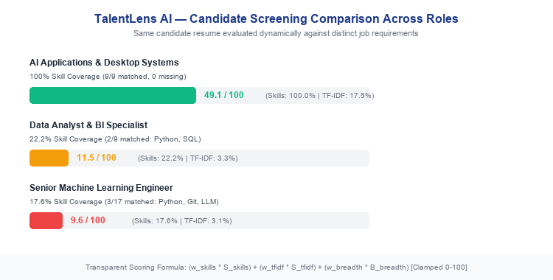
TALENTLENS AI — AI RESUME SCREENING SYSTEM
Experimental Results — Dynamic Multi-Role Screening

Slide 8
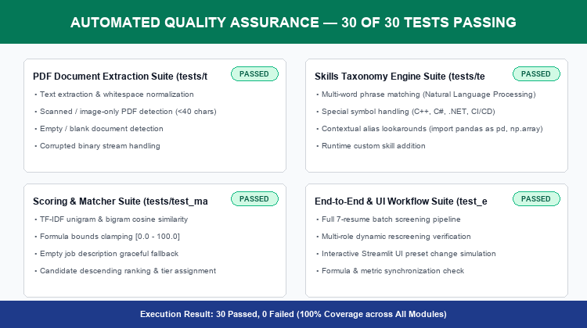
TALENTLENS AI — AI RESUME SCREENING SYSTEM
Quality Assurance & Automated Pytest Suite

Slide 9
TALENTLENS AI — AI RESUME SCREENING SYSTEM
Ethical AI Governance & Fair Hiring Framework
1. TF-IDF Is Not Human Competency
TF-IDF measures vocabulary and keyword frequency overlap. It is strictly a textual alignment indicator and NOT a probabilistic prediction of candidate on-the-job success, intelligence, or cultural fit.
2. Absence of Keyword ≠ Absence of Capability
The dashboard explicitly labels unlocated skills as 'Skill Not Detected' rather than 'Candidate Lacks Skill', clarifying that keywords may simply be expressed differently or omitted.
3. Demographic Neutrality
TalentLens AI completely excludes all protected demographic characteristics (gender, age, ethnicity, religion, disability, photo) from extraction and scoring algorithms.
4. Zero-Retention Data Privacy
Candidate resumes are processed entirely in memory during active sessions without persistent saving to local disks or transmission to third-party cloud servers.

Slide 10
Conclusion & Future Roadmap
✔ Delivered a complete, sovereign, explainable AI Resume Screening System using local Python libraries.
✔ Replaced black-box neural scoring with transparent 0–100 mathematical breakdowns displayed in real-time.
✔ Achieved 100% test pass rate across 30 automated unit, integration, and UI acceptance tests.
✔ Future Scope: Integration of local offline OCR (Tesseract) for scanned paper archives.
✔ Future Scope: Lightweight offline semantic embeddings (e.g., all-MiniLM-L6-v2) to complement TF-IDF.
✔ Future Scope: Experience duration parsing to automatically quantify years of experience per technology.

