Slide 1

WIPRO NGA Program – LSP Batch
Capstone Project Presentation – 04 Jun 2024
Project Title Here -LINUX NETWORK PACKET STATISTICS
DISPLAY
Presented by – Boyapati Rajendra Naidu
www.rpsconsulting.in

Slide 2


01
Introduction
02
Project Overview
03
Code Functionality
04
Source Code
AGENDA
05
Application Demo
06
Q and A
2024 - RPS Consulting all rights reserved

Slide 3
Objective: The packet capture and analysis application is designed to monitor network traffic in real-time.
Technology: It leverages the libpcap library for efficient packet capture.
Analysis: Detailed examination of packet headers, including Ethernet, IP, TCP, UDP, and ICMP, provides critical insights.
Logging: Packet details are logged for post-capture analysis and troubleshooting.
Statistics: Real-time statistics on packet counts and sizes offer a snapshot of network activity.
User Interface: The user-friendly interface presents packet statistics in both text and graphical formats for easy monitoring.
Introduction
2024 - RPS Consulting all rights reserved

Slide 4
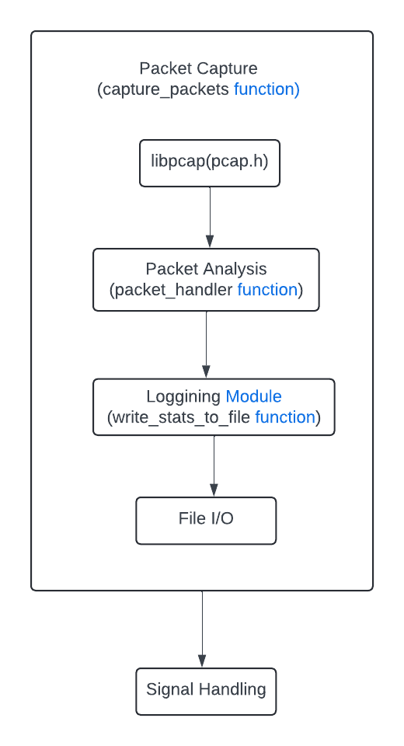
Project Overview
2024 - RPS Consulting all rights reserved

Slide 5
main()
Data Structures and Mutex Initialization
Signal Handling Setup
Command-line Argument Parsing
Packet capturing
Open Capture Device
Start Capture Loop
Packet Handler
Multi Threading
Thread Creation for Writing Statistics
Write Statistics Function
Cleanup
Close Resources
Join Threads
Code Functionality Packet Capturing
2024 - RPS Consulting all rights reserved

Slide 6
main()
Initialization
Mutex and Condition Variable Initialization
Signal Handling
Thread Creation
Main UI Loop
Locking and Waiting
Displaying Data
Resetting and Unlocking
Sleep(5)
Mutex and Thread Functionality
Mutex
Locking
Unlocking
Condition Variable
Wait
Signal
Reader Thread Function
Cleanup
Cleanup Resources
Console Display
2024 - RPS Consulting all rights reserved

Slide 7

Application Demo
Let me take you through a demo
2024 - RPS Consulting all rights reserved

Slide 8

Questions ?
Happy to answer !
2024 - RPS Consulting all rights reserved

Slide 9
Thank you
2024 - RPS Consulting all rights reserved

