Slide 1

Analysis of Providers through Yearly Medicare Beneficiary Coverage (2012 – 2015)
Rajendra kumar Rajkumar (1405755)
Arjun Ashwin Bhalani (1498951)
Aniruddha Joshi (1445393)
INFO7290
Data Warehousing and Business Intelligence

Slide 2
Presentation Agenda
Introduction
Data Mart
High Level Model
Visualization
Data Flow
Conclusion

Slide 3
1
Introduction

Slide 4

Medicare Coverage
A brief introduction of the topic (Dataset Description)
The data in this project is sourced form https://data.cms.gov/. The data in question pertains to information about healthcare providers registered under the Medicare program and Patient data for the same providers from year 2012 - 2015

Slide 5

Goal of this project
To brief about the requirements to be fulfilled by the data warehouse housing Medicare provider beneficiary and monetary data collected from Centers for Medicare & Medicaid Services (CMS) website using Kimball architecture thereby utilizing update-driven approach.
To explain the design to be followed for below parts within Datawarehouse:
Data flow from Data sources (SOR) till the destination data mart.
Relational model subject to 3-NF normalization for EDW Integration schema.
Dimension model for Destination Data mart.

Slide 6
Data Sources
Dataset containing the provider information, who are legally eligible to order and refer in the Medicare program and who possess enrolment record in Provider Enrolment and Chain Ownership System (PECOS). This data set will act as lookup to table to filter only eligible providers, who can order and refer.
https://data.cms.gov/Medicare-Enrollment/Order-and-Referring/qcn7-gc3g
Dataset containing the provider information who are actively approved to bill Medicare and who possess enrolment record in Provider Enrolment and Chain Ownership System (PECOS). This data set will act as lookup to table to filter only approved providers.
https://data.cms.gov/public-provider-enrollment
One dataset category (containing individual datasets from year 2012 to 2015) totalling to 6 datasets containing information about the provider basic details, beneficiary count, services offered to beneficiaries, special service indicators, specific beneficiary information based on factors like age, affected disease and race and monetary information comprising of Amount charged by Provider, Amount allowed by Medicare and Final Amount paid by Medicare.
https://data.cms.gov/utilization-and-payment/related-data

Slide 7
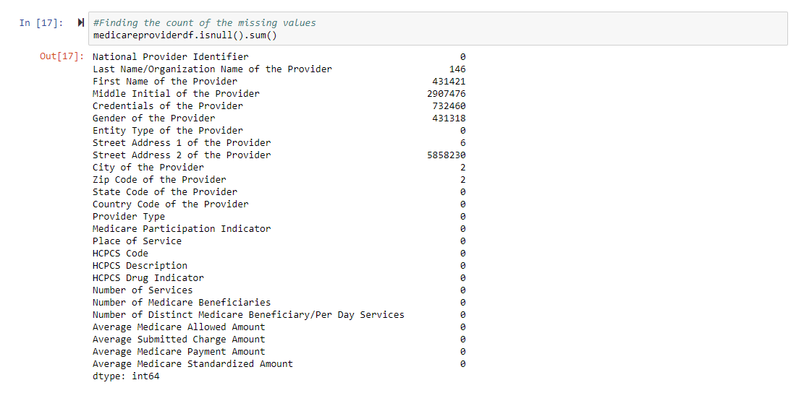


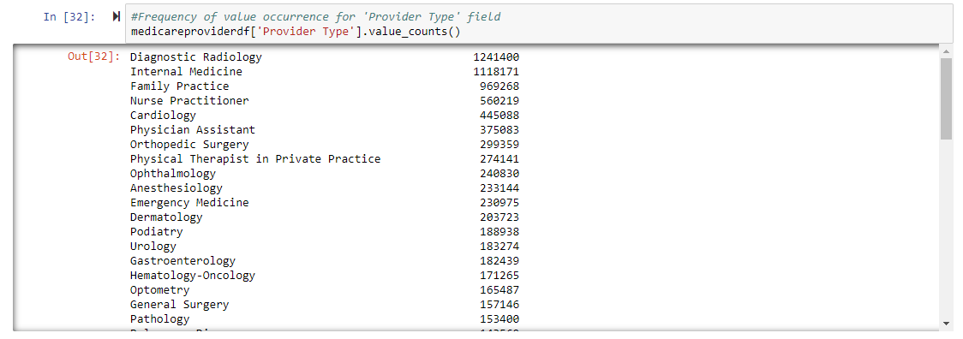

Data Profiling
NPI Data File
Missing values in ‘First Name’, ‘ ‘Middle Name’ and ‘Gender’ columns.
Attributed to the ‘Organization’ nature of the provider.
Order and Referring
Data almost in perfect condition.
Only few values missing from ‘Last Name’ column.
Again, Attributed to the ‘Organization’ nature of the provider.
Payment Data
Lots of missing values.
Attributed to the nature of the described columns.

Slide 8
2
High level model

Slide 9
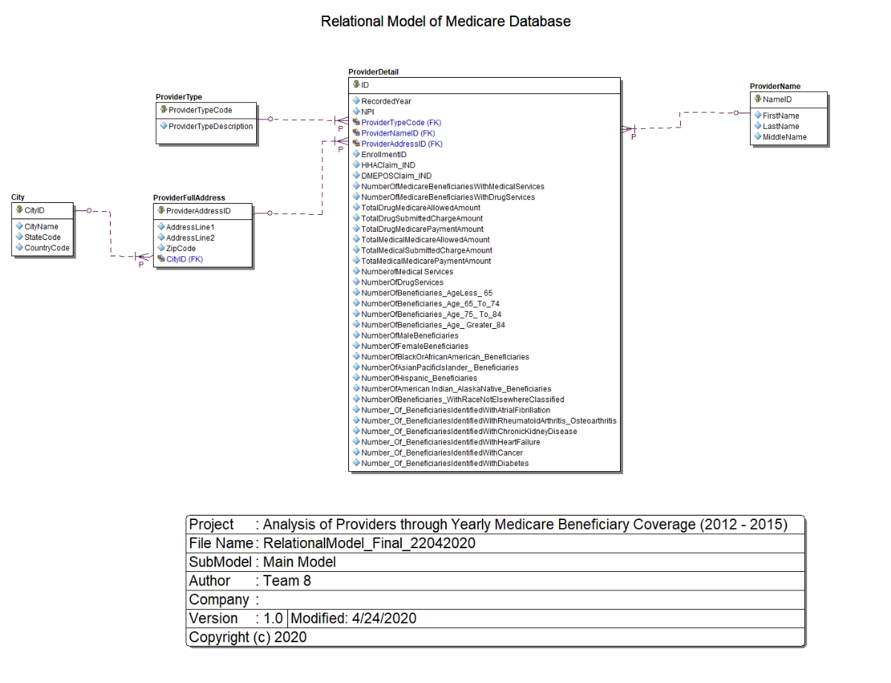
Relational Model (High Level)
9

Slide 10
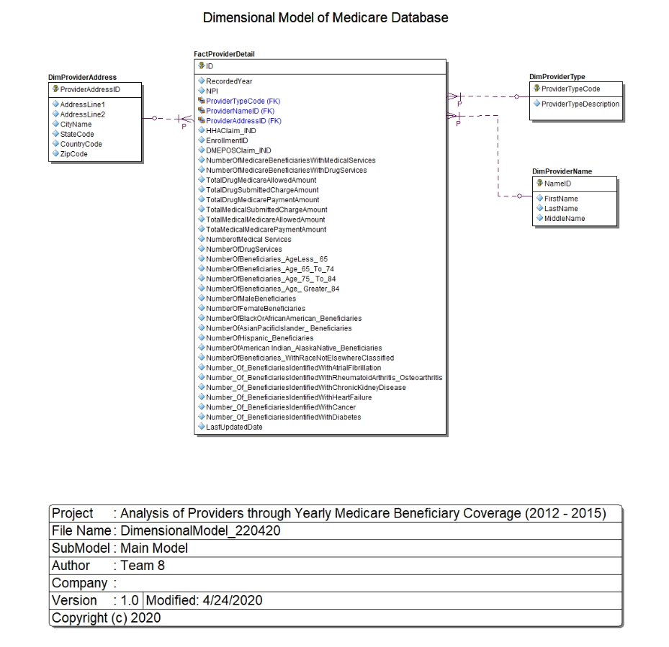
Dimensional Model (High Level)
10

Slide 11
3
Dataflow model

Slide 12
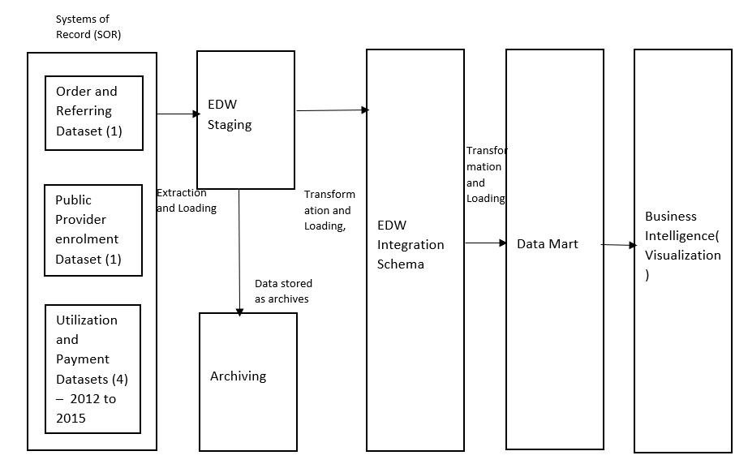
Data Flow Process
SOR
Staging
Integration
Data Marts
BI

Slide 13
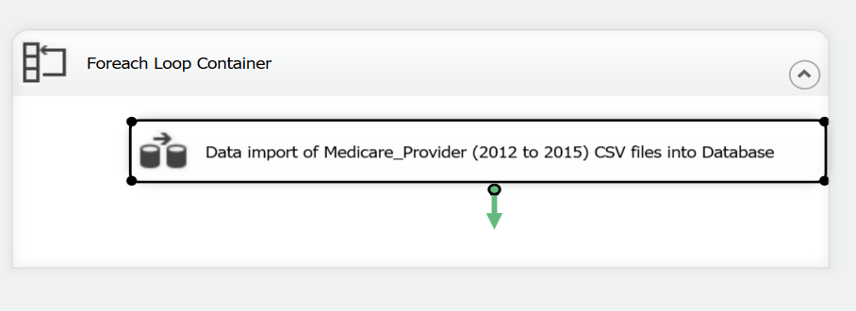
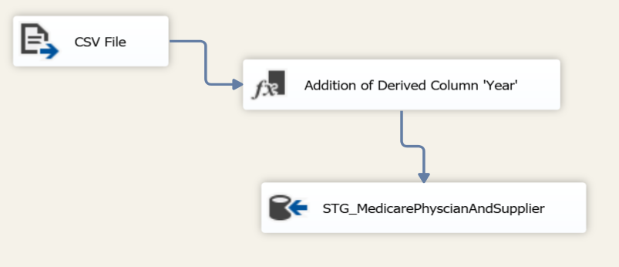
Data Flow Process
SOR to Staging Area

Slide 14
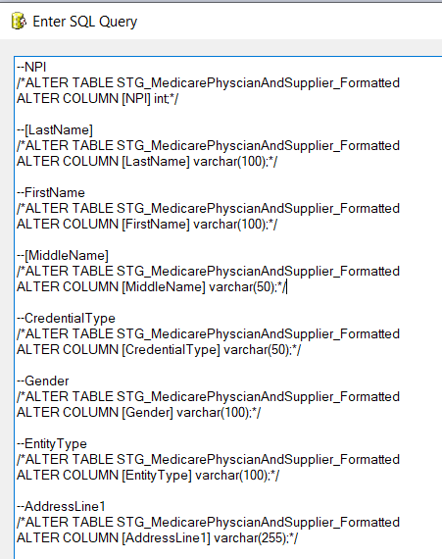
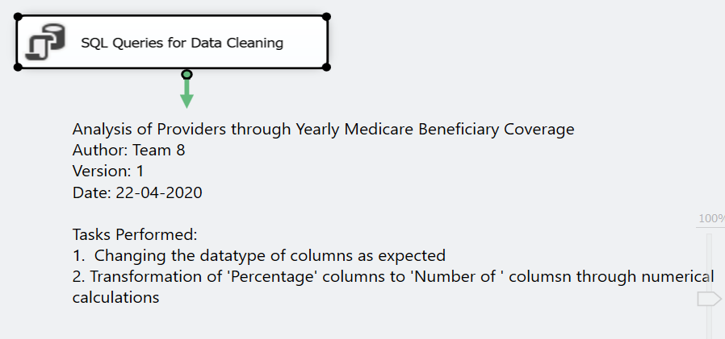
Data Flow Process
Staging Area to EDW Integration Schema – (1)

Slide 15
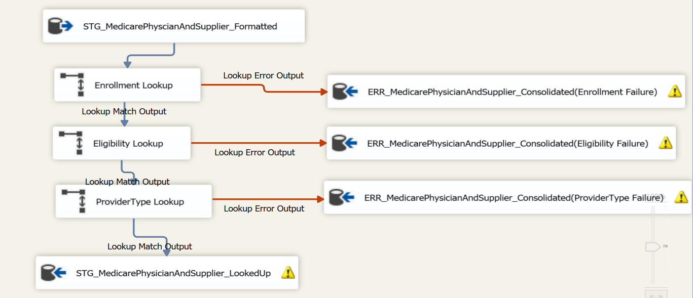
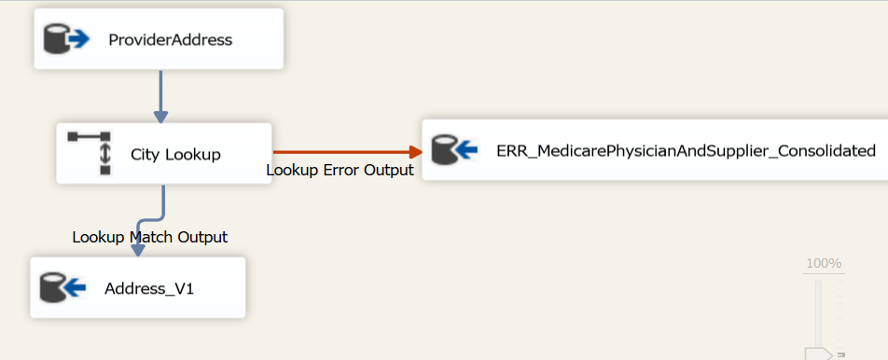
Data Flow Process
Staging Area to EDW Integration Schema – (2)

Slide 16
4
Data Mart

Slide 17
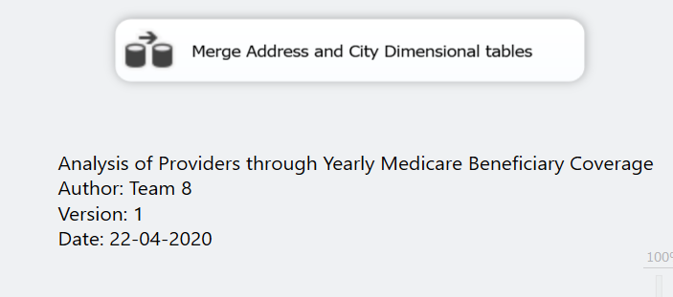
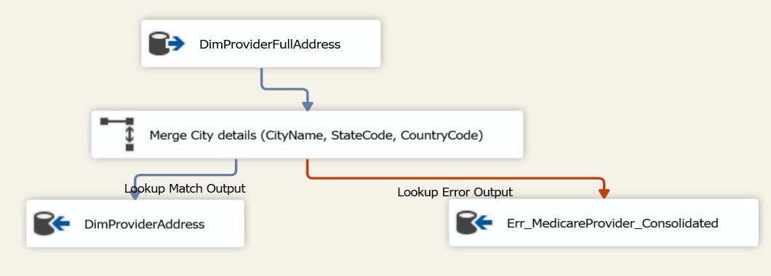
Data Mart
Data moved from EDW Integration schema to Star schema through SQL Import and Export
‘Last Updated Date’ added to keep track of the transfer
Merging of ‘Address’ and ‘City’ tables from relational model to establish a single ‘Address’ dimension
Final Dimensional model acting as source for visualization

Slide 18
5
Visualization

Slide 19
Tool Used: Tableau MS SQL Server
‘Live Connection’ established between MedicareDW (Dimensional Model) database in MS SQL Server
Following charts were made use of
Bar Chart - Beneficiary Count over years (Gender Classification)
Map chart –
Number of Services Distribution across States in 2012
Top Providers for Heart Failure in 2015
Count of Top Providers per Zipcode for Particular Age group in 2013
Pie Chart – Racewise beneficiary distribution in 2015
Line Chart - Total Medicare Payment Amount over years
Density chart - Statewise Medicare Submitted Charge Amount comparison
19

Slide 20
Live Demo
Tableau Online Site link:
https://prod-useast-a.online.tableau.com/#/site/medicareprovideranalysis/home

Slide 21
Thank you!
Any questions?

