Slide 1
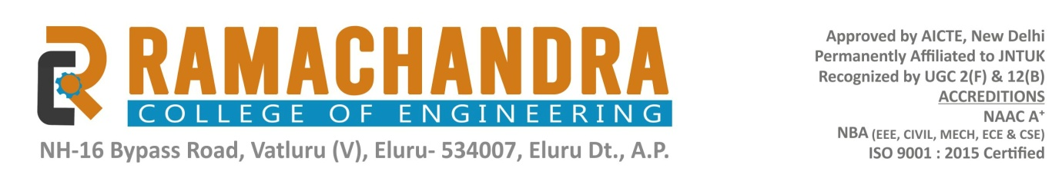
Project Presentation
On
CUSTOMER LOAN PREDICTION ANALYSIS Domain: Python
Presented By:
M. SUJITHA (19ME1A05B1)
M. RAJENDRA (19ME1A05C3)
K. GEETHIKA(19ME1A0589)
K. SARVANEE(19ME1A0590)
Guided By
Mr. P. V.KISHORE KUMAR
ASSISTANT PROFESSOR.

Slide 2


INDEX
Abstract
Introduction
Literature Survey
Existing System
Proposed System
Hardware & Software Requirements
System Architecture
Methodologies
Modules
UML Diagrams
Output Screenshots
Conclusion
References

Slide 3
ABSTRACT
With the enhancement in the banking sector lots of people are applying for bank loans but the bank has its limited assets which it has to grant to limited people only, so finding out to whom the loan can be granted which will be a safer option for the bank is a typical process. So in this project, we try to reduce this risk factor behind selecting the safe person. This is done by mining the Big Data of the previous records of the people to whom the loan was granted before and on the basis of these records the machine was trained using the machine learning model which give the most accurate result. Our project is divided into four sections (i)Data Collection (ii) Comparison of machine learning models (iii) Training of system on most promising model (iv) Testing. The main objective of this project is to predict whether assigning the loan to particular person will be safe or not.
Key Words: Machine Learning, Prediction, Decision Tree

Slide 4
INTRODUCTION
A loan is the core business part of banks. Though bank approves loan after a regress
process of verification and testimonial but still there is no surety whether the chosen
Person is the right hopeful or not.
This process takes fresh time while doing it manually. The main motive of the Project is to provide quick, fast and a easy way to choose the eligible applicants.
Bank wants to automate the loan eligibility process based on customer details provided while filling online application form. These details are Gender, Marital Status, Education, Number of Dependents, Income, Loan Amount, Credit History and others.
In this project, we built a predictive model to predict if an applicant is eligible for the loan or not and we made a user interface web application.

Slide 5
LITERATURE SURVEY
Year | Author | Title | Limitations | Summary
2020 | Jing | Loan default prediction using machine learning algorithms with financial and non-financial factors | Limited number of predictors used | The study found that logistic regression and random forest performed best in predicting loan defaults.
2017 | Keshtkaran | Credit scoring models: A comparison between logistic regression and neural networks | Limited to a single country's dataset | The study found that neural networks outperformed logistic regression in credit scoring
2016 | Chakraborty & Ghosh | Predicting credit default using data mining techniques | Limited to a single dataset | Decision trees had the highest accuracy in predicting credit default.

Slide 6
EXISTING SYSTEM
In existing system the data mining algorithms are used for the loan approval, this is the old technique for the approval of loan.
Multiple data sets are combined and form a Generalized datasets, and different machine learning algorithms are applied to generate results.
Many banks use their own software’s for the loan approval, as the mining algorithms are complex to understand, there is no surety that the chosen applicant is capable of paying the loan or not.
As these techniques are not up to the mark. Due to this, huge banks are suffering from financial crises.

Slide 7
Limitations
Complexity in analyzing the data.
Prediction is challenging task working in the model
Coding is complex maintaining multiple methods.
Libraries support was not that much familiar.

Slide 8
PROPOSED SYSTEM
Python is a good area for data analytical which helps us in analyzing the data with better models in data science. The libraries in python makes the predication for loan data and results with multiple terms considering all properties of the customer in terms of plain predicting.
In this project we have used different algorithms like PassiveAgressive Classifier, MultinomialNB, SupportVector Classifier, Adaboost Classifier

Slide 9
Advantages
Libraries helps to analyze the data.
Statistical and prediction is very easy comparing to existing technologies.
Easy to understand while predicting the person for loan.
Eligible applicant will be sanctioned loan without any delay.

Slide 10
HARDWARE &SOFTWARE REQUIREMENTS
Hardware Requirements
System : Pentium Dual Core.
Hard Disk : 120 GB.
Monitor : 15 LED
Input Devices : Keyboard, Mouse
Ram : 8 GB
Software Requirements
Operating system : Windows 10 or 11.
Coding Language : PYTHON

Slide 11
SYSTEM ARCHITECTURE
(i) Input Data: We input the data in the learning algorithm as a set of inputs, which is called as Features.
(ii) Training Models: In training, we pass the prepared data to our machine learning model to find patterns and make predictions.
Supervised Learning: This type of machine learning involves algorithms that train on labeled data.
Unsupervised Learning: This type of machine learning involves algorithms that train on unlabeled data.
Reinforcement Learning: This type of machine learning involves trail and error method.

Slide 12
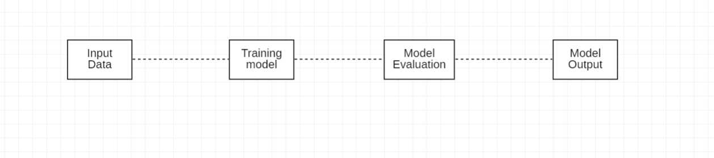
(iii) Model Evaluation: Evaluation in machine learning refers to assessment or test of entire machine learning model and its performance in various circumstances.
(iv) Model Output: Model output is the prediction or decision made by a machine learning model based on input data.

Slide 13
METHODOLOGIES
PassiveAgressive Classifier: It is a type of machine learning algorithm used for binary classification tasks. This algorithm is particularly useful in situations where data is noisy.
MultinomialNB: MNB is a fast and efficient algorithm that works on large datasets. The algorithm calculates the probability of an attribute belonging to a particular class (e.g., positive or negative).
SupportVector Classifier: SupportVector Classifier (SVC) is a supervised learning algorithm used for classification tasks. SVC can be computationally expensive for large datasets.
Adaboost Classifier: Adaboost (Adaptive Boosting) is used for classification. It works by combining multiple “weak” learners to create a “strong” learner that can make accurate predictions.

Slide 14
MODULES
Register: In register phase the user will register using his details like first name, password, email, address etc., these details will save into the mysql database.
Login: The user will login with his credentials like username and password. If he enter the correct user name and password then he will get home page of the application.
Choosing algorithms: The given algorithm need to be select and follows the following steps:
Load Dataset: Load data set using pandas read_csv() method.
Split Data Set: One is train data test and another one is test data set.
Train data set: Train data set will train our data set using fit method.
Test data set: Test data set will test the data set using algorithm.
Predict data set: Predict() method will predict the results.
Logout: If we click on the logout link it will come out form the home page.

Slide 15
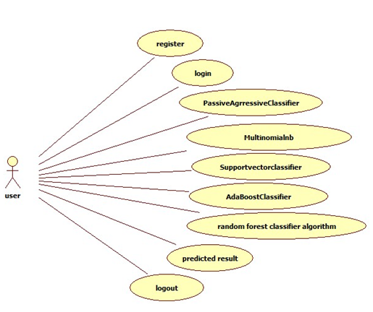
UML DIAGRAMS
USECASE DIAGRAM: It depicts the interactions between a system and its users or external systems.

Slide 16
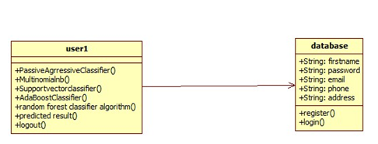
CLASS DIAGRAM: A Class diagram is a visual representation of class objects in a model system, categorized by class type.

Slide 17
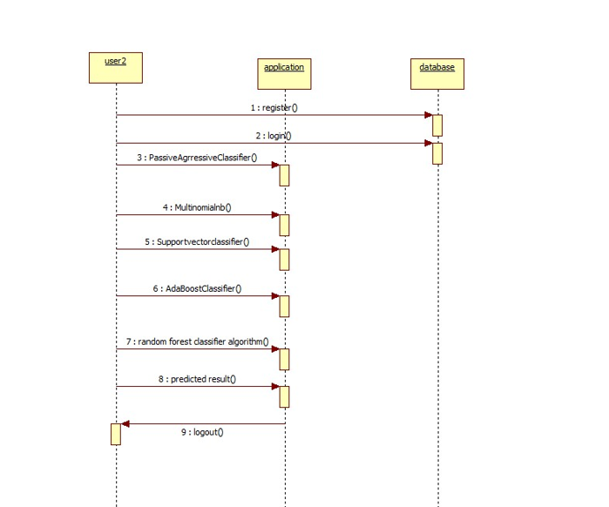
SEQUENCE DIAGRAM: It illustrates the sequence of messages between objects in an interaction.

Slide 18
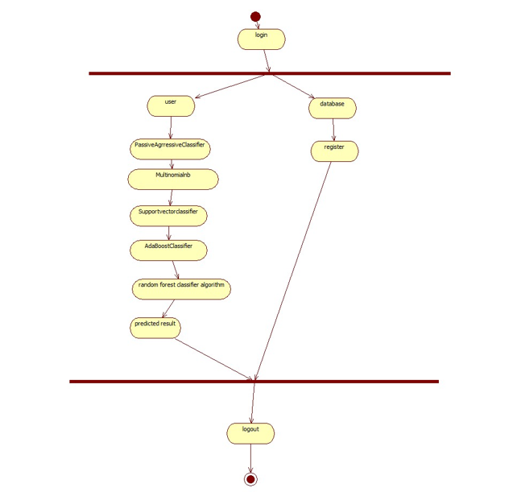
ACTIVITY DIAGRAM: Activity diagrams are similar to flowcharts because they show the flow between the actions.

Slide 19
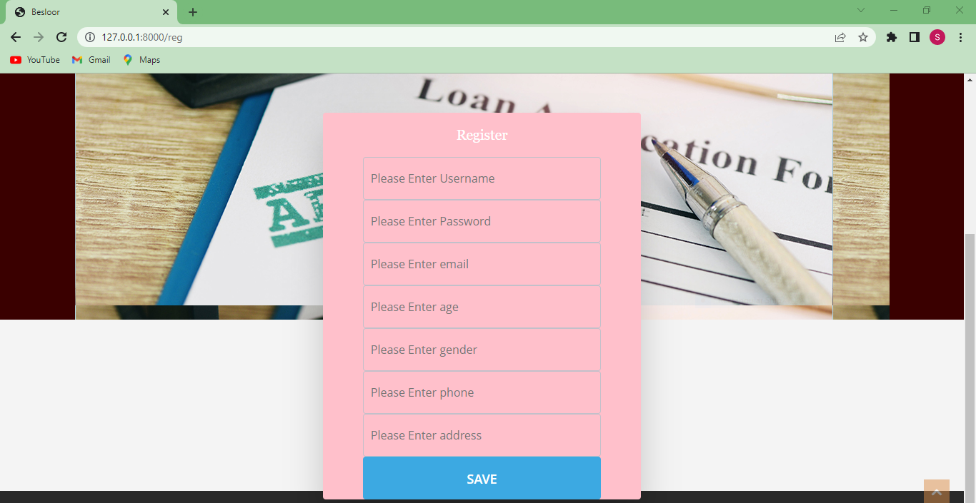
OUTPUT SCREENSHOTS
Register Page:

Slide 20
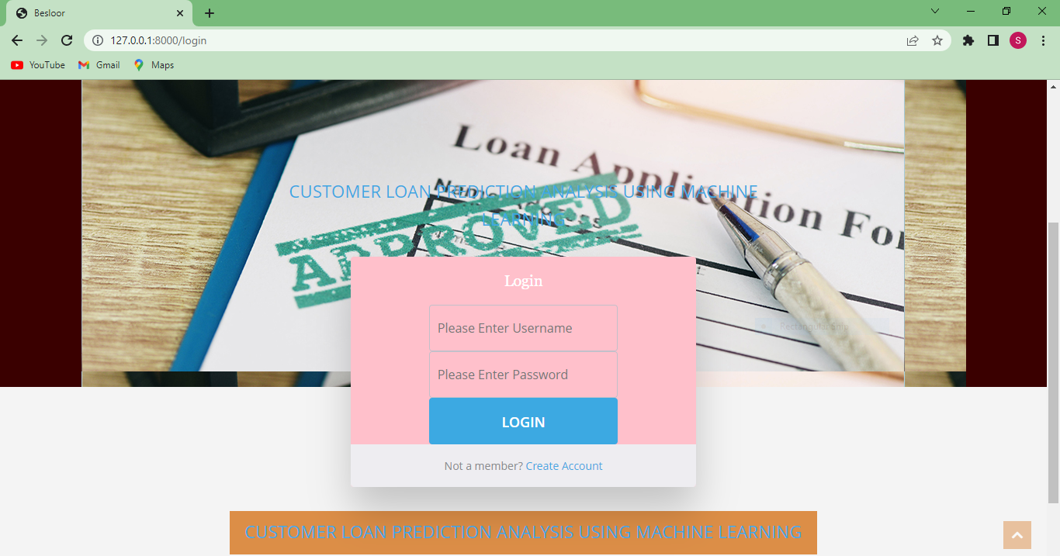
Login Page:

Slide 21
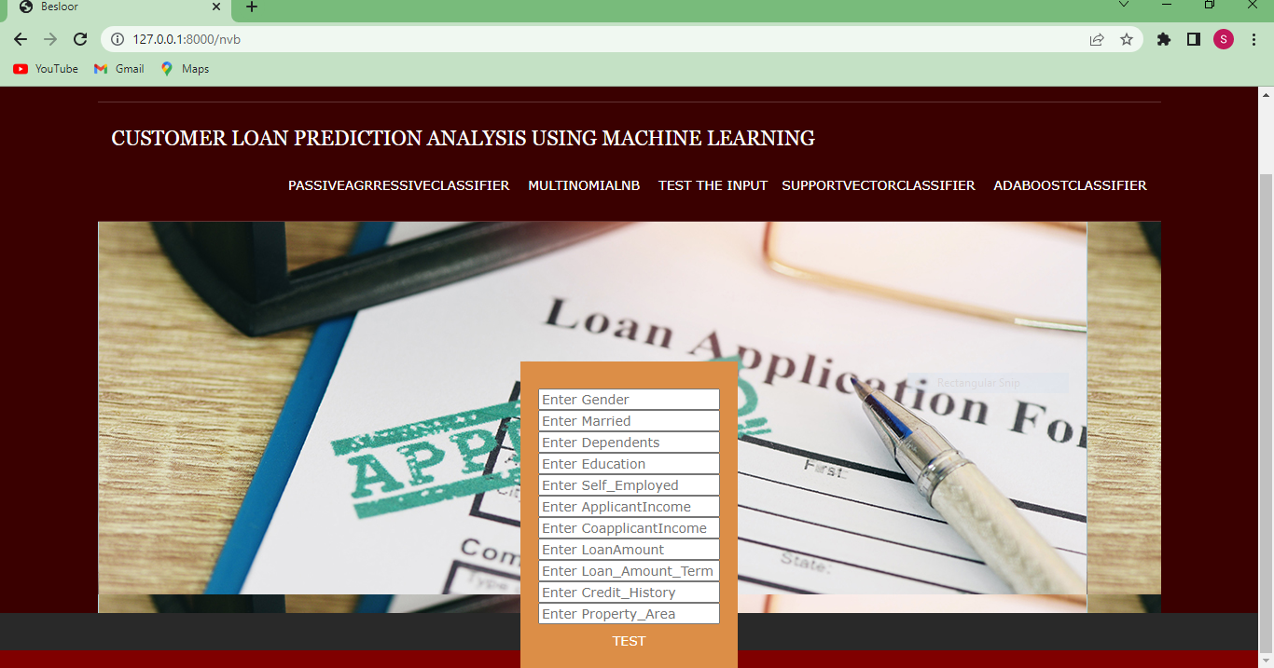
Home Page:

Slide 22
CONCLUSION
This project helped us to learn about the complicated system of the loan prediction system and the best model that can work with this particular project. It works correctly and fulfills all requirements of bankers. This system properly and accurately calculates the result. It predicts the loan is approve or reject to loan applicant or customer very accurately.

Slide 23
REFERENCES
Jing (2020) used Logistic Regression, Random Forest, SVM and found that logistic regression and random forest performed best in predicting loan defaults.
Keshtkaran (2017) used Logistic Regression, Neural Networks and found that neural networks outperformed logistic regression in credit scoring.
Chakraborty & Ghosh (2017) used Decision Tree, Logistic Regression and found that decision trees had the highest accuracy in predicting credit default.
Abu Mostafa (2015) used Logistic Regression, Decision Tree, Random Forest, SVM, KNN and found that random forest and SVM had the highest accuracy in predicting loan defaults.
Liu (2020) used Various machine learning models and found that ensemble methods, such as random forest and gradient boosting, performed well in credit scoring.

Slide 24
Thank You

