Slide 1
Applications of Artificial Intelligence and Machine Learning in
Bioinformatics and Chemo-informatics
Dr. V.K. Jayaraman
National Chemical Laboratory,
Pune
Email: vk.jayaraman@ncl.res.in

Slide 2


Pattern Recognition
Humans have skills to recognize and differentiate patterns
Provide Machines similar capabilities
Solve real life problems

Slide 3
Pattern Recognition
PROTEIN SEQUENCES
MAHFAVGFLTLGLLVPVLTWPVSAPLLVIPVALSASIIRLRTLADERGVTVRRAVRWDDIDGLRFHRGSW
AEMKTDAATLAQEAGNFERISGDLKTQIDQVESTAGSLQGQWRGAAGTAAVRFQEAANKQKQELDEIST
SQIMYNYPAMLGHAGDMAGYAGTLQSLGAEIAVEQAALQSAWQGDTGITQAMQWNQAMEDLVRYHA
MRNFILFPMMAVVLLSGCQQNRPTTLSPAVSGQAQLEQLASVAAGARYLKNRSDLPADEAINRAAINVGK
In silico identification of protein sequences having allergen properties is important as this will significantly aid in efficient design of novel vaccines.
Is it possible to identify candidate vaccines from protein sequence alone?

Slide 4
Pattern Recognition
PROTEIN SEQUENCES
MAHFAVGFLTLGLLVPVLTWPVSAPLLVIPVALSASIIRLRTLADERGVTVRRAVRWDDIDGLRFHRGSW
AEMKTDAATLAQEAGNFERISGDLKTQIDQVESTAGSLQGQWRGAAGTAAVRFQEAANKQKQELDEIST
SQIMYNYPAMLGHAGDMAGYAGTLQSLGAEIAVEQAALQSAWQGDTGITQAMQWNQAMEDLVRYHA
MRNFILFPMMAVVLLSGCQQNRPTTLSPAVSGQAQLEQLASVAAGARYLKNRSDLPADEAINRAAINVGK
MNSVQFKNHHHHHHPDMHTQVHTARLVHTADLDSETRQDIRQMVTGAFAGETDWEHTLGGMHAIWHH
Can we Identify Allergen causing Sequences?
Employ Support Vector Machine (SVM)

Slide 5
Pattern Recognition
DNA sequence
ATGCGACGATCGTACGATGCATGCATGCTGCATGACTACGCAGATCATGCGATACGTACGACTG
In silico identification of function of the given gene or DNA sequence

Slide 6
Pattern Recognition
DNA SEQUENCES
GACCTTCACGAAGTTTCCGCACGGGATCTGTCAGGACACCGGTGTTGTCGCGTGTTTCAACTTTCA
CCGCTTTCACCGAAAAAATCAGAAACGATGGCCGATGCAGTGGCGAAGGGCAACCCGGGCAAGA
AGGTGTTTGTACAGAAGTGCGCCCAGTGTCACACAGTAGAGAAGGGAGGCAAGCACAAGGCCCAA
CCTCAACGGTCTGTTCGGCCGCAAGACAGGGCAGGCATCAGGCTTCTCGTACACCGACCAAAAAC
AAGGGTATTACATGGGCTGAAGACACCCTCTGGGTCTACCTGGAGAACCCCAAGAAGTTCCCGGCA
CTAAGATGGTCTTCGCTGGCTTGAAGAAGAAGGGCGAGAGAGCAGACCTCATCTCCTAAGGAGTC
CACCTCCTCATGATGCCGGTCCTGAGACGTCTTCTCTTCCGCTACCGCTTCTTACACTCAGCGGTT
Can we Identify Coding Sequences?

Slide 7

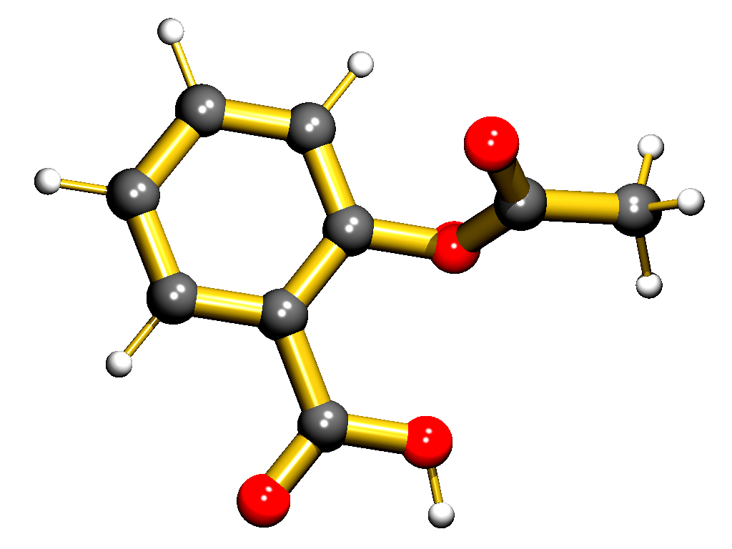
Pattern Recognition
Identify molecules having the required biological activity
recognition
Important Molecule
having Anti-tumor
activity
1-(X-phenyl)-3,3-dialkyl
triazenes series
Aspirin –
analgesic, antipyretic,anti-inflammatory

Slide 8
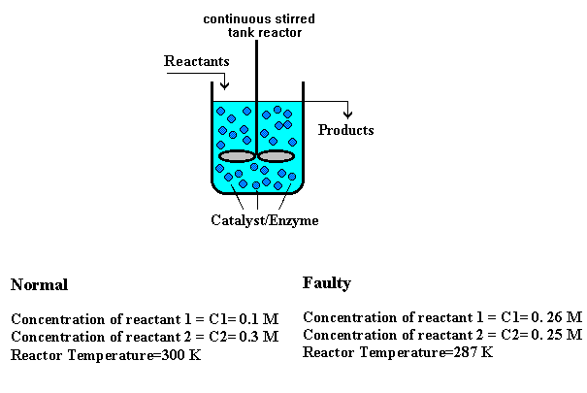
Pattern Recognition
Identify faulty operating conditions in reactor

Slide 9
APPLICATIONS OF SVM
Prediction of protein contacts.
Prediction of virulence of a given bacterial protein.
Prediction of gene function
Splice site prediction in a given DNA sequence

Slide 10
Pattern Recognition
Drug Design
Identifying Active Drug
Methodology
collect
Structural Features
Collect Data
select
Informative Subsets
Select Features
Select Model
Select Model
Train Classifier
Train Classifier
Evaluate Classifier
Evaluate Classifier

Slide 11
Steps involved in Pattern Recognition / Classification
Acquisition /Sensing of data
Pre-Processing
Feature Extraction
Feature Selection
Classification
Post Processing
Decision

Slide 12
Steps involved in Pattern Recognition / Classification
1→Data Acquisition /Sensing
Example → Epitope Prediction
Acquire the raw sequences (both positive and negative) and curate them

Slide 13
Steps involved in Pattern Recognition / Classification
2→Pre-Processing
Preprocessing is done to remove redundancy.

Slide 14
Steps involved in Pattern Recognition / Classification
3→Feature Extraction
We need to input knowledge to the classifier
Protein function Identification :
  Numerical representation of the sequence.
  Amino acid frequencies
  Dipeptide frequencies
  Tripeptide frequencies
  K-mer frequencies
  Homology information in terms of Blast and Psi-blast profiles.
  Remote Homology using PSSM
  Motive information
  Secondary Structure information
  Physical propertied like hydrophobic, hydrophilic, charge, etc.
  Structural features like surface accesibility, co-ordinates of atoms, contact order.

Slide 15
Steps involved in Pattern Recognition / Classification
Feature Calculation
We need to input knowledge to the classifier
Protein function Idenstification :
  Numerical representation of the sequence.
  Amino acid frequencies
  Dipeptide frequencies
  Tripeptide frequencies
  K-mer frequencies
  Homology information in terms of Blast and Psi-blast profiles.
  Remote Homology using PSSM
  Motif information
  Secondary Structure information
  Physical properties like hydrophobic, hydrophilic, charge, etc.
  Structural features like surface accesibility, co-ordinates of atoms, contact order.

Slide 16
Feature Calculation
Amino acid frequencies…
Given a sequence, say
ASSNRADSNRRDQAS;
calculate the frequency of occurrence for each of the 20 amino acids using: F_{r}=n_{r}/N,
where r is the type of amino acid,
n_{r} is the no. of times amino acid r occurs in the sequence,
and N the length of the sequence.
Thus for each sequence we have 20 different values corresponding to different amino acid frequencies. Thus for the above sequence we have:
A | C | D | E | F | G | H | I | K | L | M | N | P | Q | R | S | T | V | W | Y
0.2 | 0 | 0.1 | 0 | 0 | 0 | 0 | 0 | 0 | 0 | 0 | 0.1 | 0 | 0.06 | 0.2 | 0.27 | 0 | 0 | 0 | 0

Slide 17
Feature Calculation
Amino acid frequencies…
For the sequence ASSNRADSNRRDQAS; N= 15
For the frequency of Ala (A),
n_{A} = 3,
therefore, F_{A}=n_{A}/N=3/15=0.2
and for frequency of Ser(S),
n_{S} = 4,
therefore, F_{S}=n_{S}/N=4/15=0.266

Slide 18
Feature Calculation
Dipeptide frequencies…
Similarly, calculate the dipeptide frequency for each of the 20x20 combinations of dipeptides amino acids using:
F_{rs}=n_{rs}/(N-1),
where r and s are the type of amino acid,
n_{rs} is the no. of times amino acid r and s occur in the sequence
consecutively,
and N the length of the sequence.

Slide 19
Feature Calculation
Dipeptide frequencies…
For the sequence ASSNRASNRRDQASS; N= 15
For the dipeptide frequency AS,
n_{AS} = 3,
therefore, F_{AS}=n_{AS}/(N-1)=3/14=0.214
and for frequency of SS,
n_{SS} = 2,
therefore, F_{SS}=n_{SS}/(N-1)=2/14=0.142
Tripeptide and k-mer frequencies may be calculated in the same way by generalizing the formula.

Slide 20
BLAST
In bioinformatics, Basic Local Alignment Search Tool, or BLAST, is an algorithm for comparing primary biological sequence information, such as the amino-acid sequences of different proteins or the nucleotides of DNA sequences.
A BLAST search enables a researcher to compare a query sequence with a library or database of sequences, and identify library sequences that resemble the query sequence above a certain threshold. For example, following the discovery of a previously unknown gene in the mouse, a scientist will typically perform a BLAST search of the human genome to see if humans carry a similar gene; BLAST will identify sequences in the human genome that resemble the mouse gene based on similarity of sequence.

Slide 21
BLAST
The BLAST program was designed by Eugene Myers, Stephen Altschul et.al at the NIH and was published in J. Mol. Biol. in 1990.
BLAST is one of the most widely used bioinformatics programs, because it addresses a fundamental problem and the algorithm emphasizes speed over sensitivity. This emphasis on speed is vital to making the algorithm practical on the huge genome databases currently available, although subsequent algorithms can be even faster.

Slide 22
BLAST
Examples of other questions that researchers use BLAST to answer are:
Which bacterial species have a protein that is related in lineage to a certain protein with known amino-acid sequence?
Where does a certain sequence of DNA originate?
What other genes encode proteins that exhibit structures or motifs such as ones that have just been determined?
BLAST is also often used as part of other algorithms that require approximate sequence matching.

Slide 23
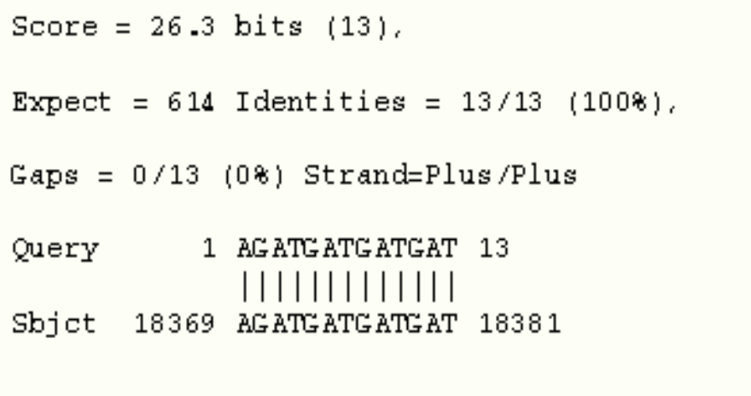
Feature Calculation
Homology Information: BLAST Scores…
The scores obtained from a standalone BLAST run against a user-specified database may be used as a feature containing homology information about the sequence.
An example of a BLAST output:

Slide 24
Position Specific Scoring Matrix(PSSM)
PSI-BLAST profiles are represented by the position-specific probabilities of this relevant weighted information
Searched against nonredundant (NR) Database
Parameters used:
3 iterations
e value-0.001

Slide 25
PSI-BLAST
Vs.
database
Query sequence
4
PSSM
1
3
PSSM
5
2

Slide 26
Position-specific scoring matrix
A PSSM is an n by m matrix, where n is the size of the alphabet, and m is the length of the sequence
The entry at (i, j) is the score assigned by the PSSM to letter i at the jth position
A
-1
-2
-1
0
-1
-2
0
-2
R
5
0
5
-2
1
-3
-2
0
N
0
6
0
0
0
-3
0
1
D
-2
1
-2
-1
0
-3
-1
-1
C
-3
-3
-3
-3
-3
-2
-3
-3
Q
1
0
1
-2
5
-3
-2
0
E
0
0
0
-2
2
-3
-2
0
G
-2
0
-2
6
-2
-3
6
-2
H
0
1
0
-2
0
-1
-2
8
I
-3
-3
-3
-4
-3
0
-4
-3
L
-2
-3
-2
-4
-2
0
-4
-3
K
2
0
2
-2
1
-3
-2
-1
M
-1
-2
-1
-3
0
0
-3
-2
F
-3
-3
-3
-3
-3
6
-3
-1
P
-2
-2
-2
-2
-1
-4
-2
-2
S
-1
1
-1
0
0
-2
0
-1
T
-1
0
-1
-2
-1
-2
-2
-2
W
-3
-4
-3
-2
-2
1
-2
-2
Y
-2
-2
-2
-3
-1
3
-3
2
V
-3
-3
-3
-3
-2
-1
-3
-3

Slide 27
A 400-dimensional input vector - summing up all rows in the PSSM corresponding to the same amino acid in the primary sequence
Every element in this input vector was divided by the length of the sequence
Scaled to 0–1 by using the standard sigmoid function

Slide 28
Feature Calculation
Homology Information: Remote homology using PSSM scores…
Another way of incorporating homology information into the sequences is by using PSSM profile scores.
>seq1
AASQRLAQS
>seq2
ASSNRADSQ
>seq3
ADSQRADSQ
….
 | Pos1 | Pos2 | Pos3 | …
A | 0.754 | 0.000 | 0.000 | …
C | 0.210 | 0.643 | 0.003 | …
D | 0.003 | 0.178 | 0.910 | …
… | … | … | … | …
Sequence dataset
PSSM Matrix

Slide 29
Feature Calculation
Homology Information: Remote homology using PSSM scores…
Given a training sequence (of length equal to Multiple alignment length), get PSSM scores for each residue.
This gives a feature set for a sequence with columns equal to the length of the Multiple Sequence Alignment
>train_seq1
AASQRLAQS
A
A
S
…
PSSM Matrix
0.754
0.000
0.000
…
Training sequence
PSSM Score vector

Slide 30
Feature Calculation
Physicochemical properties: Amino acid indices…
AAIndex (Amino Acid Index database) database of numerical indices representing various physicochemical and biochemical properties of amino acids.
I.e in each of the 20 amino acids have an experimentally/statistically quantified physicochemical value assigned in each of the indices.
E.g. In the index for the Kyte-Doolittle hydrophobicity scale (shown below), A corresponds to a value of 1.10, L to 3.80 and so on…
A/L | R/K | N/M | D/F | C/P | Q/S | E/T | G/W | H/Y | I/V
1.10 | -5.10 | -3.50 | -3.60 | 2.50 | -3.68 | -3.20 | -0.64 | -3.20 | 4.50
3.80 | -4.11 | 1.90 | 2.80 | -1.90 | -0.50 | -0.70 | -0.46 | -1.3 | 4.2

Slide 31
Feature Calculation
Physicochemical properties: Amino acid indices…
Given a sequence, say ASRVA…
The grand average of a given index over the sequence can be taken as a feature. For example, from the hydropathy scale, we can calculate the Grand Average of Hydropathy (GRAVY) by:
GRAVY=(1.10 - 0.50 - 5.10 + 4.2 + 1.10)/5=0.16

Slide 32
Feature Calculation
Physicochemical properties: Amino acid indices…
The PROFEAT server for calculation of protein sequence features uses amino acid indices to quantify sequences in terms of Moreau-Broto autocorrelations, Geary autocorrelations and Moran autocorrelations.

Slide 33
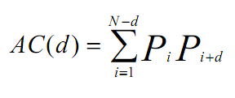

Feature Calculation
Physicochemical properties: Amino acid indices…
Moreau-Broto Autocorrelation descriptors may be defined as:
where d=1, 2, 3, ... , 30 is the lag of the autocorrelation, P_{i} and P_{i+d} are the property of the amino acid at position i and i+d respectively. The normalized Moreau-Broto autocorrelation descriptors are defined as:
where d=1, 2, 3, … , 30

Slide 34
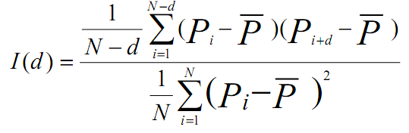

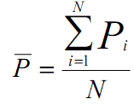
Feature Calculation
Physicochemical properties: Amino acid indices…
Moran autocorrelation descriptors may be defined as:
where d=1, 2, 3, ..., 30, P_{i} and P_{i+d} are defined in the same way as for Moreau-Broto autocorrelations, and is the average of the considered property P along the sequence

Slide 35
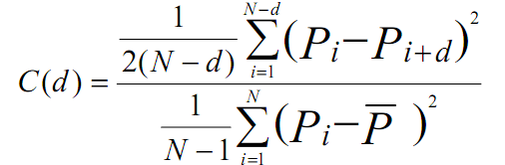
Feature Calculation
Physicochemical properties: Amino acid indices…
Geary autocorrelation descriptors may be defined as…
where d=1, 2, 3, …, 30, , P_{i} and P_{i+d} are defined in the same way as before.

Slide 36
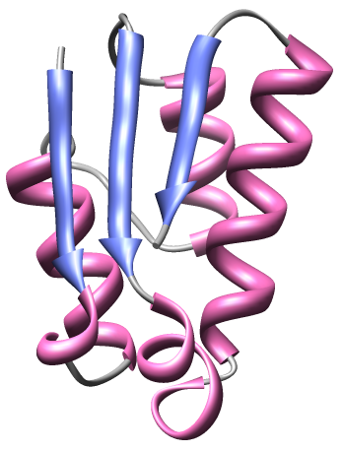
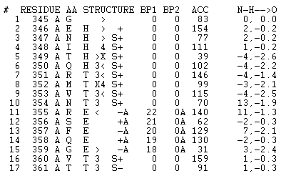
Feature Calculation
Secondary structure information…
Secondary structure information of a protein may be obtained from DSSP (Database of Secondary Structure Assignments) for proteins with a resolved structure present in PDB.

Slide 37

A protein amino acid sequence may be converted to a sequence of its secondary structure alphabets such as H (Helix), E (Extended strand), T (Turn ) and other Helix and Beta types. Their frequency, distribution, rate of structural change etc may be calculated as features.
For example :
The frequency of each of the 3 secondary structure alphabets here (H, E and T) can be calculated by counting the number of occurrence of each of them divided by the length of the sequence.
The rate of structural change may be may be calculated as the probability of a secondary structure at position n to followed by any other type of secondary structure at n+1.

Slide 38
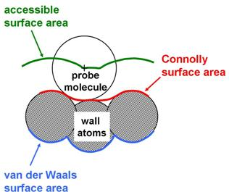
Feature Calculation
Accessible surface area…
The accessible surface area (ASA) of a protein molecule may be defined as the area of the protein accessible to a spherical probe (area measured at the centre of the sphere) of a particular radius. Generally the radius of the probe is taken as 1.4 Ǻ corresponding to the radius of a water molecule.
ASA can be calculated for the complete protein or a part of the surface, and be used as a feature.
It can be measured using the NACCESS program.

Slide 39
Feature Calculation
Contact order…
Contact order of a residue in a folded protein may be defined as the number of amino acids that lie within a defined radius around that amino acid.
Contact order of a complete protein is taken as an average of the number of contacts of all the residues of the protein.
This feature has been found to be correlated with protein folding rate; Higher contact order indicates longer folding time.

Slide 40
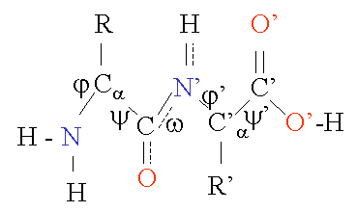
Feature Calculation
Torsion angles…
The backbone dihedral angles of proteins are:
φ (phi, involving the backbone atoms C'-N-C^{α}-C')
ψ (psi, involving the backbone atoms N-C^{α}-C'-N) and
ω (omega, involving the backbone atoms C^{α}-C'-N-C^{α}).
These can be calculated from the protein coordinate file (PDB files) to be used as features.

Slide 41
Feature Calculation
Once all the features are calculated, they must be tabulated as a feature table, where each row corresponds to a sequence (instance), and each column is a feature.
A vector containing the class label of each sequence (Y) should accompany the feature table (X).
>seq1
AASQRLAQS
>seq2
ASSNRADSQ
>seq3
ADSQRADSQ
….
A_freq
C_freq
…
AA_freq
AC_freq
…
PSSM1
PSSM2
…
Class
0.33
0.00
…
0.125
0.000
…
0.754
0.000
…
1
0.22
0.00
…
0.00
0.00
…
0.754
0.012
…
-1
…
…
…
…
…
…
…
…
…
…
Input features (X)
Class labels (Y)
Training sequences

Slide 42
FEATURE CALCULATION
Input data
……….
n training sequences
0.1 | 0.05 | 0.02 | 0.09 | 0.2 | 0.3 | 0.15 | 025 | 0.06 | 0.18 | 0.02 | 03 | 0.09 | 0.07 | 0.15 | 0.17 | 0.28 | 0.29 | 0.05 | 0.01
0.3 | 0.15 | 0.05 | 0.2 | 0.16 | 0.12 | 0.15 | 035 | 0.26 | 0.08 | 0.05 | 0.03 | 0.04 | 0.1 | 0.05 | 0.07 | 0.03 | 0.1 | 0.25 | 0.1
Build Model
Test

Slide 43
FEATURE CALCULATION
Reduced Alphabets:
Amino acid can be represented in terms of charge, hydrophobicity, size, volume etc.
Sometimes 2 properties can be combined at the same time to represent the amino acid sequence. This is known as two-tuple representation. Eg. Charge and Hydrophobicity, Volume and size etc.

Slide 44
FEATURE CALCULATION
Amino acid Sequence:
Sequence can be represented as
Where positively charged amino acids are represented by 1, negatively charged by 2 and neutral by 3
ADEFHIKLAAANMQRSTVW
3223331333333310000

Slide 45
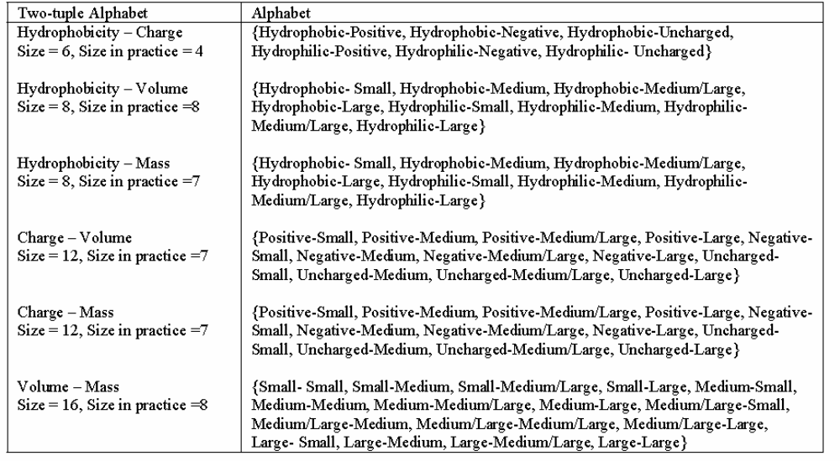
FEATURE CALCULATION
Two tuple can be represented as follows :

Slide 46
The k-Nearest Neighbor Classifier
One of the simplest machine learning algorithms for classification.
Based on the idea that training examples belonging to the same class lie close together in the euclidean space.
New examples are classified according to closest training examples in the feature space.

Slide 47
The k-Nearest Neighbor Classifier
New examples are classified based on their proximity to the k-nearest training examples. The class labels are assigned by counting votes from the labels of the k nearest neighbors. This is done as follows (say k=3):
  Compute euclidean distance from the new example to each of the examples in the train set.
  Identify the 3 (for k=3) nearest points in the train set from this point.
  Count the class labels from each class which these nearest neighbors belong to.
  Assign the class that labels 2 or more of these nearest examples to the new point.

Slide 48
Example: Classification of disordered proteins
Consider the case of classification of disorder and ordered proteins using two features: net charge and average hydrophobicity.
Ordered proteins
Disordered proteins
New protein
Net charge

Slide 49
Example contd…
Class=1 corresponds to disordered proteins, and class=-1 corresponds to ordered proteins.
Mean Hydrophobicity Net Charge Class
-1.68 -7 1
-1.315 1 1
-1.464 0 1
-1.961 2 -1
-2.003 3 -1
-1.594 -7 -1

Slide 50
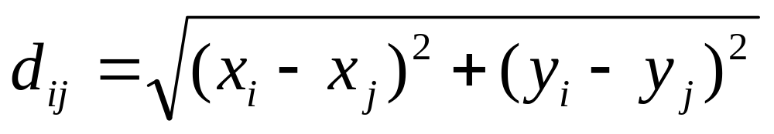
Example contd…
For a new protein which has, say, avg. hydrophobicity -2 and net charge of 3, compute euclidean distance from all the training points using the formula:
The distances of this new protein from all the 6 training examples were found as shown in the table below:

Slide 51
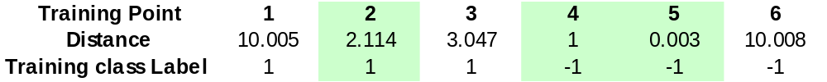
Example contd…
For k=3, identify the 3 nearest points in the training set. (shown in green)
Votes for Class 1=1
Votes for Class –1=2
Therefore, assign class label –1 to the new protein.

Slide 52
The k-Nearest Neighbor Classifier
Training involves finding the optimal value of k, which shows best generalization performance on unseen data.
The model can then be validated using a blind dataset, using this value of k.

Slide 53
Algorithmic Steps
The algorithmic steps for training and validation are as follows:
From the whole dataset, take around 70% examples for training, and keep 30% for testing.
In the training phase, start the search for optimal k from k=3. At each step, increment the value of k by 2.
Perform a 10-fold cross-validation on the training set for a particular value of k, measuring the cross-validation accuracy at each step.

Slide 54
Algorithmic steps (contd…)
4. When a sufficient number of different values of k have been tried, identify the value of k which shows the best cross-validation accuracy (say k=5).
5. Validate this model by checking the prediction accuracy using the blind test dataset on the entire training data.

