Slide 1
Applications of Support Vector Machines in Chemo and Bioinformatics
V.K. Jayaraman
Chemical Engineering Division
National Chemical Laboratory
Pune 411 008
vk.jayaraman@ncl.res.in

Slide 2
PATTERN RECOGNITION

Slide 3
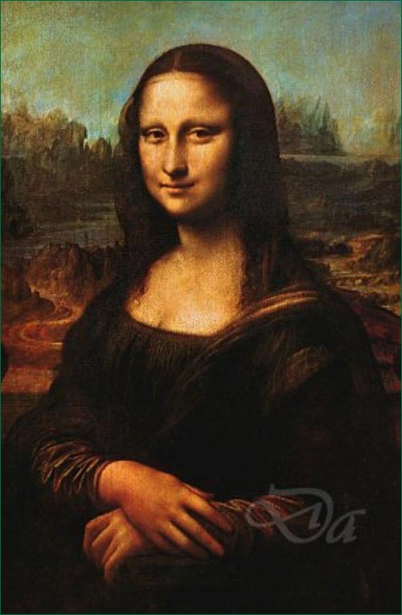
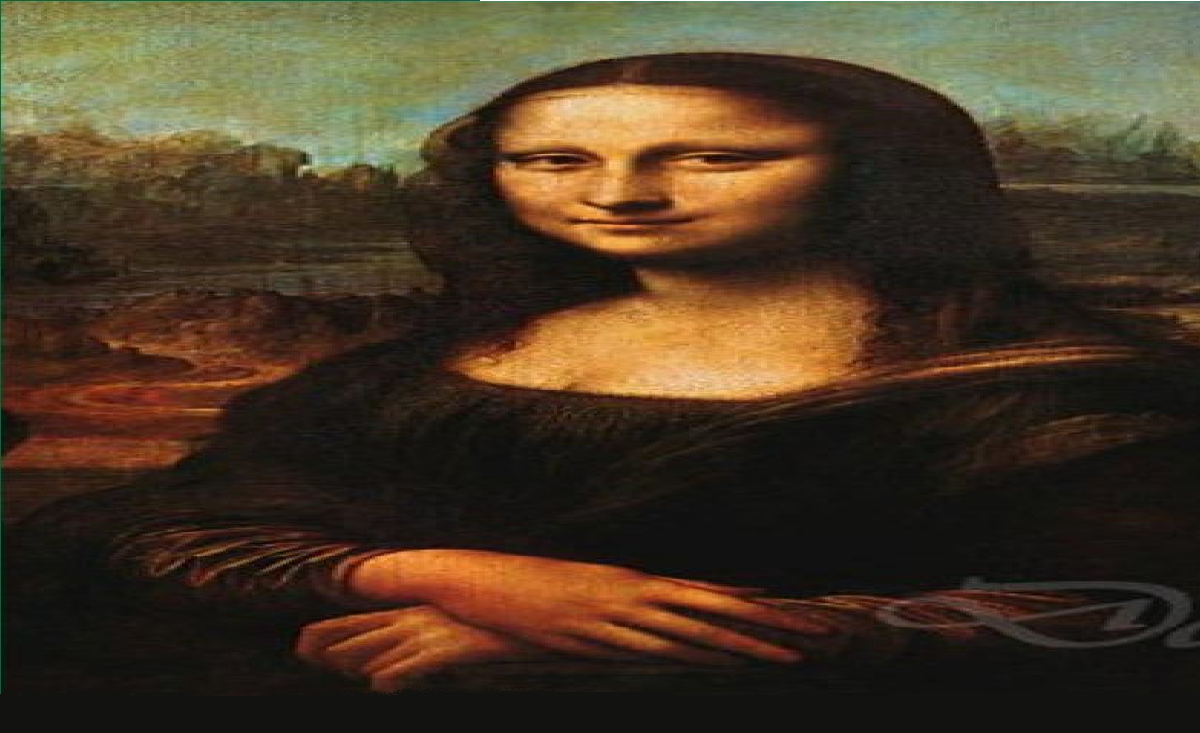
Pattern Recognition
Humans have skills to recognize and differentiate patterns
Provide Machines similar capabilities
Solve real life problems

Slide 4
Pattern Recognition
DNA SEQUENCES
GACCTTCACGAAGTTTCCGCACGGGATCTGTCAGGACACCGGTGTTGTCGCGTGTTTCAACTTTCA
CCGCTTTCACCGAAAAAATCAGAAACGATGGCCGATGCAGTGGCGAAGGGCAACCCGGGCAAGA
AGGTGTTTGTACAGAAGTGCGCCCAGTGTCACACAGTAGAGAAGGGAGGCAAGCACAAGGCCCAA
CCTCAACGGTCTGTTCGGCCGCAAGACAGGGCAGGCATCAGGCTTCTCGTACACCGACCAAAAAC
AAGGGTATTACATGGGCTGAAGACACCCTCTGGGTCTACCTGGAGAACCCCAAGAAGTTCCCGGCA
CTAAGATGGTCTTCGCTGGCTTGAAGAAGAAGGGCGAGAGAGCAGACCTCATCTCCTAAGGAGTC
CACCTCCTCATGATGCCGGTCCTGAGACGTCTTCTCTTCCGCTACCGCTTCTTACACTCAGCGGTT
Can we Identify Coding Sequences?

Slide 5
Pattern Recognition
PROTEIN SEQUENCES
MAHFAVGFLTLGLLVPVLTWPVSAPLLVIPVALSASIIRLRTLADERGVTVRRAVRWDDIDGLRFHRGSW
AEMKTDAATLAQEAGNFERISGDLKTQIDQVESTAGSLQGQWRGAAGTAAVRFQEAANKQKQELDEIST
SQIMYNYPAMLGHAGDMAGYAGTLQSLGAEIAVEQAALQSAWQGDTGITQAMQWNQAMEDLVRYHA
MRNFILFPMMAVVLLSGCQQNRPTTLSPAVSGQAQLEQLASVAAGARYLKNRSDLPADEAINRAAINVGK
MNSVQFKNHHHHHHPDMHTQVHTARLVHTADLDSETRQDIRQMVTGAFAGETDWEHTLGGMHAIWHH
Can we Identify Allergen causing Sequences?
Employ Support Vector Machine (SVM)

Slide 6

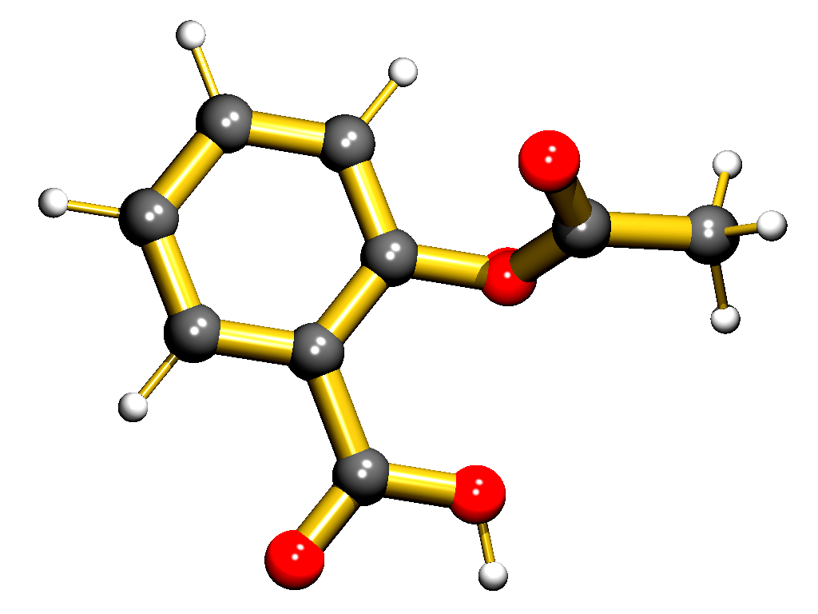
Pattern Recognition
Identify molecules having the required biological activity
recognition
Important Molecule
having Anti-tumor
activity
1-(X-phenyl)-3,3-dialkyl
triazenes series
Aspirin –
analgesic, antipyretic,anti-inflammatory

Slide 7
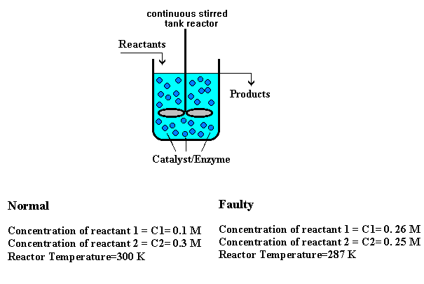
Pattern Recognition
Identify faulty operating conditions in reactor

Slide 8
Pattern Recognition
Drug Design
Identifying Active Drug
Methodology
collect
Structural Features
Collect Data
select
Informative Subsets
Select Features
Select Model
Select Model
Train Classifier
Train Classifier
Evaluate Classifier
Evaluate Classifier

Slide 9
Steps involved in Pattern Recognition / Classification
Acquisition /Sensing of data
Pre-Processing
Feature Extraction
Feature Selection
Classification
Post Processing
Decision

Slide 10
Steps involved in Pattern Recognition / Classification
1→Data Acquisition /Sensing
Example → Epitope Prediction
Acquire the raw sequences (both positive and negative) and curate them

Slide 11
Steps involved in Pattern Recognition / Classification
2→Pre-Processing
Preprocessing is done to remove redundancy.

Slide 12
Steps involved in Pattern Recognition / Classification
3→Feature Extraction
We need to input knowledge to the classifier
Protein function Identification :
  Numerical representation of the sequence.
  Amino acid frequencies
  Dipeptide frequencies
  Tripeptide frequencies
  K-mer frequencies
  Homology information in terms of Blast and Psi-blast profiles.
  Remote Homology using PSSM
  Motive information
  Secondary Structure information
  Physical propertied like hydrophobic, hydrophilic, charge, etc.
  Structural features like surface accesibility, co-ordinates of atoms, contact order.

Slide 13
Steps involved in Pattern Recognition / Classification
4→Feature Selection
Select the most important features.
Epitopes Prediction :
  Not all the amino acid/dipeptide frequencies may be of relevance.
Arrhythmia detection:
  Selecting the prominent wavelet and Fourier coefficients

Slide 14
Steps involved in Pattern Recognition / Classification
5→Classification
Identifying the most important classification methodologies
Classification:
  Linear Discriminant Analysis (LDA)
  Nearest neighbour classifier
  Artifical Neural Networks (ANN)
  Decision trees
  Random Forests
  Support Vector Classification (SVC)

Slide 15
Steps involved in Pattern Recognition / Classification
6→Post-Processing
Evaluation of confidence and decisions
Include incremental knowledge to improve performance
Combination of experts

Slide 16
IDENTIFICATION OF ORDERED DISORDERED PROTEINS
Importance of identifying disordered regions in proteins
It has been observed that disordered regions in proteins provide conformational flexibility to the proteins. This flexibility allows the proteins to bind to antigens or other molecules like drugs. Thus predicting disordered regions in proteins becomes important.

Slide 17
WORK DONE
Dunker et al. have predicted the disordered regions in proteins only on the basis of hydrophobicity and charge.
We shall now study how this can be done be supervised and unsupervised classification.

Slide 18


Supervised or Unsupervised
Unsupervised
Supervised

Slide 19
Supervised or Unsupervised
Unsupervised : Provided a set of features algorithm groups data into clusters ( does not require class information)
Supervised : Employs class label information of some instances to build a model. Model is validated employing unseen data

Slide 20
Unsupervised Classification
Algorithm will cluster the data points into groups
Input
Mean Hydrophobicity Net Charge
-1.68 -7
-1.315 1
-1.464 0
-1.961 2
-2.003 3
-1.594 -7
ordered
disordered
Class information need not be provided

Slide 21
Supervised Classification
Input
Mean Hydrophobicity Net Charge Class
-1.68 -7 1
-1.315 1 1
-1.464 0 1
-1.961 2 -1
-2.003 3 -1
-1.594 -7 -1
ordered
disordered
Algorithm will be trained on a set of given data points.
This algorithm will classify unseen data points into classes
Class information is need for training

Slide 22
SUPPORT VECTOR
CLASSIFICATION

Slide 23
Support Vector Classification
Introduced by Vapnik and co-workers in 1992
Rigorously based on statistical learning theory
SVM Classifier can Recognize Patterns efficiently
Solve Real Life Problems in :
  Chemo/Bio Informatics
  Many many other fields

Slide 24
Training / Testing Classifiers
Training
Set
Total
Data
Test
Set

Slide 25
General Approach
Train classifier to give minimum error
Test on the unknown data
Training Set
Classifier
Test Set
Classifier

Slide 26
Mean Hydrophobicity Net Charge
-1.153 2
-1.464 0
-3.300 9
-2.945 -7
. . . . . .
Mean Hydrophobicity Net Charge Class
-1.68 -7 1
-1.315 1 1
-1.464 0 1
-1.961 2 -1
-2.003 3 -1
-1.594 -7 -1
Test Data
SVM Model
Predictions
1
-1
-1
1
. . .
TRAINING DATA

Slide 27
Selecting Hyperplane
If you have several input features
Disordered
Normal
Mean Hydrophobicity Net Charge … Class
-1.68 -7 1
-1.315 1 1
-1.464 0 1
-1.961 2 -1
-2.003 3 -1
-1.594 -7 -1
y = mx + c → [ w^{T} x ] + b
W - weight vector
b - bias
W - vector : having dimensions equivalent to number of features
X : x1, x2, x3, ……. Input Vector
y : +1 class 1
y : -1 class 2

Slide 28
Selecting Hyperplane
If you have several input features
Disordered
Normal
Mean Hydrophobicity Net Charge … Class
-1.68 -7 1
-1.315 1 1
-1.464 0 1
-1.961 2 -1
-2.003 3 -1
-1.594 -7 -1
y = mx + c → (w₁ x₁ + w₂ x₂ )+b
W - weight vector
b - bias
W - vector : having dimensions equivalent to number of features
X : x1, x2, x3, ……. Input Vector
Here, x1=mean hydrophobicity, x2=net charge
y : +1 class 1
y : -1 class 2

Slide 29
Selecting Hyperplane
The job is to find a hyperplane (w₁ x₁ + w₂ x₂ )+b=0 .
Different combinations of values of w₁ and w₂ are possible:
Say, for w₁ = 1.261 and w₂ = 1.34 , we might
get a hyperplane as shown in the figure.
Disordered
Normal
for w₁ = 0.567 and w₂ = 3.165 , the hyperplane changes.

Slide 30
Selecting Hyperplane
In the same way, if we had 3 features x₁ , x₂ and x_{3,}
Solving (w₁ x₁ + w₂ x₂ + w₃ x₃)+b=0 would give us a 3D-hyperplane
Generalizing for n features, x₁ , x₂ , x₃ … x_{n}
Solving (w₁ x₁ + w₂ x₂ + w₃ x₃ + …+ w_{n} x_{n} )+b=0 would give us a n-dimensional hyperplane.

Slide 31
Which Hyperplane is Better ?
(a)
(b)
(c)
(d)

Slide 32
Concept of Margin: Auxiliary Hyperplane
[w^{T}x] + b = 0
Hyperplane
[w^{T}x] + b = + 1
[w^{T}x] + b = - 1
Support Vectors
Auxiliary Hyperplane
Margin
Notes:
Why margin given? Properties of margin.
Removing redundancy by maximizing margin

Slide 33
Concept of Margin
The best separating hyperplane (the one with maximal margin) is obtained only for an optimal set of w_{i} values and b.
This can be posed as a QP optimization problem expressed in terms of a lagrangian equation.
Training
Sequences
Features
SVM
(w₁ x₁ + w₂ x₂ )+b=0
W and b values from α
Hyperplane Equation
Lagrangian
QP solver

Slide 34
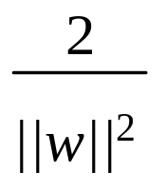
Maximum Margin Classifier
Constrain the data belonging to two different classes to be at least distance ‘1’ from the separating hyperplane
Minimize the risk of overfitting by choosing the maximal margin hyperplane in feature space
[w^{T}x] + b = 0
[w^{T}x] + b = + 1
[w^{T}x] + b = - 1
margin =
margin

Slide 35
Computing the margin(1)
We know,
wx⁺ + b = +1 …(1)
wx⁻ + b = -1 …(2)
Also, x⁺ = x⁻ + λw …(3)
for some value of λ.
Substituting x⁺ from eq. 3 in eq. 1,
w(x⁻ + λw) + b = 1
w.x⁻ + λ.(w.w) + b =1
(w.x⁻ + b) + λ.(w.w) =1
Substituting (w.x⁻ + b) from eq. 2;
[wx] + b = 0
[wx⁺] + b = + 1
[wx⁻] + b = - 1
x⁺
-1 + λ.(w.w) =1
λ=2/(w.w)
x⁻
M=margin width

Slide 36
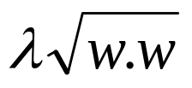
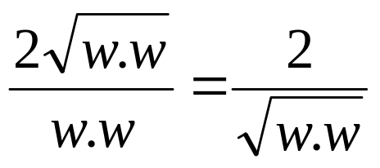
Computing the margin(1)
We know,
wx⁺ + b = +1 …(1)
wx⁻ + b = -1 …(2)
Also, x⁺ = x⁻ + λw …(3)
for some value of λ.
And λ=2/(w.w) …(4)
| x⁺ - x⁻ |=M …(5)
M = | x⁺ - x⁻ | = |λw|
Substituting λ from eq. 4;
M= λ | w|=
[wx] + b = 0
[wx⁺] + b = + 1
[wx⁻] + b = - 1
x⁺
x⁻
M=margin width
=>M=

Slide 37
SVM Linear Classifier
( Constrained Optimization)
W = (1,3)
W = (1,4)
b = 0.5
b = 0.2
Hyperplane equation : [w^{T}x] + b = 0
have weight vector (w) and bias (b)
Only a particular combination of w and b will give the best
Separation so, SVM Classification is an optimization problem

Slide 38
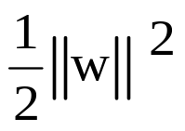
SVM Linear Classifier
( Constrained Optimization)
Constrain the data belonging to two different classes to be at least distance ‘1’ from the separating hyperplane
[w^{T}x] + b = 0
Minimize
[w^{T}x] + b = 1
[w^{T}x] + b = -1
For negative class
y_{i} = -1 and ([w^{T}x] + b)≤ -1
y_{i}([w^{T}x] + b ) ≥ 1
For positive class
y_{i} = 1 and ([w^{T}x] + b) ≥ 1
y_{i}([w^{T}x] + b ) ≥ 1
1
1

Slide 39
Primal Problem
Minimize
Subject to :
y_{i} ( [ w^{T} x_{i} ] + b ) ≥ 1 , i = 1, 2, …. N
Can be further solved
  Using Lagrange multipliers
  Primal-Dual theory of optimization.
Ultimately leads to a convex Quadratic Optimization problem containing unique solution.
  Contrast to: Neural Net Several Local Minima

Slide 40
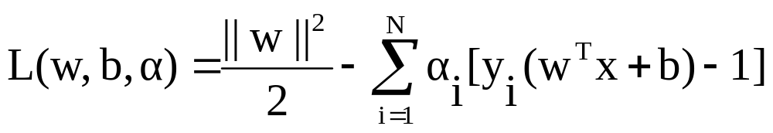
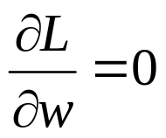
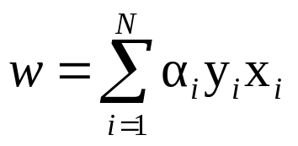
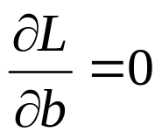
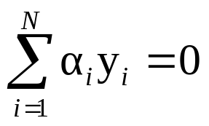
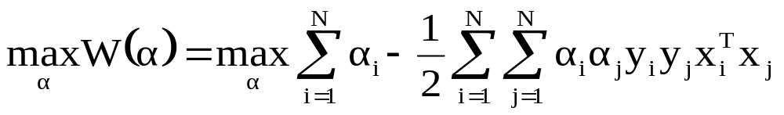

Using Lagrange multipliers
Differentiating w.r.t. w and b
→
→
We get the dual problem as
Notes:
CHANGE

Slide 41

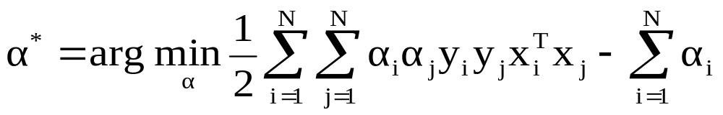
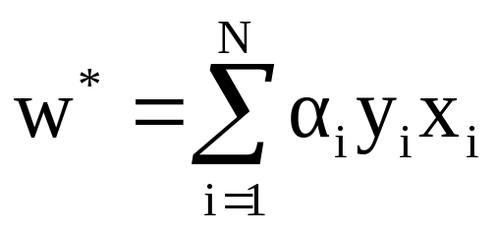
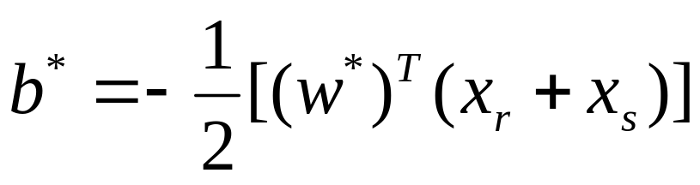
Algorithmic steps (so far):
We have a Convex QP problem, which has a unique solution
Firstly, we solve for
Then, we obtain the hyperplane, ie. values of w and b

Slide 42
Calculating the value of α
Programming libraries available for solving Quadratic Optimization problems (QP solvers) are used to compute the values of α from the lagrangian form.
Lagrangian
Equations
QP Solver
Values of
α

Slide 43
Calculating value of b - bias
Mean Hydrophobicity Net Charge … Class
-1.68 -7 1
-2.003 3 -1
w
[ w^{T} x ] + b = + 1
[ w^{T} x ] + b = - 1
[ w^{T} xr ] + b = +1
[ w^{T} xs ] + b = -1
[ w^{T} (xr + xs ) ] + 2b = 0
[ w^{T} (xr + xs ) ] = - 2b
➔ b* = - ½ [ (w*)^{T} (xr + xs ) ]
+
Xs
Xr
b

Slide 44
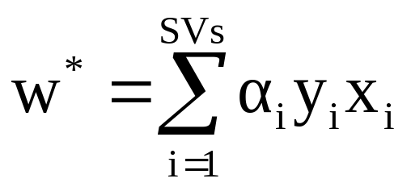
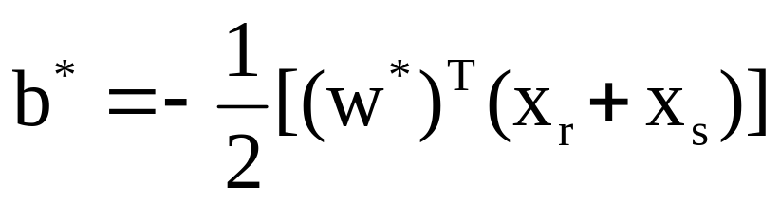
Idea of Support Vectors
From optimization, we can prove that only the points on margin
have non- zero values
These points are called as Support Vectors.
Only support vector information is sufficient to classify new
unseen data
Optimal Hyperplane
Support Vectors
Margin

Slide 45
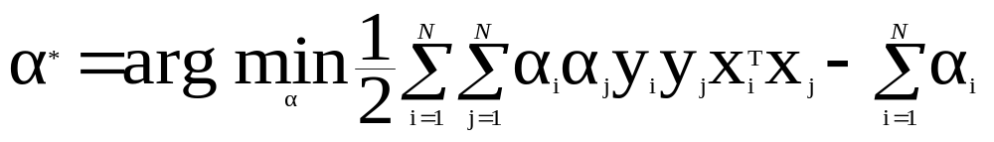
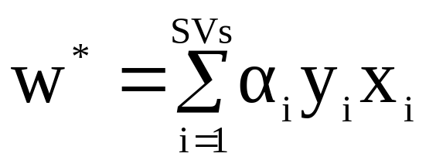
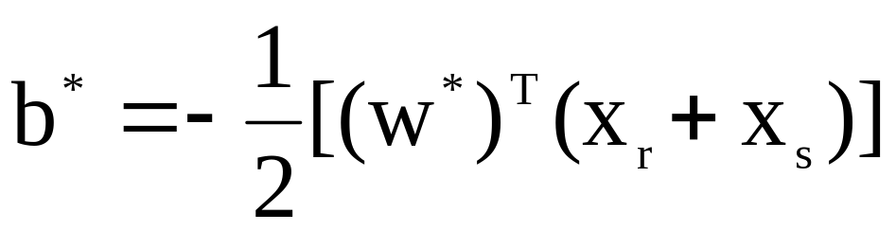
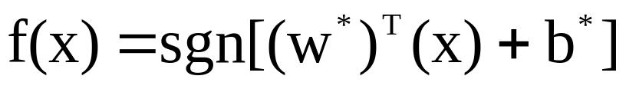
Training Algorithm (so far)
Employ the trained classifier for the unseen testing data

Slide 46
Over Fitting
Over fitting : Perfect training accuracy but poor performance on unseen data.
Employ Functions with Optimal Complexity for Good Generalization

Slide 47
Structural Risk Minimization
under fitting
over fitting
Complexity
+
Training Error
Training
Errors
complexity
Best Trade-off
Functions in increasing complexity

Slide 48
Structural Risk Minimization (SRM) Principle
Empirical Risk Minimization Minimizes average error : Overfits training error, remains functionally complex
Structural Risk : Provides a specific way to incorporate complexity measure along with empirical risk
SVM is based on SRM
Vapnik-Chervonenkis (VC) dimension controls complexity of algorithm
VC Dimension : Measures how many training points can be shattered for all possible labeling using functions of the class
Maximization of margin leads to minimization of VC dimension

Slide 49

Limitations of Linear Classifier
Linear classifier is not always the winner.

Slide 50
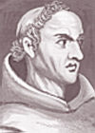
Ockham’s Razor
William of Ockham, 14th-century English logician.
As per him,
  "All things being equal, the simplest solution tends to be the best one."

Slide 51
Example: Learning in the Feature Space
Not linearly separable One-Dimensional dataset
(x , x/2) → (x , x⁴)
y
y
x
Hyperplane
x
X : -5 –4 –3 –2 –1 0 1 2 3 4 5 6
X/2 : -2.5 -2 -1.5 -1 -0.5 0 0.5 1 1.5 2 2.5 3
X^4 : 625 256 81 16 1 0 1 16 81 256 625 1296
Notes:
X : -5 –4 –3 –2 –1 0 1 2 3 4 5 6
X/2: -2.5 -2 -1.5 -1 -.5 0 .5 1 1.5 2 2.5 3
X^4 : 625 256 81 16 1 0 1 16 81 256 625 1296

Slide 52
Learning in the Feature Space
Mean Hydrophobicity Net Charge Class
-1.68 -7 1
-1.464 0 1
-1.961 2 -1
-2.003 3 -1
Can we have a function that transforms lower dimensional
non-Separable data into higher dimensional separable data
φ
x
φ (x)
-1.68 -7 1
-1.464 0 1
-1.961 2 -1
-2.003 3 -1
6.01 3.9 2.5 1
0.17 2.0 8.0 1
3.10 5.6 3.6 -1
5.0 4.3 4.7 -1

Slide 53
Learning in the Feature Space
Map the data into a feature space where they are linearly separable
φ
Input Space
x
φ (x)
Feature Space

Slide 54
Learning in the Feature Space
φ
x
φ (x)

Slide 55
SVM Linear Classifier in High Dimensional Space
[ w^{T} φ(x) ] + b = -1
[w^{T} φ(x)] + b = 0
[w^{T}φ(x)] + b = 1
Support Vectors
1
1

Slide 56
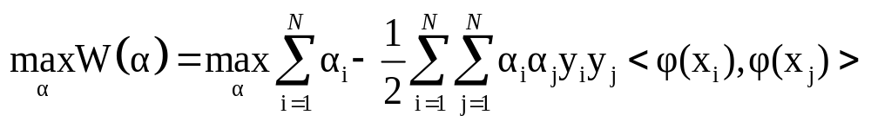

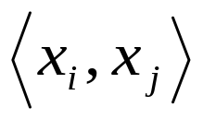
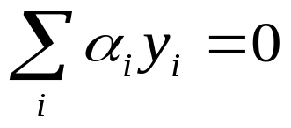
Higher Dimensional Feature Space
The Dual problem now becomes:
Real life problems have several input features
  Gene Expression Profiles → Thousands of Genes
  Drug Discovery → More than 100 thousand Descriptors
Eg. 256 dimensional data, polynomial of degree 5 gives the feature space dimension ≈ 10¹⁰
Notes:
CHANGE

Slide 57
INTRODUCTION TO KERNELS

Slide 58
EXAMPLE
Input Vector, X |  | Desired Response, Y
x₁ | x₂
-1 | -1 | -1
-1 | +1 | +1
+1 | -1 | +1
+1 | +1 | -1
Thus we have the matrix
0 0 -2
0 2 -2 0 Not classified by
0 -2 2 0 SVM
-2 0 0 2

Slide 59



EXAMPLE CONTD…
Modifying the operation to solve the problem using SVM
Now the input features are as follows:
1 1 - -1
1 -1 - 1
1 -1 -1
1 1 1
φ(x_{i}) = [ 1 x_{i1}² x_{i1} x_{i2} x_{i2}² x_{i1} x_{i2} ]

Slide 60
Thus in the same way all the input features can be obtained by using the following matrix.
Where Thus the
matrix
now is
K₁₁ = φ(x₁₁) φ(x₁₁) ^{T} K₁₂= φ(x₁₁) φ(x₁₂) ^{T} K₁₃= φ(x₁₁) φ(x₁₁) ^{T} K₁₄= φ(x₁₁) φ(x₁₂) ^{T i=1, j=1}
K₂₁ = φ(x₂₁) φ(x₂₁) ^{T} K₂₂= φ(x₂₁) φ(x₂₂) ^{T} K₂₃= φ(x₂₁) φ(x₂₁) ^{T} K₂₄= φ(x₂₁) φ(x₂₂) ^{T i=2, j=2}
K₃₁ = φ(x₃₁) φ(x₃₁) ^{T} K₃₂= φ(x₃₁) φ(x₃₂) ^{T} K₃₃= φ(x₃₁) φ(x₃₁) ^{T} K₃₄= φ(x₃₁) φ(x₃₂) ^{T i=3, j=3}
K₄₁ = φ(x₄₁) φ(x₄₁) ^{T} K₄₂= φ(x₄₁) φ(x₄₂) ^{T} K₄₃= φ(x₄₁) φ(x₄₁) ^{T} K₄₄= φ(x₄₁) φ(x₄₂) ^{T i=4, j=4}
K =
K₁₁ = φ(x_{i}) * φ(x_{j}) ^{T}
= 1 + 1 + 1 + 2 + 2 + 2
= 9
1 1 1
9 1 1
1 1 9 1
1 1 1 9
K =

Slide 61
Input Vector, XI |  | Desired Response, Y
x₁ | x₂
-1 | -1 | -1
-1 | +1 | +1
+1 | -1 | +1
+1 | +1 | -1

Slide 62



Thus by converting the feature space from 2 to 6 we can solve the given problem.
= ²
Thus by using the kernel where p = 2, we can solve the problem in the input space only.
As = 2 where i=j
Thus when we substitute it in the formula we get (2+1)² = 9

Slide 63
Thus as can be seen, now the example can be solved.
However as can be seen,
For 2 features 6 features were needed to classify
For 100 features, 1000,000 may not be simple for the SVM to classify. Hence we use kernel functions.

Slide 64
Introduction of Kernel Function
Working in high dimensional feature spaces solves the problem of expressing complex functions
BUT….
  Computationally intractable
  Data Dimensionality increases exponentially in the feature space
SOLUTION….
Introduce kernel functions for simplification

Slide 65

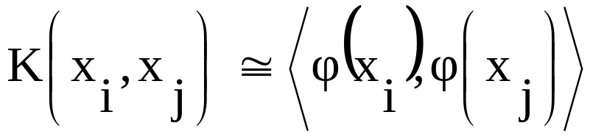
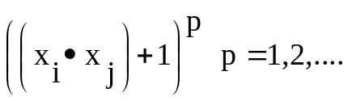
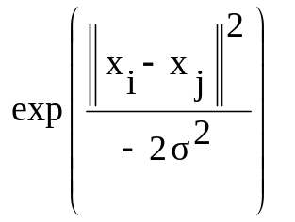
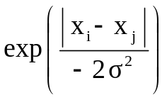
Kernel Functions
Kernel function in
input space
Dot product in the higher dimensional feature space
Polynomial
Gaussian Radial Basis Function
Exponential Radial Basis Function

Slide 66

Polynomial Kernel
For polynomial kernel of degree 2
In terms of monomials
In feature space
Similarly,

Slide 67
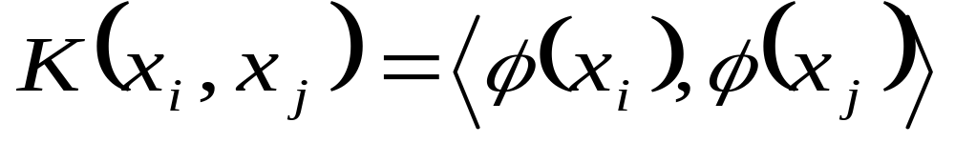
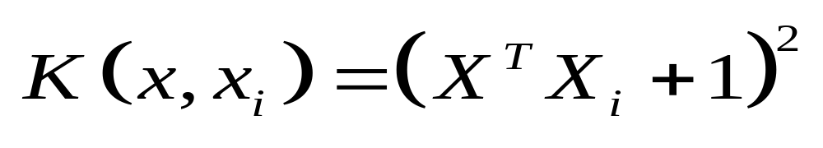
So, SVM = Linear Classifier in high dimensional space with computation in the input space itself

Slide 68
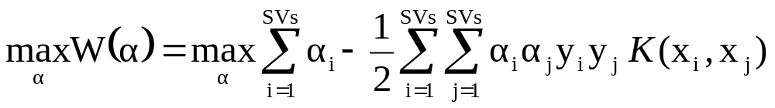
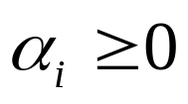
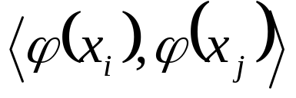
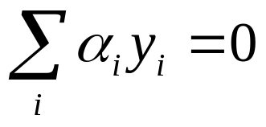
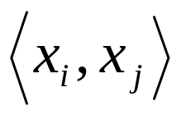
Kernel Functions
The QP problem with introduction of Kernel functions:
SVM = Linear Classifier in the High Dimensional Feature space
Introduction of Kernel Function enables computations in Input
space itself
Notes:
CHANGE

Slide 69
Synopsis-SVM Classifier
GOAL: To find the hyperplane equation from the training examples.
Input features(eg. Mean hydrophobicity, net charge)
A. Linearly non-separable input space (few features).
B. Linearly separable input space (huge number of features)
Application of some function (kernel function) transforms the input space from non-separable (A) to a linearly separable one (B).

Slide 70
Allowance for misclassifications
w^{T}x + b = 0
w^{T}x + b = 0
ξ_{i}
Perfect Classification leads in Reduction In Margin and Over fitting
Slack variable ξ_{i} reflects the extent to which the point fails to satisfy the margin

Slide 71



Soft Margin Formulation
The QP problem with soft margin:
ξ_{i}
C: Regularization parameter (user-defined)
Trade off Between Margin Maximization and Misclassification
Notes:
CHANGE

Slide 72
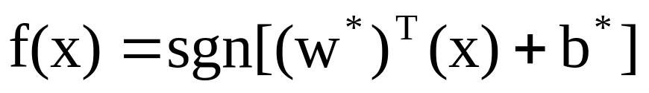
SVM Algorithm
Training a model
  Select a kernel function
  Tune the other kernel parameters (how part yet to come !!)
  Decide the best hyperplane using the previously mentioned equations
Testing the data
  For each new unseen data, decide the class as

