Slide 1
MODEL SELECTION IN SVM

Slide 2
Selecting Kernel Function
Choose best possible Kernel Function and its parameters.
Domain knowledge is useful for selecting kernel, some domain specific kernels are :
  String kernel
  Fisher kernel
  Mismatch kernel
  Graph kernel
  Wavelet kernel
One of these three kernels : Polynomial, RBF, Exponential will work in majority of domains.
SVM in combination of Genetic Algorithm can be employed for automatic selection of Kernel Function and its Parameters

Slide 3
Choosing Multiple Parameters for SVM
Choosing multiple optimal hyper parameters : An important step in SVM design
Usually done by,
  Minimizing an estimate of generalization error
  Some other related performance measure

Slide 4
Parameters that Need to be Tuned
Regularization parameter, C: determines the trade off between margin maximization and error minimization
Kernel parameter, (σ or d ): implicitly defines the nonlinear mapping from input space to some high-dimensional feature space

Slide 5
Commonly used Methods for
Parameter Tuning
k-fold cross validation
Leave-one-out error estimation

Slide 6
k-fold Cross Validation
The training data is randomly split into k mutually exclusive subsets (or the folds) of approximately equal size
For k times
  SVM decision rule is obtained using k -1 of the subsets
  Then tested on the subset left out

Slide 7
3-fold Cross Validation
Fold 1
E
r
r
o
r
Total
Data
Fold 2
Fold 2
SVM
Fold 3
Testing Data
Training Data

Slide 8
3-fold Cross Validation
Fold 1
E
r
r
o
r
Total
Data
Fold 2
Fold 2
SVM
Fold 3
Testing Data
Training Data

Slide 9
3-fold Cross Validation
Testing Data
Fold 1
Training Data
E
r
r
o
r
Total
Data
Fold 2
Fold 2
SVM
Fold 3

Slide 10
3-fold Cross Validation
Fold 1
E
r
r
o
r
s
Total
Data
Fold 2
Fold 2
SVM
Fold 3
Validation error = Average of three errors

Slide 11
Leave-one-out error (LOO) estimate
Extreme form of k -fold cross-validation
  k is equal to the number of examples, l
For l times
  SVM decision rule is obtained using l -1 of the examples
  Then tested on the subset left out example
Good thing about LOO
  Almost unbiased estimate of the expected generalization
  error
Limitation
  Computationally expensive since computations require
  running the training algorithm l times.

Slide 12


SVM with RBF Kernel
SVM with RBF kernel function has two parameters
  c → Regularization
  → Width of RBI Kernel function
Sparse grid with this parameters is :
1
10
100
1000
10000
Run SVM with grid values of parameters
Find cross validation error
Choose kernel with least cross validation error
Repeat with other kernels
1
c
10
100
1000
10000
Notes:
ALPHA

Slide 13
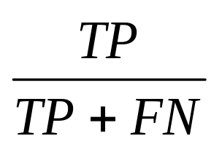
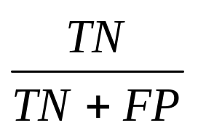
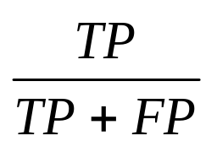
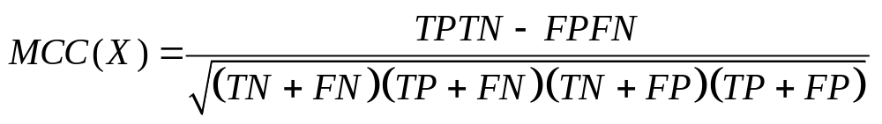
Model Evaluation Measures
Sensitivity =
TP = True Positive
TN = True Negative
FP = False Positive
FN = False Negative
Specificity =
Precision =
Matthew’s Correlation Coefficient

Slide 14
Multi-Class SVM
The multi-class classification problem
  Decomposition to several binary problems
  For which the standard (binary) SVM can be used.
Three most commonly used approaches:
  One-against-all
  One-against-one
  Directed Acyclic Graph (DAG)

Slide 15
One-Against-All
i^{th} model separates i^{th} class from the rest ‘k-1’ classes.
  ‘k’ binary SVM models
For a test case
  The class with the highest vote is the winning class
*
*
*
*
*
*
*
*
*
*
*

Slide 16
One-Against-One
Each class is trained with all the other classes
  ‘k(k-1)/2’ binary SVM models
For a test case
  The class with the maximum votes is the winning class
*
*
*
*
*
*
*
*
*
*
*

Slide 17
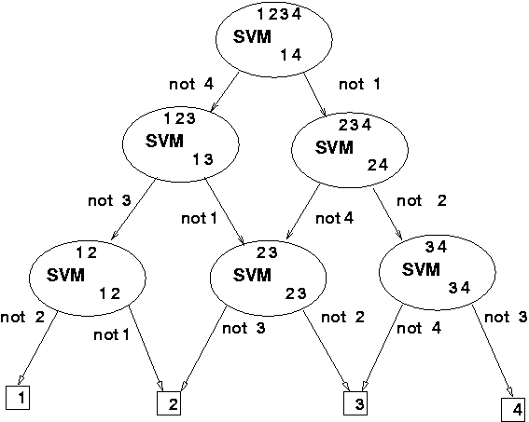
Directed Acyclic Graph (DAG)
Each node is binary SVM of i^{th} and j^{th} classes.
k(k-1)/2 internal nodes and k leaves.
Testing phase is same as the one-against-one method

Slide 18
Why Single Class SVM?
Binary or multi-class classification requires sufficient data belonging to each class
Insufficient data belonging to abnormal cases of process plant
Classification with imbalanced data is difficult
Single class SVM finds the way-out for this kind of problem
The classifier is trained only on the data belonging to normal operating conditions of process plant
The trained classifier can be used for online detection abnormal condition in the plant
Notes:
Single svm class modifies

Slide 19
Single class SVM classification
Outlier
Support Vectors lying on the sphere
Decision boundary
Construction of the smallest sphere in feature space which
contains most of the training data.
Formulated as a QP Problem

Slide 20
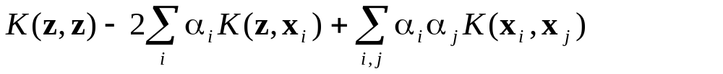
Mathematical Formulation of Single Class SVM
Data point belonging abnormal conditions
Support vectors act as the control limit
Data point belonging NOC
Distance of point z from center of the sphere in feature space
Radius of the sphere is calculated as the distance of support vector and center of the sphere.
If the distance of a new point is greater than radius of the sphere, point is declared as abnormal

Slide 21
SUPPORT VECTOR REGRESSION
Notes:
Why, What, how

Slide 22

The Regression Problem
“Close points” may be wrong due to noise only
  Line should be influenced by “real” data, not noise
  Ignore errors from those points which are close!

Slide 23
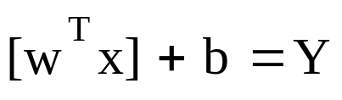
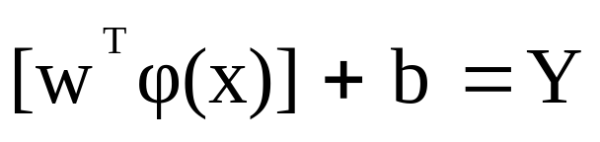
Support Vector Regression
Linear regression in the input space:
For linearly non-regressable problems, SVM methodology linearly regresses in the high dimensional feature space.
Apply same principles to convert into a kernel based algorithm Solve QP .
Very useful in process identification, QSAR/QSPR and data driven modeling

