Slide 1
ELPIS IT SOLUTIONS · 2026
Industrial Intelligence Platform
From shop floor signal to enterprise decision — connectivity, acquisition, condition monitoring, and operational intelligence in one stack.
Presented by
[ Presenter Name ]
[ Role ] · [ Date ]
ELPIS
THINK · CREATE · ENABLE
Notes:
Don't read the slide. Open with one sentence: 'I'm going to show you how to put your whole plant — every machine, every shift, every controller — on one operational view, without ripping out anything you already own.'

Slide 2
THE PROBLEM
The data is already on the floor.
Fanuc, Brother, Siemens, energy meters
Plants don't have a
data problem.
They have a
decision problem.
Each speaks a different language.
OEE numbers stitched together from spreadsheets
And from operator memory at the end of the shift.
Downtime detected in hindsight
Not in the moment it happens.
ELPIS · INDUSTRIAL INTELLIGENCE PLATFORM
02 / 14
Notes:
Anchor with a specific scenario: 'Your line manager finds out about a 47-minute downtime event at 6 AM the next morning, when she opens her email.' Pause. Let it land.

Slide 3
DESIGNED FOR
Five places this platform was built for.
01
Multi-vendor CNC manufacturing plants
Mixed Fanuc, Brother, Mazak fleets on a single operational view.
02
Brownfield modernization projects
Older controllers brought into a modern analytics stack — the iron stays.
03
Multi-site industrial operations teams
Fleet coherence across plants with one EREMOS V2 tenant.
04
OEM machine monitoring deployments
Trust-respecting telemetry on machines deployed at customer sites.
05
Automotive parts and precision machining operations
Tier-2 suppliers needing audit-defensible OEE and provenance.
ELPIS · INDUSTRIAL INTELLIGENCE PLATFORM
03 / 14
Notes:
Pause at each bullet. Pick the one your prospect is, read it directly to them, then move on. If the prospect doesn't fit any of these five, this is the moment to qualify out gracefully.

Slide 4
THE SOLUTION
Five capabilities. One ecosystem.
PILLAR 1
PILLAR 2
PILLAR 3
PILLAR 4
PILLAR 5
Connectivity & Edge
Data Acquisition
Asset Intelligence
Condition Monitoring
Operational Intelligence
Brownfield-ready connectivity to the controllers you already run.
Sensor-direct acquisition where controllers won't share data.
Utilization telemetry — even on unconnected legacy machines.
Vibration and oil-health intelligence — sensor-agnostic.
Multi-tenant OEE, alarms, and reports across plants.
EDGECONNECT · EDGE GATEWAY
MDAQ
MTRACKER
VAS · E-IDOS
EREMOS V2
Every layer of the industrial data path — collected, normalized, and understood. Built end-to-end by Elpis.
ELPIS · INDUSTRIAL INTELLIGENCE PLATFORM
04 / 14
Notes:
Establish the platform as one ecosystem across five capabilities — Elpis builds every layer, software and hardware. Don't deep-dive each pillar; the next slide covers the acquisition hardware, and the architecture slide shows how they connect. Land the line: 'every layer of the data path, built by us.'

Slide 5
ACQUISITION HARDWARE
Built by Elpis. From the sensor up.
Edge Gateway
Ruggedized DIN-rail appliance — a PLC-to-network bridge today (built-in Modbus TCP), the EdgeConnect appliance once Linux ships.
CONNECTIVITY & EDGE
mDAQ
Multi-channel acquisition for analog and digital signals — connect what controllers won't expose.
DATA ACQUISITION
mTracker
Continuous machine-run telemetry — even on un-connected legacy assets.
ASSET INTELLIGENCE
VAS
Real-time vibration capture and analysis for rotating machinery — early warning, not hindsight.
CONDITION MONITORING
E-IDOS
Hydraulic & lubrication oil-health monitoring — sensor-agnostic, Elpis-built controller. Standalone today.
CONDITION MONITORING
DEPLOYED WHERE FAILURE ISN'T AN OPTION
Deployed in defense and space-agency programs · Maintenance and AMC providers across India and the Middle East.
ELPIS · INDUSTRIAL INTELLIGENCE PLATFORM
05 / 14
Notes:
This is the slide that earns the 'built by Elpis' claim. Five hardware products — the acquisition layer the software sits on. Don't read every line; pick the one nearest the prospect's pain (vibration for rotating machinery, oil for hydraulics, mDAQ for controller-less sensors). The proof band is anonymized on purpose — defense / space / AMC channel — never name a customer.

Slide 6
THE SOFTWARE
Two products turn that signal into decisions.
EdgeConnect
EREMOS V2
Connectivity & Edge — the runtime
MQTT · OPC UA
Operational Intelligence
Collects from supported CNC, PLC, and instrumentation sources on your floor.
Canonical data pipeline. Per-route store-and-forward. Three-way diagnostics. Signed offline licensing. Deploys per plant — one per site.
Turns that data into OEE, alarms, incidents, and reports.
Multi-tenant analytics. OEE via Segments. Persistent alarm + incident workflow. Configurable alerting. PDF / Excel reports. Tool-life · tag mapping.
Licensed independently. The two software products are the bookends of the five-capability stack — the hardware sits between them.
ELPIS · INDUSTRIAL INTELLIGENCE PLATFORM
06 / 14
Notes:
The two software products are the bookends of the five capabilities: EdgeConnect is Connectivity & Edge, EREMOS V2 is Operational Intelligence. The three hardware-led capabilities sit between them. Sold and licensed independently; deployed together.

Slide 7
OUTCOMES YOU CAN HOLD US TO
Six concrete outcomes. Operational deliverables — not promises.
Cut unplanned downtime
Trust your OEE number
Persistent alarm tracking and incident workflows.
Every input collected at the controller.
Modernize legacy controllers
See your whole fleet
No replacements required.
Multiple plants, one operational view.
Keep sensitive data where it belongs
Make audit review defensible
Fully offline-capable at the edge.
Hash-chained config history, signed offline licensing.
ELPIS · INDUSTRIAL INTELLIGENCE PLATFORM
07 / 14
Notes:
This is the slide to spend time on. Read each outcome out loud. Ask the prospect which one matters most to them right now. The answer shapes the rest of the conversation.

Slide 8
REPLACE SPREADSHEET OPERATIONS
Most plants already have the data.
What they lack is a system that produces:
WITH THE PLATFORM
TODAY
shift-handover-w17.xlsx
Trusted timestamps
Time
Op
Mc
OEE
Notes
Captured at the controller — not transcribed from a clipboard.
0600
RKM
M-12
78%
Auditable OEE
0612
RKM
M-12
81%
jam cleared
Segment-based math you can show an auditor.
0635
??
M-15
—
OFFLINE
Persistent alarm history
0700
TLN
M-12
82%
shift chg
0701
TLN
M-15
78%
retry
Every fault on the record.
0712
TLN
M-15
76%
Unified machine visibility
0830
TLN
M-08
—
down 47min
One view across CNCs, PLCs, meters.
Tribal knowledge in cells. No timestamps you can trust.
Centralized workflows
Shift reports as a record — not a phone call.
ELPIS · INDUSTRIAL INTELLIGENCE PLATFORM
08 / 14
Notes:
Ask the prospect: 'How many spreadsheets does your shift handover currently depend on?' Most prospects say three to seven. That's the opening.

Slide 9
CONNECTIVITY COVERAGE
We support the protocols your controllers already speak.
SOUTHBOUND
SOUTHBOUND
CNC controllers
PLC + instrumentation
FOCAS2 · MTConnect · Brother HTTP
Modbus TCP · Siemens S7 · OPC UA Client
NORTHBOUND
NORTHBOUND
Messaging
Enterprise integration
MQTT (any compliant broker)
OPC UA Server
One canonical CNC vocabulary across every source. The same dashboard layout works across Fanuc, Brother, Siemens, and Modbus-fronted machines.
COMING · FANUC MT-LINKi (REST) · HTTP / TCP sinks · Linux host
ELPIS · INDUSTRIAL INTELLIGENCE PLATFORM
09 / 14
Notes:
This is the trust-signal slide for industrial IT buyers in the room. If you're in front of a CNC-heavy crowd, spend time on the CNC column. If you're in front of a multi-vendor fleet, spend time on the canonical-vocabulary footer line — that's the unique differentiator.

Slide 10
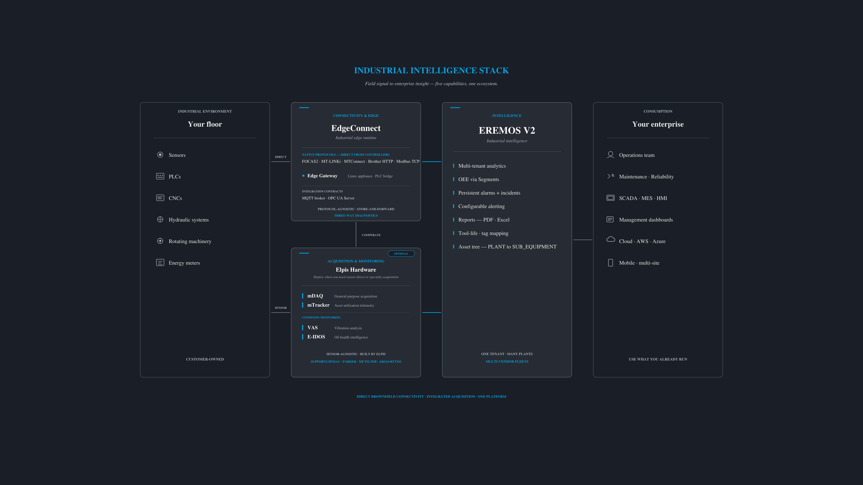
ARCHITECTURE AT A GLANCE
Edge collects · Integration carries · Intelligence aggregates · Consumers consume
Acquisition hardware and EdgeConnect collect at the edge of each plant; one EREMOS V2 tenant aggregates many sites. Standard MQTT and OPC UA keep it interoperable with whatever else you run.
ELPIS · INDUSTRIAL INTELLIGENCE PLATFORM
10 / 14
Notes:
Walk left to right. One sentence per layer. Don't dwell on the OPC UA Server box unless asked — most plant managers don't care; most SCADA engineers do.

Slide 11
WHY ELPIS
Differentiators, every one of them outcome-led.
New protocols ship without breaking the old ones
Built to run for years on a small box in a control cabinet
Protocol-agnostic core by architecture, not by accident.
Edge-first, not cloud-first. Store-and-forward by default.
Operators always know where the data flow broke
Air-gapped factories are first-class
Three-way diagnostics — source, pipeline, sink — by design.
RSA-signed JSON license, fully offline. No phone-home.
A lapsed license never stops production data
AI architecture: proposals require human confirmation
Expiration blocks configuration changes only.
Roadmap agents are designed never to silently alter the data path. Local-LLM-capable.
Pay for the connectivity you actually use
One vendor from sensor to dashboard
Per-edition packaging with modular per-protocol activation.
Acquisition hardware, edge runtime, and intelligence — all built by Elpis.
ELPIS · INDUSTRIAL INTELLIGENCE PLATFORM
11 / 14
Notes:
This is where you stop pitching features and start positioning category. The three highlighted differentiators — 'Air-gapped factories are first-class,' 'A lapsed license never stops production data,' and 'AI proposes — humans decide' — form the trust posture cluster. They are credibility wins competitors can't replicate without rewriting their products. Land them slowly; let each one breathe.

Slide 12
DEPLOY INCREMENTALLY
Start small. Expand without disruption.
One cell
One line
One plant
Fleet
...continues
Start with one machine, one line, or one plant.
EdgeConnect runs side-by-side with what you already have. EREMOS V2 onboards new sites without changing the platform underneath.
No big-bang cutover. No platform-wide upgrade that breaks the plants already running.
Typical proof-of-value deployments begin with a single line or machine cell and expand incrementally once operationally validated.
ELPIS · INDUSTRIAL INTELLIGENCE PLATFORM
12 / 14
Notes:
This slide defuses the biggest unspoken objection: 'Will this disrupt my plant?' Read the callout box verbatim. Then pause.

Slide 13
EDITIONS, MODULES, ROADMAP
Software editions — hardware scoped per BOM
RECOMMENDED
STARTER
PROFESSIONAL
ENTERPRISE
Single-plant deployments
Multi-protocol fleets
Multi-site + audit-grade
✓
Core EdgeConnect runtime
✓
Everything in Starter
✓
Everything in Professional
✓
Choice of 1 southbound module
✓
Multiple southbound modules
✓
Fleet-wide management
✓
MQTT sink
✓
OPC UA Server
✓
Hash-chained config history
Connectivity modules · FOCAS2 · MTConnect · Brother HTTP · Modbus TCP · OPC UA Client · Siemens S7 · MQTT · OPC UA Server
ON THE ROADMAP
FANUC MT-LINKi (REST, southbound)
HTTP / TCP sinks (northbound)
Linux host support
AI-assisted operations agents
ELPIS · INDUSTRIAL INTELLIGENCE PLATFORM
13 / 14
Notes:
Cover editions in 30 seconds. The detail belongs in the follow-up conversation, not the pitch. The roadmap is here so we do not blur shipped capability with planned capability — be explicit about what ships today versus what's on the way.

Slide 14
NEXT STEP
Bring us a real plant. We'll scope a real proof.
Bring us a representative plant — a controller mix, a target broker, an OEE definition.
We will scope a proof of value against it.
Demos run on real protocols against your real signals. Not canned data.
Scope your first machine
[ Presenter Name ] · [ presenter@elpisitsolutions.com ]
Elpis IT Solutions · [ website ] · [ phone ]
ELPIS · THINK · CREATE · ENABLE
Notes:
Don't end with 'Any questions?' End with 'What would the first machine look like?' That question shifts the conversation from evaluating the pitch to evaluating their own plant.

