Slide 1
Employee Management System

Slide 2
Employee Management System
The Employee Management System (EMS) is a software solution developed in C to facilitate efficient handling of employee records within an organization.
This system enables various functionalities, including adding, deleting, updating, and displaying employee information, as well as searching based on specific criteria.
The core objective of EMS is to streamline HR operations, enhance data management, and improve overall organizational efficiency.

Slide 3

EMS - FUNCTIONS
Basic operations
Add an employee
Delete an employee
Update an employee details
Display all employee
Searching
Search by name
Search by ID

Slide 4
Grouping
Display an employee detail based on their designation
Calculation
Display the payroll of all employee’s salary of a month
Other operations
Fetch salary of an employee using name
Fetch salary of an employee using ID

Slide 5
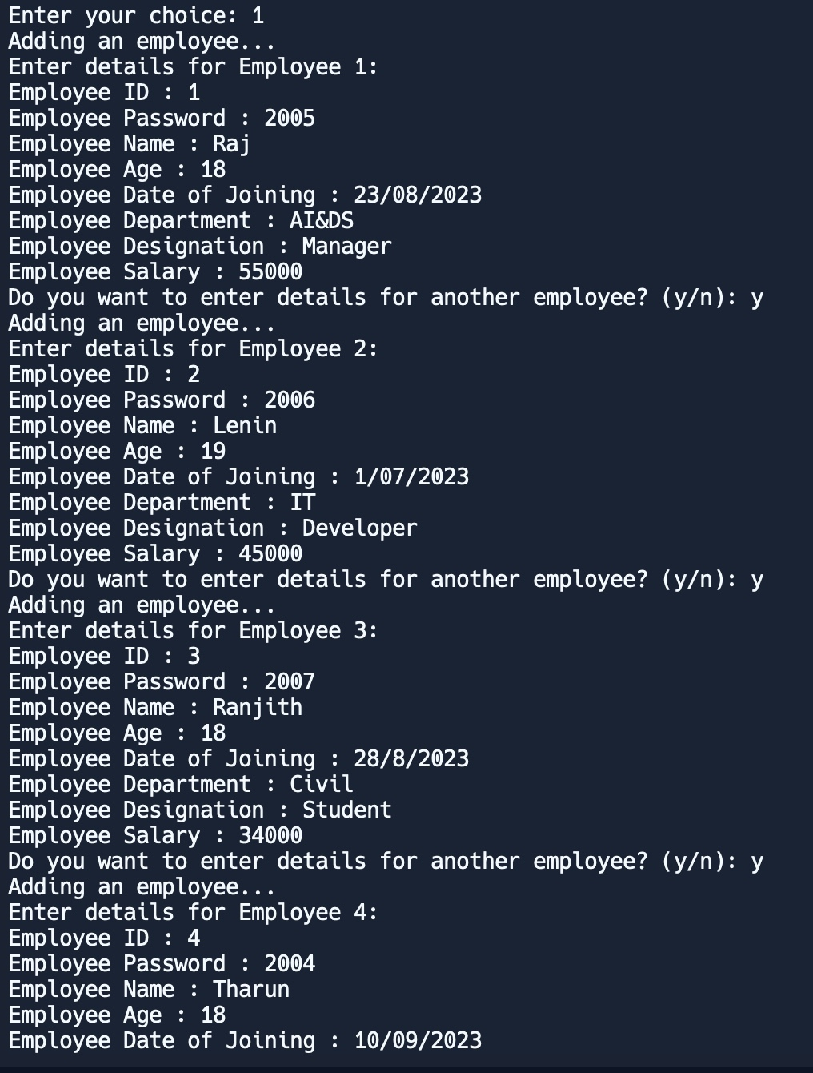
Add an employee
It allows the addition of new employee details including ID, name, age, salary, department, etc.

Slide 6
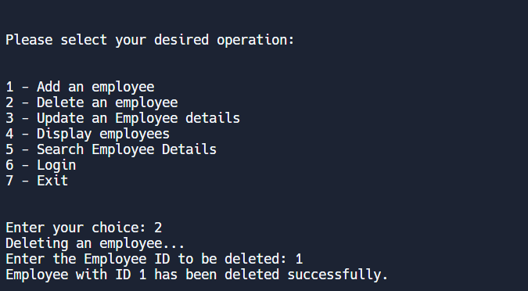
DELETE AN EMPLOYEE
It allows the deletion of employee based on a particular field
For example deletion of a employee using their ID

Slide 7
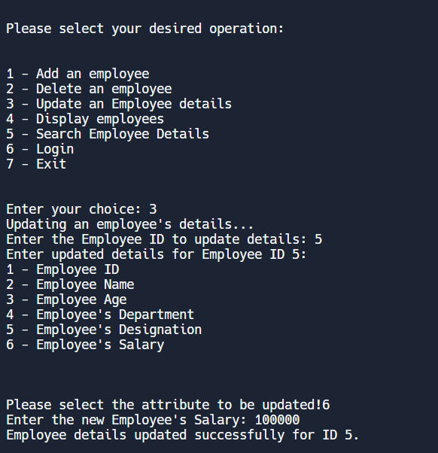
Update an employee details
It enables the updation of employee data such as ID, name, age, salary, etc..

Slide 8
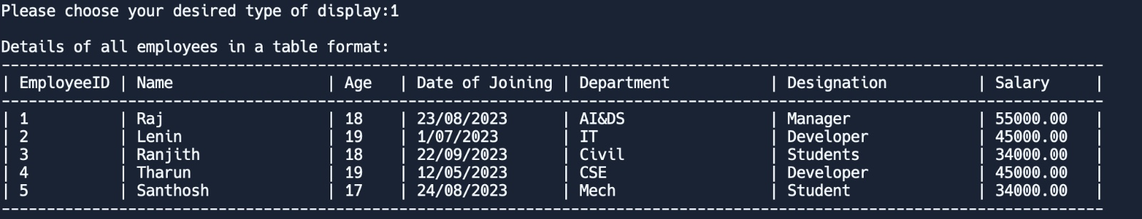
Display all employee
It enables us to display the details of all the employees

Slide 9
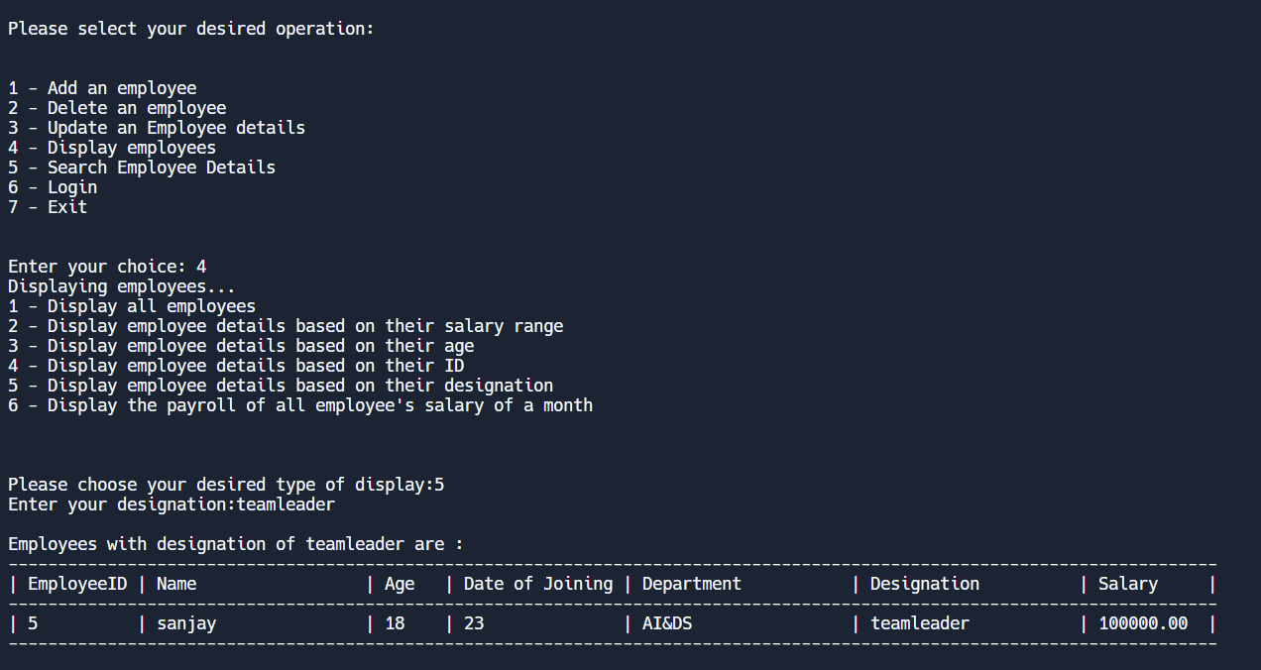
Display an employee detail based on their designation
It enables us to display the details of all the employees based on their designation.

Slide 10
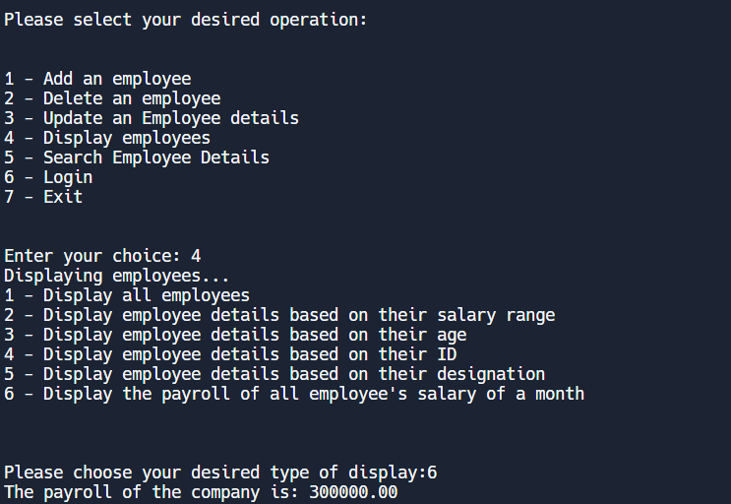
Display the payroll of all employee’s salary of a month
It is used to calculate the payroll of the of all the employees salary of that particular month

Slide 11
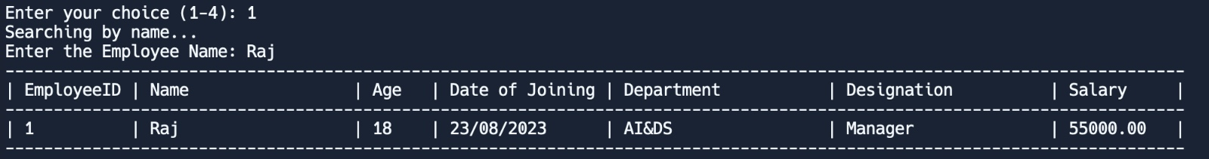
Search by name
It is used for searching the details of the employee by their name.
Let us consider this example

Slide 12
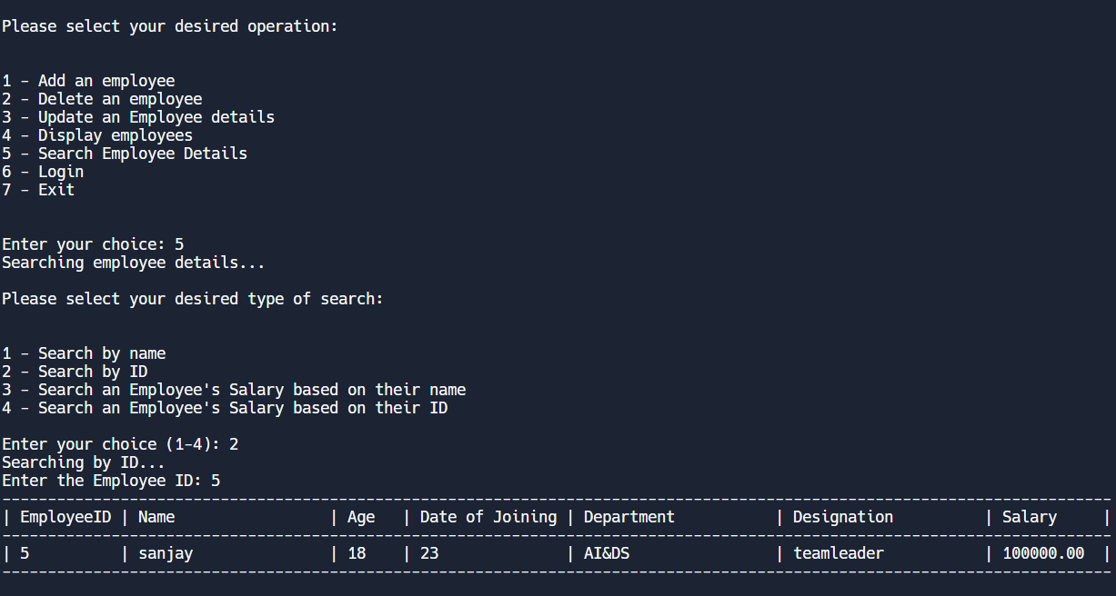
Search by id
It is used for searching the details of the employee by their ID.

Slide 13
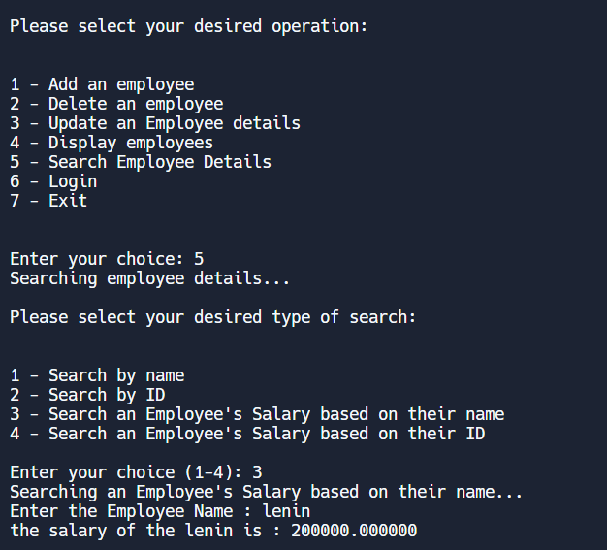
Fetch salary of an employee using name
It is to display the salary of an employee by giving name as an input.

Slide 14
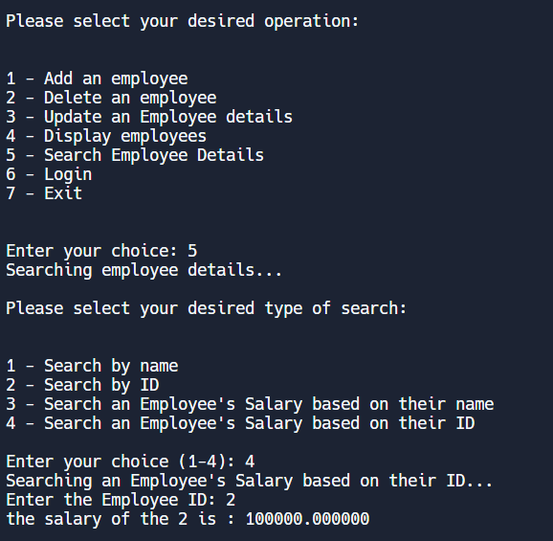
Fetch salary of an employee using ID
It is to display the salary of an employee by giving ID as an input

Slide 15

Improvements and Future Enhancements
Memory Management and Error Handling
Security Enhancements
Modularization and Code Refinement
User Interface Refinement
Testing and Scalability

Slide 16
Conclusion
The Employee Management System developed in C provides essential functionalities for managing employee records efficiently.
While the system offers fundamental operations, further enhancements in security, usability, and robustness are crucial for its broader implementation in real-world scenarios.

