Slide 1
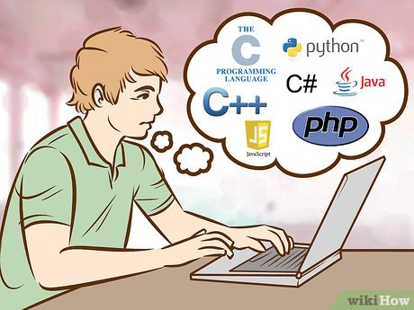
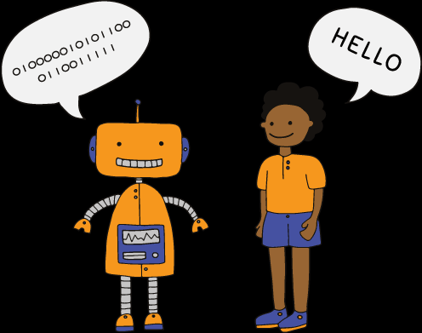
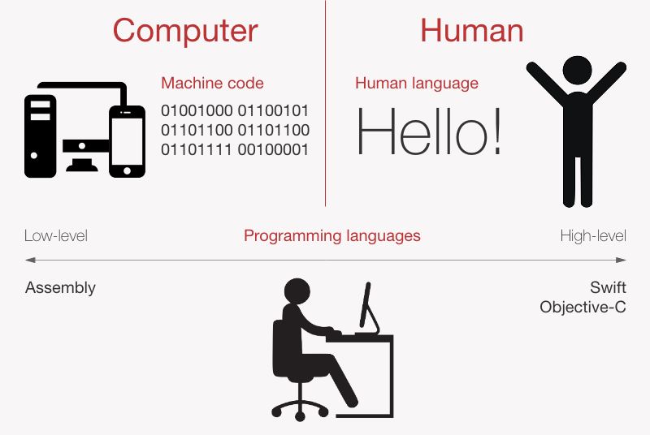
What is programming language:
communication between human and machine

Slide 2
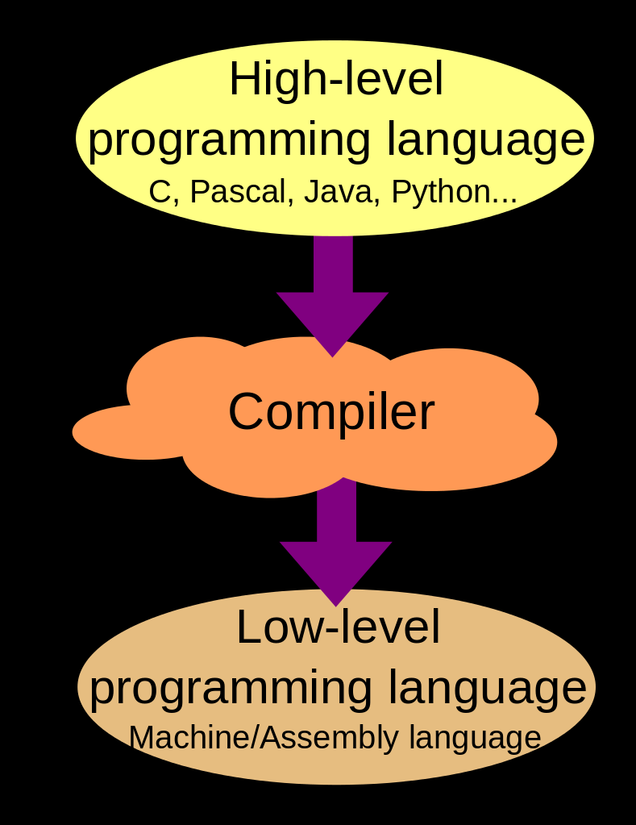
what do you mean by program:
set of instruction given to the system that performs particular task

Slide 3
types of programming language :
highlevel
high level languages can be understandable by the user. it cant be understandable by the system.
eg: python, c++, java, php, swift -Swift is a powerful and intuitive programming language for macOS, iOS, watchOS, tvOS.
R-R is a programming language and software environment for statistical analysis, graphics representation and reporting
medium level
middle level programming are closely related to machine as well as human beings
eg: c
c is used to write system softwares like os.
low level
it contains only zeros and ones. that can be read by only system.
company using python;
google - core search algorithms are written in Python
YouTube uses Python for view video, administer video, control templates
Instagram- the world's biggest online photo-sharing app, uses Python on its backend.

Slide 4
Python Introduction
history
guido van rassum - 1985-1990
Guido van Rossum was also reading the published scripts from “Monty Python's Flying Circus”, a BBC comedy series from the 1970s. Van Rossum thought he needed a name that was short, unique, and slightly mysterious
it is object oriented and interpreted.
An object-oriented paraidgm is to design the program using classes and objects.
An interpreted language is a programming language whose implementations execute instructions directly and freely, without previously compiling a program into machine-language instructions.
Features:
open source: freely available on official website www.python.org
simple and easy
platform independent - it can be run on any os.
interpreted
object oriented

Slide 5
large standard libraries(200+standard libraries)-supported for data science, machine learning,iot,ai
dynamically typed languages.
How to run python program;
windows start --> IDLE(integrated developmentlearning Environment)
www.python.org
types of python mode
shell : temprory
script : saved for future modification and execution
ctrl+n or file --> new
After creating program save--→run

Slide 6
building blocks of python:
identifiers
keyword
datatypes
operators
comments
intentations

Slide 7
identifiers
A Python identifier is a name used to identify a variable, function, class
variable is a named memory location can be accessed.
rules for variable declaration:
1.combination of alphabets,numbers
2.special characters cant be a variable name
3.should not start with numbers. _ can be used in between or start of the variable
4.spaces are not allowed in between the variable name.
keyword
special words defined for particular purpose.
35 keyword- help("keywords")

Slide 8
datatypes
basic types:
numeric values(int, float, complex) -
int(1,10,...), float(23.4, 3.13434), complex(1 + 2j)
string (str)- sequence of characters (" ", ' ' , ''' ''')- "Live wire" , 'Live wire' , ''' Live wire'''
core types:
list , set, tuples, dictionary
operators
An operator is a symbol to perform specific mathematical or logical functions
types
Arithmetic Operators
Arithmetic operators are used with numeric values to perform common mathematical operations:

Slide 9
Operator Name Example
+ Addition x + y
- Subtraction x - y
* Multiplication x * y
/ Division x / y
% Modulus x % y
** Exponentiation x ** y
// Floor division x // y (used to get only whole number of quatient in floating point result)

Slide 10
Assignment Operators
Assignment operators are used to assign values to variables:
Operator Example Same As
= x = 5 x = 5
+= x += 3 x = x + 3
-= x -= 3 x = x - 3
*= x *= 3 x = x * 3
/= x /= 3 x = x / 3
%= x %= 3 x = x % 3
//= x //= 3 x = x // 3
**= x **= 3 x = x ** 3

Slide 11
Python Comparison Operators
Comparison operators are used to compare two values:
Operator Name Example
== Equal x == y
!= Not equal x != y
> Greater than x > y
< Less than x < y
>= Greater than or equal to x >= y
<= Less than or equal to x <= y

Slide 12
Python Logical Operators
Logical operators are used to combine conditional statements:
Operator Description Example
and Returns True if both statements are true x < 5 and x < 10
or Returns True if one of the statements is true x < 5 or x < 4
not Reverse the result, returns False not(x < 5 and x < 10)
if the result is true

Slide 13
Python Identity Operators
used to check equality of the two variable objects
a,b = 1,1 a,b=1,2
>>> a is b >>> a is b
True false
>>> a is not b >>> a is not b
False true
Python Membership Operators
Membership operators are used to test if a sequence is presented in string:
Operator Description Example
in Returns True if a sequence with the specified value is x in y
present
not in Returns True if a sequence with the specified value x not in y
is not present

Slide 14
>>> a="live Wire"
>>> "Wire" in a
True
>>> "Wire" not in a
False
comments
comments is used to indicate notes in the program.
single line comment : #This is my first python program
multi line comment: ''' ........''' or """ ........ """
intentations
it indicates the block in the program. each intentation having 4 white spaces.
Input and output formatting
manual - the user already mentioned values for the variable in the program
run time - at the time of runtime the value of variable given by the user

Slide 15
input() -
>>> a=int(input("enter the value of a variable"))
enter the value of a variable1
>>> a
1
print()
a=1
>>> b=2
>>> print("a=",a,"and b=",b)
a= 1 and b= 2
using string concatination or addition(+)
print("a="+str(a)+"and b="+str(b))
a=1and b=2

Slide 16
1) a=2
b=5
a+b
2)
5**2
3) take any division operation so that u will get remainder is 5
4) have n1=100,n2=56 and do this calculation and find output for following
a) n1<=n2
b) n1!=n2
c) n1>=n2
d) not(n1==n2)
5)find out condition to donate the blood..note(define data for age and weight use logical and operator)

