Slide 1
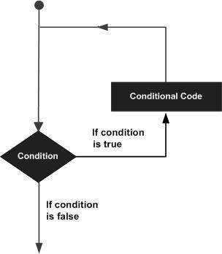
Looping statement
A loop statement allows us to execute a statement or group of statements multiple times.

Slide 2
types
1.while loop
Repeats a statement or group of statements while a given condition is TRUE. It tests the condition before executing the loop body.
2 for loop
Executes a sequence of statements multiple times and abbreviates the code that manages the loop variable.
3 nested loops
You can use one or more loop inside any another while, for or do..while loop.

Slide 3
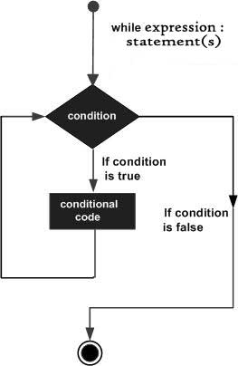
While
syntax:
intialization
while(condition):
statement
Increment/decrement

Slide 4
a=1
while(a<=5):
print(a)
a+=1
a=1
while(a<=5):
print(a)
a+=1
else:
print("a is exceed the maximum value(5)")
Infinite loop
while True : # This constructs an infinite loop
num = int(input("Enter a number :"))
print("You entered: ", num)
print ("Good bye!")

Slide 5
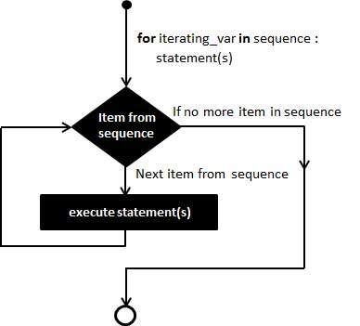
Single Statement Suites
flag = 1 while (flag): print 'Given flag is really true!' print "Good bye!"
For loop
syntax
for iterating_var in sequence:
statements(s)

Slide 6
The range() Function in for
range(start,stop,iteration)
To loop through a set of code a specified number of times, we can use the range() function,
The range() function returns a sequence of numbers, starting from 0 by default, and increments by 1 (by default), and ends at a specified number.
for x in range(6): for x in range(2, 6): for x in range(2, 30, 3):
print(x) print(x) print(x)
FOR IN STRING Iterating by Sequence Index for with else
for i in "Live Wire": str1=“Live Wire” str1="Live wire"
print(i,end=" ") for i in range(len(str1)): for i in range(len(str1)):
print(str1[i],end=" ") print(str1[i],end=" ")
else:
print("\n ", "end of string")
`

Slide 7
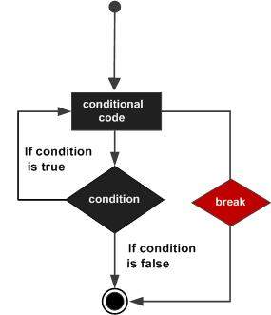
Loop Control Statements
Loop control statements change execution from its normal sequence.
1 break statement
Terminates the loop statement and transfers execution to the statement immediately following the loop.
for i in "live Wire":
if(i=='W'):
break
print(i,end="")

Slide 8
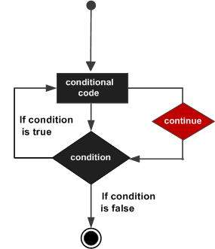
continue statement
It returns the control to the beginning of the while loop.. The continue statement rejects all the remaining statements in the current iteration of the loop and moves the control back to the top of the loop.
for i in "live Wire":
if(i=='W'):
continue
print(i,end="")

Slide 9
pass statement
The pass statement in Python is used when a statement is required syntactically but you do not want any command or code to execute.
a=-1
if(a>0):
print("positive no")
else:
pass
do loop
i = 1
while True:
print(i)
i = i + 1
if(i > 5):
break

Slide 10
1. Write a program to print first 20 numbers which is dividable by 5
2. Write a program for following output
*
**
***
****
*****
3.Write a program for following output
*****
****
***
**
*

Slide 11
4. Write a program that accepts the continues numbers and to calculate add each numbers .Print the summation also not to allow the user to enter negative number
5. Write Program that accepts the continues numbers to calculate the sum of numbers. Print the summation and check for negative values, If the user enters a negative number, it's not added to the result

Slide 12
Task1
num=int(input("Enter the number!..."))
for i in range(1,num):
if(i%7==0):
print(i)
Task 2
for i in range(0,4):
for j in range(0,i):
print("*",end="")
print("\n")

Slide 13
Task3
Task4
add=0
num=int(input("enter the max no:"))
for i in range(num):
no=int(input("enter the no"))
add=add+no
if(no<0):
break
i=i+1
print(add)

Slide 14
Task 5
num=int(input("enter the max no:"))
for i in range(num):
no=int(input("enter the no"))
if(no<0):
continue
add=add+no
i=i+1
print(add)

Slide 15
1)Give run time input as !hai go!od mor!ni!ng!!!
expected o/p --> hai good morning(use continue)
2)read the paragraph.. end if when the paragraph is having . symbol

Slide 16
Write a C program to print all natural numbers from 1 to n. - using while loop
Write a C program to print all natural numbers in reverse (from n to 1). - using while loop
Write a C program to print all alphabets from a to z. - using while loop
Write a C program to print all even numbers between 1 to 100. - using while loop
Write a C program to print all odd number between 1 to 100.
Write a C program to find sum of all natural numbers between 1 to n.
Write a C program to find sum of all even numbers between 1 to n.
Write a C program to find sum of all odd numbers between 1 to n.
Write a C program to print multiplication table of any number.
Write a C program to count number of digits in a number.

Slide 17
Write a C program to find first and last digit of a number.
Write a C program to find sum of first and last digit of a number.
Write a C program to swap first and last digits of a number.
Write a C program to calculate sum of digits of a number.
Write a C program to calculate product of digits of a number.
Write a C program to enter a number and print its reverse.
Write a C program to check whether a number is palindrome or not.
Write a C program to find frequency of each digit in a given integer.
Write a C program to enter a number and print it in words.
Write a C program to print all ASCII character with their values.
Write a C program to find power of a number using for loop.
Write a C program to find all factors of a number.
Write a C program to calculate factorial of a number.
Write a C program to find HCF (GCD) of two numbers.
Write a C program to find LCM of two numbers.
Write a C program to check whether a number is Prime number or not.
Write a C program to print all Prime numbers between 1 to n.
Write a C program to find sum of all prime numbers between 1 to n.
Write a C program to find all prime factors of a number.
Write a C program to check whether a number is Armstrong number or not.
Write a C program to print all Armstrong numbers between 1 to n.
Write a C program to check whether a number is Perfect number or not.
Write a C program to print all Perfect numbers between 1 to n.
Write a C program to check whether a number is Strong number or not.
Write a C program to print all Strong numbers between 1 to n.
Write a C program to print Fibonacci series up to n terms.

