Slide 1
Python is an object oriented programming language
a class is a blueprint for that object.
An object is simply a collection of data (variables) and methods (functions) that act on those data. Similarly,
Eg:
We can think of class as a sketch (prototype) of a house. It contains all the details about the floors, doors, windows etc. Based on these descriptions we build the house. House is the object.
As many houses can be made from a house's blueprint, we can create many objects from a class. An object is also called an instance of a class and the process of creating this object is called instantiation.
Defining a Class in Python
class MyNewClass:
'''This is a docstring. I have created a new class’‘’ → doc string
statements

Slide 2
Apple
Apple
Red
210
Class : fruit
Name
Color
Price
taste
Banana
Banana
Yellow
50
Grapes
Grapes
Black
150

Slide 3
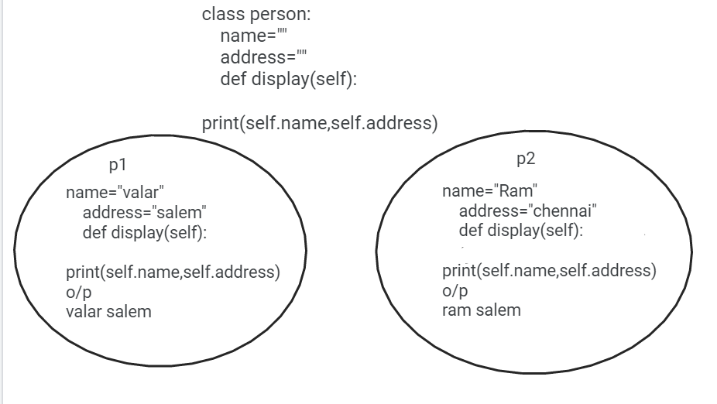
For example, __doc__ gives us the docstring of that class.
class person:
name=""
address=""
def display(self):
print(self.name,self.address)
Creating objects and Accessing members of a class using objects:
p1=person()
p2=person()
p1.name="valar"
p1.address="salem"
p2.name="Ram"
p2.address="chennai"
p1.display()
p2.display()
print(person.__doc__)

Slide 4
Creating more objects
p1=person()
p2=person()
P3=person()
p4=person()
Constructors
Class functions that begin with double underscore __ are called special functions as they have special meaning.
__init__() is special function gets called whenever a new object of that class is instantiated.
This type of function is also called constructors in Object Oriented Programming (OOP). We normally use it to initialize all the var

Slide 5
class Person:
age=0
name=""
def __init__(self,age):
self.age=age
def myname(self,name):
self.name=name
print("my name :",self.name)
person1=Person(30)
person1.myname("valar")
print("My age:",person1.age)
person2=Person(40)
person2.myname("anish")
print("My age:",person2.age)

Slide 6
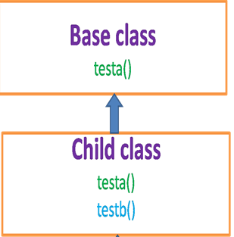
Inheritance → Deriving a class from existing class
characteristics
It can access all the members of base class
A class can have own members
Types:
Single, Multilevel, Multiple, Hybride
Single

Slide 7
class bird:
def __inti__(self):
print("I am a bird... i am a super class")
def fly(self):
print("I can fly....")
class parrot(bird):
mycolor="green"
def __init__(self):
print("I am a parrot...")
def mynature(self):
print("I can sing!...")
bird=parrot()
bird.fly()
bird.mynature()

Slide 8
accessing super class methods in child class
class bird:
def __init__(self):
print("I am a bird... i am a super class")
def fly(self):
print("I can fly....")
class parrot(bird):
mycolor="green"
mynose="red"
def __init__(self):
bird
print("I am a parror...")
def mynature(self):
bird.fly() #super().fly()
print("My color is ",self.mycolor)
print("I can sing!...")
bird=parrot()
print("my nose color is ",bird.mynose)
bird.mynature()

Slide 9
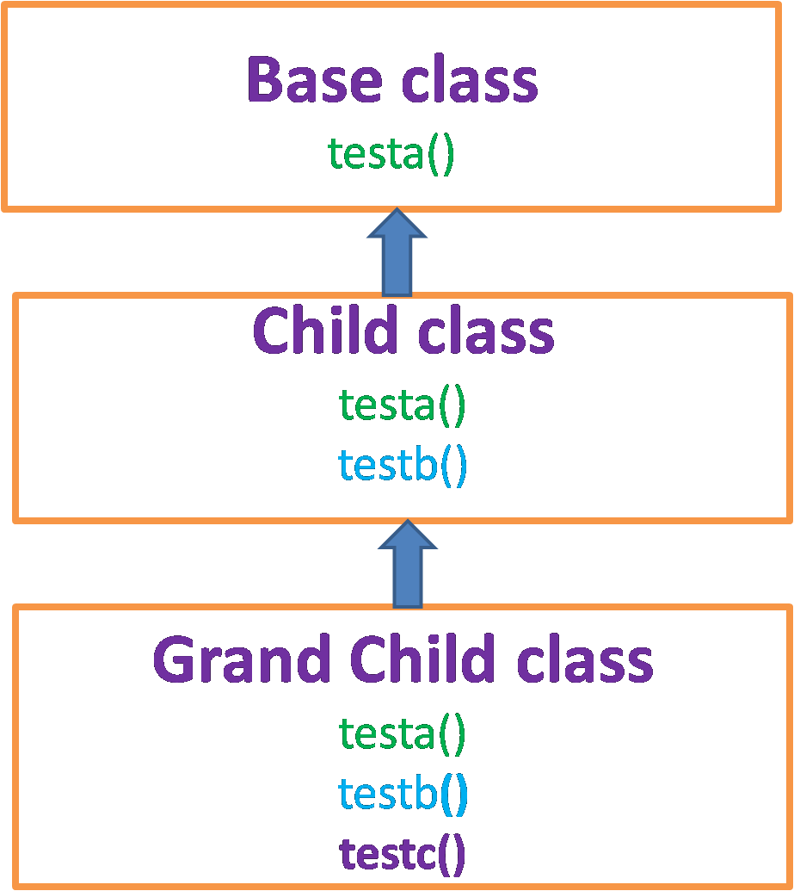
Multi level

Slide 10
class bird:
def __init__(self):
print("I am a bird... i am a super class")
def fly(self):
print("I can fly....")
class parrot(bird):
mycolor="green"
mynose="red"
def __init__(self):
#bird.__init__(self)
print("I am a parrot under bird...")
def mynature(self):
print("normally parrot color is ",self.mycolor)
print("I can sing!...")
class lovebirds(parrot):
def __init__(self):
#parrot.__init__(self)
print("I am a love bird under parrot!..")
def lovebirds_mynature(self):
print("since love birds i am having different color")
print("I can whisle!...")
bird=lovebirds()
bird.fly()
bird.mynature()
bird.lovebirds_mynature()

Slide 11
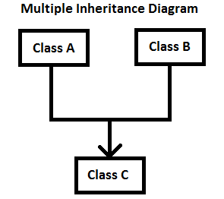
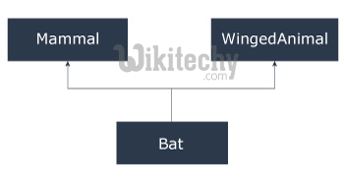
Multiple inheritance

Slide 12
class mammals:
def mammalsnature(self):
print("Mammals give birth to live young unlike birds or reptiles that lay eggs")
class wingedanimal:
def wingedanimalnature(self):
print("I can fly...")
class bat(mammals,wingedanimal):
def mynature(self):
print("i am bat.. the only mammals the can fly is bat bcz i am also having wings")
bat1=bat()
bat1.mynature()
bat1.mammalsnature()
bat1.wingedanimalnature()

Slide 13
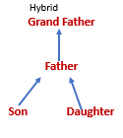
Hybride
bird
|
parrot
|
/ \
love birds
Eg:

Slide 14


Task
Task1:identify what type of inheritance and implement in python program
Task 2: identify what type of inheritance and implement in python program

Slide 15
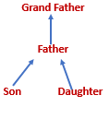
Task 3: identify what type of inheritance and implement in python program

Slide 16
Task 4
Write own pgm for multiple inheritance
Eg: father mother
\ /
son
Task5 :
Create a Bus child class that inherits from the Vehicle class. The default fare charge of any vehicle is seating capacity * 100. If Vehicle is Bus instance, we need to add an extra 10% on full fare as a maintenance charge. So total fare for bus instance will become the final amount = total fare + 10% of the total fare.
Note: The bus seating capacity is 50. so the final fare amount should be 5500. You need to override the fare() method of a Vehicle class in Bus class.

Slide 17
Task 6 :Determine which class a given Bus object belongs to
(Check type of an object)
Task 7:Determine if School_bus is also an instance of the Vehicle class

Slide 18
Task4:
class Vehicle:
def __init__(self, name, mileage, capacity):
self.name = name
self.mileage = mileage
self.capacity = capacity
def fare(self):
return self.capacity * 100
class Bus(Vehicle):
def fare(self):
amount = super().fare()
amount += amount * 10 / 100
return amount
School_bus = Bus("School Volvo", 12, 50)
print("Total Bus fare is:", School_bus.fare())

Slide 19
Task 5 task 6:
class Vehicle:
def __init__(self, name, mileage, capacity):
self.name = name
self.mileage = mileage
self.capacity = capacity
class Bus(Vehicle):
pass
School_bus = Bus("School Volvo", 12, 50)
# use Python's built-in type() function
print(type(School_bus))
class Vehicle:
def __init__(self, name, mileage, capacity):
self.name = name
self.mileage = mileage
self.capacity = capacity
class Bus(Vehicle):
pass
School_bus = Bus("School Volvo", 12, 50)
# use Python's built-in isinstance() function
print(isinstance(School_bus, Vehicle))

Slide 20
Polymorphism
Same function name with different behaviour
class sample:
def display(self,a="none",b="none",c="none"):
if(a!="none") and (b!="none") and (c!="none"):
print("You have passed three args!..")
elif((a!="none")and(b!="none")):
print("You have passed two args!..")
elif(a!=“none”):
print("You have passed one args!..")
else:
print("You have passed one args!..")
s=sample()
s.display(1)
s.display(1,,2)
s.display(1,2,3)
function name but different operation

Slide 21
Method overriding
Same function name used in base and child class
So that child class function override the base class function
This concept can bring polymormism in inheritance
class a:
def demo(self):
print("class a demo()")
class b(a):
def demo(self):
print("class b demo()")
#super().demo()
obj=b()
obj.demo()
obj1=a()
obj1.demo()

Slide 22
class a:
def demo(self):
print("class a demo()")
class b(a):
def demo(self):
print("class b demo()")
#super().demo()
obj=b()
obj.demo()
obj=a()
obj.demo()

Slide 23
Task in polymormism
Task1
pass 3 arguments
if it is one argument, self increment
if it is two argument then do addition operation
if it is three argument then do multiplication
Task 2:
implement polymorphism in bird class as base class that inherits ostrich and sparrow
Ostrich is non flying bird.. Sparrow is flying bird..
Say flight() is a nature of all the classes..

Slide 24
bank as base class and two sub class -> SBI, ICICI
reservebank -> balance(variable) ,getinterest() – 5% function
sbi -> getintersest() should be override for interest percentage 10% based on balance
sbi -> getintersest() should be override for interest percentage 5% based on balance

Slide 25
Task1:
class calc:
def sample(self,a=None,b=None,c=None):
if (a!=None and b!=None and c!=None):
print("multiplication ",a*b*c)
elif (a!=None and b!=None):
print("addition : ",a+b)
else:
print("self increment: ",a+1)
obj=calc()
obj.sample(1)
obj.sample(1,2)
obj.sample(1,2,3)

Slide 26
Task 2
class Bird:
def intro(self):
print("There are many types of birds.")
def flight(self):
print("Most of the birds can fly but some cannot.")
class sparrow(Bird):
def flight(self):
print("Sparrows can fly.")
class ostrich(Bird):
def flight(self):
print("Ostriches cannot fly.")
obj_bird = Bird()
obj_spr = sparrow()
obj_ost = ostrich()
obj_bird.intro()
obj_bird.flight()
obj_spr.intro()
obj_spr.flight()
obj_ost.intro()
obj_ost.flight()

