Slide 1
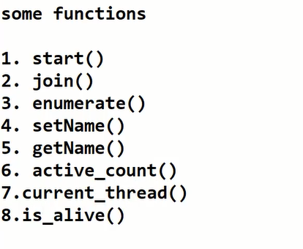
Thread
What is → it’s a unit of code that executes the task simultaneously with out affecting other
Threading is a process of running multiple threads at the same time.
Multi thread → more than one task at a time
To implement a thread we need a threading module. → all the threads can be created by using Thread()

Slide 2
import threading
def thread1():
print("I am a thread1..")
def thread2():
print("I am a thread2..")
t1=threading.Thread(target=thread1)
t2=threading.Thread(target=thread2)
t1.start()
t2.start()

Slide 3
import threading
import time
def add(a,b):
time.sleep(5)
print("I am a addition thread..", "a+b=",a+b,"\n")
def sub(a,b):
c=a-b
time.sleep(10)
print("I am a subtraction thread..", "a-b=",a-b,"\n")
a=10
b=5
t1=threading.Thread(target=add,args=(a,b,))
t2=threading.Thread(target=sub,args=(a,b,))
t1.setName("Additionthread")
t2.setName("subtraction")
print(t1.getName())
print(t2.getName())
t1.start()
t2.start()
print(t1.is_alive())
print(t2.is_alive())
print(threading.enumerate())

Slide 4
Daemon thread
It is a background thread

Slide 5
import threading
import time
def call():
print("Thread 1 started...")
#time.sleep(10)
print("end of thread2..")
def call1():
print("thread 2 started...")
print("End of thread 2...")
t1=threading.Thread(target=call,daemon=True)
t2=threading.Thread(target=call1)
t1.start()
t2.start()
t1.join()

Slide 6
To implement a new thread using the threading module, you have to do the following −
Define a new subclass of the Thread class.
Override the __init__(self [,args]) method to add additional arguments.
Then, override the run(self [,args]) method to implement what the thread should do when started.

Slide 7
Creating thread using thread class
from threading import Thread
import threading
import time
class mythread (Thread):
def __init__(self,idno,name):
Thread.__init__(self)
print("the thread is created..")
def run(self):
print("Thread running!..")
for i in range(5):
time.sleep(5)
print(i)
t1=mythread(1,"thread1")
t2=mythread(2,"thread1")
t1.start()
t1.join()
t2.start()

Slide 8
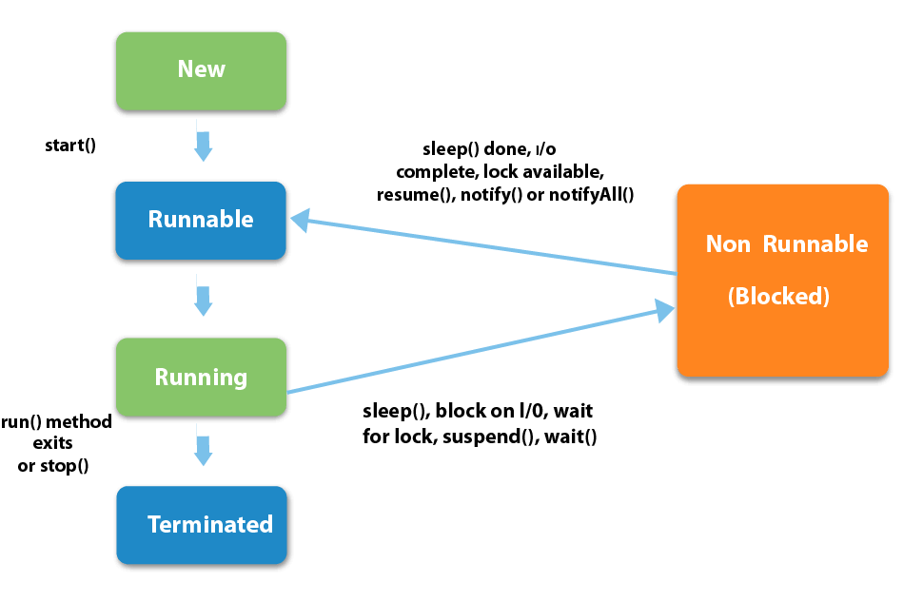

Slide 9
Task 1
Write a two thread to print even and odd no
Write your own daemon thread program
https://medium.com/mindful-engineering/multithreading-multiprocessing-in-python3-f6314ab5e23f
https://www.geeksforgeeks.org/multithreading-python-set-1/
https://www.studytonight.com/python/threading-module-in-python

