Slide 1
PULMONARY INFECTION DETECTION
IN
FOOD PROCESSING INDUSTRY
REVOLUTIONIZING HEALTHCARE WITH AI

Slide 2





MEET OUR TEAM
RAJENDRAN S
BALA MURALI M
KEVIN PATRICK S S
DEEPITHA M
First Year
Department of AI & DS

Slide 3
PROBLEM

Slide 4


PROBLEM STATEMENT
INCREASED SPREAD OF RESPIRATORY DISEASES IN FOOD INDUSTRIES
In food processing industries, ensuring the health and safety of workers is of utmost importance. Respiratory problems pose a significant risk to workers in food processing industries, where exposure to airborne particles and contaminants is common. Early detection of respiratory issues is crucial for preventing long-term health complications and ensuring the well-being of employees.

Slide 5
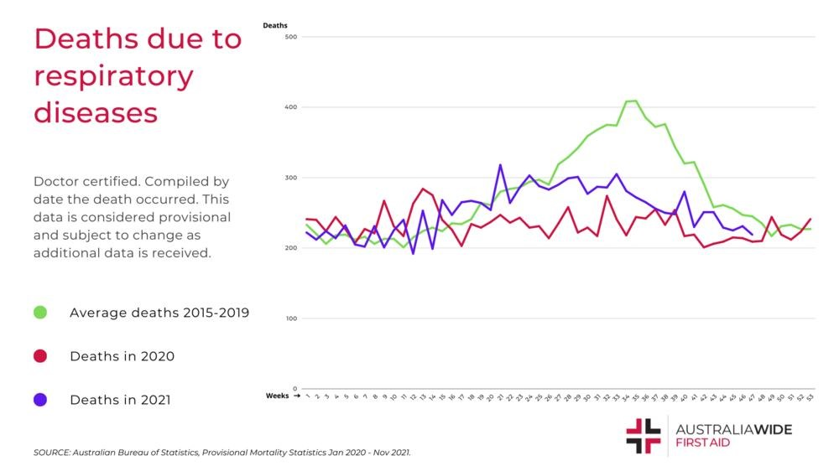

Slide 6
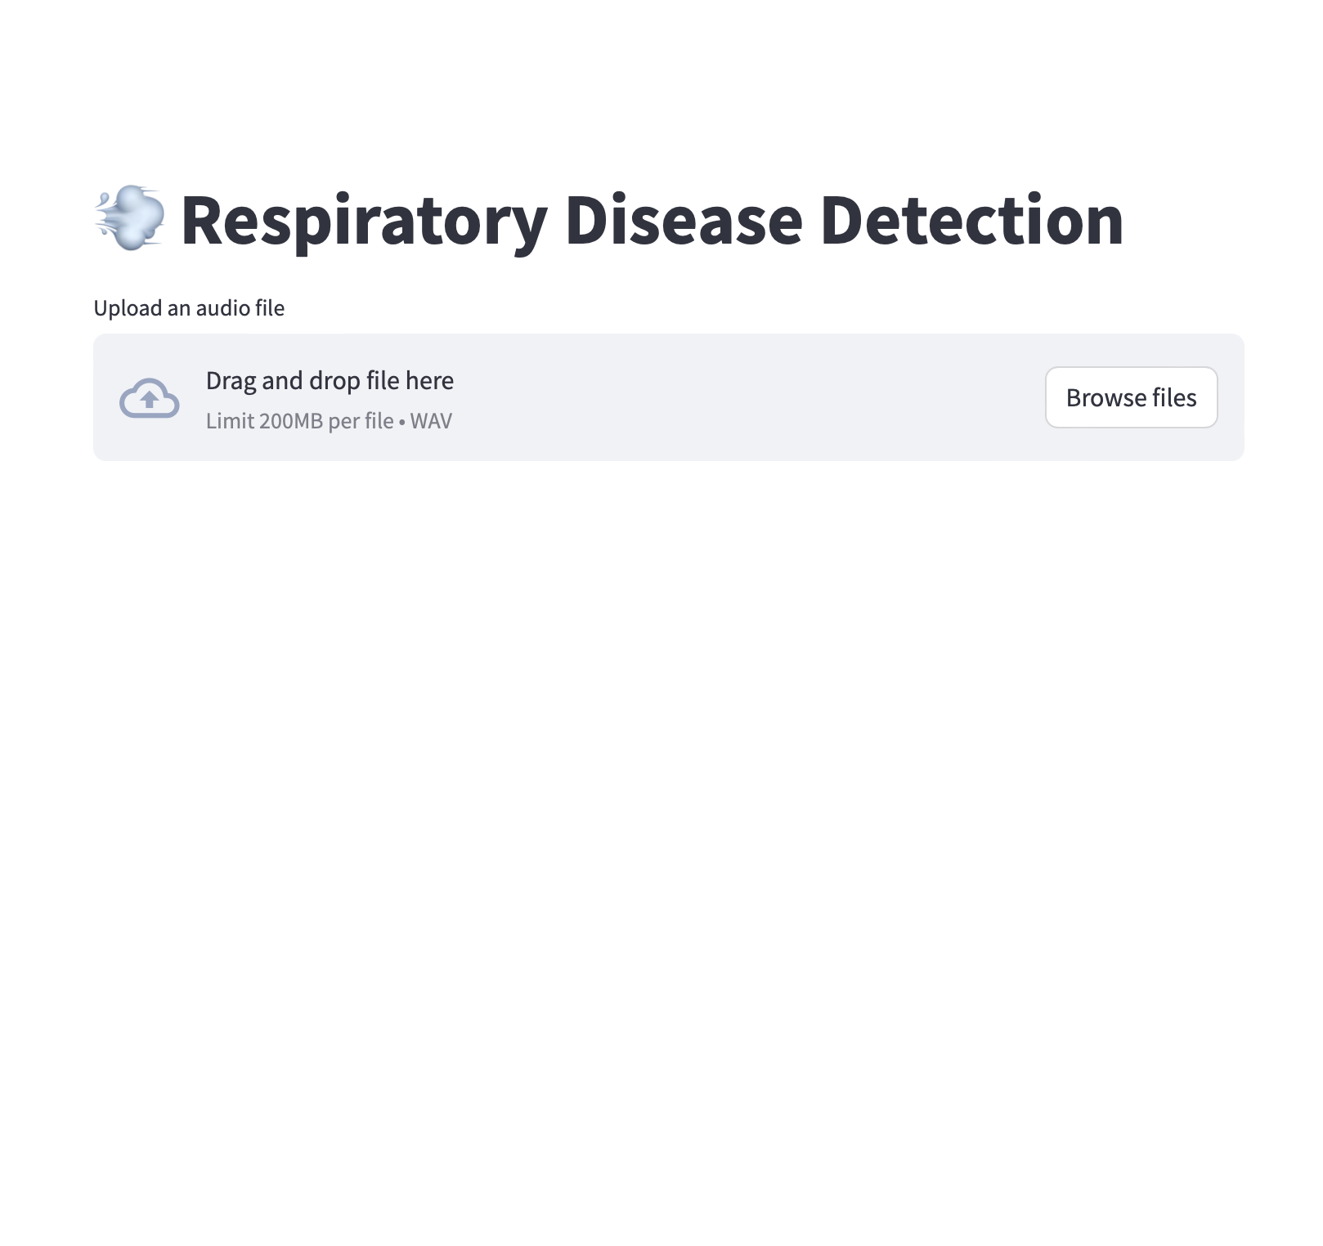
IS THIS A SOLVABLE PROBLEM ?
OF COURSE IT IS!
We have created an AI model that receives the employee’s respiratory audio as input and the trained model will analyze the audio and output what kind of infection is being affected to the employee.

Slide 7
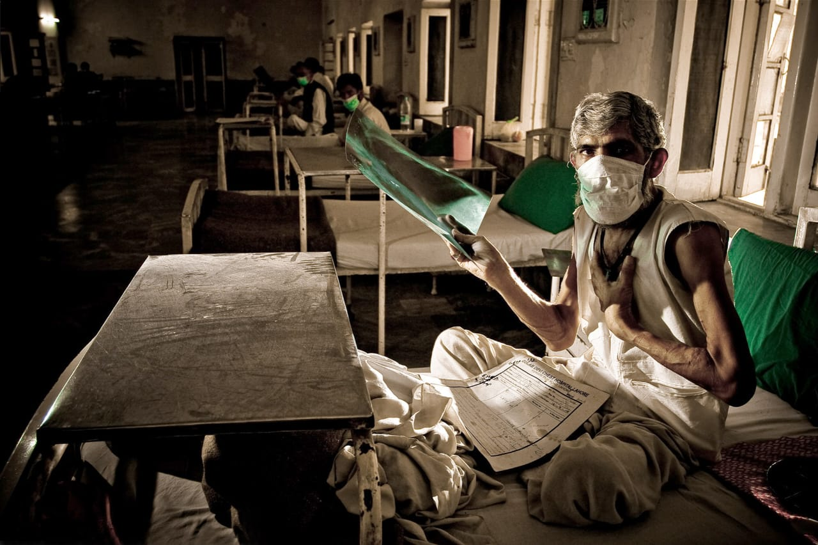
HOW DOES THIS HELP ?
The implementation of respiratory disease detection through cough sounds offers a proactive approach to safeguarding the health of workers in the food processing industry. By leveraging AI and machine learning algorithms to analyze cough sounds, potential respiratory issues can be identified early, allowing for timely intervention and preventive measures. This innovative approach can complement existing occupational health and safety protocols, enhancing workplace health surveillance and promoting a safer working environment.

Slide 8
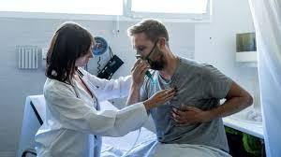
WHY IS THIS MODEL REQUIRED ?
Implementing these models in the food processing industry can significantly enhance consumer safety and save lives. By leveraging these advanced technologies, companies can ensure that the food products they produce meet the highest standards of quality and safety. What's particularly advantageous is that these models don't require extensive hardware modules, making implementation cost-efficient.
Source : Effects of exposure to flour dust on respiratory symptoms and pulmonary function of mill workers (Hamdy A. Mohammadien a, Mona T. Hussein a 1, Raafat T. El-Sokkary b 2)

Slide 9
FEATURES
OF OUR MODEL
Early Detection: By analyzing cough sounds, respiratory issues can be detected at an early stage, allowing for prompt medical attention and intervention. This can prevent the progression of respiratory diseases and minimize their impact on workers' health.
Real-time Monitoring: AI-based cough analysis systems can provide real-time insights into workers' respiratory health status, enabling proactive management and mitigation of occupational health risks. Continuous monitoring allows for prompt identification of emerging issues and implementation of preventive measures.
Improved Productivity: By maintaining a healthier workforce, the implementation of respiratory disease detection can help minimize absenteeism due to respiratory illnesses. Healthy workers are more productive and contribute to the efficient operation of food processing facilities.Enhanced
Food Safety: Respiratory health monitoring can contribute to maintaining high food safety standards by reducing the risk of contamination from sick workers. Ensuring the health of workers helps prevent the spread of pathogens and allergens in food processing environments.

Slide 10
DATASET
The Kaggle dataset used in the project is called the "Respiratory Sound Database," which contains audio recordings of respiratory sounds along with corresponding diagnostic information. The dataset includes audio recordings of respiratory sounds, such as coughs, wheezes, and normal breathing, collected from patients with various respiratory conditions. Each audio file is accompanied by metadata providing information about the patient, including their diagnosis. The Respiratory Sound Database was created by two research teams in Portugal and Greece. It includes 920 annotated recordings of varying length - 10s to 90s. These recordings were taken from 126 patients. There are a total of 5.5 hours of recordings containing 6898 respiratory cycles - 1864 contain crackles, 886 contain wheezes and 506 contain both crackles and wheezes. The data includes both clean respiratory sounds as well as noisy recordings that simulate real life conditions. The patients span all age groups - children, adults and the elderly.
The Kaggle dataset comprises 920 .wav sound files, each accompanied by a corresponding annotation .txt file, providing detailed information about the respiratory sounds captured in the audio recordings. Additionally, there is a text file listing the diagnosis for each patient, offering valuable insights into the respiratory conditions or health status of the individuals. Another text file explains the file naming format, facilitating easy navigation and interpretation of the dataset. Furthermore, a list of 91 names is provided in the filename_differences.txt file, which may contain variations or discrepancies in file naming conventions. Lastly, demographic information for each patient is available in a separate text file, enabling researchers to analyze the association between patient characteristics and respiratory conditions.

Slide 11
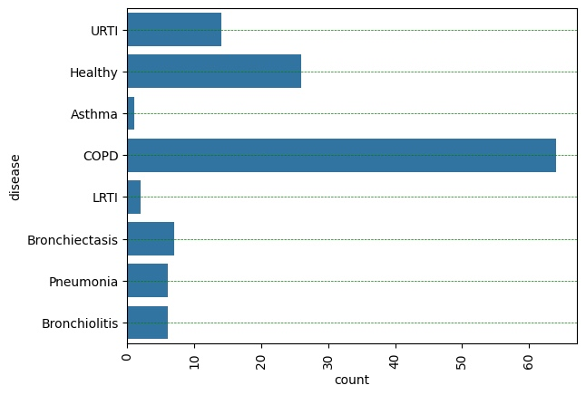
DISEASES IN TRAINING DATA
The dataset comprises eight distinct features representing various respiratory conditions :
COPD (Chronic Obstructive Pulmonary Disease)
Healthy (No respiratory condition detected)
URTI (Upper Respiratory Tract Infection)
Bronchiectasis (A condition where the airways in the lungs become widened and scarred)
Bronchiolitis (Inflammation of the bronchioles, typically affecting infants and young children)
Pneumonia (Infection that inflames the air sacs in one or both lungs)
LRTI (Lower Respiratory Tract Infection)
Asthma (Chronic condition that affects the airways, causing difficulty in breathing)

Slide 12
FEATURES OF DATASET
AUDIO FILES
1. Patient number (101,102,...,226)
2. Recording index
3. Chest location
a. Trachea (Tc)
b. Anterior left (Al)
c. Anterior right (Ar)
d. Posterior left (Pl)
e. Posterior right (Pr)
f. Lateral left (Ll)
g. Lateral right (Lr)
4. Acquisition mode
a. sequential/single channel (sc),
b. simultaneous/multichannel (mc)
5. Recording equipment
a. AKG C417L Microphone (AKGC417L),
b. 3M Littmann Classic II SE Stethoscope (LittC2SE),
c. 3M Litmmann 3200 Electronic Stethoscope (Litt3200),
d. WelchAllyn Meditron Master Elite
Electronic Stethoscope (Meditron)

Slide 13
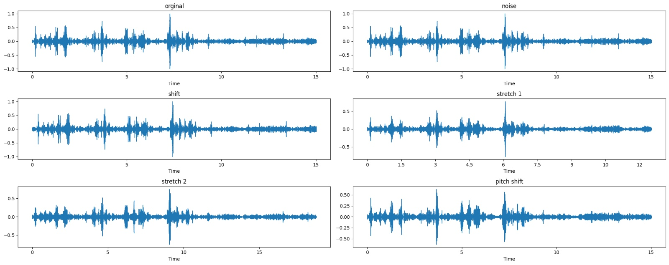

Slide 14
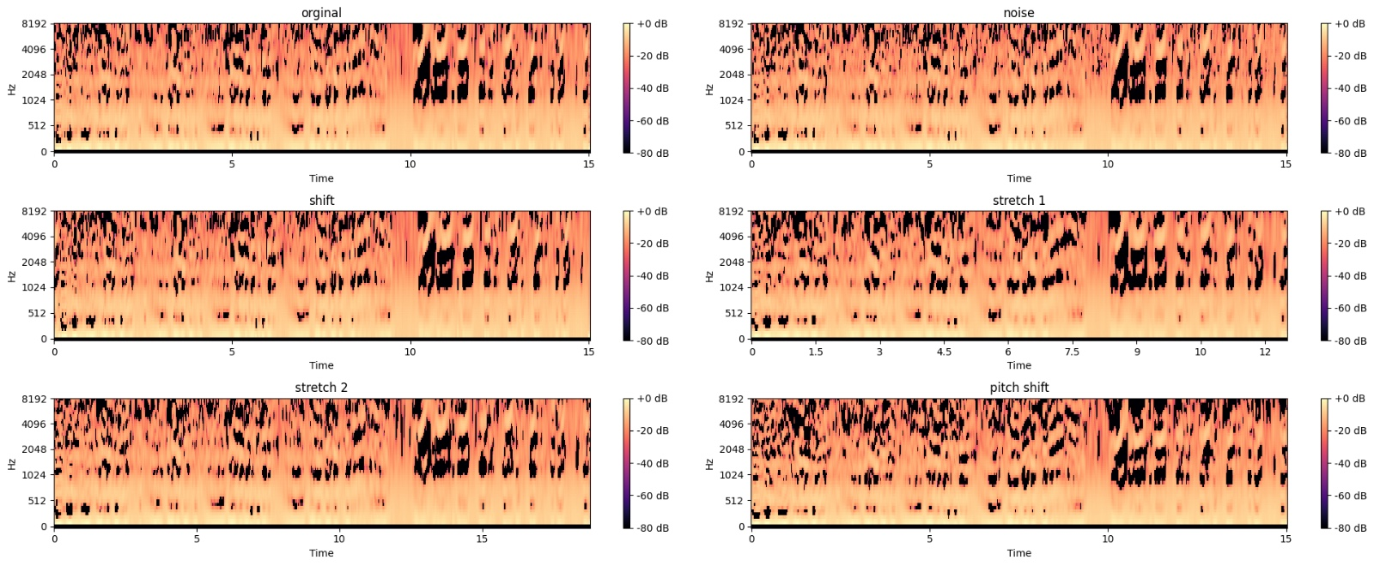
MEL SPECTROGRAPHY

Slide 15
FEATURES OF DATASET
TEXT FILES
Patient number
Age
Sex
Adult BMI (kg/m2)
Child Weight (kg)
Child Height (cm)

Slide 16
TARGET AUDIENCE
Food Processing Industries
Human Resource Researchers
Healthcare professionals
Patients and Caregivers
Public Health Organisations
Medical Device Manufacturers

Slide 17


FOOD PROCESSING INDUSTRY
HYGIENE ?

Slide 18
OTHER USE CASES

Slide 19

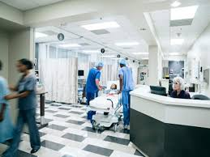
HOSPITALS

Slide 20


ATHELETICS

Slide 21


MINING AND EXCAVATION

Slide 22
IMPACT
Early Detection and Diagnosis: By leveraging AI algorithms to analyze cough sounds, Our application can facilitate early detection and diagnosis of respiratory diseases. Early intervention can lead to better treatment outcomes, reduced complications, and improved patient prognosis.
Improving Healthcare Access: Our application can improve access to healthcare services, especially in underserved communities or regions with limited access to specialized medical facilities. Remote monitoring and telemedicine capabilities can enable patients to receive timely care and support regardless of their geographical location.
Reducing Healthcare Costs: Early detection and intervention can help reduce healthcare costs associated with managing advanced stages of respiratory diseases. By preventing disease progression and hospitalizations, your application can contribute to cost savings for healthcare systems and patients.
Enhancing Patient Outcomes: Timely detection and personalized treatment based on cough sound analysis can lead to better patient outcomes, including symptom management, quality of life improvement, and reduced mortality rates for respiratory diseases.

Slide 23
MARKET OPPORTUNITY
Growing Prevalence of Respiratory Diseases: The global burden of respiratory diseases, including asthma, COPD, pneumonia, and respiratory infections, continues to rise due to factors such as air pollution, smoking, aging populations, and respiratory infections like COVID-19.
Demand for Early Detection and Prevention: There is a growing recognition of the importance of early detection and prevention in managing respiratory diseases effectively.
Telemedicine and Remote Monitoring: The rise of telemedicine and remote monitoring solutions, accelerated by the COVID-19 pandemic, has created a conducive environment for the adoption of digital health tools for respiratory disease management.
Market Segmentation and Targeted Solutions: The respiratory disease market can be segmented based on factors such as disease type, patient demographics, and healthcare settings.

Slide 24
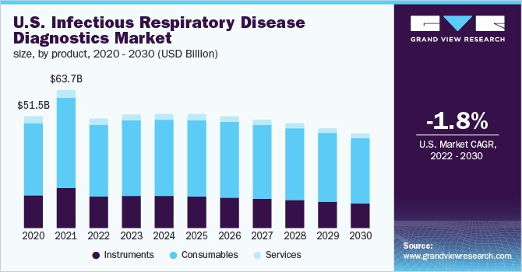

Slide 25
BUSINESS MODEL

Slide 26
VALUE PROPOSITION
Our application offers accurate and early detection of respiratory diseases through the analysis of cough sounds, enabling timely intervention and improved patient outcomes.
It provides convenience and accessibility by allowing users to monitor their respiratory health remotely and consult healthcare professionals as needed.
It provides the food industries to enhance food safety and hygiene with the application of the respiratory disease prediction.

Slide 27
CHANNELS
Food Processing Industries: Implement features for real-time monitoring of cough sounds, respiratory symptoms, and employee health status. Monetize through pay-per-use models tailored to the size and scale of food processing facilities.
Direct Sales: We aim to deploy the application and sell it directly to our potential users.
Partnerships: Collaborating with healthcare providers, telemedicine platforms, and public health and government organizations to distribute and promote the application to their networks.
Research and Development: Facilitate collaboration between research scholars and your development team to conduct joint research projects and studies focused on respiratory health.
Defence and Military Services: Integrating our application with existing military health information systems (HIS) and electronic health record (EHR) platforms used by defense healthcare providers and military medical facilities.

Slide 28
CHALLENGES
Workforce Adoption and Engagement: Encouraging workforce adoption and engagement with your application may face resistance or reluctance from employees, especially if they perceive it as intrusive or burdensome. Educating employees about the benefits of respiratory health monitoring, addressing privacy concerns, and providing training and support for using the application effectively are essential for overcoming barriers to adoption and promoting user engagement.
Integration with Existing Systems: Integrating your application with existing systems and workflows used by food processing companies can be challenging. Compatibility issues, data interoperability concerns, and technical constraints may arise when integrating with legacy software, ERP systems, or IoT devices. Seamless integration and interoperability are crucial for ensuring user adoption and maximizing the value of your application within food processing operations.

Slide 29
FUTURE PLANS AND MILESTONES
Emergency Alert System: The strategy of implementing an alert system to notify nearby healthcare institutions when a patient's respiratory health is deemed severe adds significant value to your respiratory disease detection application
Predictive Modeling: Develop advanced data analytics capabilities and predictive modeling algorithms to identify trends, patterns, and risk factors associated with respiratory diseases.
Integration with Wearable Devices: Integrate your respiratory disease detection application with wearable devices and Internet of Things (IoT) sensors to capture real-time physiological data and environmental variables relevant to respiratory health.
Iterative Improvement: Implement an iterative development process to incorporate user feedback, address usability issues, and enhance the functionality, usability, and user experience of your application over time.

Slide 30
CONCLUSION
So the implementation of respiratory disease detection through cough sounds in the food processing industry represents a proactive approach to safeguarding worker health and safety while enhancing operational efficiency and ensuring compliance with regulatory standards. By targeting key stakeholders such as food processing companies, HR managers, occupational health professionals, technology providers, industry associations, and regulatory agencies, the respiratory disease detection solution can effectively address the specific needs and challenges of the industry.

Slide 31
THANK YOU

