Slide 1

Exploratory Data Analysis AMCAT Data
EDA with Data Visualizations
By
S.Rajendra
(BATCH NO-256)

Slide 2
About me
Welcome to my journey! 👋 I'm a recent mechanical engineering graduate with a passion for leveraging data to drive impactful insights and solve complex problems. 🛠💡 🔍 Why Data Science? My engineering background has honed my analytical and problem-solving skills, and now I'm thrilled to apply these skills to the world of data science. I believe in the power of data to uncover hidden patterns, inform decision-making, and drive innovation. 📚 Education: > Bachelor of Science in Mechanical Engineering 🎓 -->[Rajeev Gandhi Memorial College of Engineering and Technology,2023 ]
🔗 Let's Connect! I'm excited to connect with professionals in the data science community, learn from your experiences, and explore potential collaborations. Feel free to reach out if you share a passion for transforming data into actionable insights.
LinkedIn : https://www.linkedin.com/in/rajendrasura9701194872/

Slide 3
🔍 Objective: Explored factors influencing salary and career decisions among engineering graduates.
📈 Key Findings: Conducted thorough univariate analysis, including identifying outliers and understanding frequency distributions. In bivariate analysis, uncovered relationships between variables through scatter plots and explored the gender-specialization relationship using stacked bar plots. 🔍 Conclusion: Found varying salary trends across engineering roles and a significant gender-specialization relationship

Slide 4
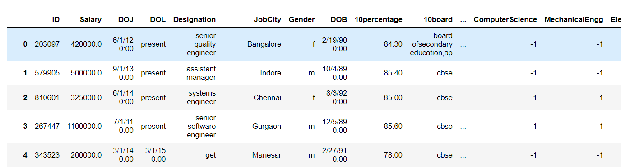
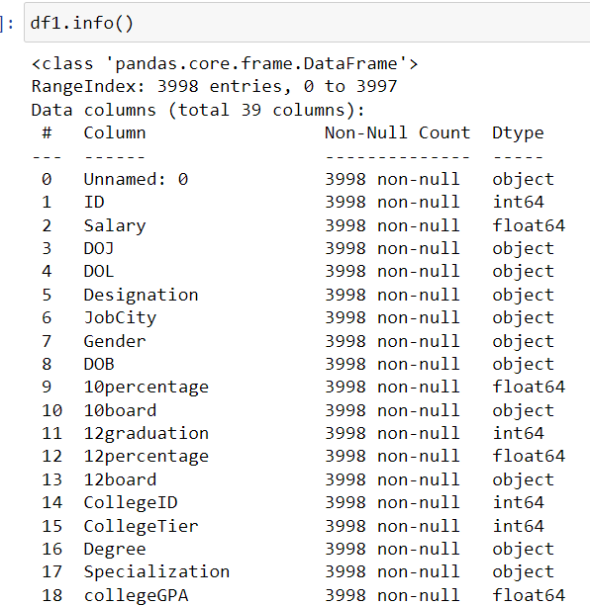
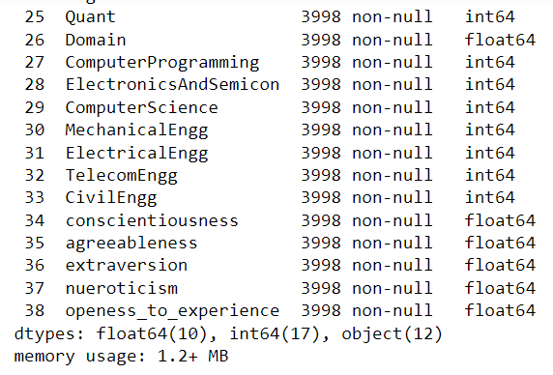
Data Loading

Slide 5
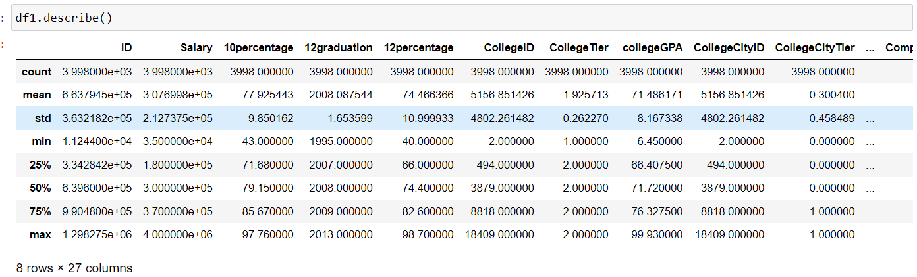
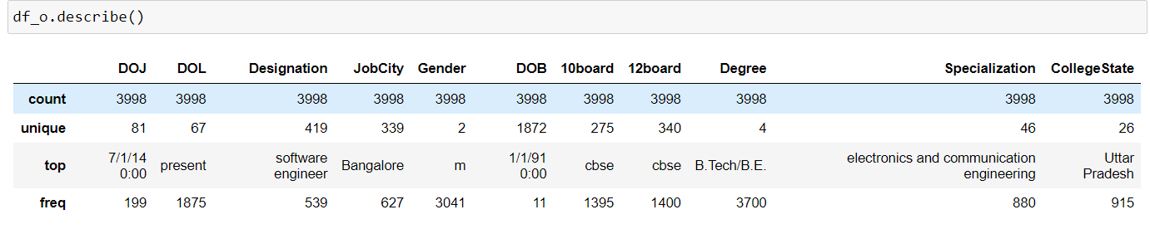

Slide 6
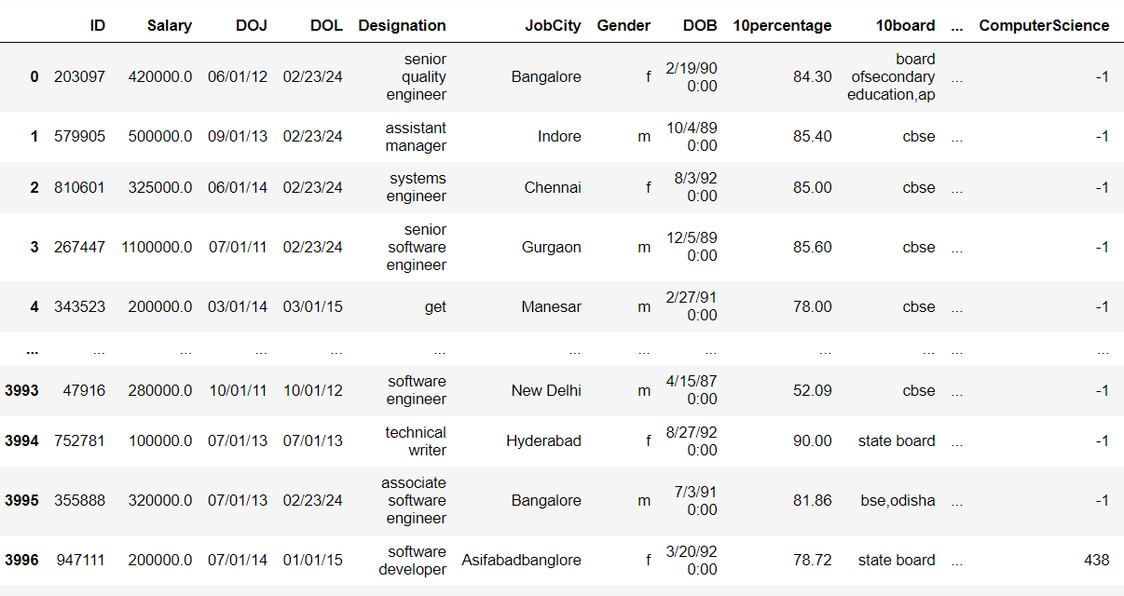
Cleaned Data

Slide 7
Data Visualization
Univariate Analysis:
It is used to summarize only one variable at a time.
Bivariate Analysis:
Bivariate statistics compare two variables and determine relation between them.

Slide 8
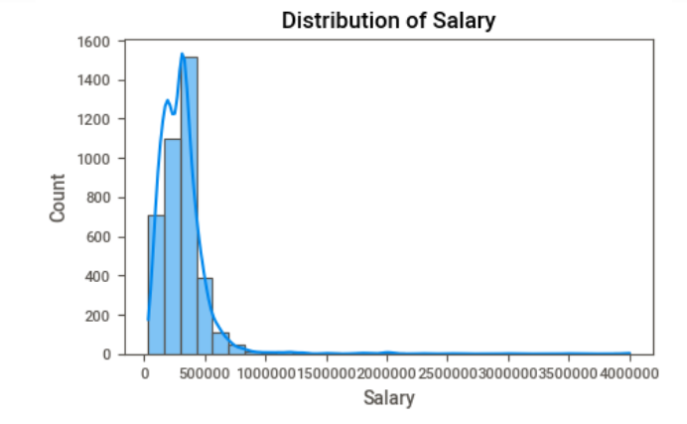
Variate Analysis
Observations
most observation salary below 10 lakhs.

Slide 9
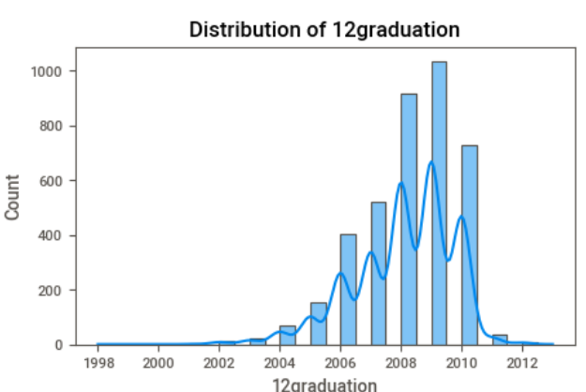
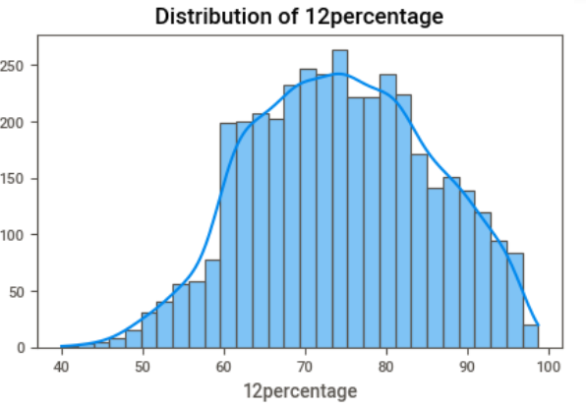
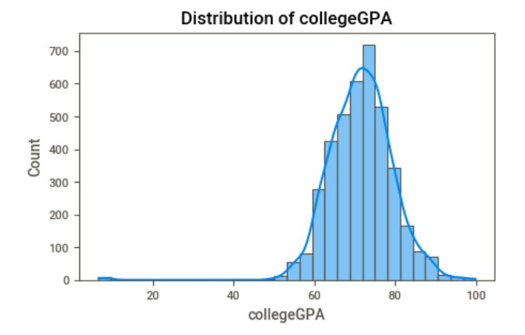
Observations:
Distribution of 12th is between 60-90 max.
Distribution of college is between 65-80 max.

Slide 10
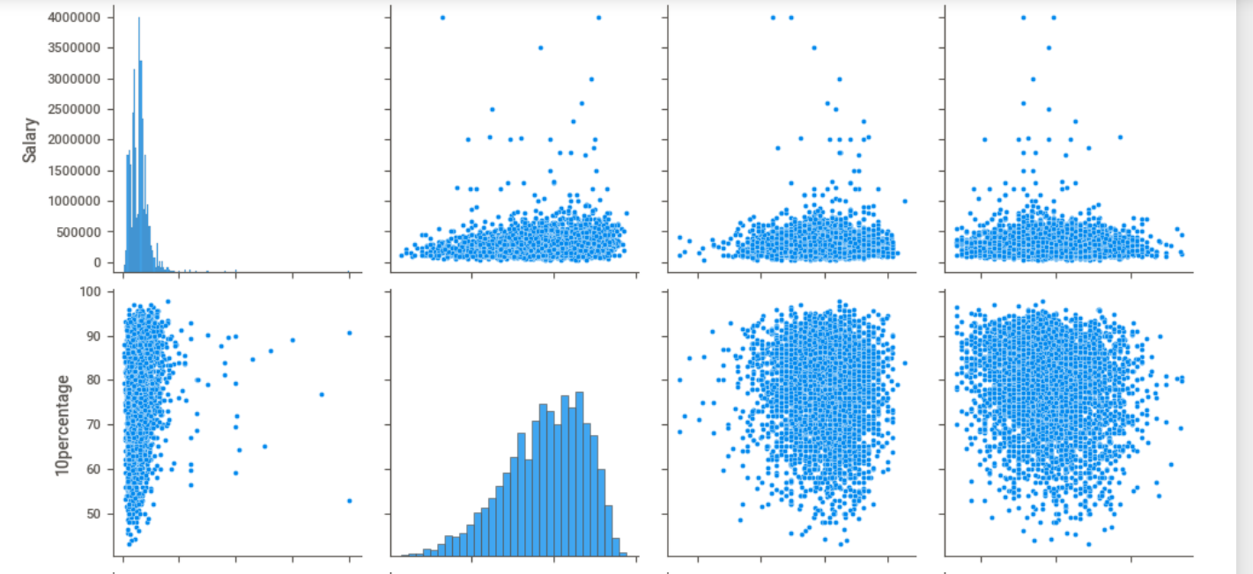
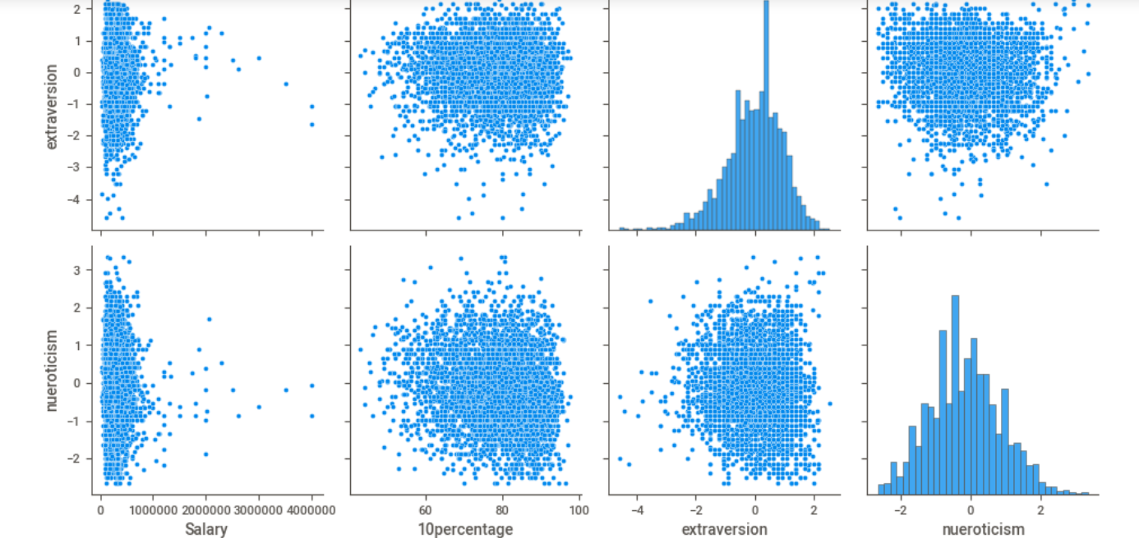

Slide 11
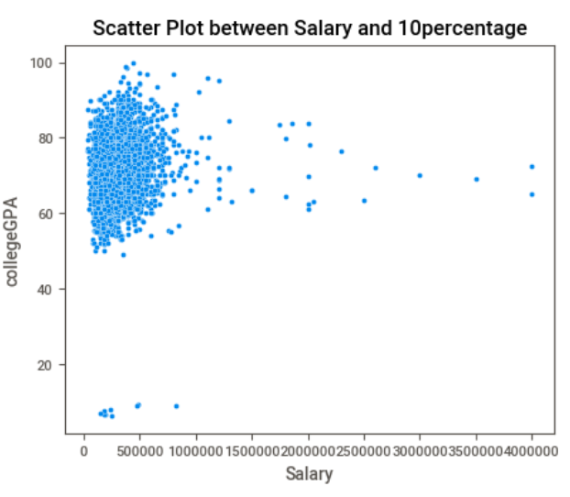
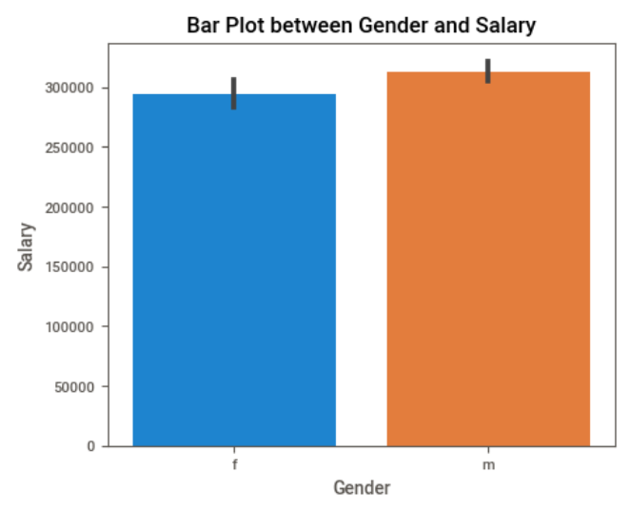

Slide 12
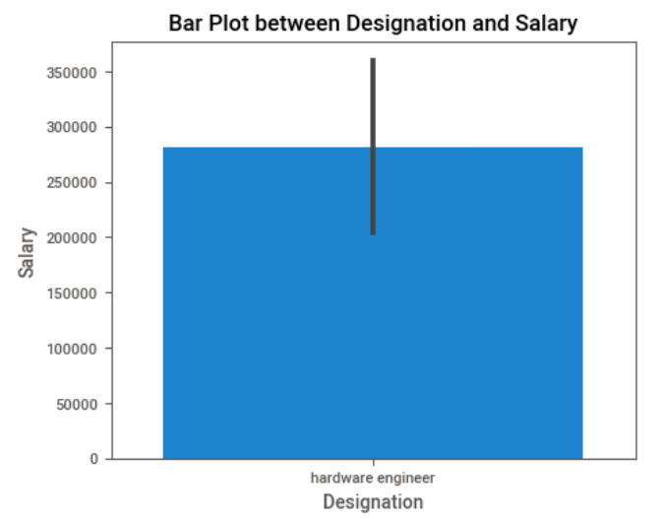
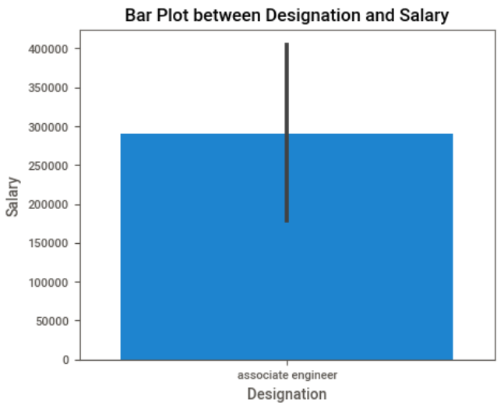
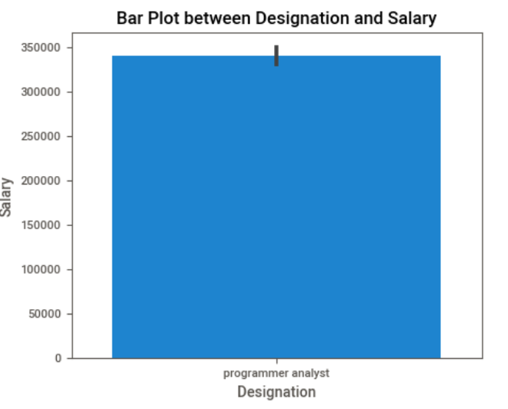
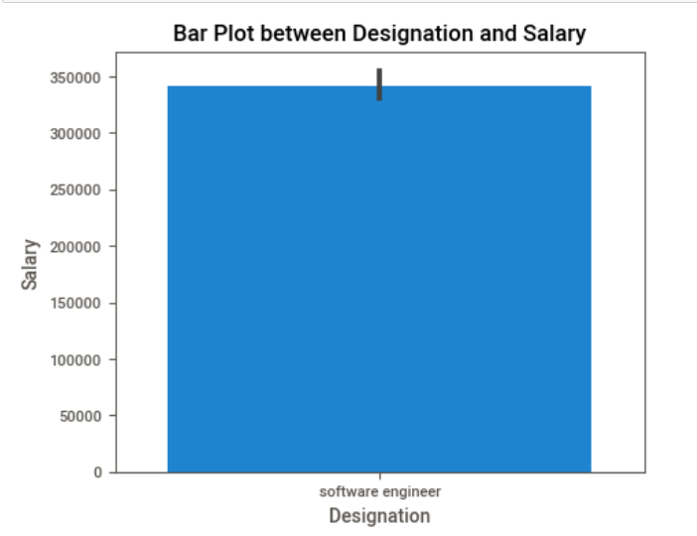
By this Observation:
“After doing your Computer Science Engineering if you take up jobs as a Programming Analyst, Software Engineer, Hardware Engineer and Associate Engineer you can earn up to 2.5-3 lakhs as a fresh graduate.”

Slide 13

THANK YOU

