Slide 1
Configuration of High Availability
TAC and Job server
*You can set up a cluster in your Talend system to provide high availability and failover features for task execution scheduling in Talend Administration Center.
*You do this by deploying multiple Job Conductors and Job execution servers on different machines.
*Implementing High Availability in Talend provides a robust and reliable foundation for data integration processes, offering benefits such as
continuous operation
fault tolerance
reduced downtime
disaster recovery
business continuity.

Slide 2
Talend High Availability feature Available in below licenses.
Big Data Platform
Data Fabric
Data Management Platform
Data Services Platform
MDM Platform
Real-Time Big Data Platform
NOTE:- Documentation link for Talend High Availability.
https://help.talend.com/r/en-US/8.0/installation-guide-linux/talend-high-availability

Slide 3
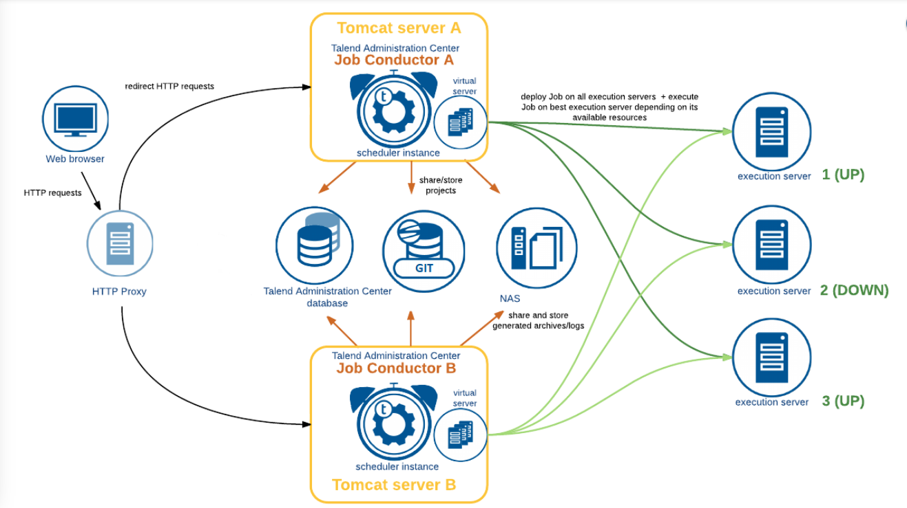

Slide 4
To summarize:
Two application servers (Tomcat or JBoss) holding the Talend Administration Center Job Conductors and Virtual Servers pointing to the same Git shared project.
All instances of the application server are connected to the project administration database.
When an execution server fails, the other execution servers can recover the interrupted tasks.
A shared storage is implemented to store and share between active instances all archives and logs generated during each Job execution, for example through a Network-Attached Storage (NAS). This feature is not provided by Talend and thus needs to be implemented separately.
It will be work as a Active Active configuration. If we run a job on one TAC parally it will be run on the another TAC.
We need to configure Same configurations for both the TAC. If one of the TAC server fails, we can recover the jobs from another TAC server.
If one of the job server fails job will run parallel on another job server.

Slide 5
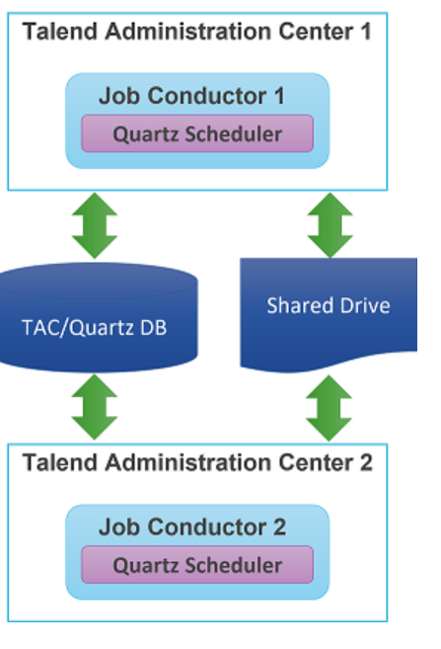
Setting up High Availability
The quartz cluster is in active - active configuration, so any Talend Administration Center node can potentially instantiate a Job according to the schedule.
The quartz cluster configuration is different from the High Availability of the Talend Administration Center web application.
Both primary and secondary Talend Administration Center must be set as active (they must be up and running), but only one node is used at a given time.
If the primary node is used in the failover device, then the secondary node must be configured as a failover. This means that when the primary node is down, the failover device redirects to the secondary node.
NOTE:- Talend Documentation link.
https://help.talend.com/r/en-US/8.0/installation-guide-linux/defining-emergency-user-for-talend-administration-center

Slide 6
*For configuring the High Availability for Two TAC servers.
We need common nfs shared drive path of logs files.
We need common git connection for both TAC configurations.
We need same database configuration for both TAC.
We need to add the job servers on virtual servers in TAC.
*High Availability for Job server
We have to install the 2 different job servers on both server and need to configure in virtual servers in TAC servers.
# Use case:
If one of the job server fails job will run parallel on another job server.
*High Availability for TAC server.
We have to install the 2 TAC servers on the two different servers. and configure the both servers job server in both TAC virtual server’s configuration.
#Use case:
It will be work as a Active Active configuration. If we run a job on one TAC parally it will be run on the another TAC.
We need to configure Same configurations for both the TAC. If one of the TAC server fails, we can recover the jobs from another TAC server.

Slide 7
Installation and Configuration of High Availability.
*We have installed Talend TAC and Job servers on Two Linux servers.
Ex:- 192.168.1.179
192.168.1.178
*Check all the services are running.
*Created a common share drive path for storing the log files and configure it to both TAC.
*Collect the git and database credentials and configure same credentials in both TAC servers.
*Configure the same Nexus credentials in TAC servsers.
*Add the both job servers in TAC and Create a virtual server and add the job servers in virtual server.

Slide 8
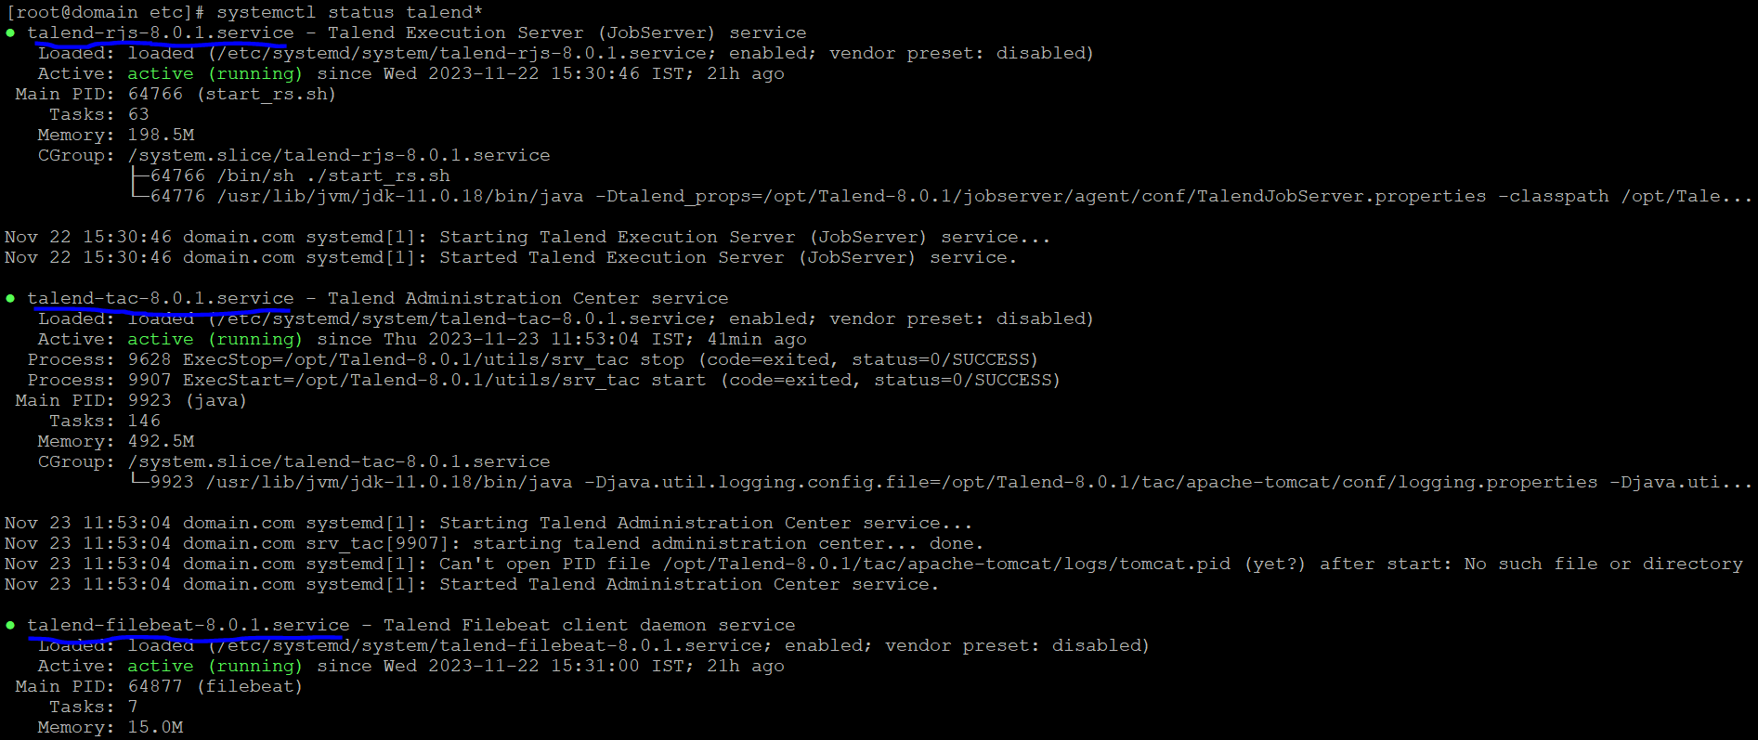

Slide 9
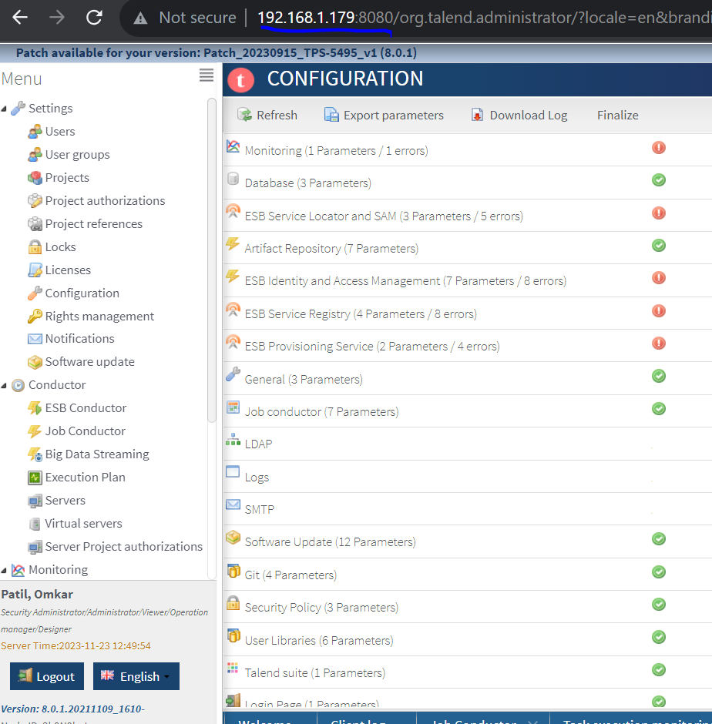
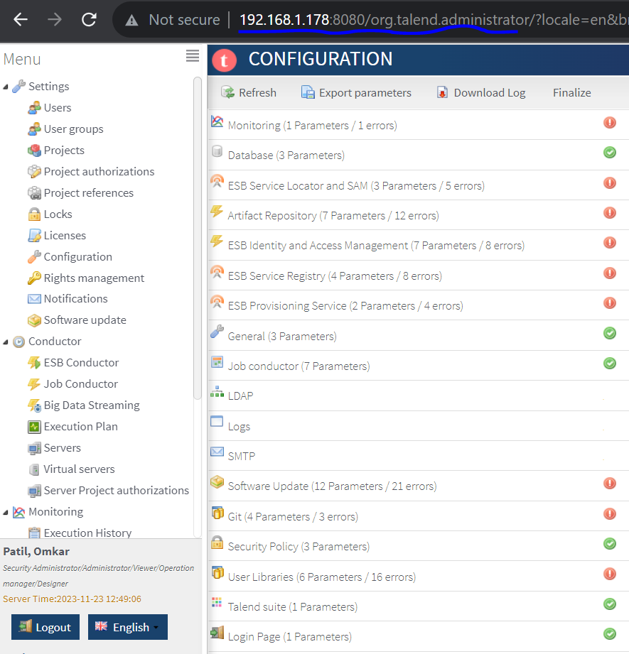

Slide 10
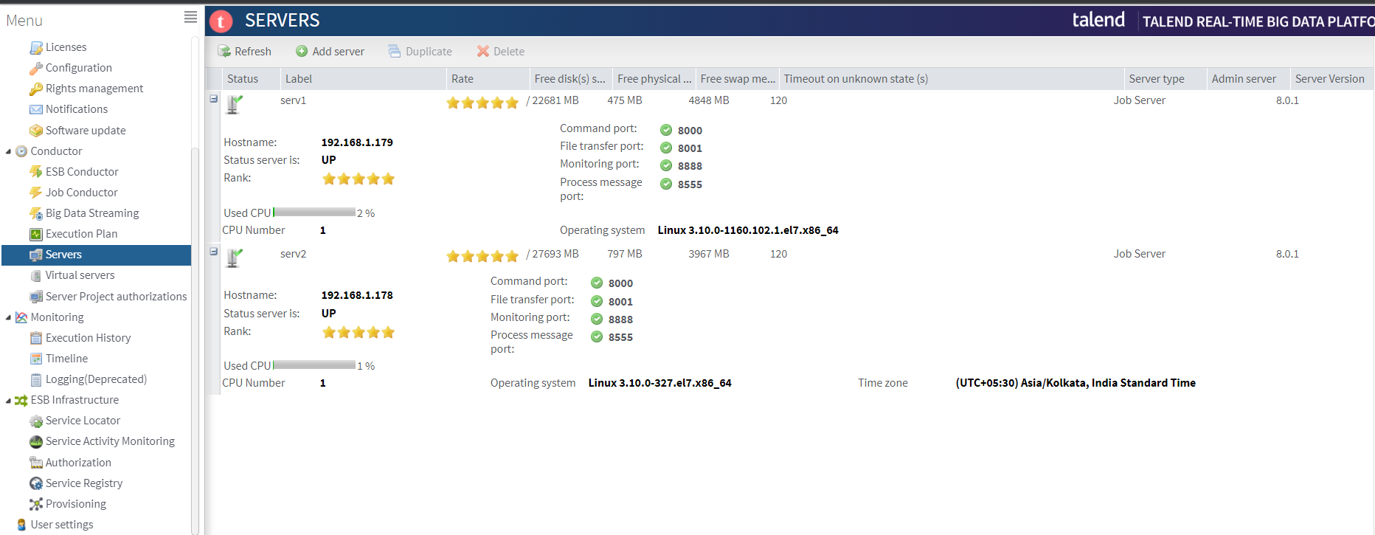

Slide 11
