Slide 1
What is Docker?
Docker is a software platform that allows you to build, test, and deploy applications quickly, packaging software into standardized units called containers.

Slide 2
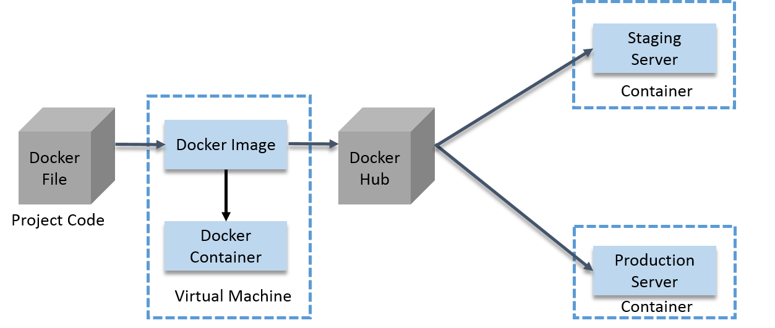

Slide 3
Docker file Builds Docker image and contains all the project code
You can run that image to create as many Docker container as you want.
Then this image can be uploaded on Docker hub. From Docker hub any one can pull the image and build the container.
You can run several micro services in the same VM by running various Docker container for each micro service.
Provides the consistent computing environment through the whole SDLC (Software development life cycle)

Slide 4
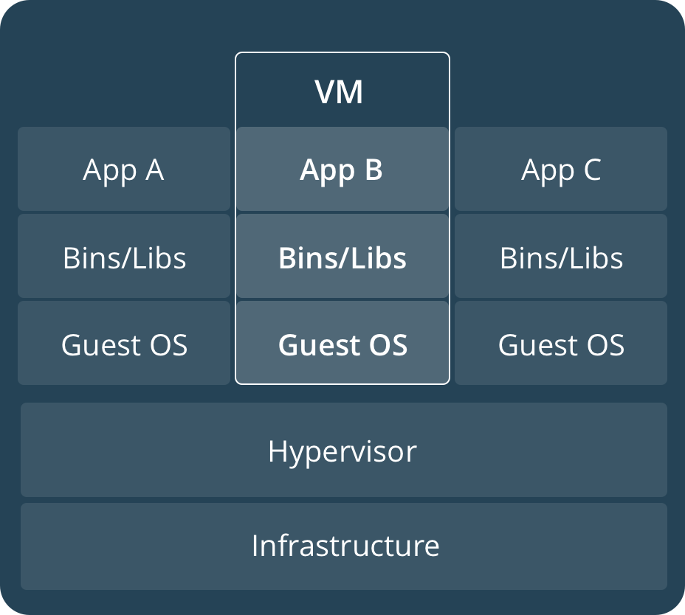
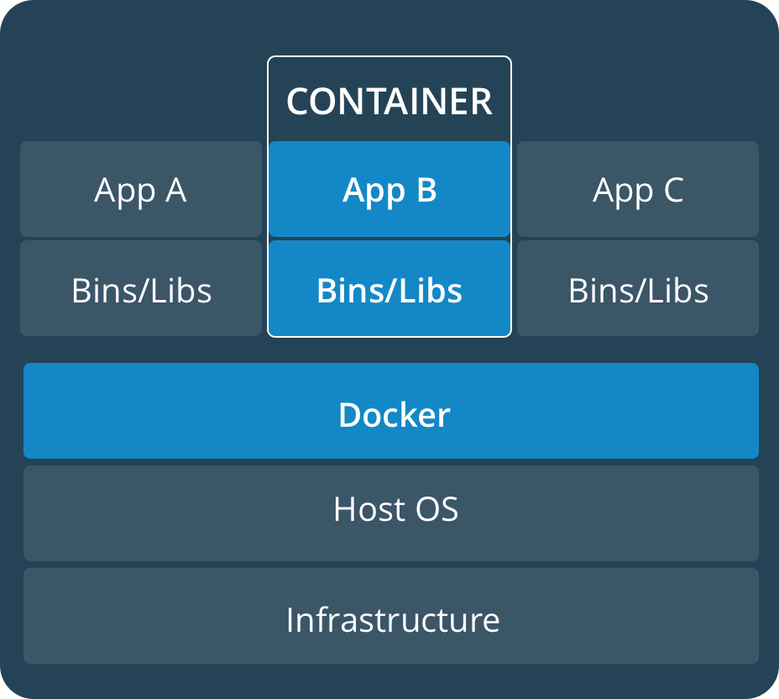
What is a container?
Isolated Application platform.
Contains everything needed to run the Application.
It can be built from one or more images.
Source: docs.Docker.com

Slide 5
Docker images
A Docker image is a file used to execute code in a Docker container
Read only Templates used to create container.
Built by Docker user.
Stored in Docker Hub or local registry.

Slide 6
Dockerfile
It is possible to build your own images reading instructions from a Dockerfile
FROM centos:7
RUN yum install -y python-devel python-virtualenv
RUN virtualenv /opt/indico/venv
RUN pip install indico
COPY entrypoint.sh /opt/indico/entrypoint.sh
EXPOSE 8000
ENTRYPOINT /opt/indico/entrypoint.sh

Slide 7
Docker-compose
Allows to run multi-container Docker applications reading instructions from a Docker-compose.yml file
version: "2"
services:
my-application:
build: ./
ports:
- "8000:8000"
environment:
- CONFIG_FILE
db:
image: postgres
redis:
image: redis
command: redis-server --save "" --appendonly no
ports:
- "6379"

Slide 8
Docker-registry
Docker registry is a storage component for Docker images.
We can store the images in either public/private repositories.
Docker Hub is Docker very own cloud repository.
A Docker registry is a storage and distribution system for named Docker images.

Slide 9

Demo
indico-Docker
$ git clone https://github.com/mvidalgarcia/indico-Docker.git
$ cd indico-Docker
$ Docker-compose up
Go to localhost:8080

