Slide 1
HELM CHART
What is Helm chart?
Helm uses a packaging format called charts. A chart is a collection of files that describe a related set of Kubernetes resources.
Helm helps you manage Kubernetes applications — Helm Charts help you define, install, and upgrade even the most complex Kubernetes application.
Helm is widely known as "the package manager for Kubernetes".
Charts allow you to version your manifest files too, just like we do with Node.js or any other package. This lets you install specific chart versions, which means keeping specific configurations for your infrastructure in the form of code.
Helm also keeps a release history of all deployed charts, so you can go back to a previous release if something went wrong.
Helm supports Kubernetes natively, which means you don't have to write any complex syntax files or anything to start using Helm. Just drop your template files into a new chart and you're good to go.

Slide 2
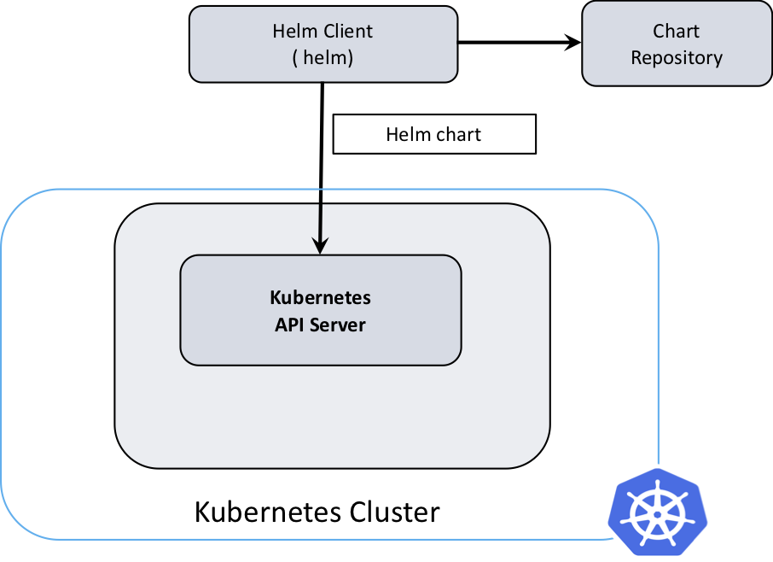
Helm 3 Architecture
Helm 3 is a single service architecture one executable is responsible for implementing helm .
Helm 3 has a client-only architecture with the client still called helm. As seen in the following diagram, it operates similar to the Helm 2 client, but the client interacts directly with the Kubernetes API server. The in-cluster server Tiller is now removed.

Slide 3
Helm packaging and managing
Introduce first time in 2015
Helm helps you to manage k8s application with helm charts which helps you install and upgrade even the most complex k8s application
Helm is the k8s equivalent of yum and apt
Helm is now an official k8s project .
The main building block of helm based deployments are helm. helm charts these charts describe a configuration set of dynamically generated k8s resources.
Chart can either be stored locally or fetched from remote chart repository.

Slide 4
Why use Helm/Benefits
Writing and maintaining k8s YAML manifest for all the required k8s objects can be a time consuming and tedious task for the simplest of deployment .
Helm is a package manager for Kubernetes that makes it easy to take applications and services that are either highly repeatable or used in multiple scenarios and deploy them to a typical K8s cluster
Greatly improved productivity
Reduced complexity of deployments
Implementation of cloud-native applications
More reproducible deployments and results
Ability to leverage Kubernetes with a single CLI command
Better scalability
Ability to re-use Helm charts across multiple environments
More streamlined CI/CD pipeline
Easier rolling back to previous versions of an app (should something go away)
Numerous CI/CD hooks to automate actions and even schedule health checks

Slide 5
Issues with Helm
Helm only adds value when you install community components. Otherwise you need to write yaml anyway.
Leads to too much logic in the templates (not good for inexperienced k8s users)
GitOps/Infrastructure as Code best practices are violated, because you version control before it has been template.

Slide 6
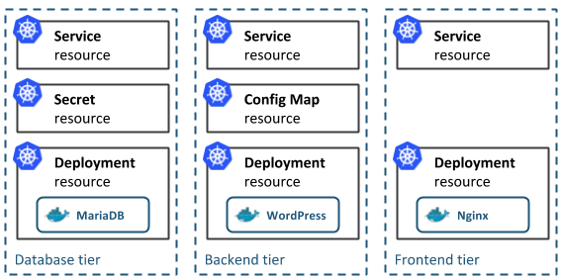
chart
Helm uses a packaging format called charts. A chart is a collection of files that describe a related set of Kubernetes resources.
Helm charts are simply k8s YAML manifest combined into a single package that can be advertise your k8s cluster.

Slide 7
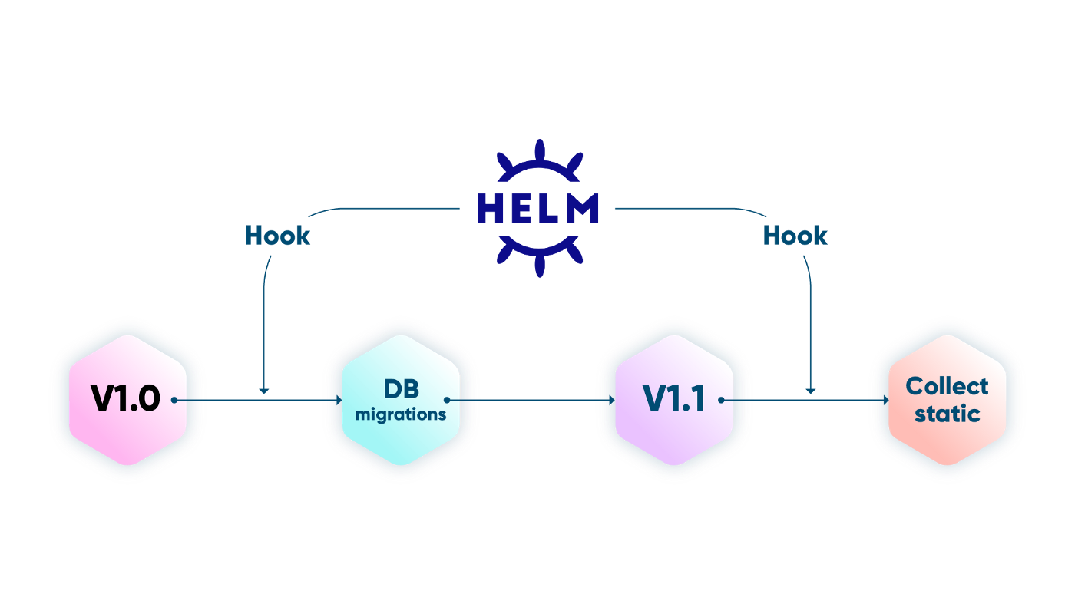
Release
A Release is an instance of a chart running in a Kubernetes cluster. One chart can often be installed many times into the same cluster. And each time it is installed, a new release is created. Consider a MySQL chart. If you want two databases running in your cluster, you can install that chart twice.
Each one will have its own release, which will in turn have its own release name.
Helm keeps track of all chart execution
(install / update / rollback)

Slide 8
Repository
A Helm repository is a collection of Helm charts. Developers can upload charts to a Helm repository, and users can download them from there.
The ability to share charts using a repository is another advantage of Helm. Helm repositories make it easy for developers to share their applications with users, and for users to find the applications they need, in a centralized location. Without Helm repositories, users would be left to scour GitHub manually when looking for the charts they need to deploy applications on Kubernetes.
It is the location where packages can be stored and shared

