Slide 1
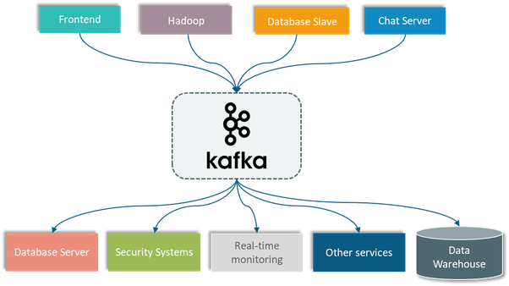
*Apache Kafka*
Kafka:-
#Kafka is a distributed event streaming platform that lets you read, write, store, and process events (also called records or messages in the documentation) across many machines.
#Apache Kafka is a distributed publish subscribe messaging system that receives data from disparate source systems
and makes the data available to target system in real time.
#Kafka is used to build real-time streaming data pipelines and real-time streaming applications. A data pipeline reliably processes and moves data from one system to another, and a streaming application is an application that consumes streams of data.

Slide 2
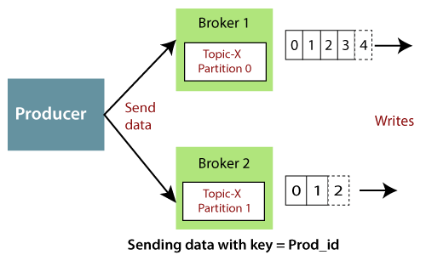
Producer:-
#Producers are the publisher of messages to one or more Kafka topics. Producers send data to Kafka brokers. Every time a producer publishes a message to a broker, the broker simply appends the message to the last segment file. Actually, the message will be appended to a partition. Producer can also send messages to a partition of their choice.
# A producer is the one which publishes or writes data to the topics within different partitions. Producers automatically know that, what data should be written to which partition and broker.

Slide 3
Broker:-
#Brokers are simple system responsible for maintaining the published data. Each broker may have zero or more partitions per topic. Assume, if there are N partitions in a topic and N number of brokers, each broker will have one partition.
#A Kafka broker receives messages from producers and stores them on disk keyed by unique offset. A Kafka broker allows consumers to fetch messages by topic, partition and offset. Kafka brokers can create a Kafka cluster by sharing information between each other directly or indirectly using Zookeeper.
Zookeeper:-
# Zookeeper acts a Kafka cluster coordinator that manages cluster membership of brokers, producers, and consumers participating in message transfers via Kafka. It is like a centralized service that manages cluster memberships, relevant configurations, and cluster registry services.
# The goal is to make these systems easier to manage with improved, more reliable propagation of changes.

Slide 4
Consumer:-
#Consumers read data from brokers. Consumers subscribes to one or more topics and consume published messages by pulling data from the brokers.
#Kafka consumers act as end-users or applications that retrieve data from Kafka servers inside which Kafka producers publish real-time messages.
Topics:-
# A stream of messages belonging to a particular category is called a topic. Data is stored in topics.
Partition:-
# Topics are split into partitions. For each topic, Kafka keeps a minimum of one partition. Each such partition contains messages in an immutable ordered sequence. A partition is implemented as a set of segment files of equal sizes.
#4000 partitions stored in Each Broker .200,000 partions in zookeeper (kafka clusters)
Replicas of partition:-
# Replicas are nothing but “backups” of a partition. Replicas are never read or write data. They are used to prevent data loss.

Slide 5
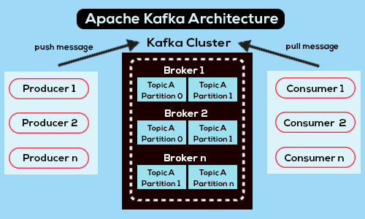
Benefits Following are a few benefits of Kafka:
#Reliability - Kafka is distributed, partitioned, replicated and fault tolerance. •
#Scalability - Kafka messaging system scales easily without down time. #
# Durability - Kafka uses “Distributed commit log” which means messages persists on disk as fast as possible, hence it is durable.
#Performance - Kafka has high throughput for both publishing and subscribing messages. It maintains stable performance even many TB of messages are stored.

Slide 6
Need for Kafka
# Kafka is a unified platform for handling all the real-time data feeds. Kafka supports low latency message delivery and gives guarantee for fault tolerance in the presence of machine failures.
#It has the ability to handle a large number of diverse consumers.
#Kafka is very fast, performs 2 million writes/sec

