Slide 1
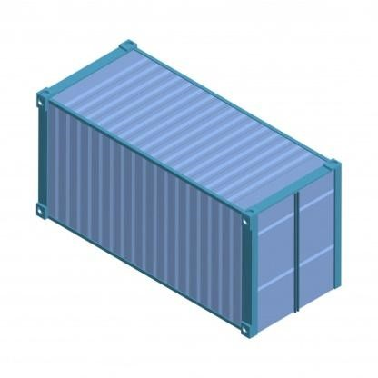




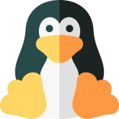

KUBERNETES
Container
Container are the abstraction at the application layer that packages codes and dependencies together.
Containers are packages of software that contain all of the necessary elements to run in any environment.
*consumes less storage and memory.
*Easier and faster to ship.
*If they work on one machine they work on all machines.
*cost efficient and easy to scale.
*possible to eliminate data loss and downtime.
Code
Libraries

Slide 2

Kubernetes (k8s)
Kubernetes (K8s) is an open source system to deploy, scale, and manage containerized applications anywhere.
It is a tool that allows us to manage multiple containers at the same time.
Kubernetes is an open source container orchestration tool that allows us to manage multiple containers in different types of environment.
It schedules, runs and manages isolated container which are running on virtual / physical / cloud machine.
All top cloud providers support k8s.

Slide 3
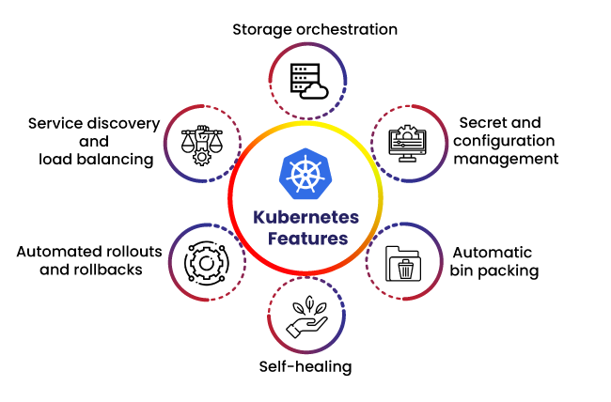
Features of kubernetes
1. Auto scaling and load balancing
2. Service Discovery & Load balancing
3. Storage Orchestration
4. Self-Healing
5. Secret & Configuration Management
6. Batch Execution
7. Horizontal Scaling
8. Automatic Rollbacks & Rollouts
9.Platform independent
10.Roll Back

Slide 4
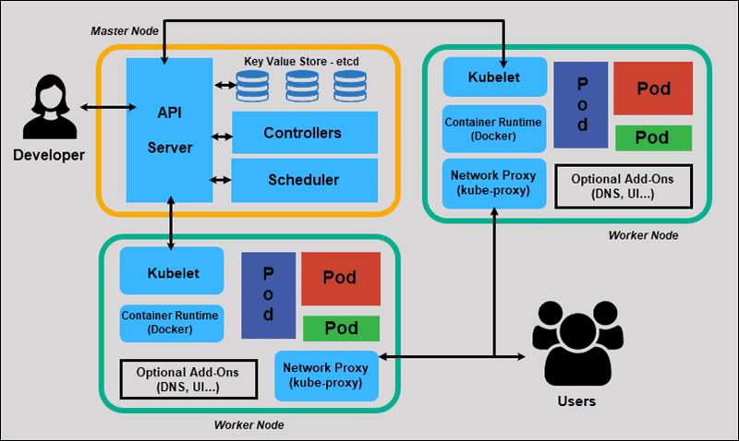
kubernetes Architecture

Slide 5
Kubernetes (k8s) Architecture
An administrator creates and places the desired state of an application into a manifest file.
The file is provided to the Kubernetes API Server using a CLI or UI. Kubernetes’ default command-line tool is called kubectl.
Kubernetes stores the file (an application’s desired state) in a database called the Key-Value Store (etcd).
Kubernetes then implements desired state on all the relevant applications within the cluster.
Kubernetes continuously monitors the elements of the cluster to make sure the current state of the application does not vary from the desired state.

Slide 6
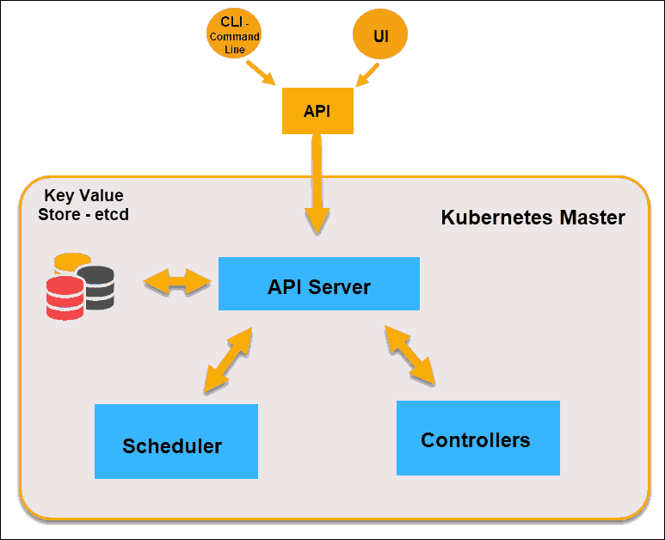
kubernetes master Architecture
The Kubernetes Master (Master Node) receives input from a CLI (Command-Line Interface) or UI (User Interface) via an API. These are the commands you provide to Kubernetes.
You define pods, replica sets, and services that you want Kubernetes to maintain. For example, which container image to use, which ports to expose, and how many pod replicas to run.
You also provide the parameters of the desired state for the application(s) running in that cluster.

Slide 7
API server
The API Server is the front-end of the control plane and the only component in the control plane that we interact with directly. Internal system components, as well as external user components, all communicate via the same API.
i.e we apply .yml or .json manifest to kube api server
Key value store (etcd)
The Key-Value Store, also called etcd, is a database Kubernetes uses to back-up all cluster data.
It stores the entire configuration and state of the cluster.
The Master node queries etcd to retrieve parameters for the state of the nodes, pods, and containers.
Controller
The role of the Controller is to obtain the desired state from the API Server.
It checks the current state of the nodes it is tasked to control, and determines if there are any differences, and resolves them, if any.
Scheduler
A Scheduler watches for new requests coming from the API Server and assigns them to healthy nodes. It ranks the quality of the nodes and deploys pods to the best-suited node. If there are no suitable nodes, the pods are put in a pending state until such a node appears.

Slide 8
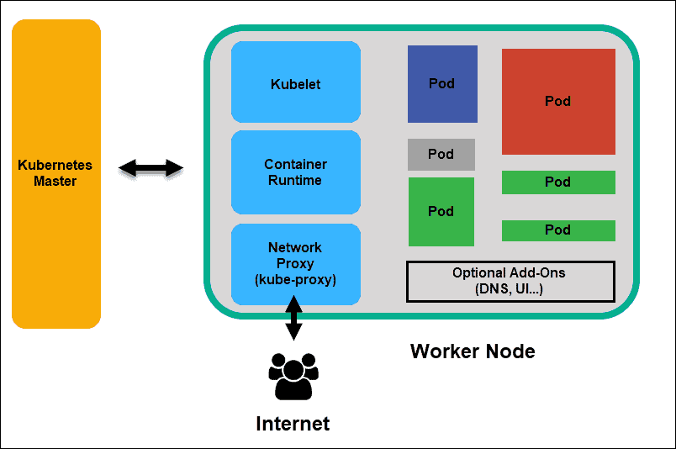
kubernetes worker node
Worker nodes listen to the API Server for new work assignments; they execute the work assignments and then report the results back to the Kubernetes Master node.

Slide 9
kubelet
The kubelet runs on every node in the cluster. It is the principal Kubernetes agent.
By installing kubelet, the node’s CPU, RAM, and storage become part of the broader cluster.
It watches for tasks sent from the API Server, executes the task, and reports back to the Master.
It also monitors pods and reports back to the control panel if a pod is not fully functional. Based on that information, the Master can then decide how to allocate tasks and resources to reach the desired state.
Container runtime
The container runtime pulls images from a container image registry and starts and stops containers. A 3rd party software or plugin, such as Docker, usually performs this function.
Kube -proxy
The kube-proxy makes sure that each node gets its IP address, implements local ip tables and rules to handle routing and traffic load-balancing.

Slide 10
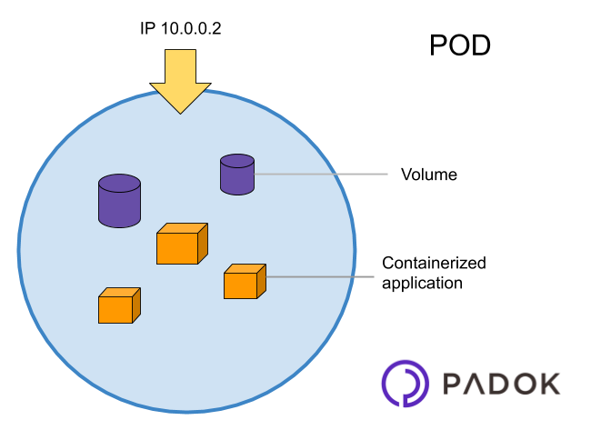
Pods
A pod is the smallest element of scheduling in Kubernetes. Without it, a container cannot be part of a cluster.
If you need to scale your app, you can only do so by adding or removing pods.
The pod serves as a ‘wrapper’ for a single container with the application code.
Based on the availability of resources, the Master schedules the pod on a specific node and coordinates with the container runtime to launch the container.

Slide 11
