Slide 1
PROJECT TITLE
CAPSTONE PROJECT
Presented By: Chinta Rajesh
Student Name : Chinta Satyam Narayana
College Name & Department : Sri Venkateswara College of Engineering and Technology, Computer Science Engineering

Slide 2
OUTLINE
Problem Statement
Technology used
Wow factor
End users
Result
Conclusion
Git-hub Link
Future scope

Slide 3
Problem Statement
Digital communication is vulnerable to eavesdropping. Encryption alone may attract attention; steganography provides hidden security. Current methods are either complex or easy to detect. Our solution embeds text into an image to enhance secrecy.

Slide 4
Technology used
Programming Language: Python Libraries Used: OpenCV (cv2), OS Platform: Works on Windows Methodology: Pixel modification for message embedding

Slide 5
Wow factors
Uses Images for Message Encryption: Not easily noticeable compared to text encryption.
Password-Based Access: Only the correct passcode can retrieve the message.
Lightweight Implementation: Simple Python script with minimal dependencies.

Slide 6
End users
Journalists & Activists: Hide sensitive data in images.
Cybersecurity Enthusiasts: Experiment with steganography.
Personal Communication: Individuals who want secure messages

Slide 7
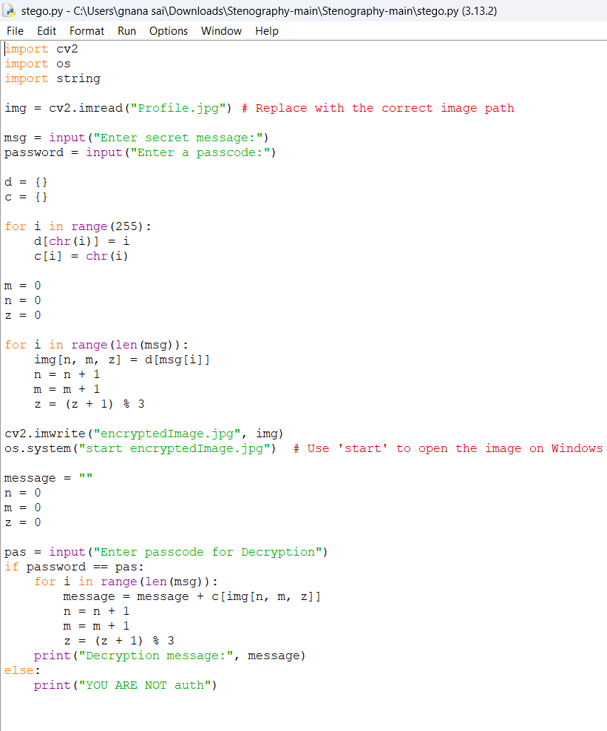
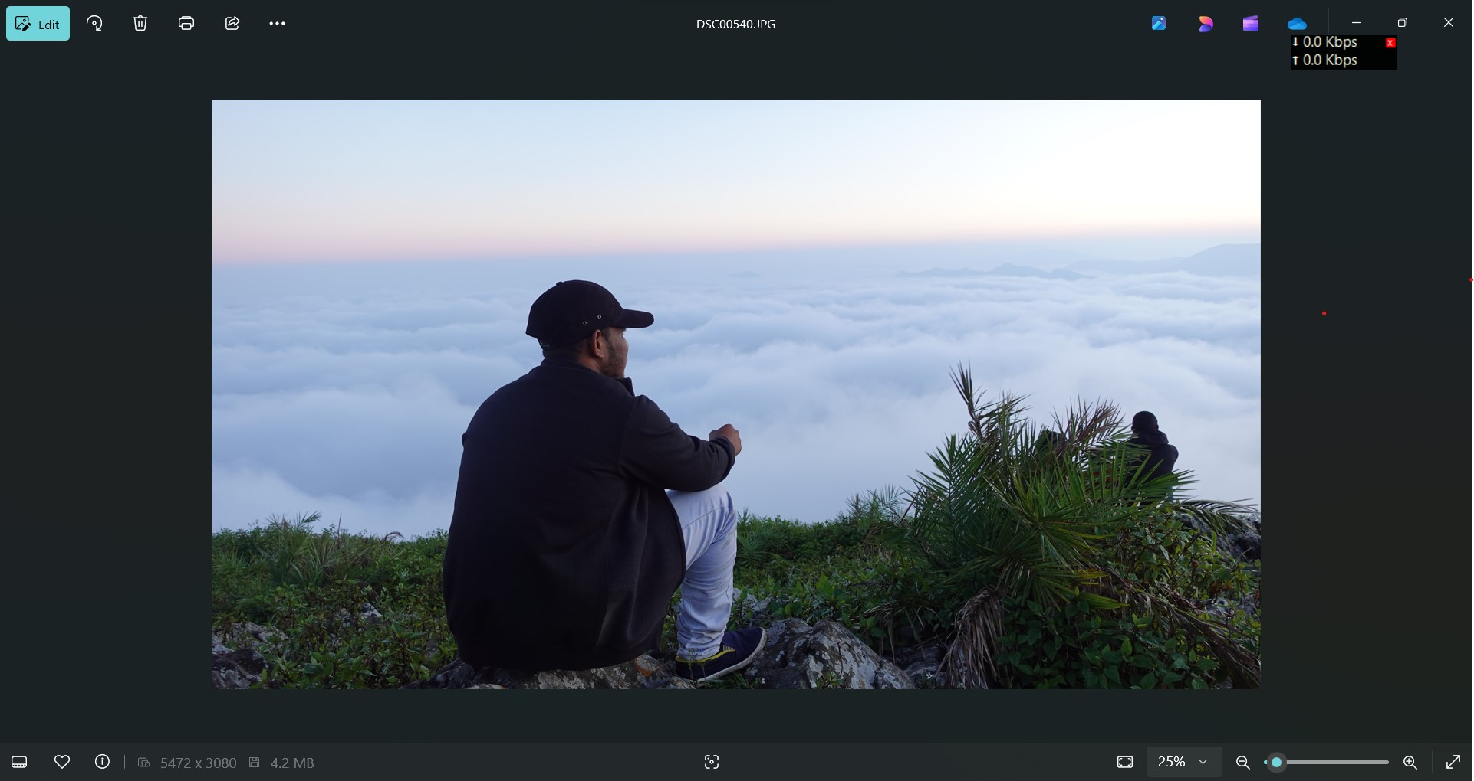
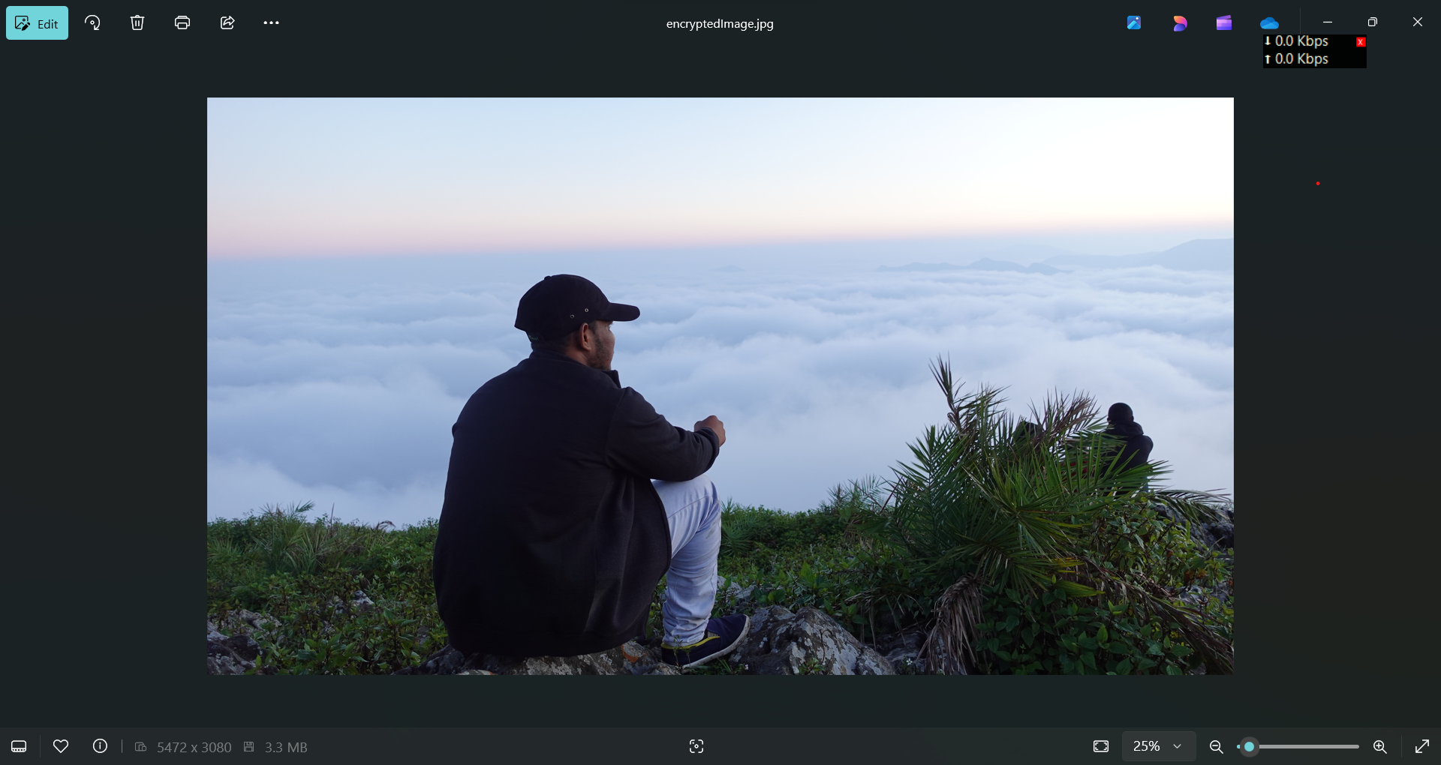
Results

Slide 8
Conclusion
✅ Implemented Steganography-Based Message Encryption using Images. ✅ Successfully embedded a secret message into an image without noticeable visual changes. ✅ Password-protected decryption ensures only authorized users can retrieve the message. ✅ The project demonstrates a basic but effective cybersecurity technique for secure communication. ✅ This method can be enhanced with encryption techniques to improve security. Key Takeaways: Steganography provides an extra security layer beyond encryption. Images can be used as a secure medium to store hidden data. Further improvements can make it more resistant to attacks and detection.

Slide 9
GitHub Link
https://github.com/Rajesh-151103/myproject_aicte.git

Slide 10
Future scope(optional)
Implement Least Significant Bit (LSB) encoding for better security.
Use AES encryption before embedding messages.
Develop a GUI-based version for easier use.
Expand to audio or video steganography in future versions.

Slide 11
THANK YOU

