Slide 1




VIDYAVARDHAKA COLLEGE OF ENGINEERING
Autonomous Institute | Accredited by NAAC with 'A' Gra﻿de
Gokulam 3rd stage, Mysuru - 570002
Passion-fueled Creativity, Purpose-driven Innovation
TEAM NAME :BIT by BIT
DOMAIN : WEB

Slide 2
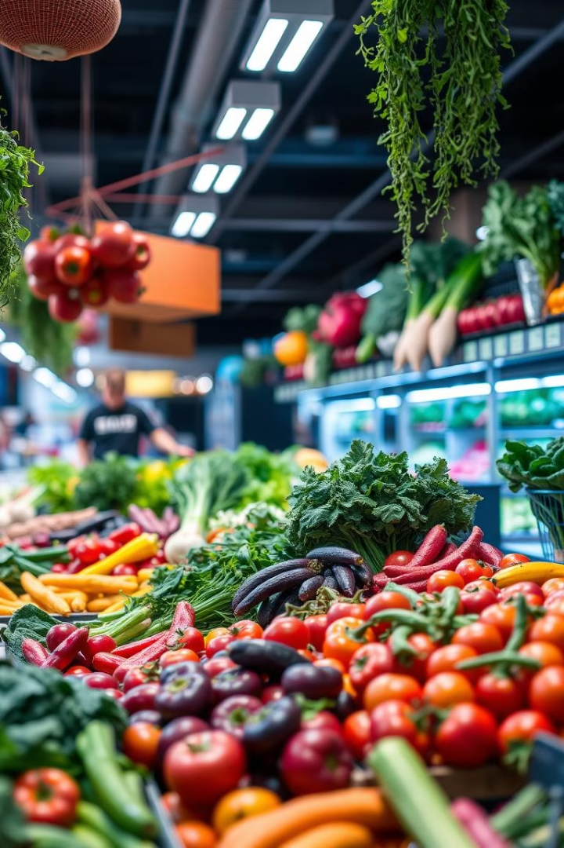
Problem statement :
Farmers struggle with accessing direct markets and face multiple intermediaries.
Traditional supply chains lead to lower profits for farmers and higher costs for consumers.
Need for a web-based Direct Market Access (DMA) platform to connect farmers directly with buyers.
Solution we are offering:
Eliminates middlemen – farmers can sell directly to consumers, retailers, or wholesalers, ensuring better profits.
Fair pricing – ai-driven price recommendations prevent price manipulation and ensure fair rates.
Transparency & trust – secure transactions and smart contracts build trust between buyers and sellers.
Market expansion – farmers gain access to a larger customer base beyond local markets.
Efficient logistics – streamlined delivery options ensure faster and fresher produce.
Financial security – integrated secure payment gateways reduce delays and fraud.
Data-driven insights – demand forecasting helps farmers plan crops efficiently, reducing wastage.
Government & ngo support – potential collaborations can bring subsidies and support to farmers.
INFOTHON 4.0

Slide 3
Workflow / Idea
WORKFLOW
Component | Technology Used
Frontend | React.js, Tailwind CSS
Backend | Node.js, Express.js
Database | MongoDB, PostgreSQL
AI/ML | TensorFlow, OpenAI API
Payment | Razorpay, Stripe
Deployment | AWS, Docker
List Produce
Manage Transactions
Farmers list their produce, specifying details like variety, quantity, and pricing.
Secure payment and delivery options are integrated for smooth transactions.
Connect with Buyers
Track Prices
Buyers browse listings, filter by criteria, and contact farmers directly.
Farmers and buyers can track historical prices for different produce.
INFOTHON 4.0

Slide 4
Features :
Current Features:
Basic Farmer-to-Buyer Listing – Allow farmers to list their produce and buyers to browse.
AI-Based Price Recommendation – Use a simple ML model to suggest fair pricing.
Secure Payment Integration – Implement basic Razorpay or Stripe for transactions.
Order Tracking System – Enable farmers and buyers to track order status.
Chat Support for Direct Negotiation – Basic chat feature for communication.
Future updates:
Multi-Language Support – Ensures accessibility for farmers from diverse regions.
Farmer Profiles & Ratings – Builds credibility and trust among buyers.
Automated Inventory Management – Notifies farmers about low stock and demand trends.
Geo-Tagging & Local Market Insights – Helps farmers identify profitable markets nearby.
Smart Contract-Based Transactions – Ensures secure and dispute-free payments.
Integrated Weather Forecasts – Helps farmers make informed harvesting and selling decisions.
Bulk Order Management – Allows wholesalers to place large orders efficiently.
Government Schemes & Subsidy Integration – Provides farmers with relevant financial assistance.
INFOTHON 4.0

Slide 5
Conclusion / Future Scope
Our Web-Based Direct Market Access (DMA) Platform bridges the gap between farmers and buyers, eliminating intermediaries and ensuring fair pricing.
By leveraging AI-driven analytics, secure transactions, and a user-friendly interface, we create a transparent and efficient marketplace.
This solution empowers farmers with better profit margins, provides consumers with fresher produce, and streamlines agricultural trade.
Future enhancements include blockchain integration, AI-powered demand forecasting, and collaborations with government and NGOs to maximize impact.
INFOTHON 4.0

