Slide 1

Underwriting score prediction for Autism Spectrum Disorder(ASD)
Rajesh Sharma

Slide 2
Contents
What is ASD?
ASD prevalence in Canada
Asia Region ASD Progression
ASD Health Insurance Expenditure
Problem Statement
Proposed Business Solution
Prototype Solution
Prototype Results
Potential extension for future
Appendix

Slide 3
What is ASD?
Autism spectrum disorder (ASD) is a neurodevelopment disability that can cause significant social, communication and behavioral challenges
There is often nothing about how people with ASD look that sets them apart from other people, but people with ASD may communicate, interact, behave, and learn in ways that are different from most other people
ASD begins early in childhood and typically lasts throughout a person's life and some people with ASD need a lot of help in their daily lives; others need less
ASD is a broad term used to describe a group of neurodevelopmental disorders:
Autistic disorder
Asperger’s syndrome
Pervasive development disorder(PDD)
Childhood disintegrative disorder

Slide 4
ASD Prevalence among Children & Youth in Canada
In Canada, among children and youth 5-17 years of age:
An estimated 1 in 66 have been diagnosed with ASD
Males were identified with ASD 4x more frequently than females
1 in 42 males & 1 in 165 females were diagnosed with ASD
More than half of children and youth (56%) had received their diagnosis by age 6; and more than 90% of children and youth were diagnosed by age 12.
As per the recent strategies of The Province of Canada, Ontario families with an autistic child receives $20,000 a year until their child turns six. After the age of six, families receives $5,000 a year until their child turns 18.
And, it is estimated that Ontario could add $952 million of insurance for autism services.

Slide 5
ASD Prevalence in Canada
Below graphs are representing:
Top ASD prevalent countries
ASD incidence rate in Canada region

Slide 6
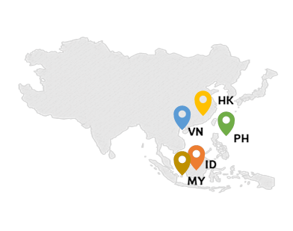
Asia Region ASD Progression
In Hong Kong, 25,000 are already registered for autistic children, and a further 10,000-plus are expected to be diagnosed in 2017-2018, up from 7,200 in 2015-2016.
Based on the recent estimates, in Hong Kong, 65 or more in every 10,000 children are affected with autism.
The Vietnam Public Health Association estimates there are 160,000 people living with ASD in Vietnam by 2012.
As per the latest studies, 0.75 percent of young children in northern Vietnam have autism according to a large study of children in the region.
The number of people with ASD in the Philippines has almost doubled in the past six years and the number is still rising.
In the Philippines, estimated autism cases rose from 500,000 in 2008 to one million people by 2014.

Slide 7
ASD ASIA Region Progression
Below bar charts are representing:
Number of ASD cases till 2008 and 2016
Percentage rise in number of cases from 2008 to 2016

Slide 8
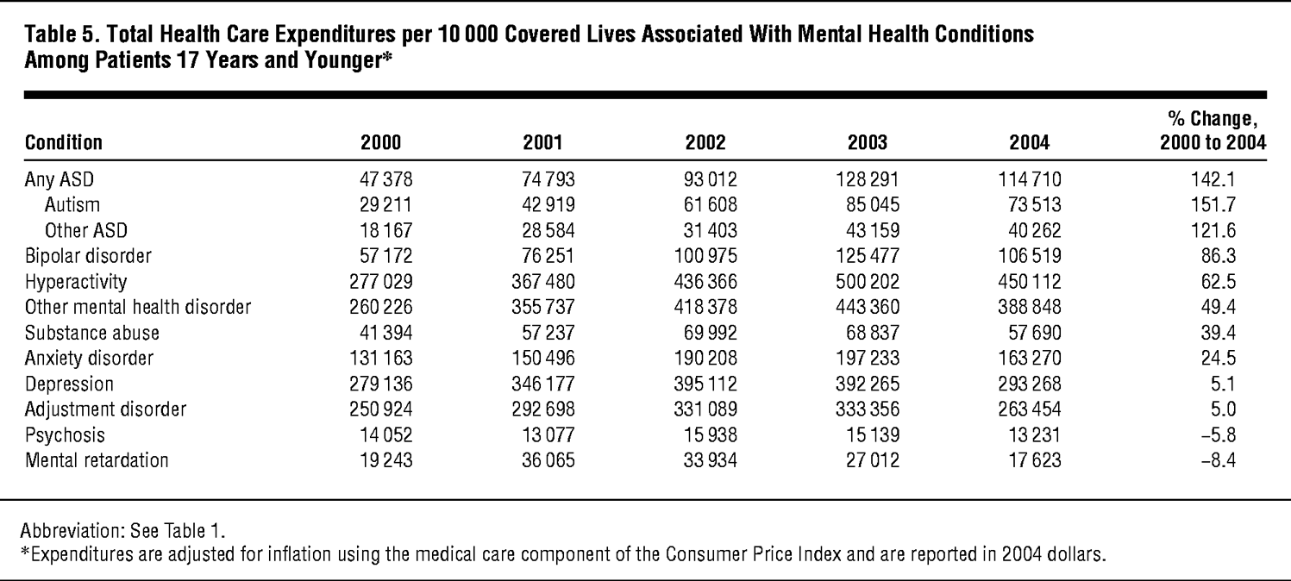
ASD Health Insurance Expenditure
According to the CDC, ASD treatment services costs an estimated USD 17,000 more per year to care for a child with ASD compared to a child without autism.
Costs include health care, education, ASD-related therapy, family-coordinated services, and caregiver time. For a child with more severe ASD, costs increase to over USD 21,000 more per year.
Data based on research done for some US States

Slide 9
ASD Health Care Expenditure
Below graphs are representing the Total Healthcare Expenditure for “Autism Spectrum Disorder”, “Autistic cases” and “other ASD disorders”.

Slide 10
Rise(%) in ASD Healthcare Expenditure
Below graphs are representing the percentage rise in Total Healthcare Expenditure for “Autism Spectrum Disorder”, “Autistic cases” and “other ASD disorders”.

Slide 11
ASD Diagnosis
Diagnosing ASD can be difficult since there is no medical test, like a blood test, to diagnose the disorders
Doctors look at the child’s behavior and development to make a diagnosis.
ASD can sometimes be detected by the child’s age of 18 months or younger
By age 2, a diagnosis by an experienced professional can be considered very reliable.
Almost all the ASD cases been diagnosed by the age of 18 years. However, many children do not receive a final diagnosis until much older.

Slide 12
ASD Treatment & associated risks
Cost of treatment
ASD treatment services costs an estimated from USD 17,000 to USD 21,000 more per year to care for a child with ASD compared to a child without autism.
Recovery time
Generally, treatment services starts in early childhood and lasts till the child turns 18 or ASD signs are minimized
There is no fixed time length that child should receive the treatment services
Treatment therapies
Very initial services can include therapies to help the child talk, walk, and interact with others.
Other ASD treatment therapies are:
Applied Behavior Analysis
Anger Management
Sensory Processing
Speech/language therapy and others are offered at different age time based on symptoms.
Some medicines can help with related symptoms like depression, insomnia(sleep disorder), and trouble focusing. And, recent studies have shown that medication is most effective when it’s combined with behavioral therapies.

Slide 13
Problem Statement
How the process currently works?
The only way to predict the risk is using some behavioral questionnaires and ASD leading factors. As, there is no option to identify ASD via medical procedures thus it is hard to assess the risk of the disease.
There 2 core parts of this problem:
Risk assessment of ASD
Generation of an accurate Underwriting score based on questionnaires and supporting variables

Slide 14
Proposed Business Solution
What we are proposing in our solution?
Predict Underwriting score for ASD like the others Health or LTC(Long Term Cure) Insurances
Based on 10 questionnaires and other supporting variables we have build the Underwriting Score ML Model to predict a probabilistic score which will help SunLife in approving or rejecting the policy against ASD cases in the children, adolescents and adults in more accurate manner
Refer to <Autism Dataset Description.docx> for the 10 questionnaires and supporting variables.
A correct underwriting score will help the Actuarial to fluctuate the premium and other important insurance rates
Business can follow any one of the below approaches to capture the data
Medical professional can help in capturing the answers against the questionnaires(virtual call)
Physical visit to the customer’s residence
Direct answers by the patient or parent

Slide 15
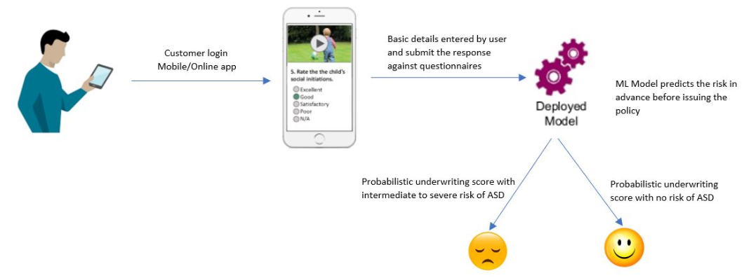
Prototype Solution
To build the ML model used the ASD Dataset for Children, Adolescents and Adults available on UCI ML Repository:
http://archive.ics.uci.edu/ml/datasets/Autism+Screening+Adult
http://archive.ics.uci.edu/ml/datasets/Autistic+Spectrum+Disorder+Screening+Data+for+Children++
http://archive.ics.uci.edu/ml/datasets/Autistic+Spectrum+Disorder+Screening+Data+for+Adolescent+++
Combined dataset contains 10 questionnaires variables and 9 supporting variables with a total of 1100 cases from various countries and ethnicities, and age group.
Solution Design

Slide 16
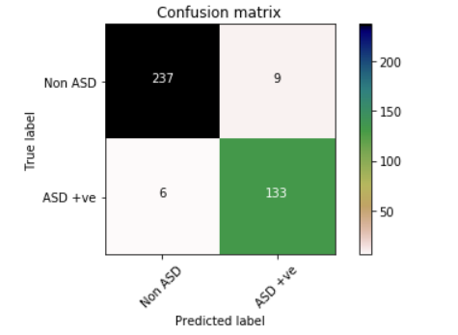
Prototype Results
Using AWS SageMaker as a platform, Python 3 and its prominent ML libraries created a ML Classifier Model to predict the existence of ASD in a person and achieved a ROC Score of 0.96.
Out of 1100 cases, used 715 cases to train the model and 385 cases to test or validate the model.
Also, predicts the probabilistic underwriting score that is useful to approve/reject the policy or increase the premium amount.
[0-0.3) → Low risk, [0.3-0.5) → Intermediate risk, [0.5 >] → High or Severe risk

Slide 17
Potential extension for future
Can we predict ASD during pregnancy?
By reading this question you might wonder, how it is related to Health Insurance business or predicting the underwriting score, however, it has a direct link with our ML Model to predict the insurance risk. And, answers to this question can be the potential features for our ML Model.
Now, to predict ASD during pregnancy we actually have to understand how fetal brain develops:
Development of fetal brain is directly related to the mother’s diet. The last 3 months of pregnancy and first 3 years of post-natal life are most crucial for brain development. Health and nutritional status of mother during pregnancy has significant effect on the development of brain during fetal life.
Brain size of the baby at birth is almost 70% of adult size of the brain but his body weight is only 5% of an adult. During first year of life, 15% brain growth occurs thus emphasizing the need for promotion of breast feeding to enhance brain growth.
In the past decade, dozens of papers have proposed a vast array of factors that potentially contribute to autism: vitamins such as folic acid, maternal depression and antidepressant use, premature birth, advanced paternal and maternal age, overweight parents, excess smoking or alcohol consumption and exposure to air pollutants and pesticides.
Some research even suggests that a younger sibling born either too soon or too long after the first child has a heightened risk of autism.

Slide 18


Slide 19
Appendix

Slide 20
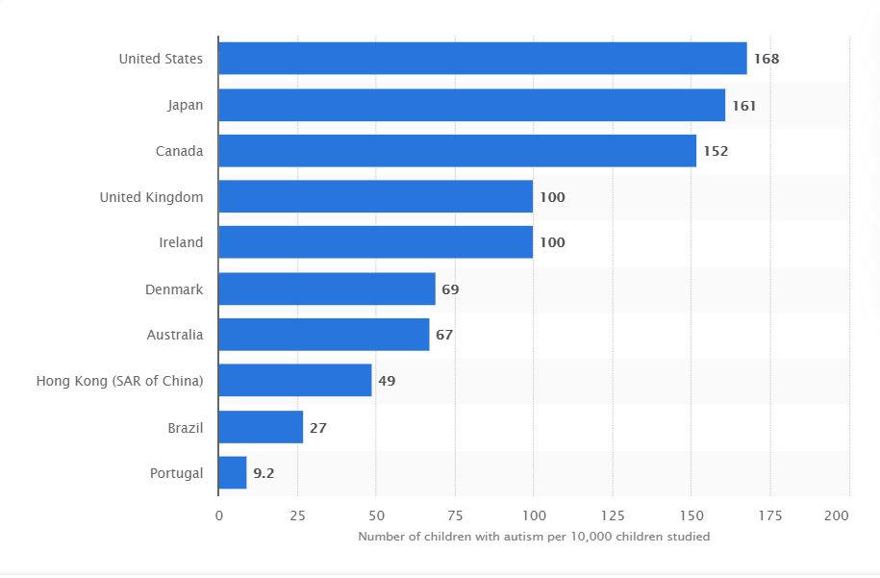
Top ASD prevalent countries & ASD v/s Age
Worldwide, 1 in every 160 children has an Autism Spectrum Disorder, with 3 times as prevalent among boys as among girls. However, some other well-controlled studies have reported the figures that are substantially higher.

Slide 21
ASD Signs & Symptoms
People with ASD often have problems with social, emotional, and communication skills.
Children or adults with ASD might:
not point at objects to show interest
not look at objects when another person points at them
avoid eye contact and want to be alone
have trouble understanding other people’s feelings
have no interest in other people
appear to be unaware when people talk to them, but respond to other sounds
be very interested in people, but not know how to talk, play, or relate to them
repeat words or phrases said to them
not play “pretend” games (for example, not pretend to “feed” a doll)
repeat actions over and over again
have unusual reactions to the way things smell, taste, look, feel, or sound
lose skills they once had (for example, stop saying words they were using)

Slide 22
Abbreviations
ASD → ASD stands for Autism Spectrum Disorder
Prevalence → In epidemiology it is the proportion of a particular population found to be affected by a medical condition at a specific time.
Epidemic → As per WHO, Epidemic is the occurrence in a community or region of cases of an illness, specific health-related behavior, or other health-related events clearly in excess of normal expectancy. The community or region and the period in which the cases occur are specified precisely. The number of cases indicating the presence of an epidemic varies according to the agent, size, and type of population exposed, previous experience or lack of exposure to the disease, and time and place of occurrence.
CDC → U.S. Centers for Disease Control and Prevention (CDC)
LTD → Long Term Disease
LTC → Long Term Cure
ML → Machine Learning

Slide 23
References
https://www.webmd.com/brain/autism/understanding-autism-treatment
https://www.webmd.com/brain/autism/features/cutting-edge-autism-treatment#1
https://www.medscape.com/answers/912781-193662/what-is-the-global-prevalence-of-autism-spectrum-disorder-asd
https://en.wikipedia.org/wiki/Epidemiology_of_autism
https://www.cdc.gov/ncbddd/autism/data.html
https://www.cdc.gov/ncbddd/autism/documents/ASDPrevalenceDataTable2016-508.pdf
https://www.cdc.gov/mmwr/volumes/69/ss/ss6904a1.htm?s_cid=ss6904a1_w#T1_down
https://www.who.int/news-room/fact-sheets/detail/autism-spectrum-disorders
https://www.who.int/hac/about/definitions/en/
https://www.sciencedaily.com/releases/2018/04/180426141604.htm
https://www.autism.org.uk/about/what-is/myths-facts-stats.aspx
https://www.canada.ca/en/public-health/services/publications/diseases-conditions/infographic-autism-spectrum-disorder-children-youth-canada-2018.html
https://www.statista.com/statistics/676354/autism-rate-among-children-select-countries-worldwide/
https://www.ncsl.org/research/health/autism-and-insurance-coverage-state-laws.aspx
https://www.fwd.com.hk/en/live/articles/all/autism/
https://jamanetwork.com/journals/jamapediatrics/fullarticle/570065
https://www.spectrumnews.org/features/deep-dive/pregnancy-may-shape-childs-autism/
https://indianpediatrics.net/mar2003/mar-213-220.htm
https://www.cdc.gov/ncbddd/autism/hcp-screening.html
https://www.ncbi.nlm.nih.gov/pmc/articles/PMC6706245/

Slide 24
Underwriting Score prediction for ASD
Problem Background
In Canada, among children and youth from 5 to 17 years of age:
An estimated 1 in 66 have been diagnosed with Autism Spectrum Disorder(ASD)
Males were identified with ASD 4x more frequently than females
One in 42 males and one in 165 females were diagnosed with ASD
Solution
Using AWS SageMaker as a platform, Python3 and its other libraries built the ML model on the ASD Dataset for Children, Adolescents and Adults available on UCI ML Repository:
http://archive.ics.uci.edu/ml/datasets/Autism+Screening+Adult
http://archive.ics.uci.edu/ml/datasets/Autistic+Spectrum+Disorder+Screening+Data+for+Children++
http://archive.ics.uci.edu/ml/datasets/Autistic+Spectrum+Disorder+Screening+Data+for+Adolescent+++
Combined dataset contains 10 questionnaires variables and 9 supporting variables with a total of 1100 cases from various countries and ethnicities, and age group.
Problem Statement
As per the recent strategies of The Province of Canada, Ontario families with an autistic child receives $20,000 a year until their child turns six. After the age of six, families receives $5,000 a year until their child turns 18.
And, it is estimated that Ontario could add $952 million of insurance for autism services including Applied Behavioral Analysis (ABA) and speech/language therapy.
Solution Design
Business Impact
This model predicts the probabilistic underwriting score for health/disability/long term cure or disease insurances against ASD in Children, Adolescents and Adults
This score will help Sunlife in approving or rejecting the policy
By using a threshold value along with the model generated score helps the actuarial to fluctuate the premium amount based upon the case

