Slide 1
AWS Cloud Computing

Slide 2
Course Concepts
1. AWS
2. Git -- Git/GitHub
3. Linux Fundamentals
4. Apache 2 -- web server
5. Docker -containerizations platform
6. New Relic -- monitoring tool
7. sonar Qube
8. HTML, CSS, Java Script
9. AWS - Command Line Interface (CLI)
10.AMI - Amazon Machine Image

Slide 3
Cloud Computing
A “Cloud” is used to store large amounts of data .There are many types of cloud platforms Example, AWS, Google cloud, Microsoft Azure, IBM ( International Business Machine), etc…
Usually any cloud storage provides a base limit of storage ,If he needs any additional storage he can purchase a new plan.
Cloud Computing is classified into 3 categories, those are:
1.Public – Everyone can access Ex: News channels
2.Private – Limited access Ex: WhatsApp
3.Hybrid – Both public & private Ex: Company website, Result portals
Cloud provides 3 types of services, those are:
IAAS – Infrastructure as a service
PAAS - Platform as a service
SAAS – Software as a service
VPC stands for “Virtual Private Cloud” which acts as a Firewall.

Slide 4
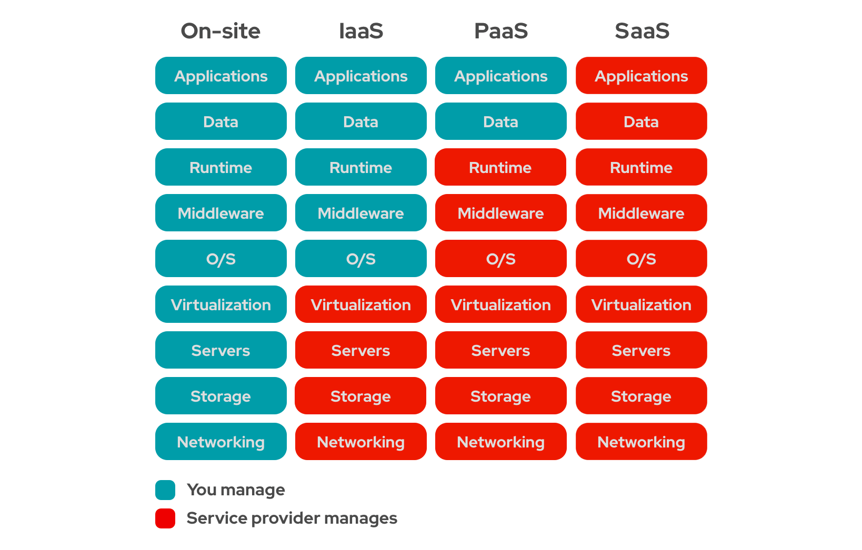
Different types of Cloud Services

Slide 5
Basic Requirements:
VMWARE / Oracle Virtual Box
Ubuntu Live Server 22.04 LTS→ LTS means Long Term Support
Putty SSH client
We get the IP address from your VMWARE or ORACLE VIRTUAL BOX and use that to connect to PUTTY.
You can know your IP address in VMWARE using this command: “ip a”
If you encounter any errors like “ssh service not found”, then try the below commands;
sudo apt-get install openssh-server
sudo apt-get install openssh-client

Slide 6
If Ip address is not displaying, then Go to settings->network settings->change NAT to bridged adapter.
To install any Package in the Linux;
sudo apt-get install <package name>
(or)
sudo apt install <package name>

Slide 7
Linux Commands:
1. To change the user to root : sudo -i or sudo su-
2. To logout : exit
3. To clear the terminal : clear
4. To update or save the session : bash
5. To change the hostname : hostnamectl set-hostname <name>
6. To know the username : whoami
7. To know the IP address : ip a
8. To know the SSH status : systemctl status shh
9. To start the SSH : systemctl start ssh
10.To stop the SSH : systemctl stop ssh
11.To restart the SSH : systemctl restart ssh

Slide 8
Steps to create a root user in vmware to putty:-
login as normal user and password
Switch the normal user to root user : sudo –i or sudo su –
Go to the path to change the settings: vi /etc/ssh/ssh_config
Press i : it is nothing to edit the file and it is a insert mode
Enable the permitrootlogin prohibit password→ yes
Enable the pubkeyAuthentication yes
Enable the passwordAuthentication yes
Bash
to set the password: “passwd”
New password :xxxxxxx
Re-type password:xxxxxx

Slide 9
Steps to install or Create EC2 Instance
1.Go to AWS account
2.Click on launch instance
3.Give the name of the machine or server.
4.then select the operating system--> ubuntu 22.04 LTS
5. It will take the default image AMI based on the OS
6. Instance Type--> select only "free tier eligible" like t2 micro,t3.micro
7. Key pair-> to access the putty and SSH,two types of key pairs
-->.ppk : it is a private key but to access the putty, it is access to public server
-->.pem : it is also a private key and it is used to access private
8. Network settings --> VPC(virtual private cloud) it acts as a firewall,there are two types of subnets i.e., private and public
Public subnet can be accessed by everyone
Private subnet can have a .pem key

Slide 10
Steps to create a root user from normal user in AWS EC2 Instance
1. Launch an instance
2. To work as root use : sudo -i or sudo su-
3. change hostname--> hostnamectl set-hostname <name>
4. use "bash" to update the session
5. Use this path to change settings: vi /etc/ssh/sshd_config
6. On that file enable-->
permitRootLogin yes
PubKeyAuthentication yes
PasswordAUthentication yes
7. There will be a hidden key, you can enable it using this path:
vi etc/ssh/sshd_config.d/60-cloudimg-settings.conf
and enable this --> PasswordAuthentication yes
8. bash

Slide 11
9. Restart the ssh : sytemctl restart ssh
10. To set password to the created root user : passwd
11. Enter New password: XXXX
12. Re-type password: XXXX
13. To update the sessioin: bash
14. Restart the SSH : systemctl restart ssh
15. Check SSH status : systemctl status ssh
16. Enter the root user name created ; login as :root
17. Enter the new password created; password: XXXX

