Slide 1
Half Yearly Review Reinforcement Learning for Predictive Maintenance
Student: Rajesh Siraskar
Batch: 2021
Supervisor: Dr. Satish Kumar
Co-Supervisor: Dr. Shruti Patil
12-Jul-2023

Slide 2
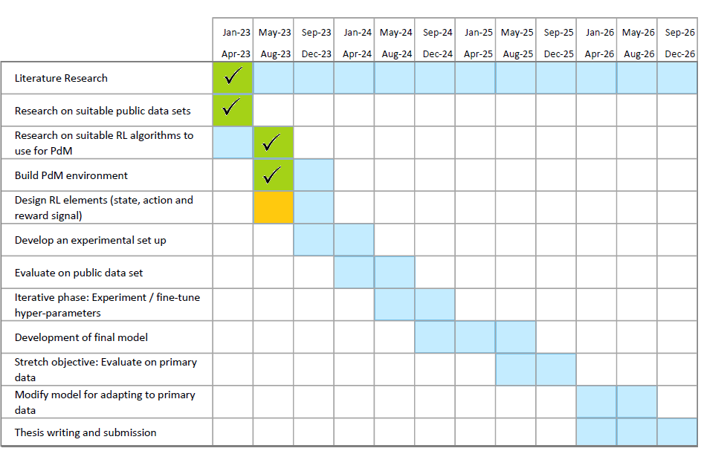

Planned schedule and status
OBJECTIVES:
Evaluate various RL algorithms suitable for solving predictive maintenance (PdM)
Design and develop a PdM application with above recommendation.
Extract features and explore techniques for standardizing the features across various applications.
To develop a data-driven model on real world data set
Current status:
SLR paper published in Q1 journal
Obj. 1: Empirical study on 4 RL algorithms completed
WIP

Slide 3
Agenda
Objective 
The RL environment 
Evaluation strategy 
Findings 
Results, Plots, Tests 

Slide 4
Objectives
Research goal*: An optimal predictive maintenance policy for replacement of milling tool
Experiment with the very basic, naïve, REINFORCE algorithm
Implemented from “scratch” (Bigger objective: Start with basic REINFORCE, then keep improving it)
Compare against industry grade implementation of DQN, A2C and PPO (Stable-Baselines-3)
This is a purely experimental (empirical) exercise.

Slide 5

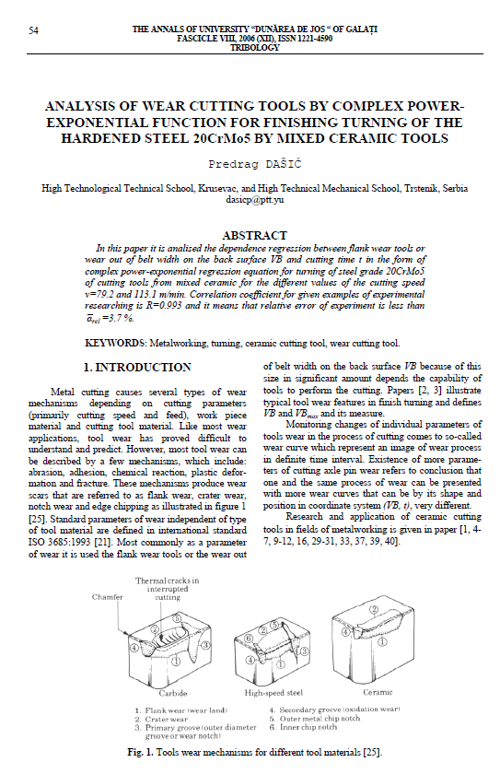

RL environment
Two different sources – simulated and real milling data
 Simulated. Dašić, Predrag (2006): Analysis of wear cutting tools by complex power exponential function for finishing turning of the hardened steel 20CrMo5 by mixed ceramic tools.
 Real data. IEEE – PHM Society

Slide 6
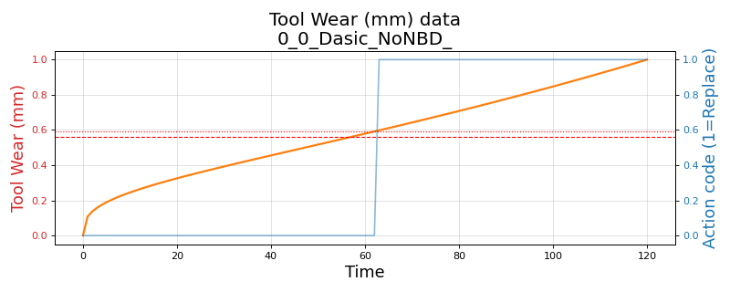
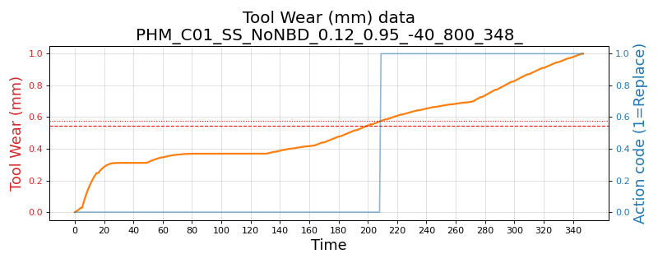
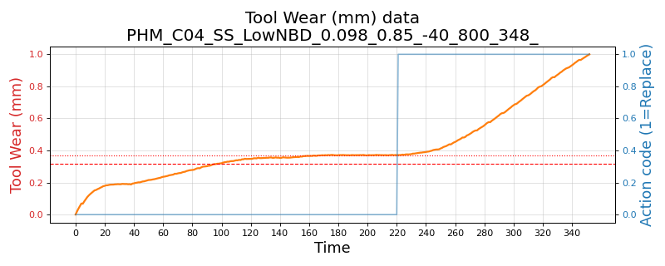
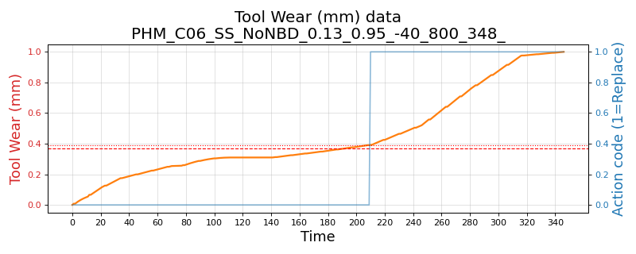
RL environment - Variants
Three environments and their variants:
Simulated. Based on Dašić (2006). Simple single-variate state (tool wear)
Variants: (1) No noise (2) Low noise and low break-down chance and (3) High noise and high break-down chance
PHM 2010 real data – Simple single-variate state (tool wear)
Variants: C-01, C-04 and C-06 data-sets
Variants: (1) No noise (2) Low noise and low break-down chance and (3) High noise and high break-down chance
PHM 2010 real data – Complex multivariate state (tool wear, 3-axis forces, 3-axis vibration and acoustic data)
Variants: C-01, C-04 and C-06 data-sets

Slide 7
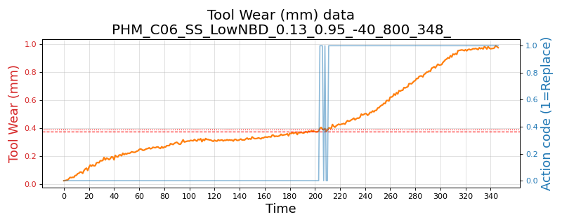
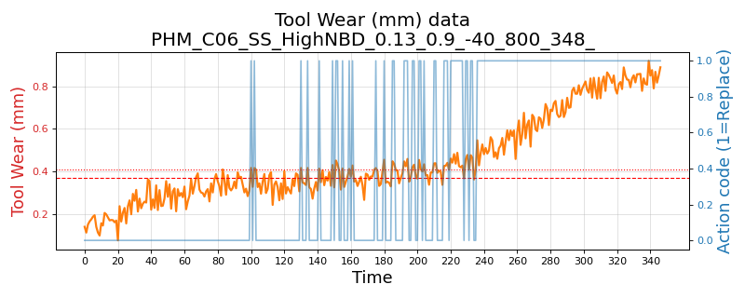
Wear plot - real data (PHM C06) and its variants
PHM 2010 C-06 data-set
No noise, no break-down chance
Low noise: 1e-3 and break-down chance 5%
High noise: 1e-2 and break-down chance 10%

Slide 8
Evaluation strategy
RL policy decides when to replace tool
Compare against “human” preventive replacement policy
REINFORCE trained for 800 episodes. SB-3 trained with 10,000 episodes
Train over 10 rounds to understand training stability
Evaluate: During each round, test from another test set, randomly sampled 40 points, and tested over 10 rounds
Compute Precision, Recall and F1, F1-Beta
Compare mean and std. deviations

Slide 9
Findings and Results

Slide 10
Findings
The naïve implementation of REINFORCE algorithm was implemented in PyTorch with an extremely simple architecture: One hidden layer and ReLU activation and an Adam optimizer.
Despite its simplicity, REINFORCE performs significantly better than the three advanced algorithms.
Average across 10 trained models, across all variants:
Precision: 0.687 against A2C: 0.449, DQN: 0.418, PPO: 0.472
F1-score: 0.609 against A2C: 0.442, DQN: 0.374, PPO: 0.345
Variability: Precision and F1 lower by 0.08 and 0.016, when compared to the average of A2C, DQN, PPO
“Best” model from the 10, across all variants:
Precision: 0.884 against A2C: 0.520, DQN: 0.651, PPO: 0.558
F1-score : 0.873 against A2C: 0.639, DQN: 0.740, PPO: 0.580

Slide 11
Results: Overall – all environments and their variants
Overall:
(1) Simulated x 3 with noise levels
(2) PHM Real-data: Uni-variate state x 3 data sets x 3 noise levels
(3) PHM Real-data: Multi-variate state x 3 data sets

Slide 12
Results: Simple single variate state. Including noise variants
Simulated – Dašić, Predrag (2006).
PHM 2010: Single-variate environment, across three data sets C-01, C-04 and C-06

Slide 13
Results: Complex, multi-variate environment
PHM 2010: Complex, multi-variate environment, across three data sets C-01, C-04 and C-06
No noise or break-down

Slide 14
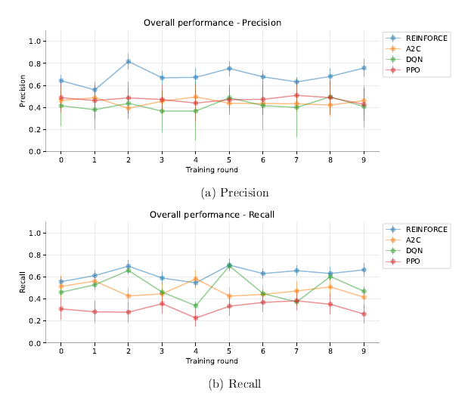
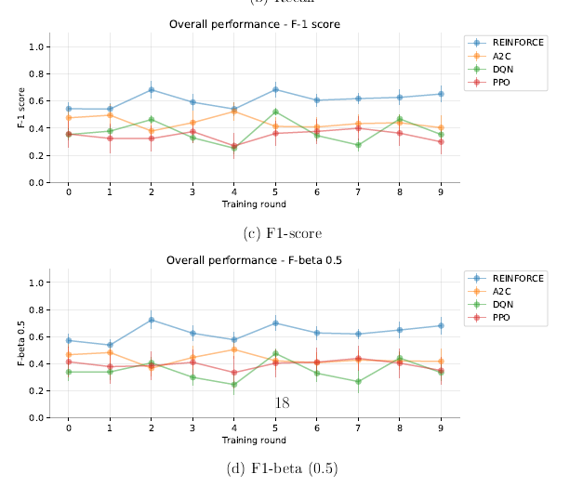
Results: Overall – Training across 10 rounds

Slide 15
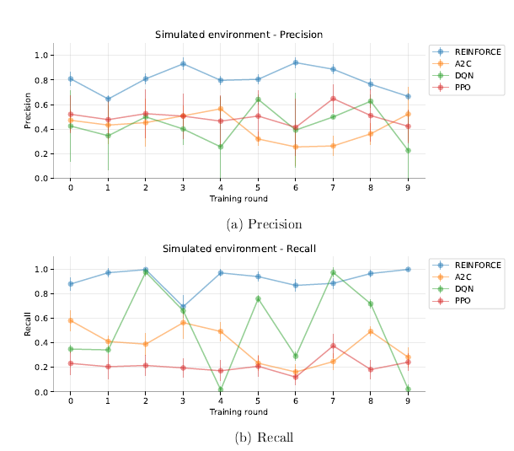
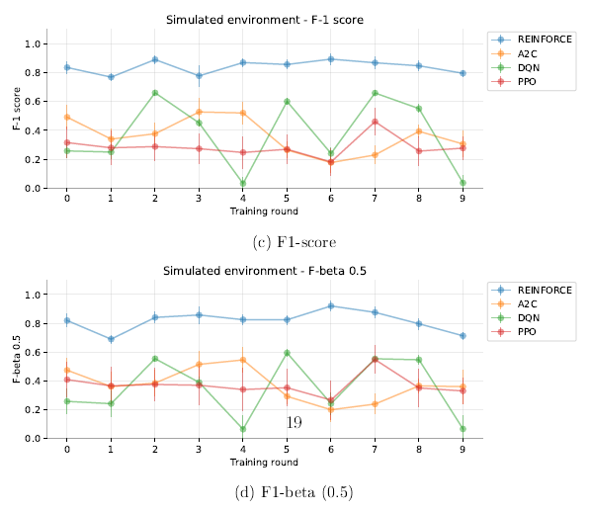
Results: Simulated – Training across 10 rounds

Slide 16
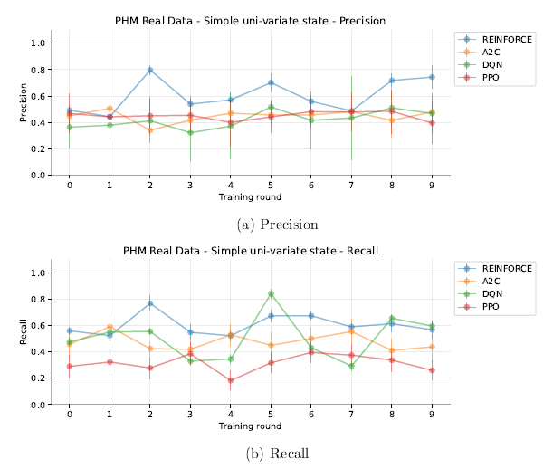
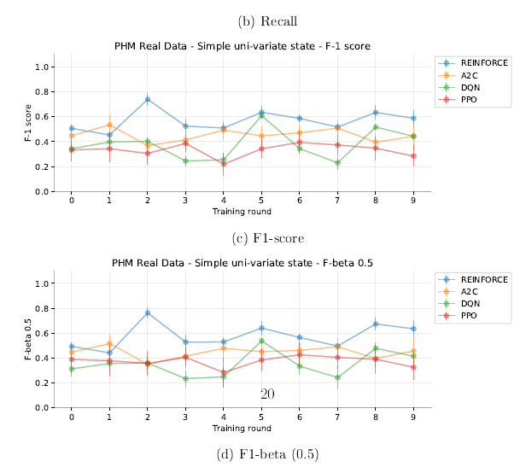
Results: PHM Real Data – 3 data-sets - Simple univariate

Slide 17
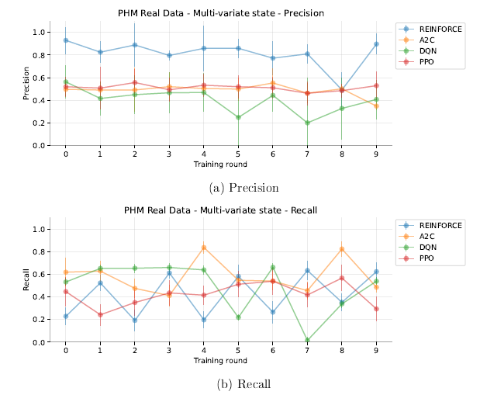
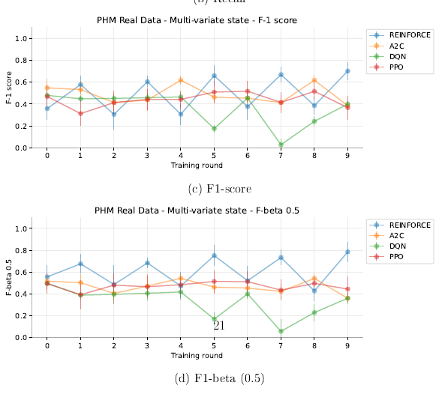
Results: PHM Real Data – 3 data-sets – Multi-variate

Slide 18
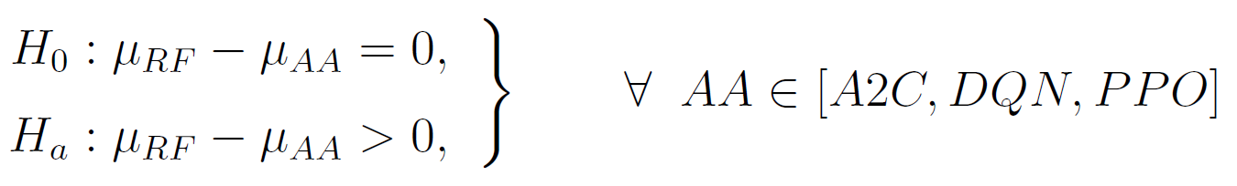
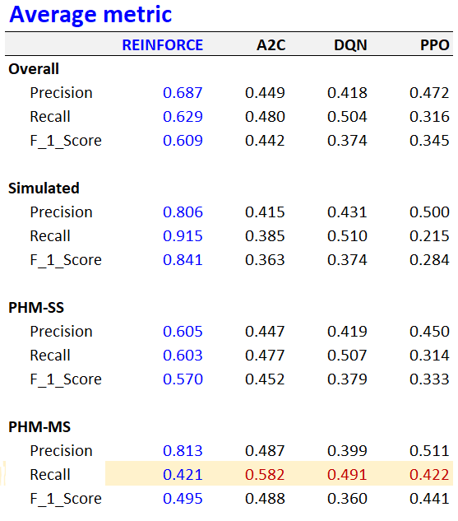
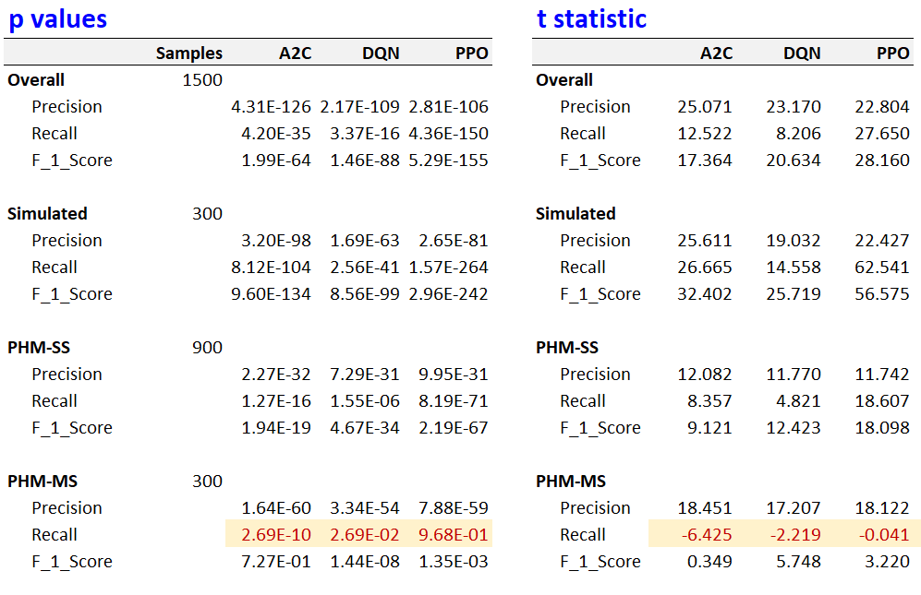
Statistical validation: Two sample, one-tail test
Two sample, one-tail test
α = 0.05, 95% confidence

Slide 19
Some plots

Slide 20
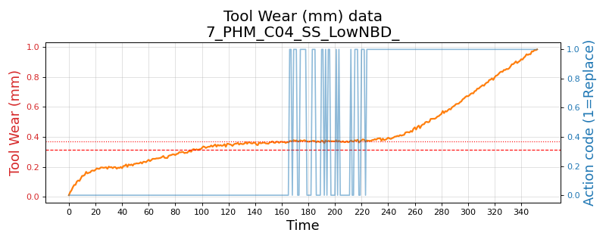
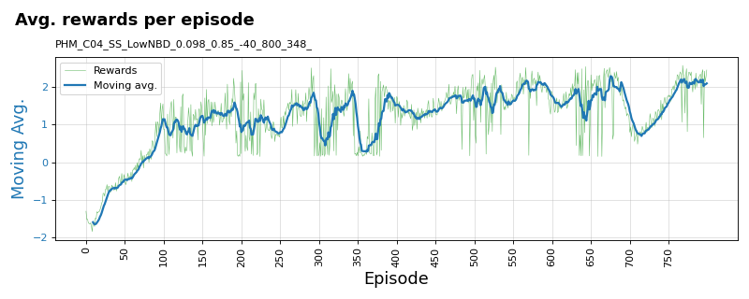
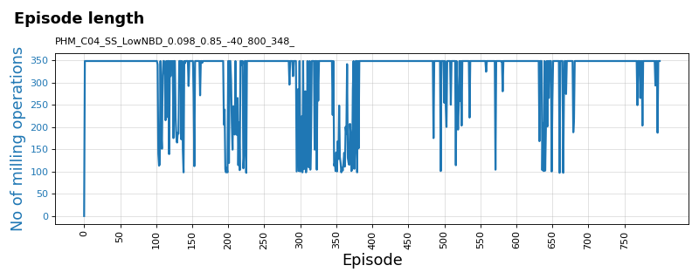
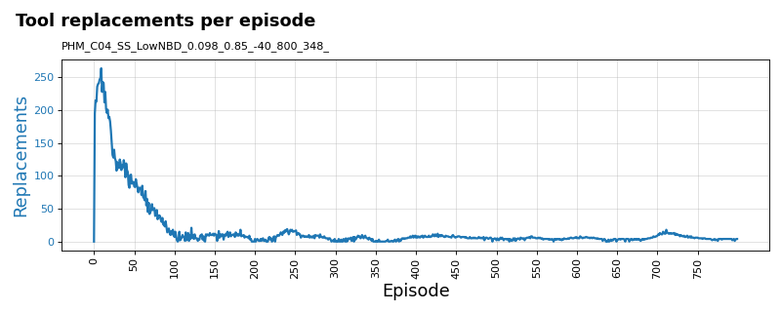
Training plots for REINFORCE algorithm
PHM 2010 C-04 data-set: Variant: Single-state tool-wear with low noise (1e-3) and low break-down chance (5%)

Slide 21
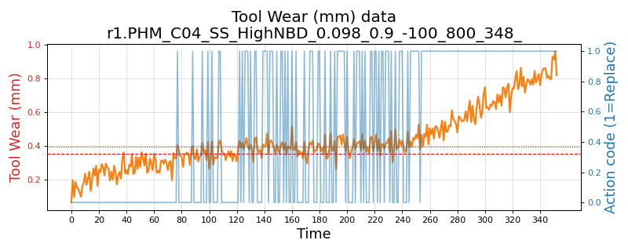
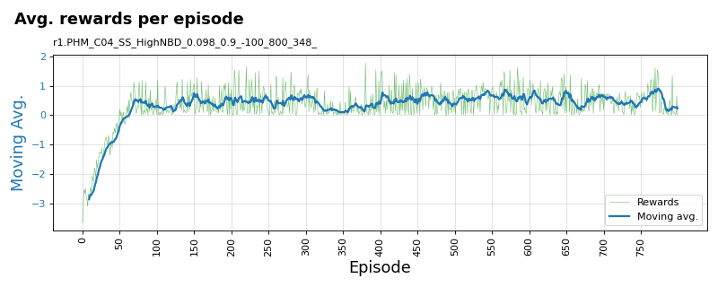
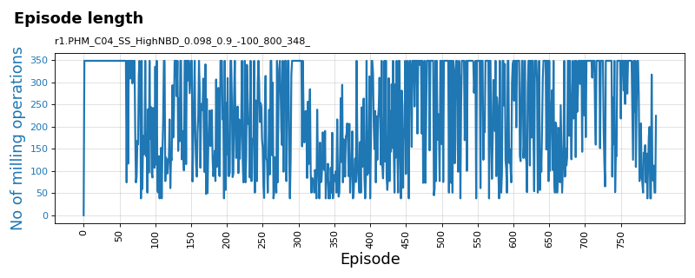
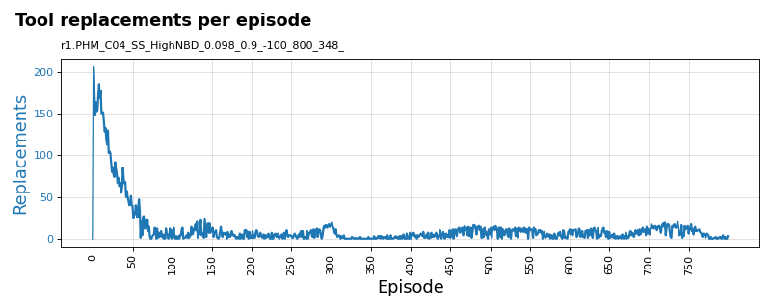
Training plots for REINFORCE algorithm
PHM 2010 C-04 data-set: Variant: Single-state tool-wear with high noise (1e-2) and low break-down chance (10%)

Slide 22
Discussions / Q&A

Slide 23
Thank you

