Slide 1
Experiments with REINFORCE algorithm
Rajesh Siraskar
12-Jul-2023 V.3.0

Slide 2
Agenda
Objective of this presentation
The RL environment
Evaluation strategy
Findings
Discussion

Slide 3
Objectives
Research goal*: An optimal predictive maintenance policy for replacement of milling tool
Experiment with the very basic, naïve, REINFORCE algorithm
Implemented from “scratch”
Compare against industry grade implementation of DQN, A2C and PPO (Stable-Baselines-3)
REINFORCE trained for 800 episodes. SB-3 trained with 10,000 episodes
This is a purely experimental (empirical) exercise.
Bigger objective: Start with basic REINFORCE, then keep improving it
* Note: My “proposal” goal is “Deep RL for predicting RUL”, this is a sub/related goal

Slide 4

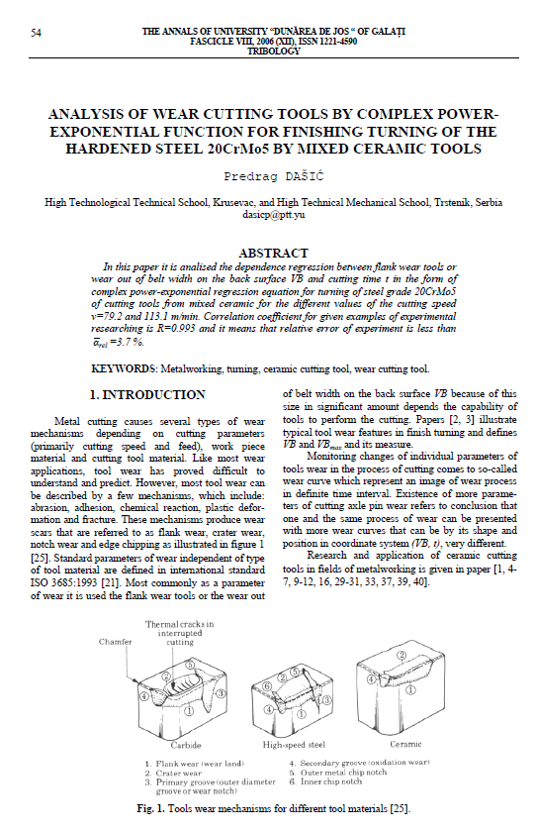

RL environment
Two different sources – simulated and real milling data
 Simulated. Dašić, Predrag (2006): Analysis of wear cutting tools by complex power exponential function for finishing turning of the hardened steel 20CrMo5 by mixed ceramic tools.
 Real data. IEEE – PHM Society

Slide 5
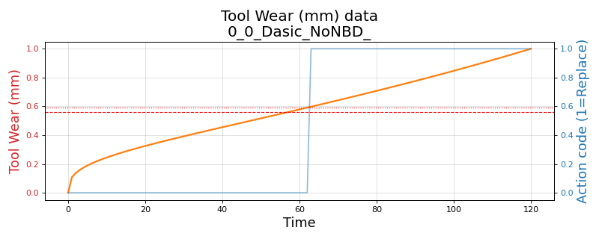
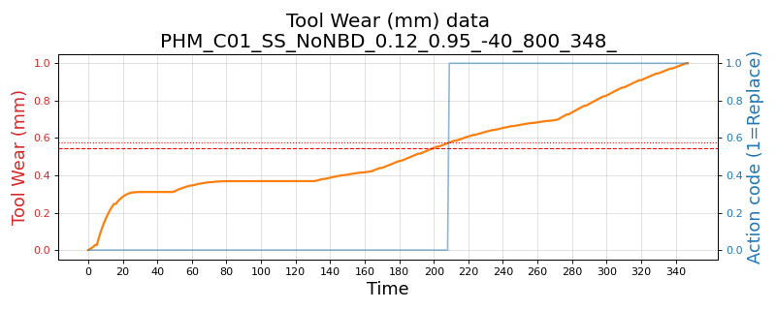
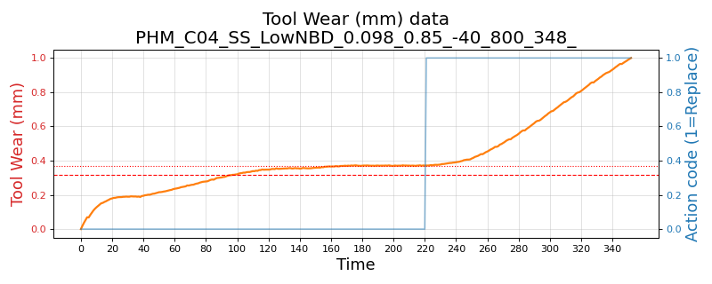
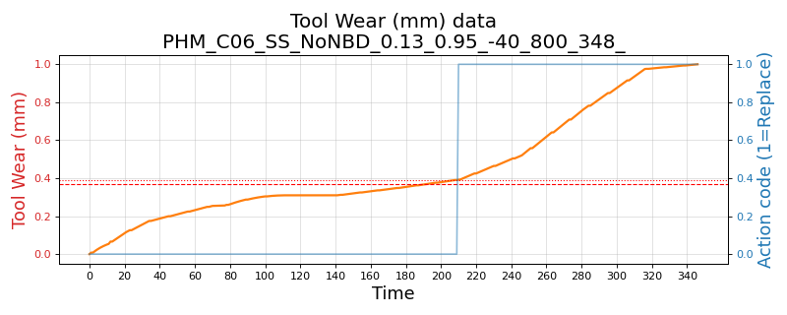
RL environment - Variants
Three environments and their variants:
Simulated. Based on Dašić (2006). Simple single-variate state (tool wear)
Variants: (1) No noise (2) Low noise and low break-down chance and (3) High noise and high break-down chance
PHM 2010 real data – Simple single-variate state (tool wear)
Variants: C-01, C-04 and C-06 data-sets
Variants: (1) No noise (2) Low noise and low break-down chance and (3) High noise and high break-down chance
PHM 2010 real data – Complex multivariate state (tool wear, 3-axis forces, 3-axis vibration and acoustic data)
Variants: C-01, C-04 and C-06 data-sets

Slide 6
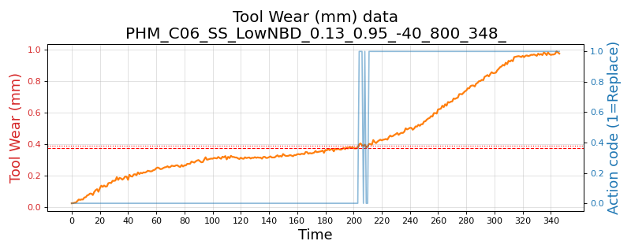
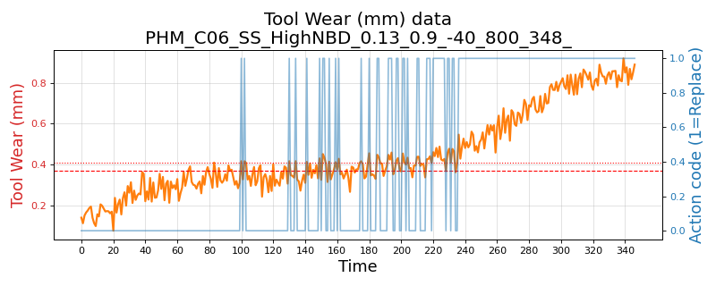
Wear plot - real data (PHM C06) and its variants
PHM 2010 C-06 data-set
No noise, no break-down chance
Low noise: 1e-3 and break-down chance 5%
High noise: 1e-2 and break-down chance 10%

Slide 7
Evaluation strategy
RL policy decides when to replace tool
Compare against “human” preventive replacement policy
Train over 10 rounds to understand training stability
Evaluate: During each round, test from another test set, randomly sampled 40 points, and tested over 10 rounds
Compute Precision, Recall and F1, F1-Beta
Compare mean and std. deviations

Slide 8
Findings
The naïve implementation of REINFORCE algorithm was implemented in PyTorch with an extremely simple architecture: One hidden layer and ReLU activation and an Adam optimizer.
Despite its simplicity, REINFORCE performs significantly better than the three advanced algorithms.
Average across 10 trained models, across all variants:
Precision: 0.687 against A2C: 0.449, DQN: 0.418, PPO: 0.472
F1-score: 0.609 against A2C: 0.442, DQN: 0.374, PPO: 0.345
Variability: Precision and F1 lower by 0.08 and 0.016, when compared to the average of A2C, DQN, PPO
“Best” model from the 10, across all variants:
Precision: 0.884 against A2C: 0.520, DQN: 0.651, PPO: 0.558
F1-score : 0.873 against A2C: 0.639, DQN: 0.740, PPO: 0.580

Slide 9
Results: Overall – all environments and their variants

Slide 10
Results: Simple single variate state. Including noise variants
Simulated – Dašić, Predrag (2006).
PHM 2010: Single-variate environment, across three data sets C-01, C-04 and C-06

Slide 11
Results: Complex, multi-variate environment
PHM 2010: Complex, multi-variate environment, across three data sets C-01, C-04 and C-06
No noise or break-down
 | Precision |  | Recall |  | F1-score
Algorithm | Mean | Std.Dev | Mean | Std.Dev | Mean | Std.Dev
A2C | 0.485 | 0.067 | 0.637 | 0.072 | 0.534 | 0.065
DQN | 0.398 | 0.156 | 0.647 | 0.031 | 0.444 | 0.025
PPO | 0.537 | 0.080 | 0.423 | 0.068 | 0.458 | 0.055
REINFORCE | 0.842 | 0.040 | 0.657 | 0.062 | 0.721 | 0.052

Slide 12
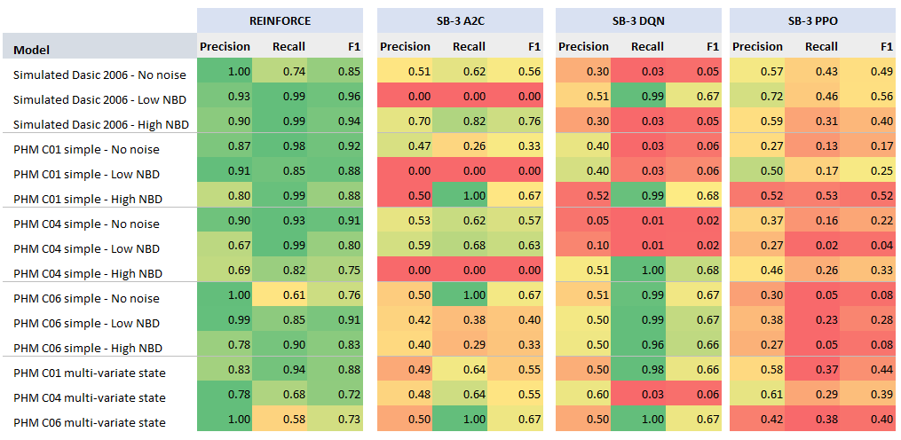
Results Summary (13-Jun-2023 run)

Slide 13
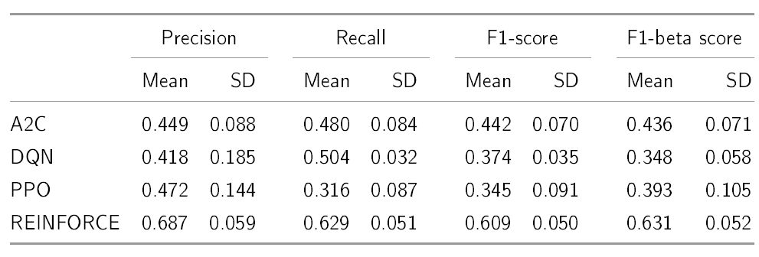
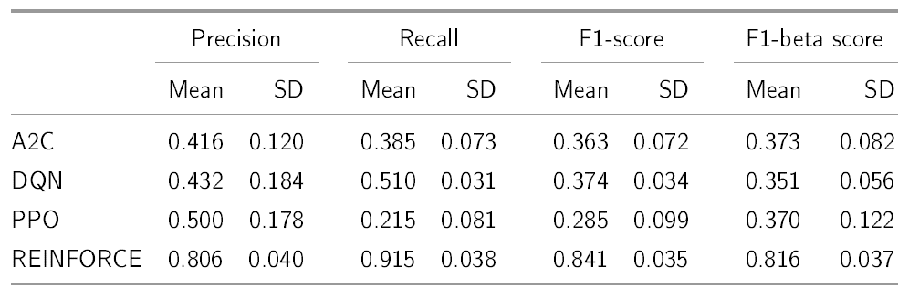
Statistical validation: Two sample, one-tail test

Slide 14
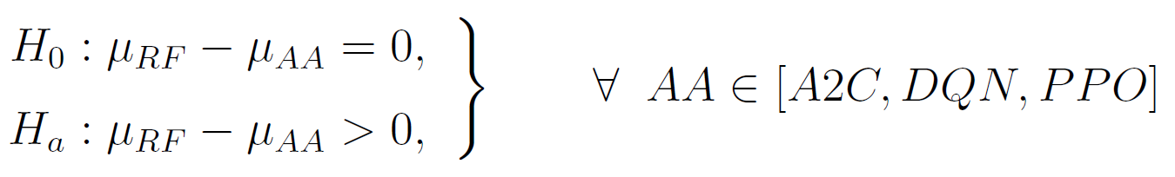
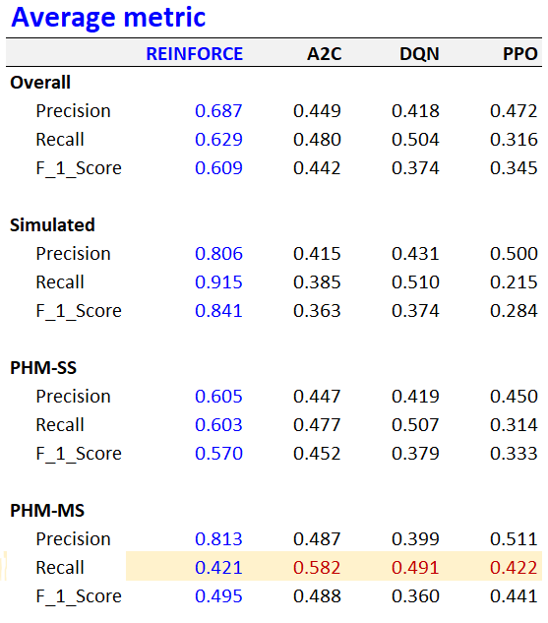
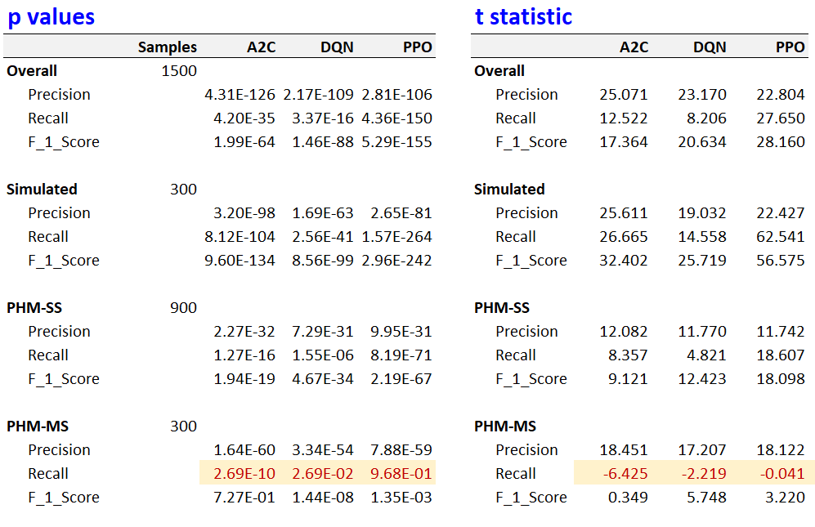
Statistical validation: Two sample, one-tail test
Two sample, one-tail test
α = 0.05, 95% confidence

Slide 15
Training time: Avg. over different variants
Average training time in secs.
Variant | A2C | DQN | PPO | REINFORCE
Dasic 2006 Simulated - Single variate state | 33.53 | 3.04 | 34.23 | 182.76
PHM-2010 Real data - Single variate state | 21.53 | 2.37 | 24.27 | 313.99
PHM-2010 Real data - Multi-variate state | 37.23 | 6.06 | 42.46 | 632.05
Overall average | 27.07 | 3.24 | 29.90 | 351.36
Average training time per 1,000 time-steps, in secs. Stable-baseline algorithms are trained for 10,000 time-steps, while REINFORCE uses 96,800 for simulated and 278,400 for PHM based environments
Variant | A2C | DQN | PPO | REINFORCE
Dasic 2006 Simulated - Single variate state | 3.35 | 0.30 | 3.42 | 1.89
PHM-2010 Real data - Single variate state | 2.15 | 0.24 | 2.43 | 1.13
PHM-2010 Real data - Multi-variate state | 3.72 | 0.61 | 4.25 | 2.27
Overall average | 9.23 | 1.15 | 10.10 | 1.73

Slide 16
Some plots

Slide 17
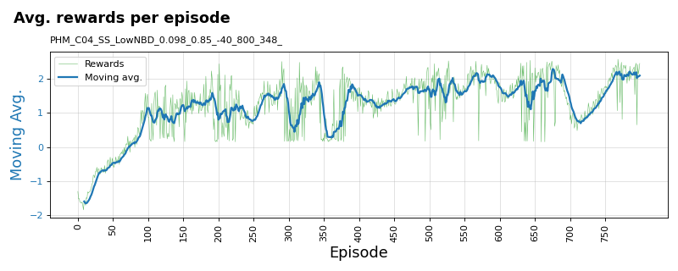
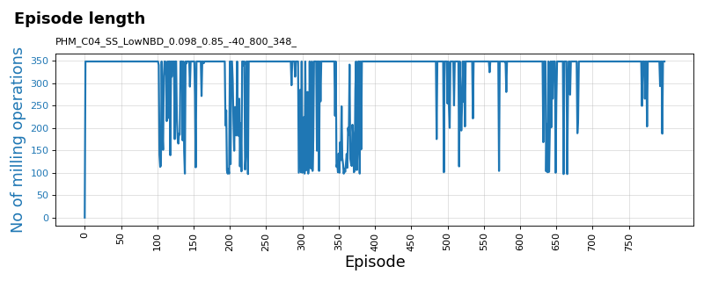
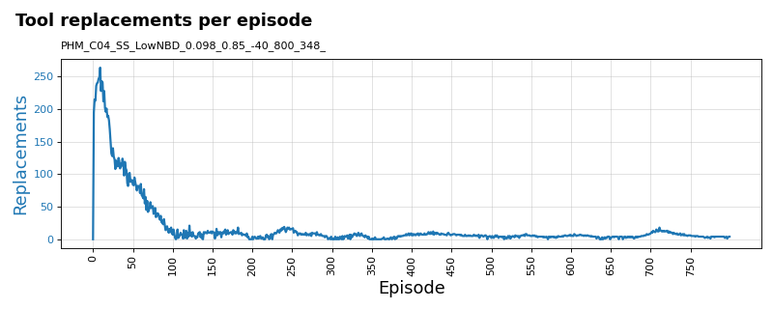
Training plots for REINFORCE algorithm
PHM 2010 C-04 data-set: Variant: Single-state tool-wear with low noise (1e-3) and low break-down chance (5%)

Slide 18
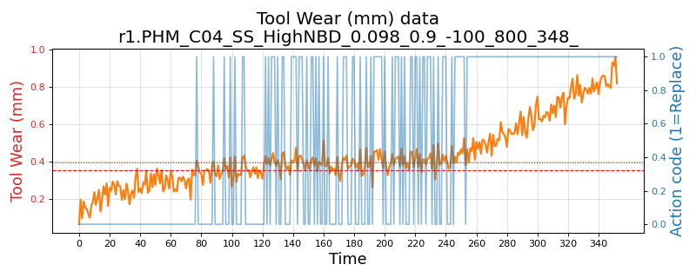
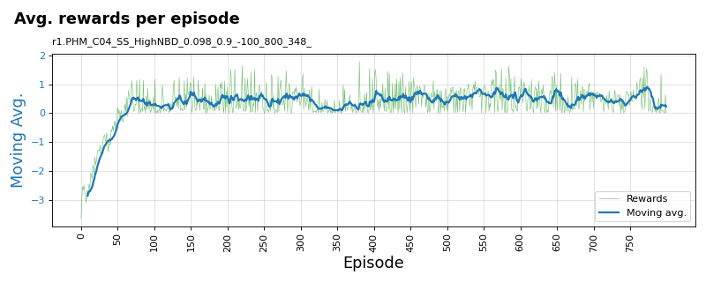
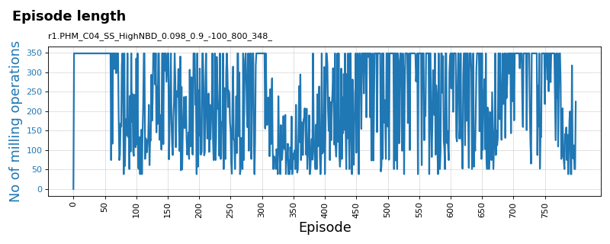
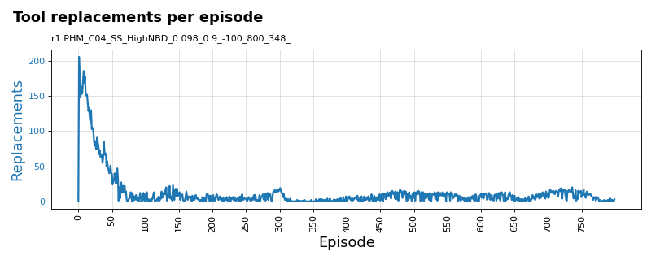
Training plots for REINFORCE algorithm
PHM 2010 C-04 data-set: Variant: Single-state tool-wear with high noise (1e-2) and low break-down chance (10%)

Slide 19
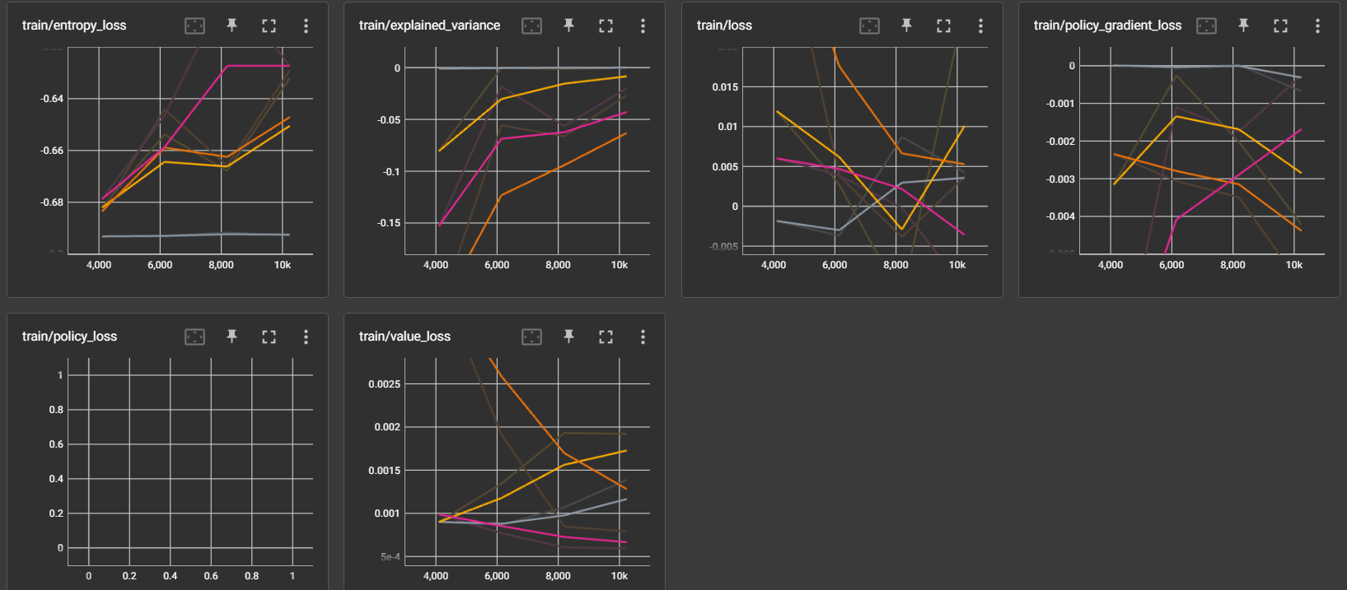
Tensorboard plots for SB-3 algorithms - PPO

Slide 20
SB-3 stability doubts

Slide 21
SB-3 stability issue?
Earlier runs with same episodes = 800
But REINFORCE has an internal loop of 348
Increased SB-3 algo runs to 10,000, then 800 x 348 then 20,000
Re-installed SB-3 and upgraded the version
Tested on cart-pole and mountain-car environment
Re-trained SB-3 models and re-ran experiments for 20,000 – see next slide

Slide 22
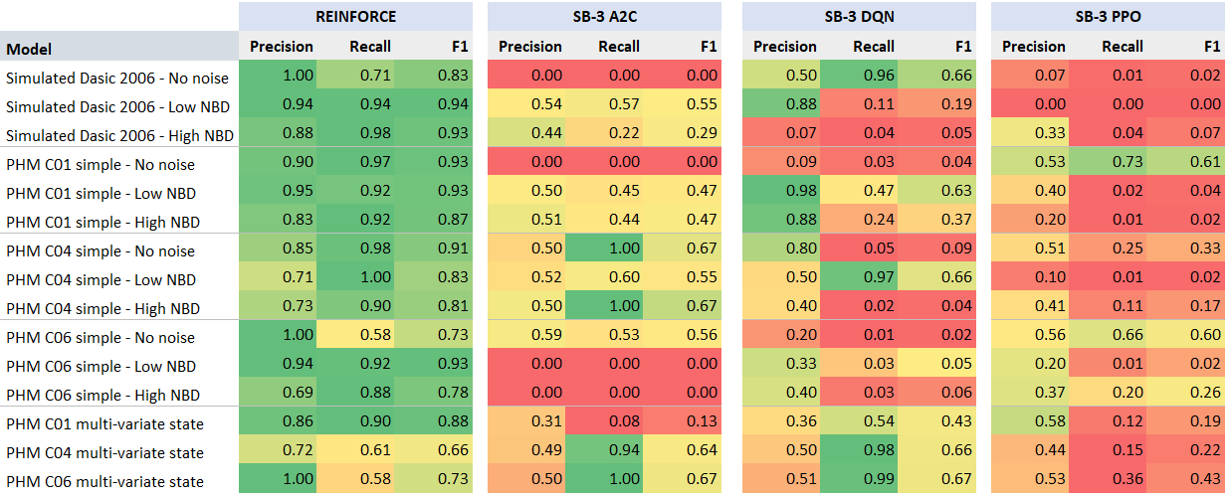
Results: SB-3 updated. Episodes = 20 K

Slide 23
Thank you

