Slide 1
Experiments with REINFORCE algorithm
Rajesh Siraskar

Slide 2
Agenda
Objective of this presentation
The RL environment
Evaluation strategy
Findings
Discussion

Slide 3
Objectives
Research goal*: An optimal predictive maintenance policy for replacement of milling tool
Experiment with the very basic, naïve, REINFORCE algorithm
Implemented from “scratch”
Compare against industry gold-standard Stable-Baselines-3 implementation of DQN, A2C and PPO
This is a purely experimental (empirical) exercise.
* Note: My “proposal” goal is “Deep RL for predicting RUL”, this is a sub/related goal

Slide 4

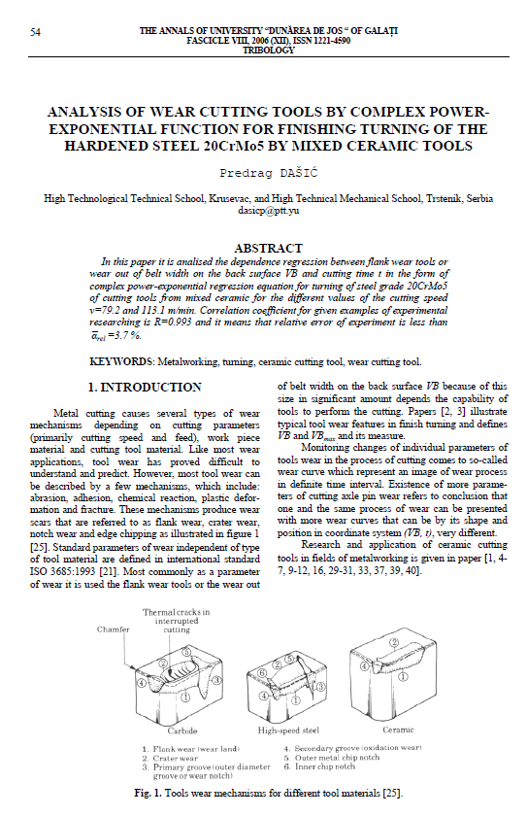

RL environment
Two different sources – created three environments, with three variations each
 Simulated. Dašić, Predrag (2006): Analysis of wear cutting tools by complex power exponential function for finishing turning of the hardened steel 20CrMo5 by mixed ceramic tools.
 Real data. IEEE – PHM Society

Slide 5
RL environment
Three environments, with three variations used
Three environments:
Simulated. Based on Dašić (2006). Simple “single-variable” state (tool wear)
PHM 2010 data – Simple “single-variable” state (tool wear)
PHM 2010 data – Complex multi-variable state (tool wear, forces and vibration, acoustic data)
Three variants of each:
No noise
Low noise
High noise

Slide 6
Evaluation strategy
RL policy decides when to replace tool
Compare against “human” replacement action
Test from randomly sampled 40 points, 5 rounds
Compute Precision, Recall and F1
Compare mean and std. deviations

Slide 7
Findings
High level observation from 1000’s of experiments:
Surprisingly, the naïve implementation of REINFORCE performs well in some conditions
Naïve REINFORCE performs better than DQN, A2C and PPO in few cases
PPO and A2C are very stable, but almost always perform at about F1 0.47-0.55
REINFORCE often performed between 0.60 (for complex environment) to 0.90 (for simpler environment)

Slide 8
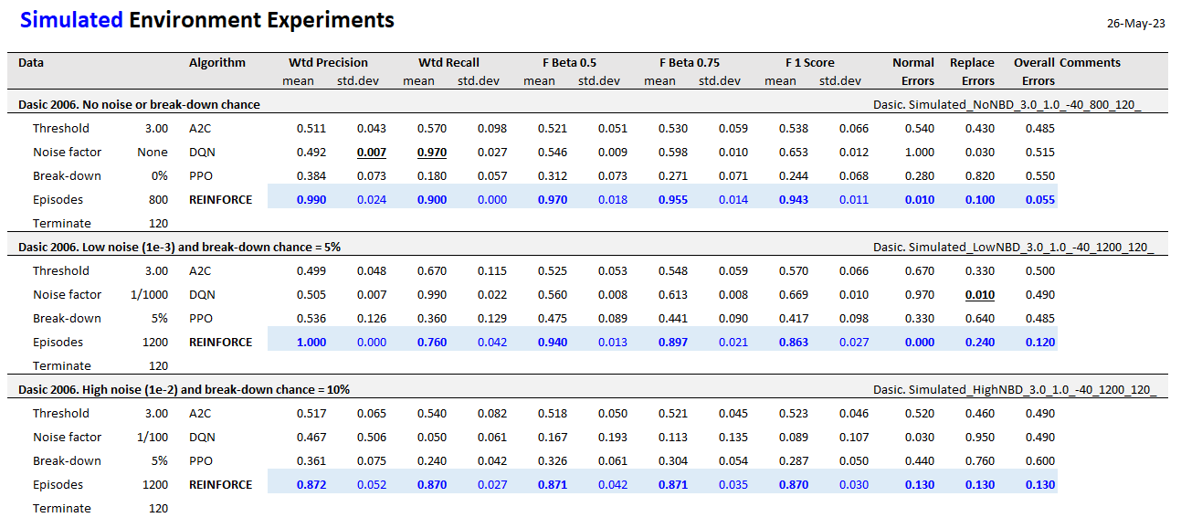
Results – Simulated data. Simplest environment
REINFORCE performs well in all three variants. No noise, low and high noise

Slide 9
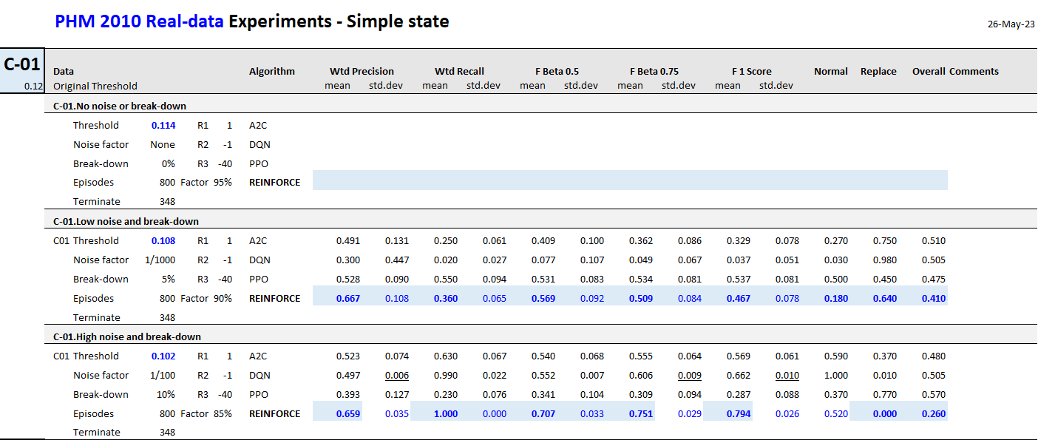
Results – Real data. Simple environment
REINFORCE performs well in two of three cases. Low and high noise.

Slide 10
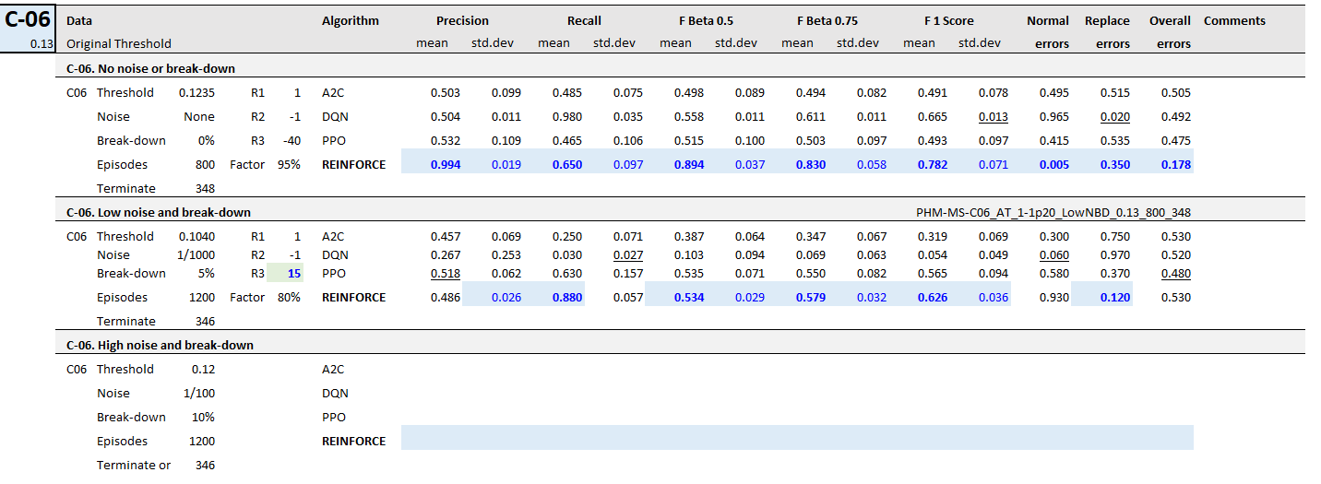
Results – Real data. Complex environment
REINFORCE performs well in two of three cases. No and Low noise.

Slide 11
Thank you

