Slide 1
Experiments with REINFORCE algorithm
Rajesh Siraskar
09-Jun-2023

Slide 2
Agenda
Objective of this presentation
The RL environment
Evaluation strategy
Findings
Discussion

Slide 3
Objectives
Research goal*: An optimal predictive maintenance policy for replacement of milling tool
Experiment with the very basic, naïve, REINFORCE algorithm
Implemented from “scratch”
Compare against industry gold-standard Stable-Baselines-3 implementation of DQN, A2C and PPO
This is a purely experimental (empirical) exercise.
* Note: My “proposal” goal is “Deep RL for predicting RUL”, this is a sub/related goal

Slide 4

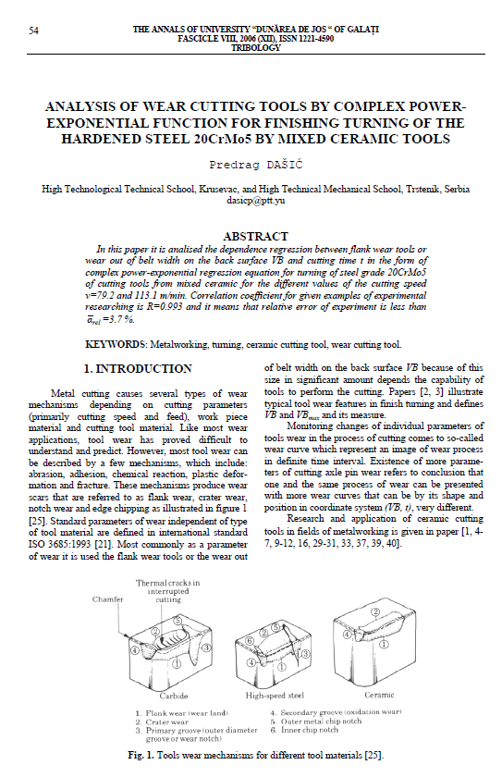

RL environment
Two different sources – created three environments, with three variations each
 Simulated. Dašić, Predrag (2006): Analysis of wear cutting tools by complex power exponential function for finishing turning of the hardened steel 20CrMo5 by mixed ceramic tools.
 Real data. IEEE – PHM Society

Slide 5
RL environment - Variants
Three environments and their variants:
Simulated. Based on Dašić (2006). Simple “single-variable” state (tool wear)
Variants: (1) No noise (2) Low noise and low break-down chance and (3) High noise and high break-down chance
PHM 2010 data – Simple “single-variable” state (tool wear)
Variants: C-01, C-04 and C-06 data-sets
Variants: (1) No noise (2) Low noise and low break-down chance and (3) High noise and high break-down chance
PHM 2010 data – Complex multi-variable state (tool wear, 3-axis forces, 3-axis vibration and acoustic data)
Variants: C-01, C-04 and C-06 data-sets

Slide 6
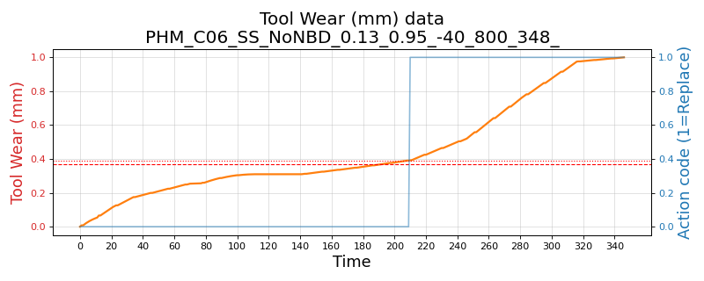
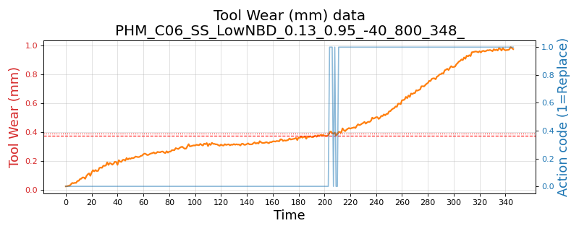
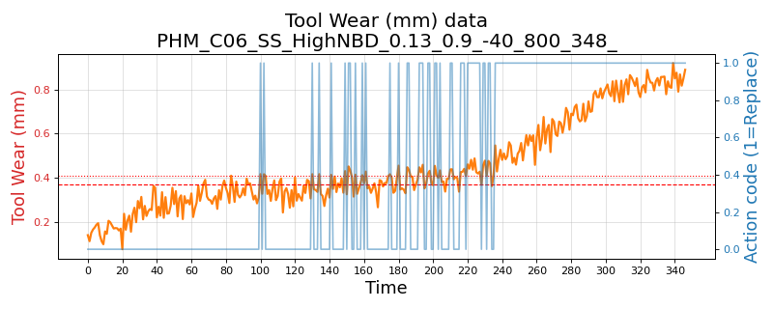
Wear plot - real data and its variants
PHM 2010 C-06 data-set
No noise, no break-down chance
Low noise: 1e-3 and break-down chance 5%
High noise: 1e-2 and break-down chance 10%

Slide 7
Evaluation strategy
RL policy decides when to replace tool
Compare against “human” replacement action
Test from randomly sampled 40 points, 5 rounds
Compute Precision, Recall and F1
Compare mean and std. deviations

Slide 8
Findings
The naïve implementation of REINFORCE algorithm was implemented in PyTorch with an extremely simple architecture: Three layers and ReLU activation and an Adam optimizer.
In training, the SB-3 algorithms were extremely stable, but the performance was always around F1 0.47-0.50. The naïve REINFORCE, on the other-hand, was quite unstable in training.
We saved models that performed better than 0.7 and these cases, the REINFORCE performs surprisingly better than DQN, A2C and PPO in all cases
The SB-3 algorithms almost always perform at about F1 0.47-0.50
REINFORCE performed between 0.77 (for complex real data environment) to 0.89 (for simulated environment)
Across precision, recall and F1 – REINFORCE was better than the best performing SB-3 algorithm by 0.347 basis-points and its standard deviation was lower by -0.008

Slide 9
Results: Overall – all environments and their variants
 | Precision |  | Recall |  | F1-score
Algorithm | Mean | Std.Dev | Mean | Std.Dev | Mean | Std.Dev
A2C | 0.513 | 0.057 | 0.504 | 0.070 | 0.505 | 0.057
DQN | 0.464 | 0.225 | 0.317 | 0.026 | 0.242 | 0.035
PPO | 0.494 | 0.057 | 0.478 | 0.064 | 0.479 | 0.057
REINFORCE | 0.865 | 0.028 | 0.852 | 0.038 | 0.845 | 0.028

Slide 10
Results: Simple single variate state. Including noise variants
Simulated – Dašić, Predrag (2006).
 | Precision |  | Recall |  | F1-score
Algorithm | Mean | Std.Dev | Mean | Std.Dev | Mean | Std.Dev
A2C | 0.542 | 0.094 | 0.440 | 0.081 | 0.483 | 0.076
DQN | 0.432 | 0.156 | 0.657 | 0.038 | 0.457 | 0.038
PPO | 0.497 | 0.055 | 0.457 | 0.072 | 0.474 | 0.062
REINFORCE | 0.944 | 0.025 | 0.877 | 0.053 | 0.898 | 0.033
PHM 2010: Single-variate environment, across three data sets C-01, C-04 and C-06
 | Precision |  | Recall |  | F1-score
Algorithm | Mean | Std.Dev | Mean | Std.Dev | Mean | Std.Dev
A2C | 0.506 | 0.047 | 0.531 | 0.072 | 0.517 | 0.055
DQN | 0.495 | 0.191 | 0.302 | 0.023 | 0.236 | 0.031
PPO | 0.490 | 0.054 | 0.486 | 0.060 | 0.478 | 0.053
REINFORCE | 0.846 | 0.025 | 0.885 | 0.034 | 0.853 | 0.025

Slide 11
Results: Complex, multi-variate environment
PHM 2010: Complex, multi-variate environment, across three data sets C-01, C-04 and C-06
No noise or break-down
 | Precision |  | Recall |  | F1-score
Algorithm | Mean | Std.Dev | Mean | Std.Dev | Mean | Std.Dev
A2C | 0.505 | 0.047 | 0.485 | 0.054 | 0.493 | 0.044
DQN | 0.401 | 0.397 | 0.023 | 0.024 | 0.042 | 0.044
PPO | 0.500 | 0.066 | 0.477 | 0.066 | 0.486 | 0.064
REINFORCE | 0.843 | 0.041 | 0.729 | 0.038 | 0.770 | 0.033

Slide 12
Some plots

Slide 13
Thank you

